Slide 1
AIM: Evaluate how the Five Themes of Geography can be applied to the study of history.
Do Now: Where are we right now?

Slide 2
Where are we right now?

Slide 3
Five Themes of Geography Reading.

Slide 4
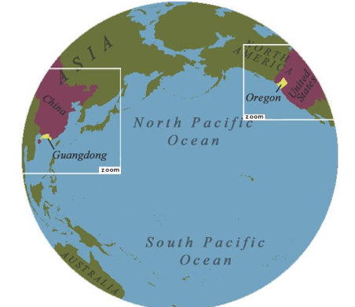
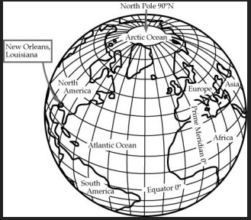
Relative Location vs. Absolute Location

Slide 5
Write down 3 examples of relative location.

Slide 6
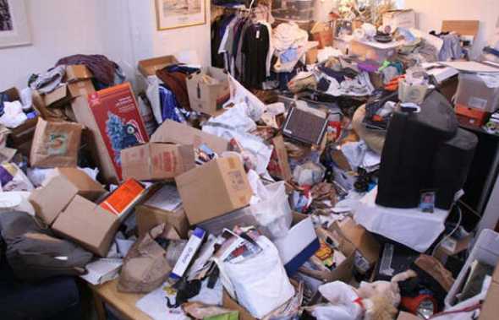
How would you describe this place?

Slide 7
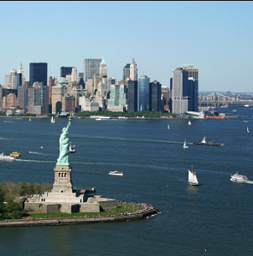
What is one way place can affect someone’s diet?

Slide 8
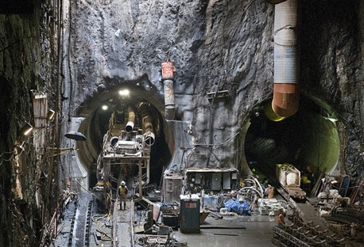
Human-Environmental Interactions

Slide 9
Movement
Where did you or your ancestors come from?
What factors pushed them/you from their homeland?
What factors pushed you/them to the United States?

Slide 10
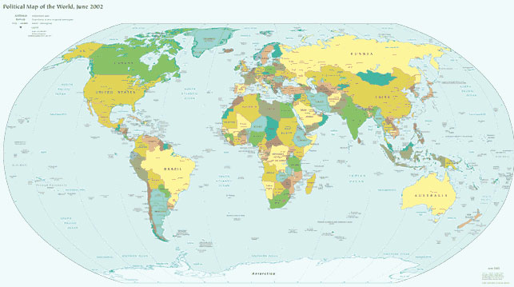
Formal Regions

Slide 11
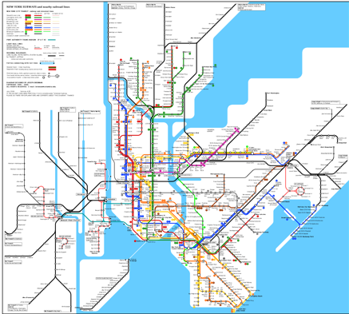
Functional Regions

Slide 12
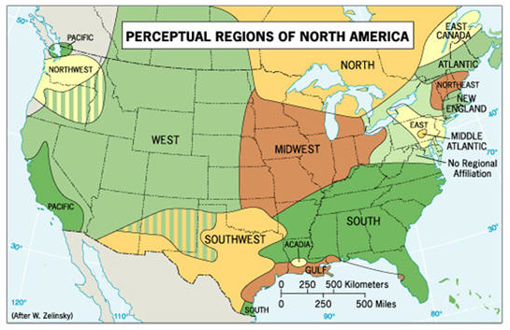
Vernacular Regions/Informal Regions/Perceptual Regions

