Slide 1
AIM: Where is everything?
Do Now: Rank the continents in size from smallest to largest in area in your notebook.

Slide 2
Name the projection

Slide 3
Continent Size by Land Area
1. Asia - 17,139,445 square miles (44,391,162 square km) 2. Africa - 11,677,239 square miles (30,244,049 square km) 3. North America - 9,361,791 square miles (24,247,039 square km) 4. South America - 6,880,706 square miles (17,821,029 square km) 5. Antarctica - About 5,500,000 square miles (14,245,000 square km) 6. Europe - 3,997,929 square miles (10,354,636 square km) 7. Australia - 2,967,909 square miles (7,686,884 square km)

Slide 4
Rank the continents by population size from largest to smallest.

Slide 5
Continents by Population
1. Asia - 4,055,000,000 (Over 4 billion) 2. Africa - 1,108,500,000 (Over 1 billion) 3. Europe - 729,871,042 (including all of Russia) 4. North America - 522,807,432 5. South America - 379,919,602 6. Australia - 20,434,176 7. Antarctica - No permanent residents but up to 4000 researchers and personnel in the summer and 1000 in the winter.

Slide 6
World Population Density

Slide 7
Africa
Land Area - 11,677,239 square miles (30,244,049 square km)
Total Population - 1.216 billion (As of 2016)
Largest Country (Area) - Algeria: 919,600 square miles (2,381,741 sq km)
Smallest Country (Area)- Seychelles: 175.7 square miles (455 sq km)
Island Nations - Seychelles, Madagascar, Mauritius, Comoros, Cape Verde, Sao Tome and Principe
River Systems – Nile (Egypt), Niger (West Africa), Congo (Democratic Republic of the Congo)

Slide 8
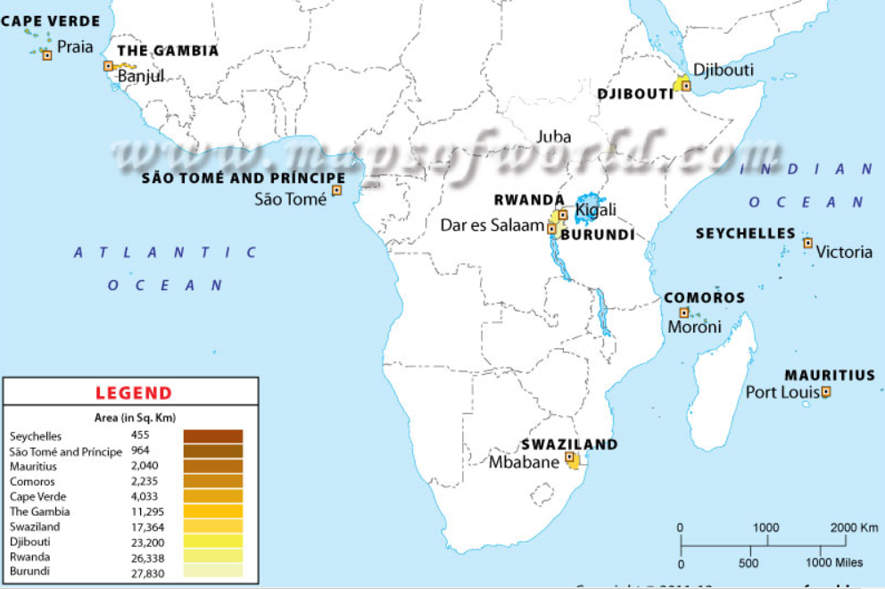
Small Nations and Capitals

Slide 9
Africa
Highest Point - Mt. Kilimanjaro (19,341feet) (5,895 m)
Mountain Ranges – Atlas Mountains,

Slide 10
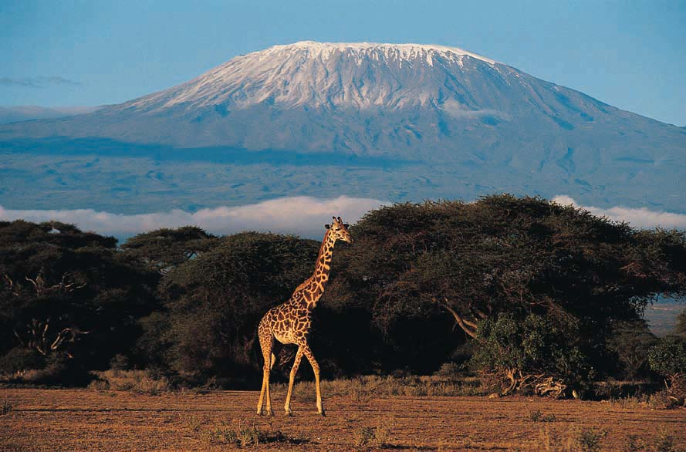
Kilimanjaro

Slide 11
Africa Bordered by Bodies of Water
Mediterranean Sea
Red Sea
Indian Ocean
Atlantic Ocean

Slide 12
Main Religious Groups Africa
Traditional African Religions (Animism), Christianity, Islam, Bahai Faith, Hinduism, Judaism

Slide 13
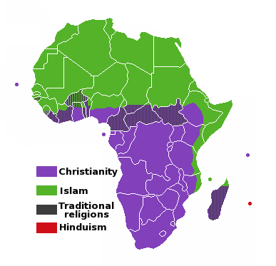
Main Religions by Region

Slide 14
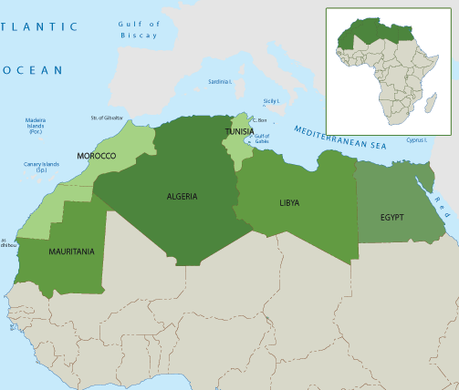
North Africa

Slide 15
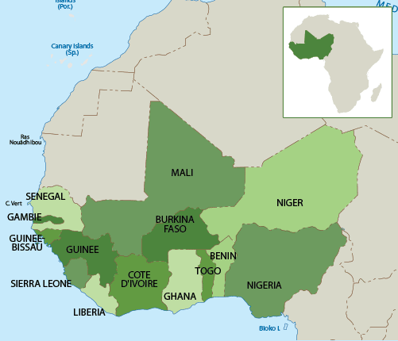
West Africa

Slide 16
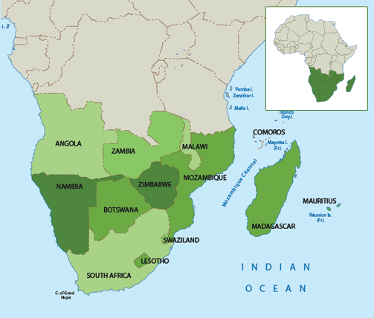
Southern Africa

Slide 17
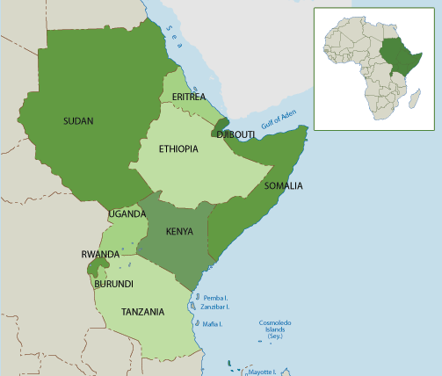
East Africa

Slide 18
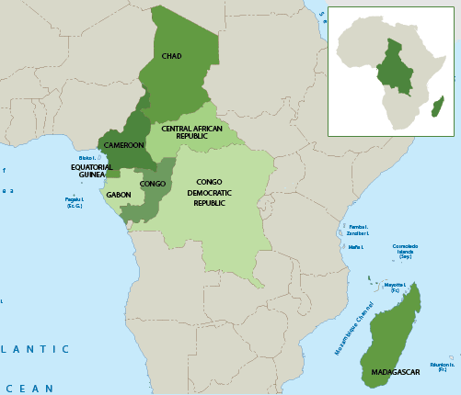
Central Africa

Slide 19
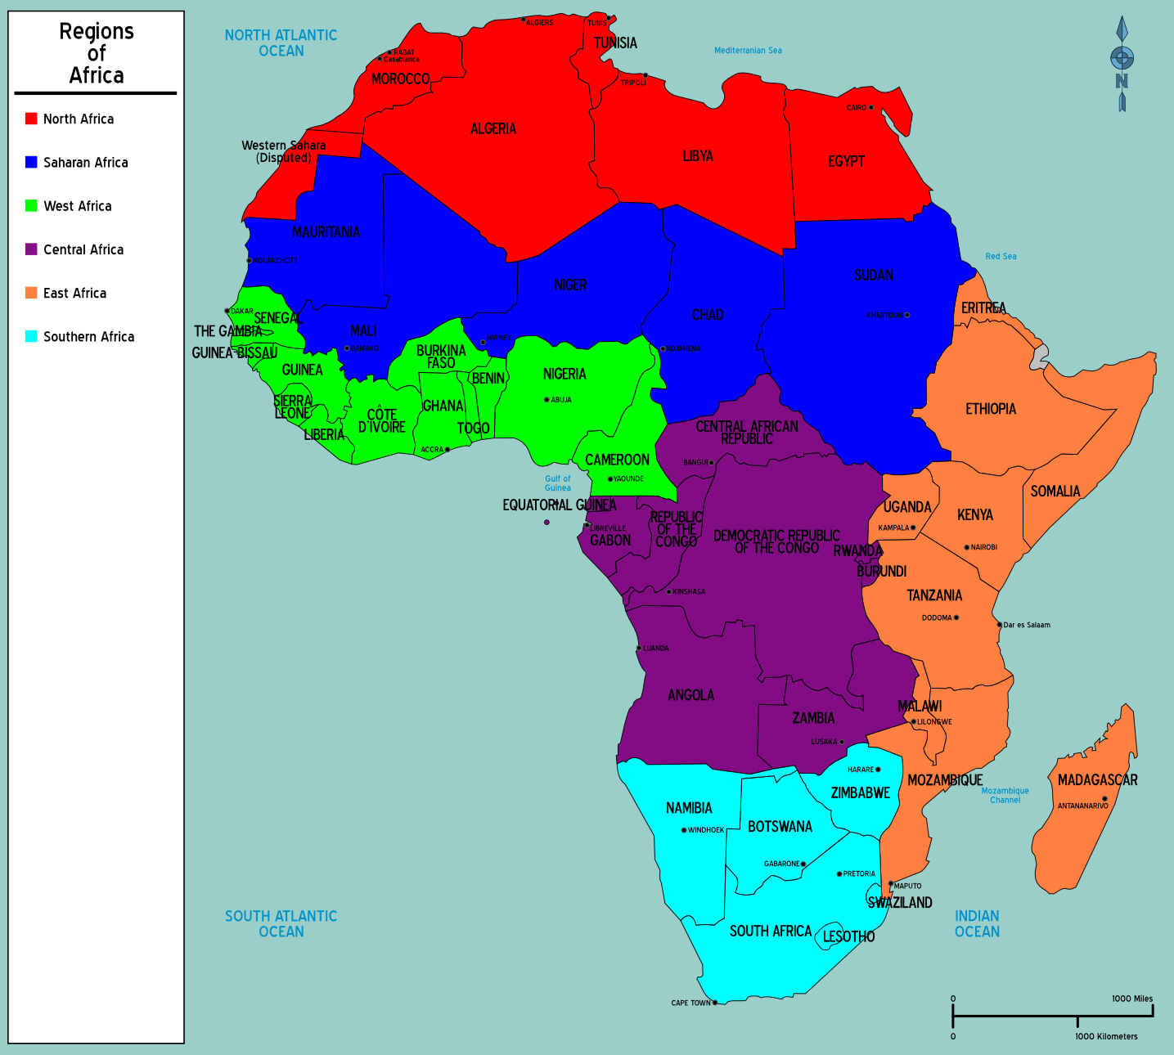

Slide 20
Pop Quiz –On loose leaf paper, match the country with the region. Part I.
Oman A. Southeast Asia
China B. Central Asia
Kyrgyzstan C. East Asia
Pakistan D. South Asia
Cambodia E. Southwest Asia (Middle East)

Slide 21
Part B
6. Which of the following countries is landlocked?
Which of the following is a country where the majority is Muslim?
Democratic Republic of the Congo
Republic of the Congo
Mozambique
Togo
Benin
South Africa
Mali
Namibia
Tanzania
Democratic Republic of the Congo

Slide 22
Part C
Name a country in Africa where an attempted genocide has taken place in the last 30 years.

Slide 23
Where is everything?
Do Now: Identify which of the following is not an island country.
Madagascar B) Cape Verde C) Sao Tome and Principe
D) Sychelles E) Senegal F) Comoros

Slide 24
Asia
Land Area - 17,139,445 square miles (44,391,162 square km)
Total Population – 4.436 billion (As of 2016)
Largest Country (Area) - Russia: 6,601,668 square miles (17,098,242 sq km)
Smallest Country (Area)- Maldives: 116 square miles (300 sq km)
Island Nations - Maldives, Singapore, Philippines, Japan, Indonesia, East Timor, Brunei
River Systems – Huang He, Yangtze (China), Ganges, Indus (South Asia), Tigris, Euphrates (Iraq)

Slide 25
Asia
Highest Point - Mt. Everest (29,029 feet)
Mountain Ranges – Hindu Kush, Himalayas, Ural Mountains, Kunlun Mountains, Ghats, Altay, Tien Shan, Zagros

Slide 26
Mountain Ranges

Slide 27
Asia – Bordered by Bodies of Water
Arctic Ocean
Arabian Sea
Indian Ocean
Bay of Bengal
Pacific Ocean
East China Sea
Sea of Japan
Sea of Okhotsh
Bering Sea
Red Sea
Persian Gulf

Slide 28
Asia Bodies of Water

Slide 29
Main Religious Groups Asia
Christianity, Islam, Hinduism, Buddhism, Bahai, Judaism, Jainism, Zoroastrianism, Confucianism, Shintoism, Daoism, Chinese Ethnic Religions,

Slide 30
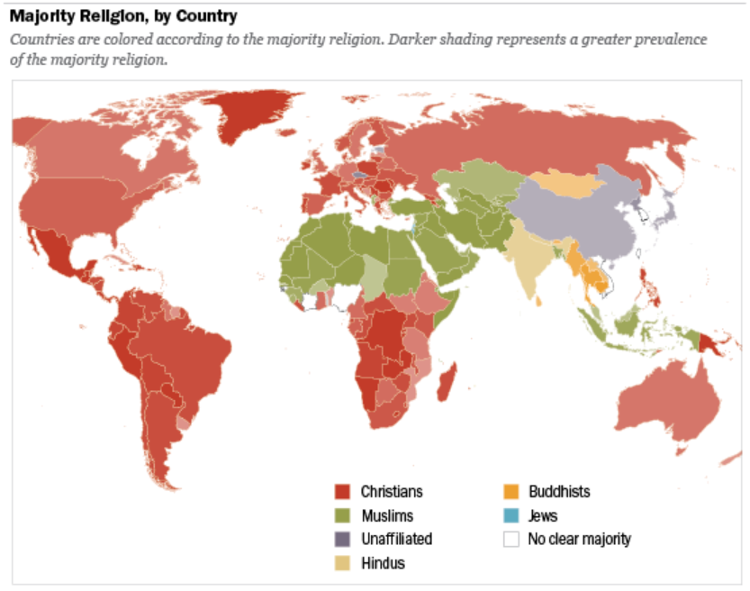

Slide 31
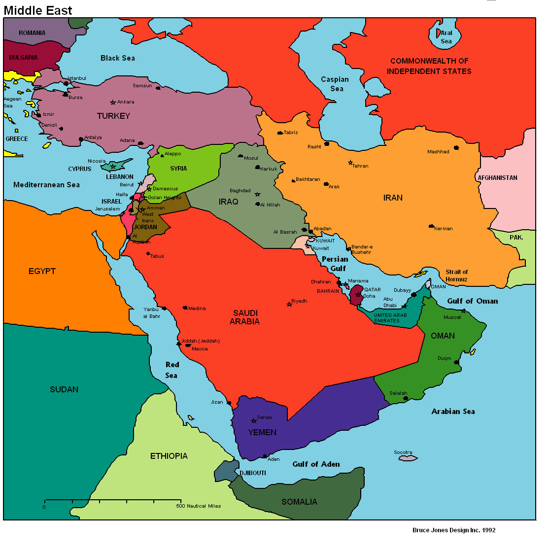

Slide 32
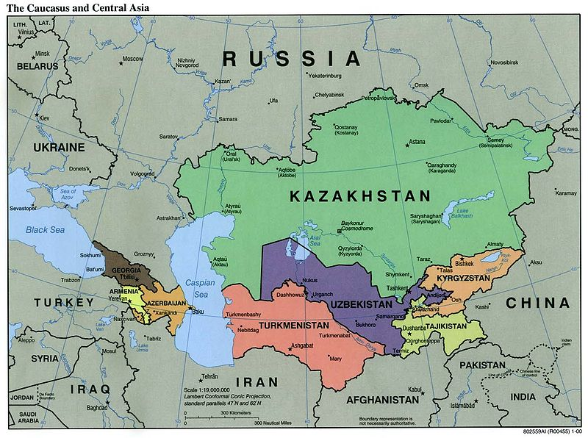

Slide 33
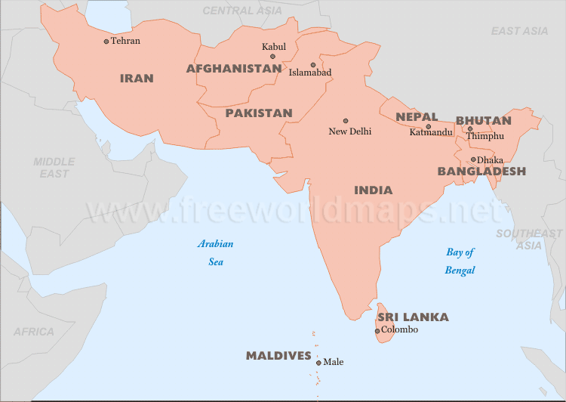

Slide 34
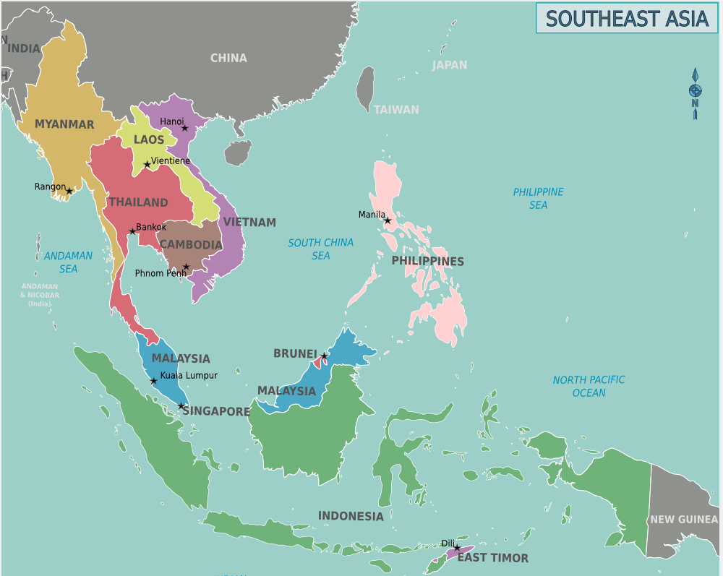

Slide 35
