Slide 1
AIM: Why is each point on earth unique?
Do Now: Name game

Slide 2
If you could rename our city, what would you rename it?
In pairs, come up with new names for
New York City
Long Island
Brooklyn Technical High School
New York State
The United States of America
Fort Greene
Your neighborhood.
Write a reason for why your new name is a better fit than the old name.
Which of the four ways we name things fits your new name for each place?

Slide 3
How do we identify locations?

Slide 4
There are 4 ways!

Slide 5
1. NAMES!!!!
Names come in a number of different ways.
Place names are referred to as, toponyms.

Slide 6
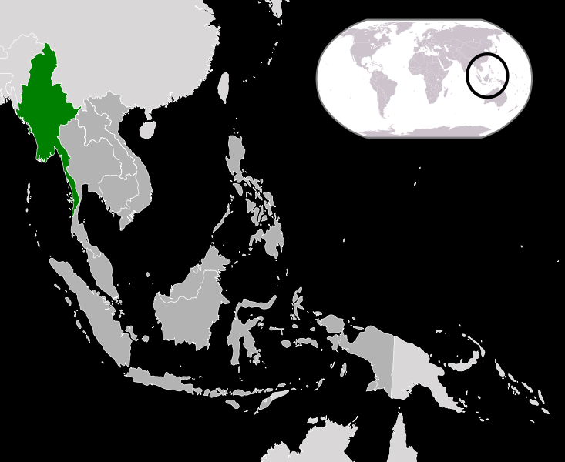
Sometimes places might change their name due to political upheaval.
In 1989, Burma’s military government changed the name of their country to “Myanmar”.

Slide 7
Other places change their name to honor someone important.
St. Petersburg became Leningrad.
Also, after the fall of communism, many eastern European cities changed their names back to their original names.
Leningrad renamed itself St. Petersburg again.

Slide 8
II. Site
The physical characteristics of a place.
Includes climate and topography, water sources, soil vegetation, latitude, and elevation.

Slide 9
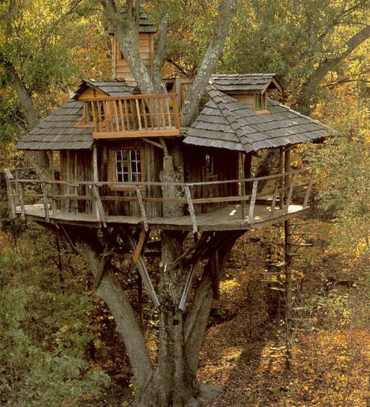
Site affects how people build.

Slide 10
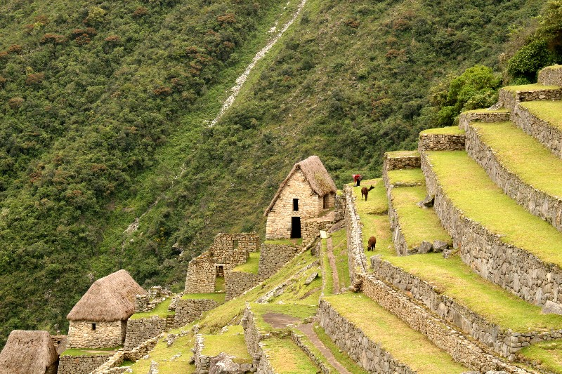
Humans can modify the characteristics of a site.

Slide 11
III. Situation
Situation is a places location in relation to other places.
Have you ever used a familiar landmark to help you navigate through an unfamiliar place?

Slide 12
Familiar place

Slide 13
The Equator and the Prime Meridian

Slide 14
We use these familiar sites to find where we are via degrees of latitude and longitude.
Degrees are subdivided into hours, minutes and seconds.

Slide 15
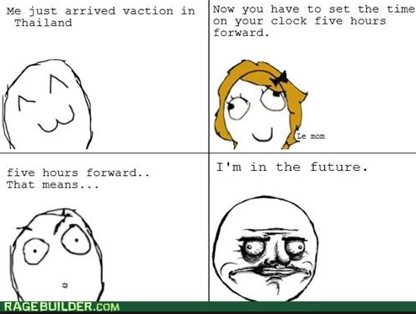
Longitude helps us divide the world into time zones.
The earth is divided into 24 time zones. Each zone is comprised of 15 degrees.

Slide 16
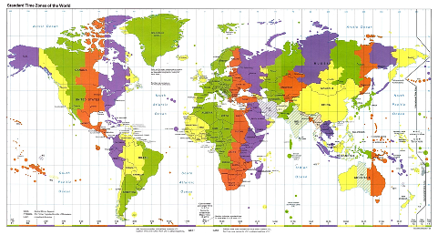

Slide 17
When are we?
Standard time zones were adopted in the United States in 1883 based on the creation of longitude in the 1700s.
Until standard time zones were adopted, every place on earth kept their own local time. Why was this a bad idea?

Slide 18
When Are We?
Greenwich England counts as the place from which all time is measured because the Prime Meridian passes through it.

Slide 19
IV. Mathematical Location
Absolute location.
How does latitude affect place?
How does longitude affect place?

