Slide 1
AIM: What are geographic questions?
Do Now: Quiz

Slide 2
If you could rename our city, what would you rename it?
In pairs, come up with new names for
New York City
Long Island
Brooklyn Technical High School
New York State
The United States of America
Fort Greene
Your neighborhood.
Write a reason for why your new name is a better fit than the old name.
Which of the four ways we name things fits your new name for each place?

Slide 3
How can we identify patterns on a map?

Slide 4
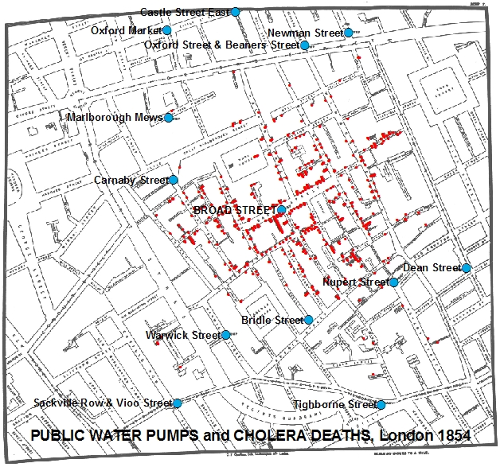
Dr. John Snow
Using maps, Dr. Snow was able to figure out the source of a deadly cholera outbreak in 1854.
Where did Cholera originate?
Where does it still thrive today?

Slide 5
What is a problem we could realistically map in this school?

Slide 6
How did draining part of the Everglades make Florida more at risk for hurricane damage?

Slide 7
If you could live anywhere in the USA, where would it be? Why?

Slide 8
Site
The physical characteristics of a place.
Includes climate and topography, water sources, soil vegetation, latitude, and elevation.

Slide 9
Site affects how people build.

Slide 10
Humans can modify the characteristics of a site.

Slide 11
III. Situation
Situation is a places location in relation to other places.
Have you ever used a familiar landmark to help you navigate through an unfamiliar place?

Slide 12
Familiar place

Slide 13
The Equator and the Prime Meridian

Slide 14
We use these familiar sites to find where we are via degrees of latitude and longitude.
Degrees are subdivided into hours, minutes and seconds.

Slide 15
AIM: What are geographic questions?
Do Now: How many time zones exist on earth?
Approximately how many degrees longitude equals a time zone?

Slide 16
Longitude helps us divide the world into time zones.
The earth is divided into 24 time zones. Each zone is comprised of 15 degrees.

Slide 17
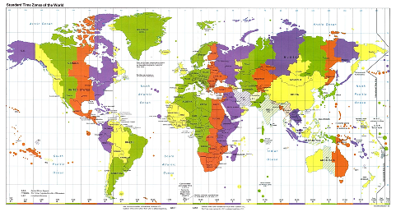

Slide 18
When are we?
Standard time zones were adopted in the United States in 1883 based on the creation of longitude in the 1700s.
Until standard time zones were adopted, every place on earth kept their own local time. Why was this a bad idea?

Slide 19
When Are We?
Greenwich England counts as the place from which all time is measured because the Prime Meridian passes through it.

Slide 20
IV. Mathematical Location
Absolute location.
How does latitude affect place?
How does longitude affect place?

Slide 21
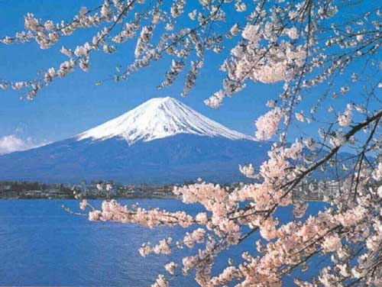
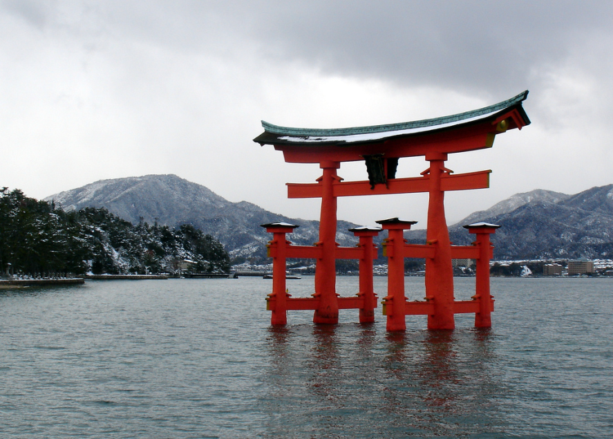
Regional Studies Approach
Each region has its own distinct landscape that results from a unique combination of social relationships and physical processes.

Slide 22
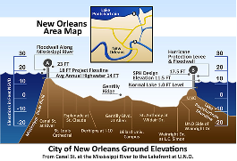
Two factors lead to the distinct landscapes of regions.
Human characteristics
Environmental characteristics

Slide 23
How are regions different?
Region divides the world into manageable units for geographic study. Regions have some sort of characteristic that unifies the area. Regions can be formal, functional, or vernacular.

Slide 24
Cultural Ecology
The geographic study of human-environmental relationships.

Slide 25
5 Major types of climates.
Tropical
Dry
Warm Mid-Latitude
Cold Mid-Latitude
Polar

Slide 26
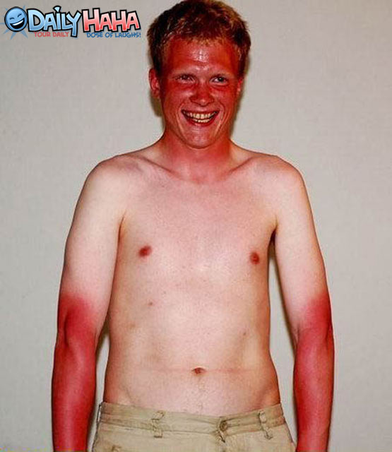
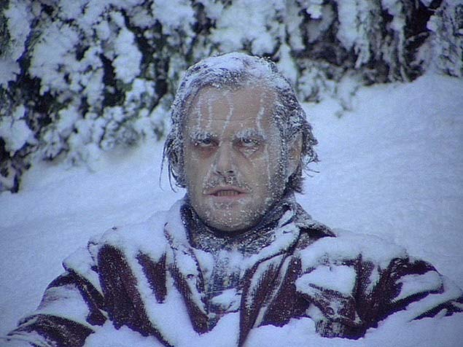
Climates affect where we live
Humans have a limited tolerance to extreme environments

Slide 27
How does the cultural landscape affect the environment?
“Forms superimposed on the physical landscape” –Carl Sauer

Slide 28
4 major plant biomes
Forest
Savanna
Grassland
Desert

Slide 29
Soil is important for growing stuff.
Two issues we face with soil are;
Erosion
Depletion of Nutrients.
Determine why these problems occur.

Slide 30
AIM: Why do geographers use maps and what do maps tell us?

Slide 31
Reference maps – show locations of places and geographic features.
Thematic Maps – tell stories, showing the degree of some attribute or the movement of a geographic phenomenon.

Slide 32
Chropleth Map
Uses shading to show data on a map.

Slide 33
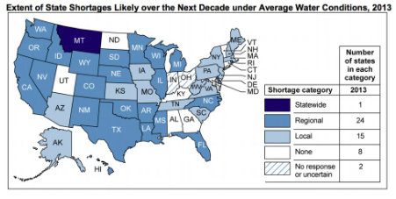
Thematic Chloropleth Map

Slide 34
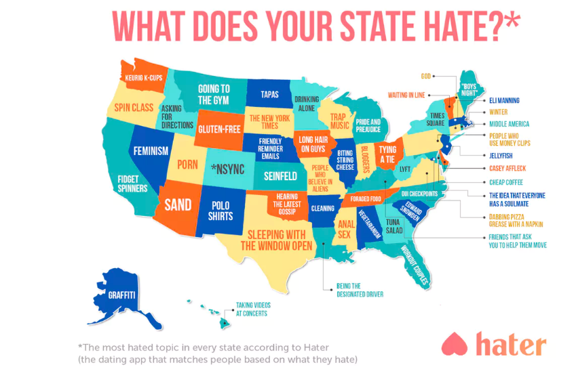

Slide 35
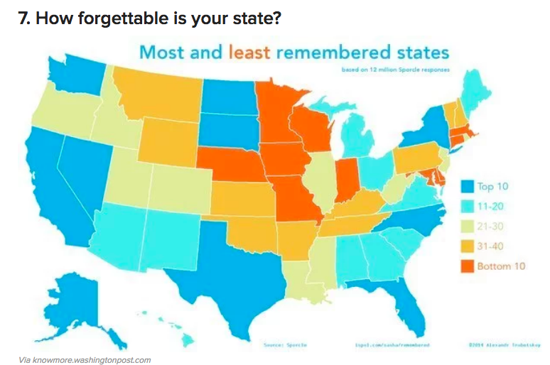

Slide 36
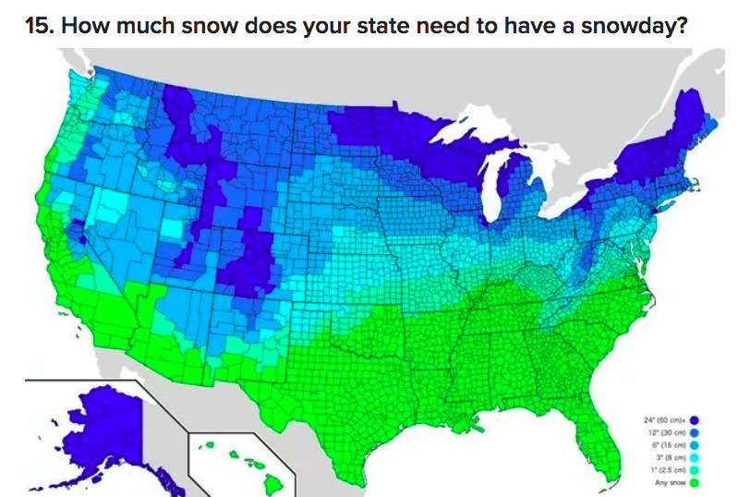

Slide 37
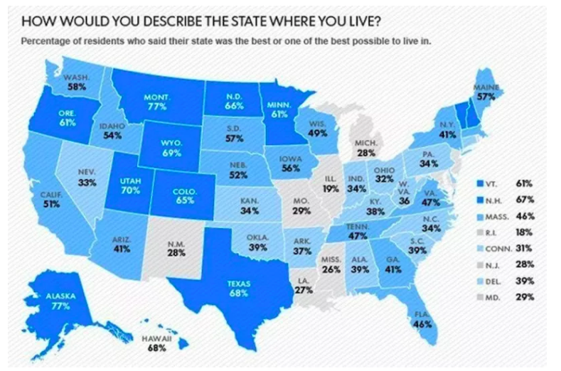

Slide 38
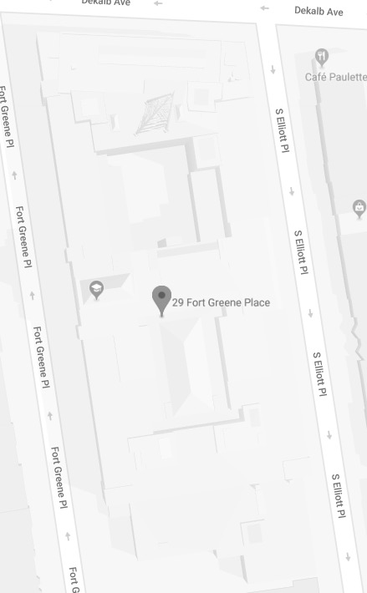
Make a choropleth of your class’s attitude towards Brooklyn Tech

Slide 39
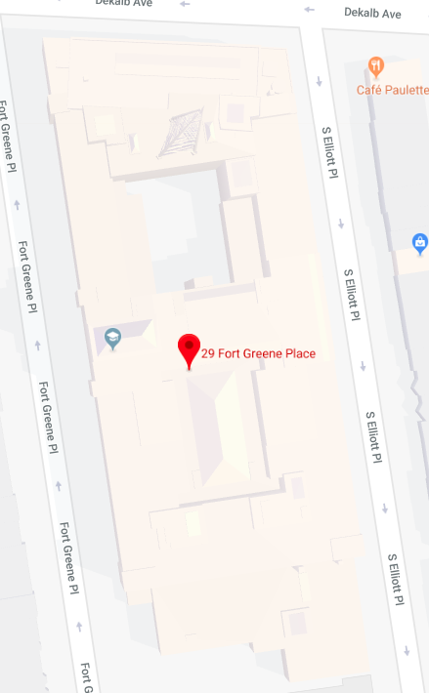
Make a transportation map of Brooklyn Technical High School. (How people travel within the building)

