Slide 1
AIM: How are different regions unique?
Do Now: Quiz

Slide 2
Questions
How many time zones exist on earth?
How many degrees longitude make up a time zone?
What is the name of the meridian that lies at 180 degrees longitude?

Slide 3
Answers
24
15
The International Date Line

Slide 4
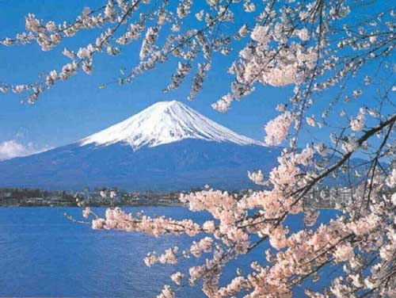
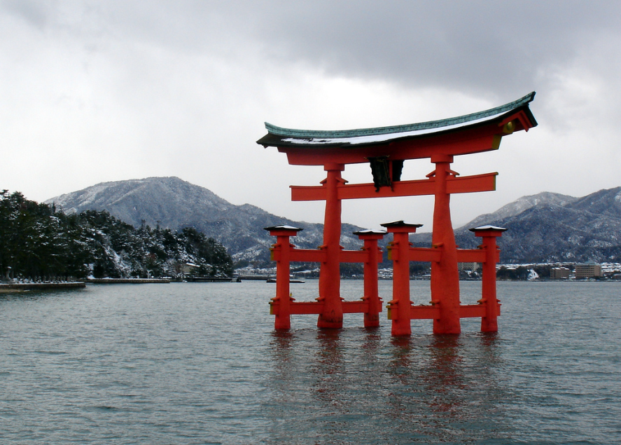
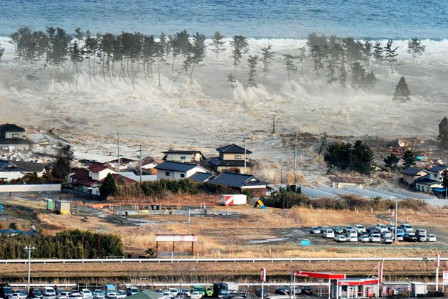
Regional Studies Approach
Each region has its own distinct landscape that results from a unique combination of social relationships and physical processes.

Slide 5
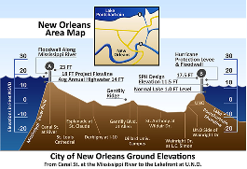
Two factors lead to the distinct landscapes of regions.
Human characteristics
Environmental characteristics

Slide 6
How are regions different?
Region divides the world into manageable units for geographic study. Regions have some sort of characteristic that unifies the area. Regions can be formal, functional, or vernacular.

Slide 7
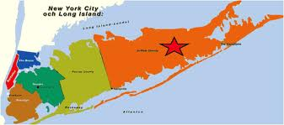
Formal Region (Uniform/Homogenous)
An area where everyone shares in common one or more distinct characteristics.
Ie: country, state, town, county

Slide 8
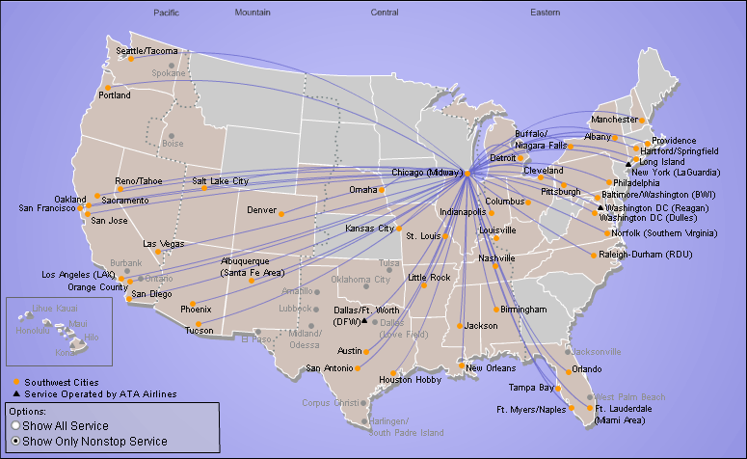
Functional Regions (Nodal Regions)
Organized around a focal point or node. Usually have an economic basis. The further away one gets from the center, distance decay sets in, and the connection grows weaker.
Ie: Southwest
airlines service
map.

Slide 9
Vernacular Regions (Perceptual region)
Vernacular regions are perceived regions. They exist because people believe they exist as part of their cultural identity.
How do you perceive the city?
How do you perceive upstate?

Slide 10
Vernacular Region Illustrated

Slide 11
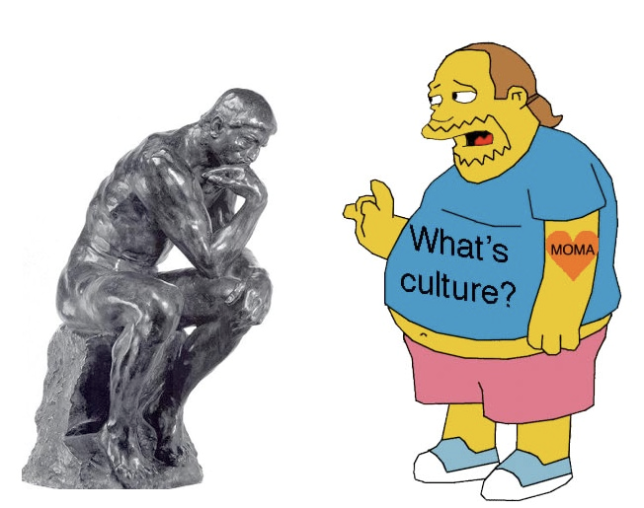
Culture
Geographers refer to culture when thinking about how different regions are unique.

Slide 12
Some Long Islanders look like this…

Slide 13
Culture
An integrated pattern of human knowledge, belief, and behavior that depends upon the capacity for symbolic thought and social learning
The set of shared attitudes, values, goals, and practices that characterizes an institution, organization, or group

Slide 14
Cultural Ecology
The geographic study of human-environmental relationships.

Slide 15
Environmental Determinism
The idea that the physical environment causes social development.
critics charged that determinism served to justify racism and imperialism.

Slide 16
Possibilism
is the theory that the environment sets certain constraints or limitations, but culture is otherwise determined by social conditions.

Slide 17
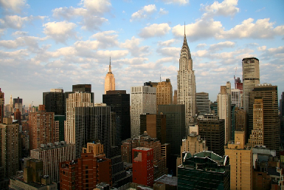
Environmentally Determined?

Slide 18
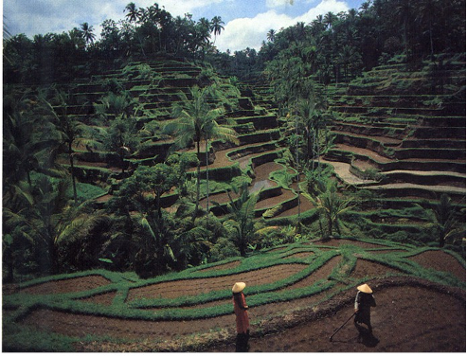
What about Bali,
Indonesia?

Slide 19
5 Major types of climates.
Tropical
Dry
Warm Mid-Latitude
Cold Mid-Latitude
Polar

Slide 20
Tropical

Slide 21
Dry

Slide 22
Warm Mid-Latitude

Slide 23
Cold Mid-Latitude

Slide 24
Polar

Slide 25
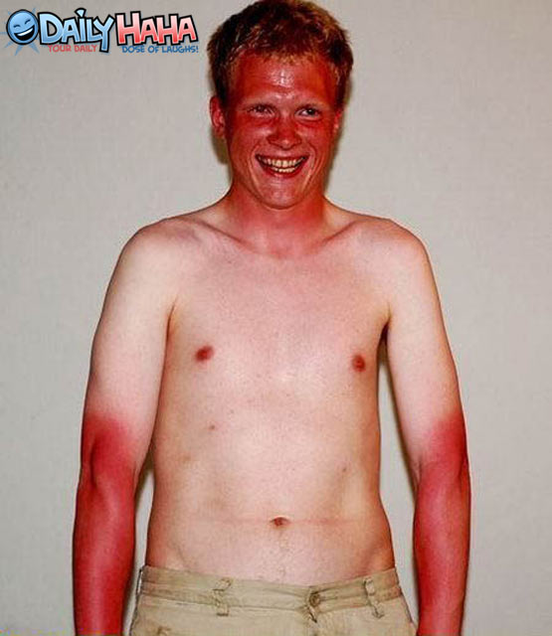
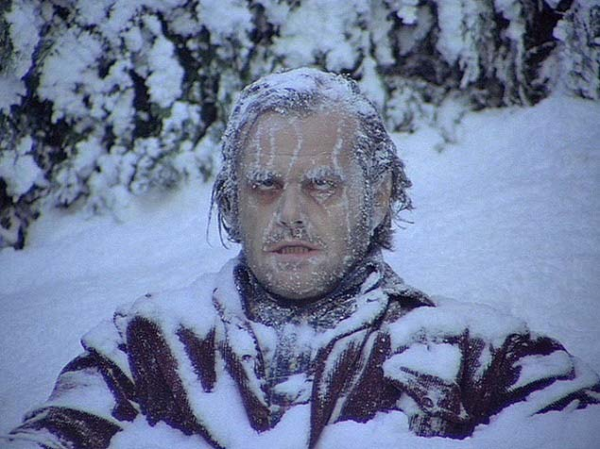
Climates affect where we live
Humans have a limited tolerance to extreme environments

Slide 26
4 major plant biomes
Forest
Savanna
Grassland
Desert

Slide 27
Forest

Slide 28
Savanna

Slide 29
Grassland

Slide 30
Desert

Slide 31
Soil is important for growing stuff.
Two issues we face with soil are;
Erosion
Depletion of Nutrients.
Determine why these problems occur.

