Slide 1
AIM: How do geographers address where things are?
Do Now: Please restate Tobler’s First Law of Geography.

Slide 2
Tobler’s 1st Law of Geography
All things are related. However, all other things being equal, those things that are closest together are more related.
Related Concepts:
Distance Decay / Friction of Distance
Spatial Interaction
Movement

Slide 3
Key Concepts in Spatial Distribution
Spatial Distribution – the regular arrangement of phenomena across the Earth’s surface.
Density – the frequency with which something exists within a certain area.

Slide 4
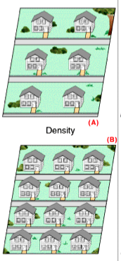
Spatial Distribution #1
Density – the frequency with which something exists within a certain area.

Slide 5
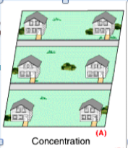
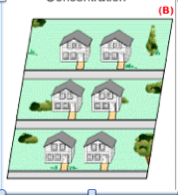
Spatial Distribution #2
Concentration – The spread of something over a given study area.

Slide 6
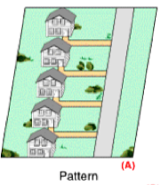
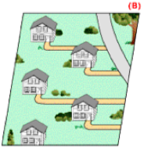
Spatial Distribution #3
Pattern – the geometric or regular arrangement of something over a given area.

Slide 7
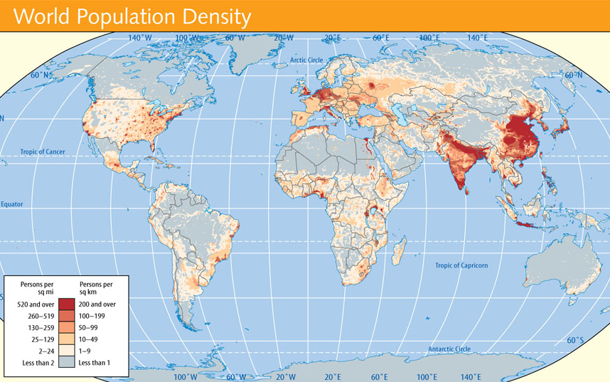
Notes:
Figure 1.4b: This is an isarithmic map designed to show the approximate distribution of global population. By comparing 1.4a and 1.4b, you can see the different visual messages sent by different maps.

Slide 8
Key Concepts
REGION – an area defined by shared characteristic
3 Types of Culture Regions
Formal - all members share a characteristic
Functional - defined by a node of activity and distance decay from center
Vernacular - perception of cultural identity

Slide 9
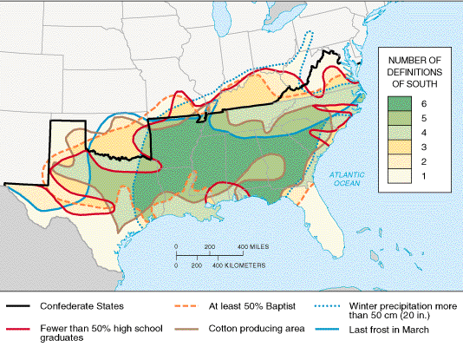
Vernacular Regions

Slide 10
Core-Periphery Model
A model that describes how economic, political, and/or cultural power is spatially distributed between dominant core regions, and more marginal or dependent semi-peripheral and peripheral regions.

Slide 11
Key Concepts: Core-Periphery
Periphery
Less Developed
Poor
Dependent upon Core countries for:
Education
Technology
Media
Military Equipment
Core
U.S., Europe, Japan, Australia
Wealthy
Powerful
Controls Media and Finance
Technologically advanced

Slide 12
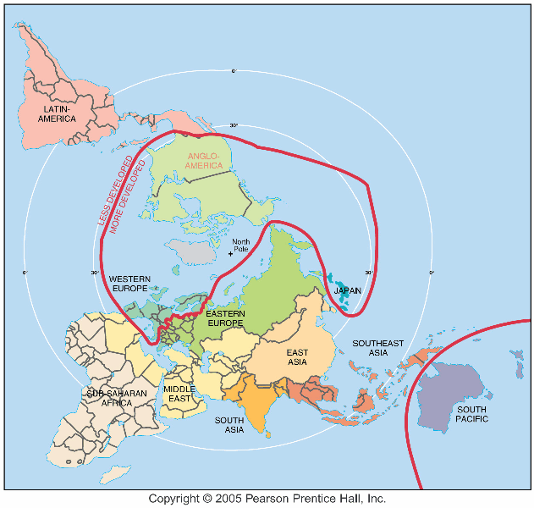

Slide 13
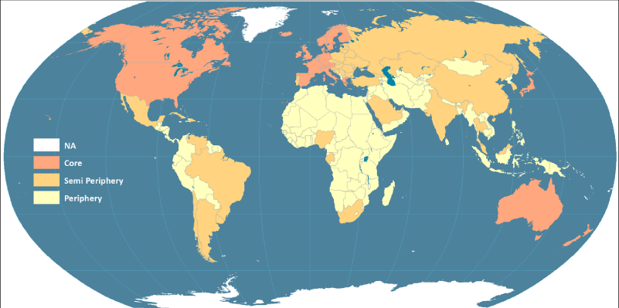

Slide 14
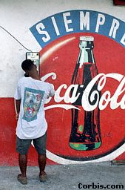
Globalization
The increasing interconnectedness of different parts of the world through common processes of economic, political, and cultural change. Economic globalization is happening fastest.
Panama, 1997

Slide 15
Who was the first person to coin the term geography?
Eratosthenes
Calculated the circumference of the earth.
Created an early world map.
Separated the earth into 5 climate zones.

Slide 16
Early Map-Makers
The Babylonians
Miletus, Turkey
2300 B.C.E.
800 B.C.E.

Slide 17
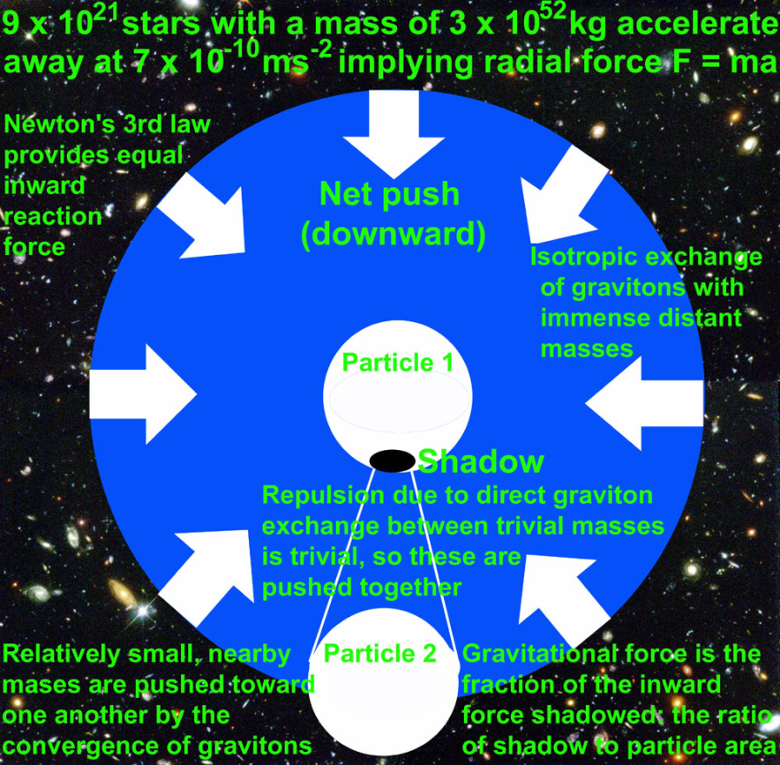
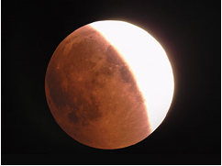
Aristotle
First to demonstrate that the earth was spherical.

Slide 18
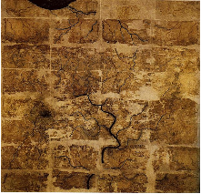
Early world-wide achievements
Pei Xiu (224–271) created a map of China in 267 C.E.

Slide 19
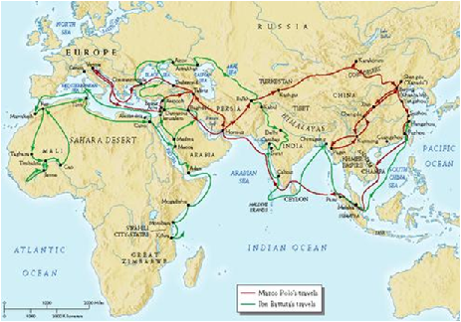
Early world-wide achievements
Al-Idrisi prepared a world map and geography text in 1154
Ibn Battutah traveled the world more than Marco Polo and wrote about it in the 1300s.

