Slide 1
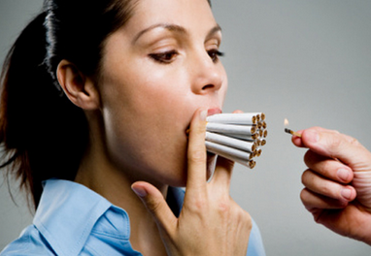
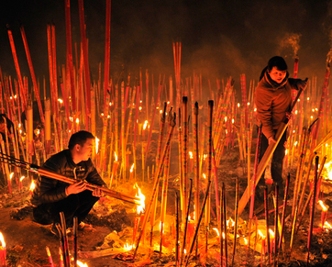
AIM: How do we differentiate between folk and popular culture in New York City?
Do Now: What is the difference between a habit and a custom?

Slide 2
What is the difference between a habit and a custom?
Habit
Custom

Slide 3
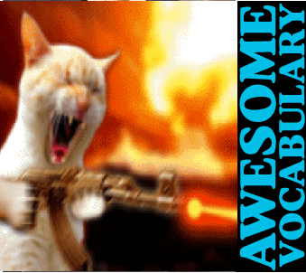
Vocabulary
Habit – a repetitive act that an individual performs (biting nails, procrastinating, doodling)
Custom – A repetitive act of a group, that has become characteristic of the group. (Casual Friday, Blowing things up on the 4th of July)

Slide 4
Apply this to New York?
Where are folk cultures and popular cultures located in space?
Where do we see folk culture in New York?

Slide 5
Brainstorm a list

Slide 6
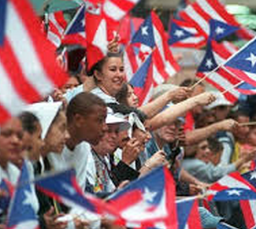
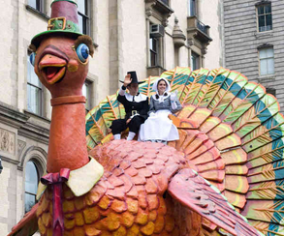
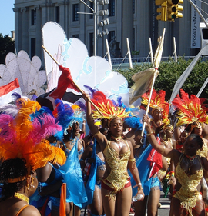
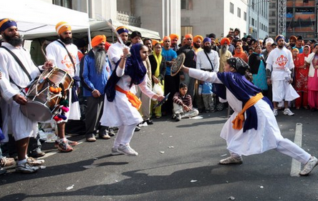
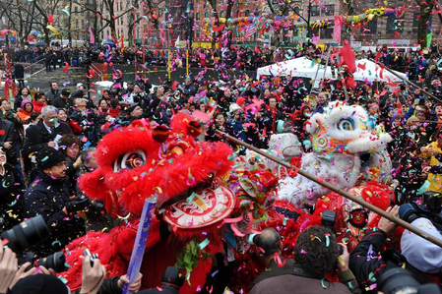
Parades

Slide 7
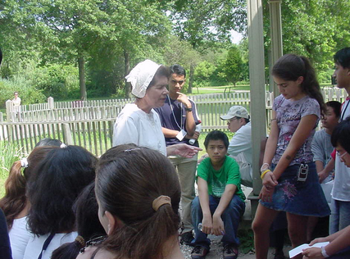
Old Bethpage Village

Slide 8
Annual Reenactment of the Battle of Brooklyn

Slide 9
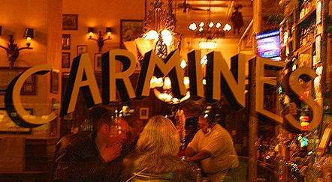
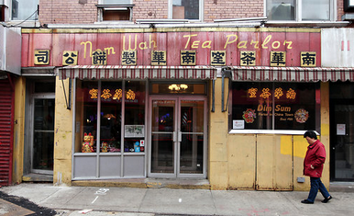
Restaurants

Slide 10
Specialty Spas

Slide 11
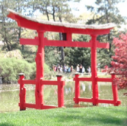
Brooklyn Botanical Garden

Slide 12
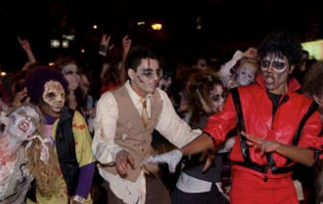
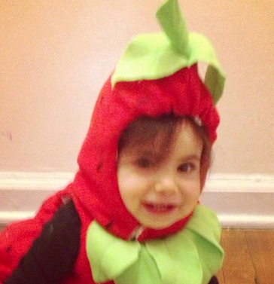
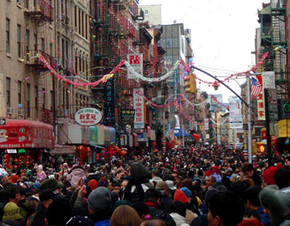
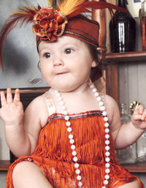
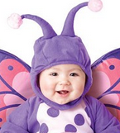
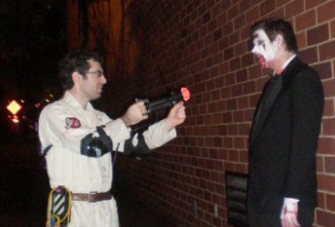
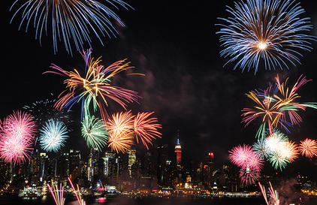
Holiday Celebrations

Slide 13
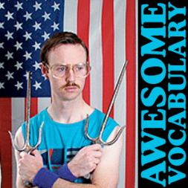
Placelessness
Aka: Homogenization, Sameness
The lack of a sense of place.
It looks like it could be anywhere really.
Globalization can lead to this.
Most airports and malls look like they can be clones of each other. Similarly, the spread of restaurant franchises makes places lose their regional distinctiveness.

Slide 14
Pop Culture?
Everywhere

Slide 15
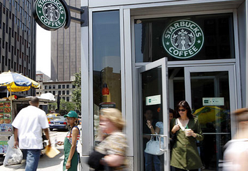

Slide 16
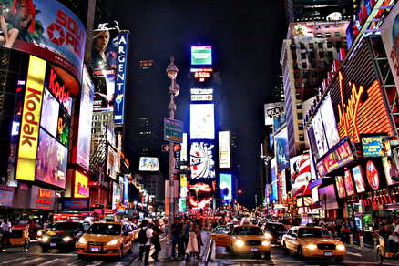

Slide 17
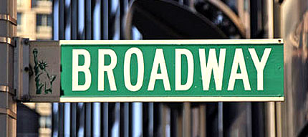

Slide 18
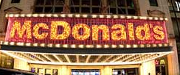

Slide 19
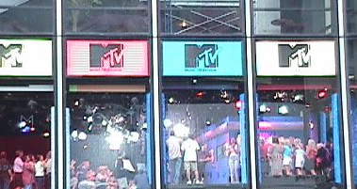

Slide 20
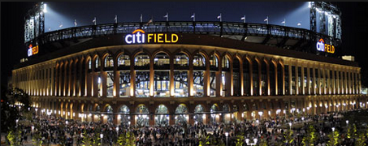
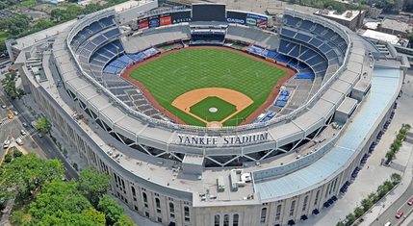

Slide 21
How do visitors define New York?

Slide 22
Homer vs. New York

Slide 24
