Slide 1
AIM: Where is everything?
Do Now: Why did your family originally immigrate to the USA?

Slide 2
South America
Land Area - 17,840,000 km² (6,890,000 sq mi)
Total Population - 387,489,196
Largest Country (Area) – Brazil 8,515,767 km2
3,287,597 sq mi
Smallest Country (Area)- Suriname: 163,821 km2
63,251 sq mi
Island Nations - Zero
River Systems – Amazon River

Slide 3
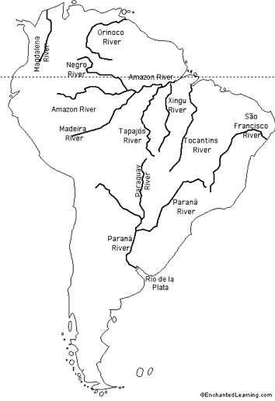
River Systems

Slide 4
South America
Highest Point - Aconcagua (22,841 ft)
Mountain Ranges – Andes Mountains, Guyana Highlands, Brazilian Highlands, Patagonia

Slide 5
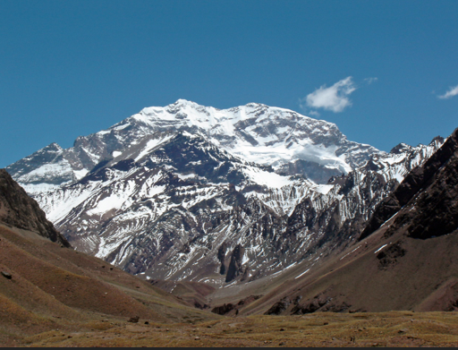
Aconcagua

Slide 6
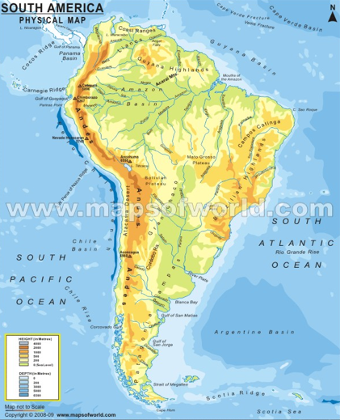

Slide 7
South America – Bordered by Bodies of Water
Atlantic Ocean
Scotia Sea
Southern Ocean
Pacific Ocean
Caribbean Sea

Slide 8
Europe
Land Area - 10,180,000 km² (3,930,000 sq mi)
Total Population – 743.1 million (As of 2016)
Largest Country (Area) – Russia - 17,098,242 km² (6,601,668 sq mi)
Smallest Country (Area)- Vatican City: 0.44 km² (0.17 sq mi)
Island Nations - United Kingdom, Ireland, Malta, Cyprus, Iceland
River Systems – Rhine River, Thames River, Danube River, Tiber River, Elbe River, Loire River, Volga River

Slide 9
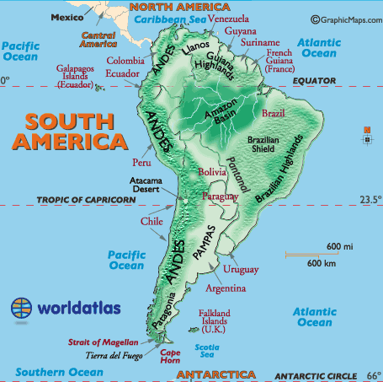
Bodies of Water

Slide 10
Main Religious Groups South America
Christianity (Catholicism 82% of total population), Judaism, Islam, Hinduism

Slide 11
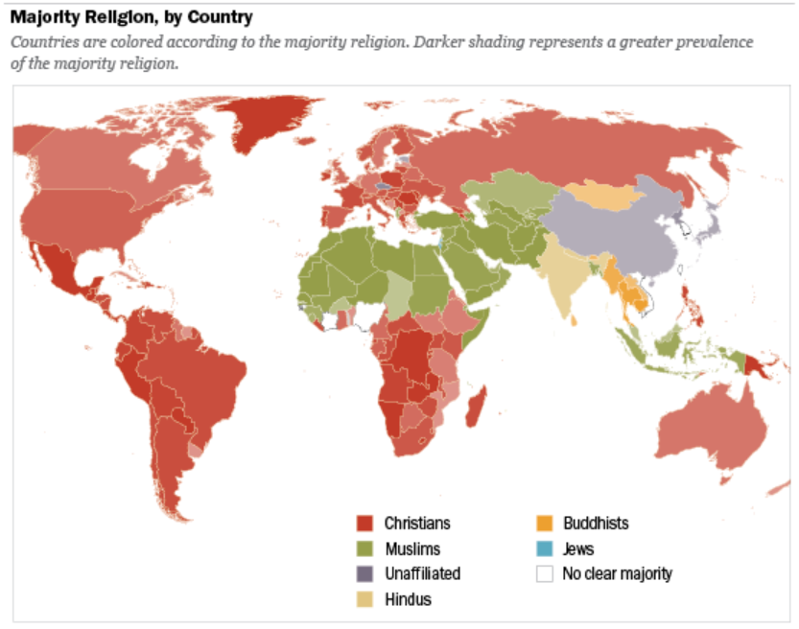

Slide 12
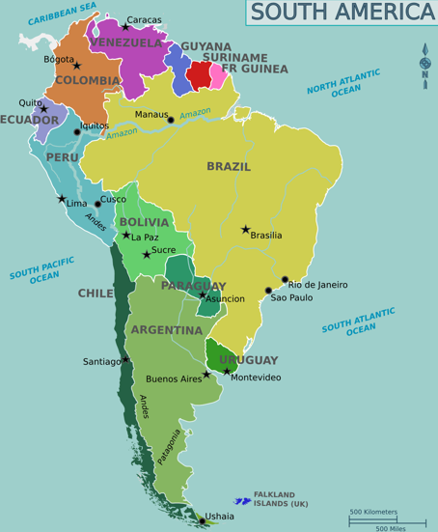

Slide 13
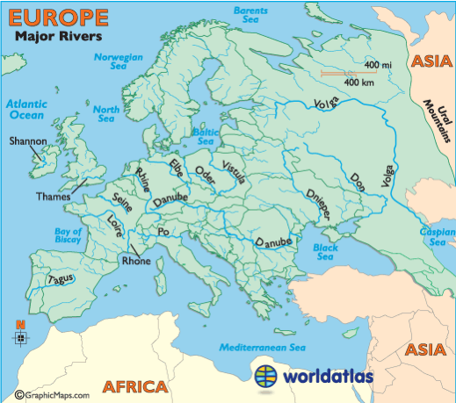

Slide 14
Europe
Highest Point - Mt. Elbrus (18,510 feet)
Mountain Ranges – Alps, Ural Mountains, Caucasus, Balkan Mountains, Pyrenees, Carpathian Mountains

Slide 15
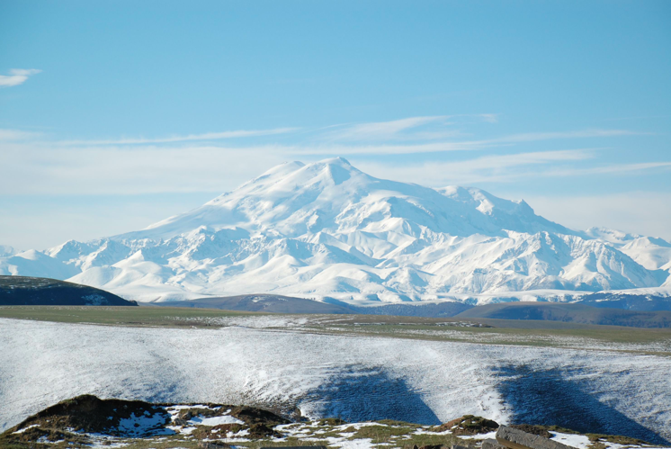
Mt. Elebrus

Slide 16
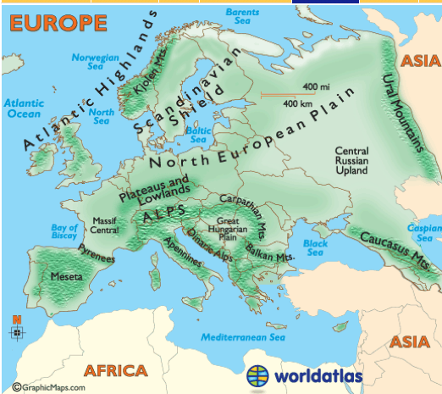

Slide 17
Europe– Bordered by Bodies of Water
Atlantic Ocean
Arctic Ocean
Mediterranean Sea
Black Sea
Caspian Sea
North Sea
Norwegian Sea
Baltic Sea
Barents Sea
Bay of Biscay

Slide 19
Main Religious Groups Europe
Christianity (Catholicism, Protestantism, Orthodox), Islam, Judaism,

Slide 20
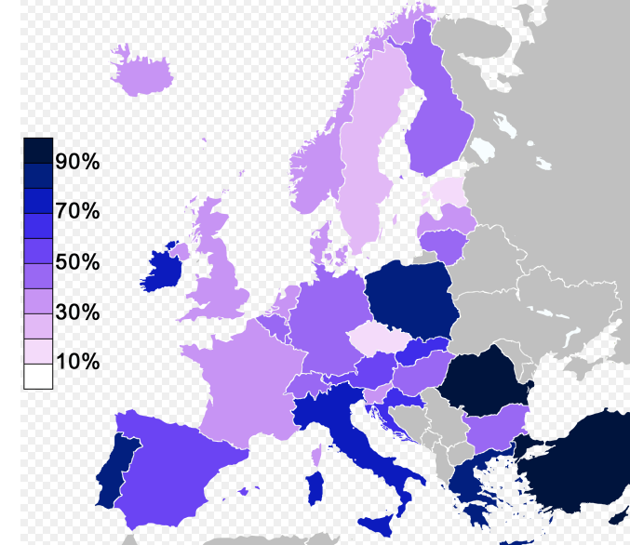
Belief in God

Slide 21
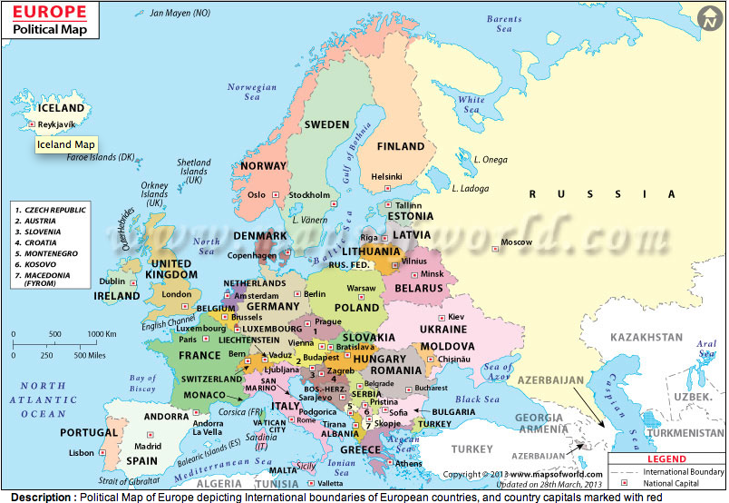

Slide 22
Australia and Oceania
Land Area - 8,525,989 km² (3,291,903 sq mi)
Total Population – 39,901,000 (As of 2016)
Largest Country (Area) – Australia - 2,988,901 square miles (7,741,220 sq km)
Smallest Country (Area)- Nauru: 8.1 square miles (21 sq km) Island Nations - Papua New Guinea, New Zealand, Solomon Islands, Fiji, Vanuatu, Somoa, Kiribati, Tonga, Federated States of Micronesia, Palau, Marshall Islands, Tuvalu, Nauru
River Systems – Lachlan River, Darling River, Diamantia River

Slide 23
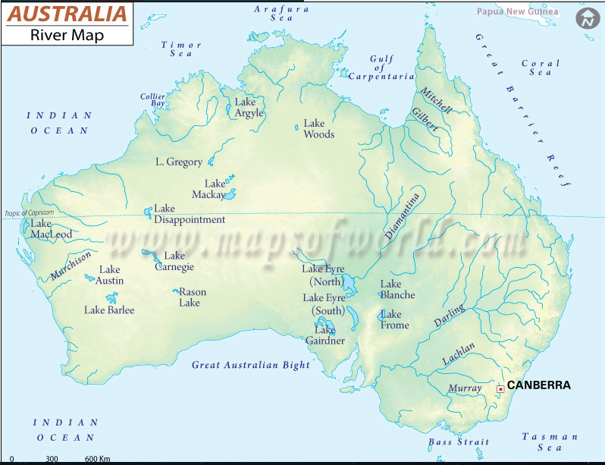

Slide 24
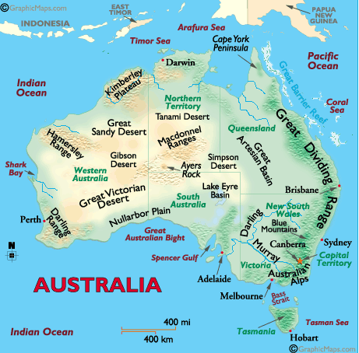

Slide 25
Australia
Highest Point - Mt. Kosciusko: 7310 feet
Mountain Ranges – Great Dividing Range

Slide 26
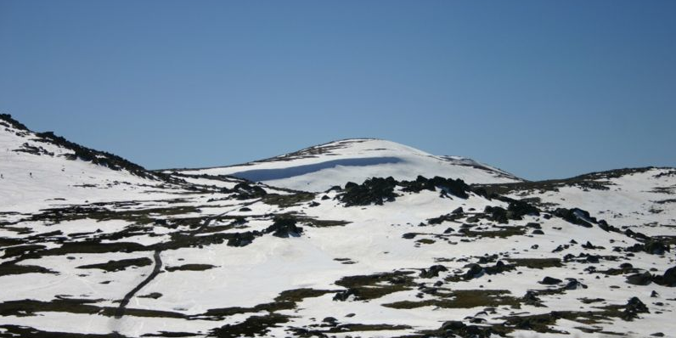
Mt. Kosciusko

Slide 27
Oceania– Bordered by Bodies of Water
Indian Ocean
Timer Sea
Arafura Sea
Great Australian Bight
Bass Straight
Tasman Sea
Gulf of Carpentaria
Pacific Ocean

Slide 28
Main Religious Groups Australia
Christianity, Animism, Bahai

Slide 29
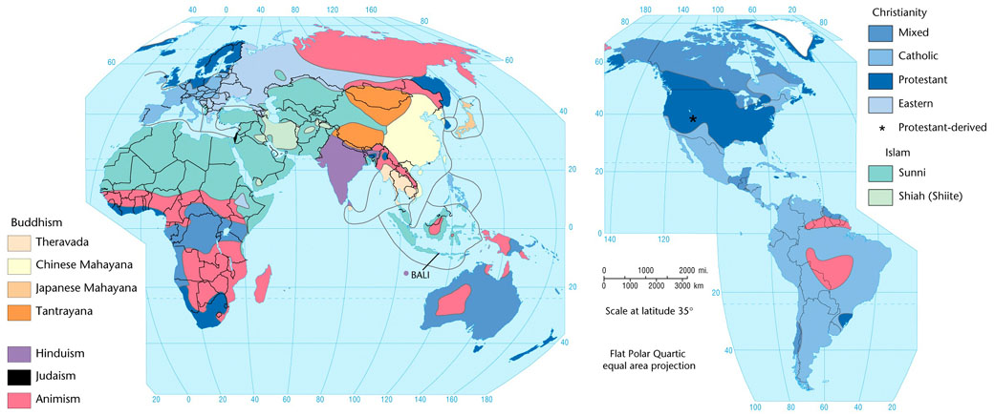
Religions Map

Slide 30
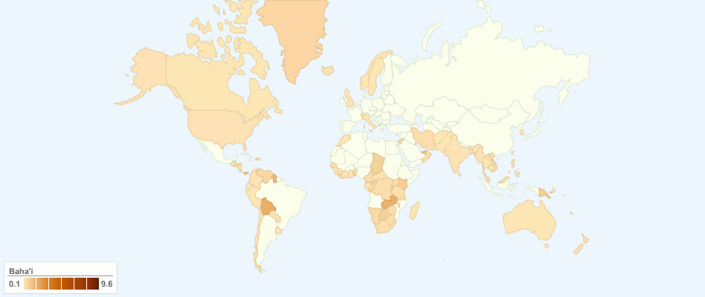
Because you might be curious

Slide 31
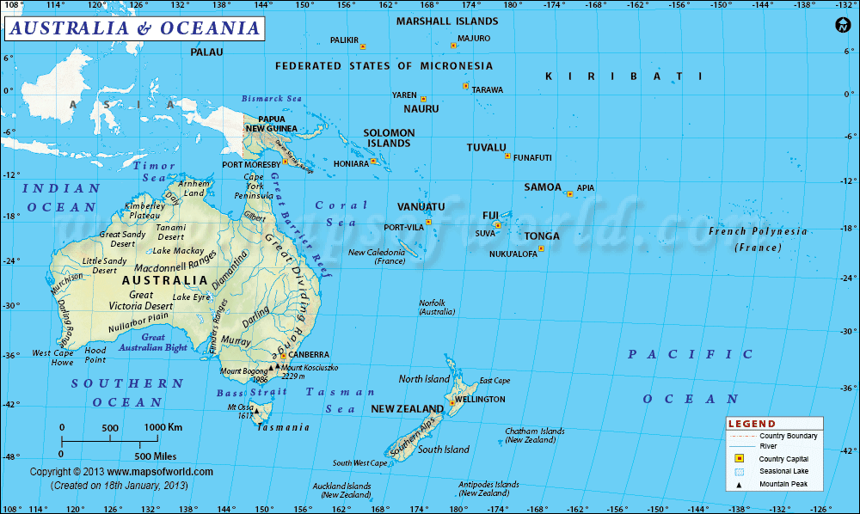
Political Map

