Slide 1
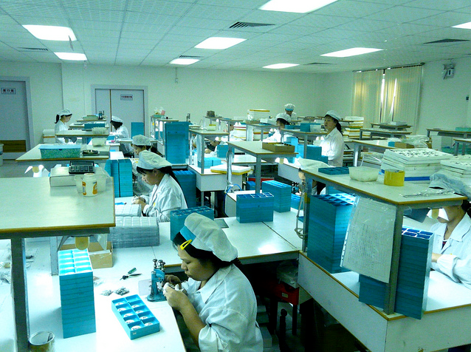
AIM: Does time matter?
Do Now: Why do transnational corporations put their factories in developing countries?

Slide 2
What are the benefits to putting factories in developing countries?

Slide 3
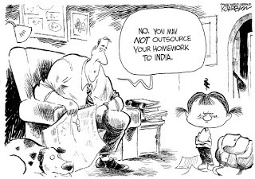
In your judgment will any developing country serve as an adequate location for outsourcing??

Slide 4
Why can’t countries such as Afghanistan and Mali serve as good locations for outsourcing?

Slide 5
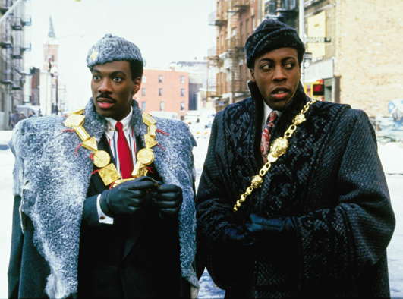
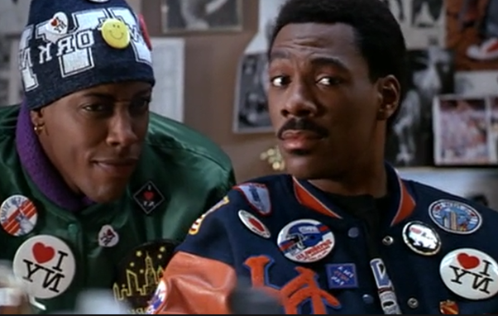
Acculturation
cultural modification of an individual, group, or people by adapting to or borrowing traits from another culture.
IE: Eddie Murphy and Arsenio Hall’s characters in Coming to America go through Acculturation.

Slide 6
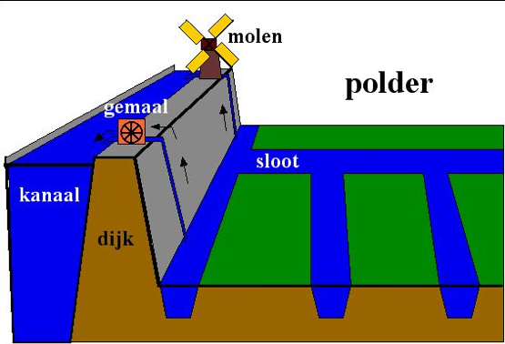
Useful Vocabulary
Polder - a tract of low land (as in the Netherlands) reclaimed from a body of water (as the sea)

Slide 7
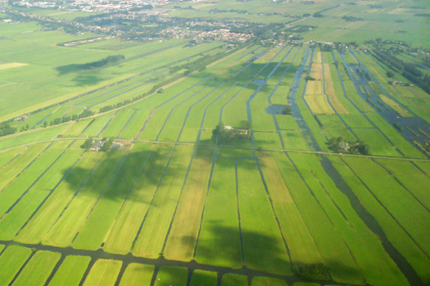
Polder

Slide 8
Time Zone Discussion
1. What be the benefits of switching permanently to daylight savings time? Personally? For society at large?
2. What would be the drawbacks of switching permanently to daylight savings time? Personally? For society at large?
3. What would you prefer and why?
4. Why does Massachusetts need New York to make the change if they make the change?

Slide 9
Free Response Questions
You must answer all three free-response questions on the AP exam.
You have 75 minutes to answer them.
They are worth 50% of the exam.

Slide 10
Steps to Answering Free-Response Questions
Take 4-6 minutes to write an outline.
Answer the question using relevant examples, and terminology.
Try to write a healthy paragraph with an answer.

Slide 11
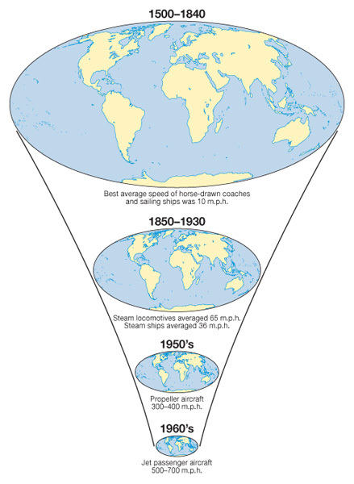
Write one paragraph answering the following.
FRQ 1: Of great interest to geographers are the cultural and political implications of technological innovations that affect human interaction. What is space-time compression as it relates to technological innovations and how did that impact human interactions?

