Slide 1
AIM: What does the fossil record tell us about human origins?
Do Now:
What advantages come from both being bipedal and having opposable thumbs?
HW#6: Read pages 11-14 in the textbook, and answer questions 1,2,3,4,5 on page 14 on a piece of loose leaf.

Slide 2
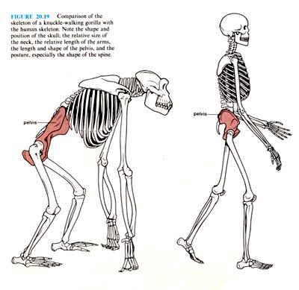
What is an advantage of having bipedalism?

Slide 3
Paleolithic Age 2.5MillionB.C.E.-8000B.C.E.
human ancestors started making tools out of stone (describes cultural stage)
During the Ice Age, which describe the Earth’s stage, end about 10,000 BCE
Neolithic or New Stone Age 8,000-2500 BCE, depending on the area

Slide 4
Identify the following

Slide 5
Identify the Following…

Slide 6
Identify the Following…

Slide 7
Identify the following

Slide 8
How did our human ancestors make progress during the Paleolithic Age?
Homo habilis- 2.4-1.5 BCE→ “handy man”, man of skill→ cut meat and crack open bones
Homo erectus- 1.8-300,000 BCE “upright man”, 895-1040 cc brain size → found in 1890’s before they found earlier evidence of bipedalism,
Homo erectus migrated out of Africa to India, China, SE Asia and Europe.

Slide 9
Early Ancestors
Homo Habilis
Homo Erectus

Slide 10
Early Ancestors
Homo Habilis
Homo Erectus

Slide 11
What do you think is the greatest early human advancement?

Slide 12
We learned to control fire.

Slide 13
Why did Homo erectus survive and flourish while other species living at the same time went extinct?
CULTURAL ADAPTATIONS→ could adapt to new environments quickly because they weren’t physically adapting, which takes a long time
control/use of fire→ crucial adaptation to colder climates outside of Africa
fires can be started by natural events, like lightning, not 100% conclusive that H. erectus could start on fire, but we know from hearths that they used it for warmth, to cook foods, keep predators away

Slide 14
Homo Erectus Continued
more sophisticated tool kit→ tools for digging, scraping, cutting, and hunting
Homo habilis technology was more crude, relied on scavenging and small game hunting
H. erectus tools and use of fire probably allowed them to hunt bigger animals→ better and greater variety in diet, which other species did not have so they had to compete for resources with H. erectus who had better tools!
could skin animals for clothes→ warmth on the move, not just around fires
no evidence of religion or ritual

Slide 15
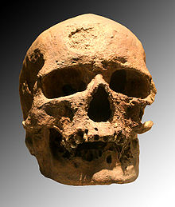
Cro-Magnon – first early modern humans

Slide 16
Homo Sapiens
100,000 around 50,000 homo sapiens sapiens→ 1350 cc
Cro-Magnon→ c40,000-35,000 BCE, lived in Europe alongside Neanderthals
superior hunting skills- planned due to language abilities, could hunt big game
language abilities→ physical placement of vocal chords, etc, bigger brains for syntax and grammar
more advanced technology- ivory, bones, antler
created social alliances and social networks that helped with survival
art- cave paintings, statues, necklaces, and pendants

Slide 17
Why do Neanderthals get such a bad rap? Stereotypes.

Slide 18
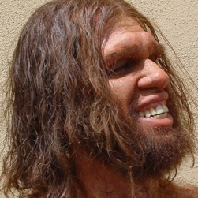
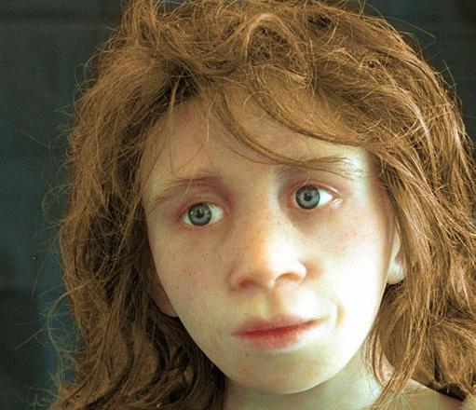
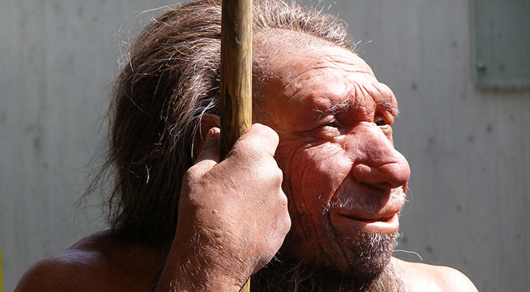
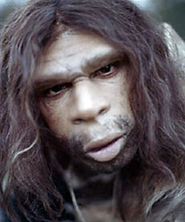
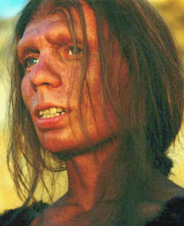
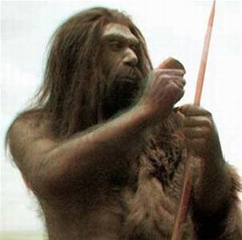
Neanderthals

Slide 19
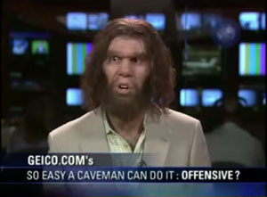

Slide 20
Neanderthals
Homo neanderthalensis→ “cavemen” Geico commercials
200,000- 30,000 BCE, 1450 cc (large!), short and stocky
What evidence of culture?
religious beliefs due to burial sites and funerals, cared for elderly and disabled people→ evidence of healed bones, etc
Why did the Neanderthals disappear?
Interbreeding- not been proven by DNA and fossil evidence
Genocide- mass burial sites have not been found
Extinction→ could not compete with modern humans
most likely lacked language ability
may not have been able to run as fast due to difference in body size, not as skilled hunter-gather

Slide 21
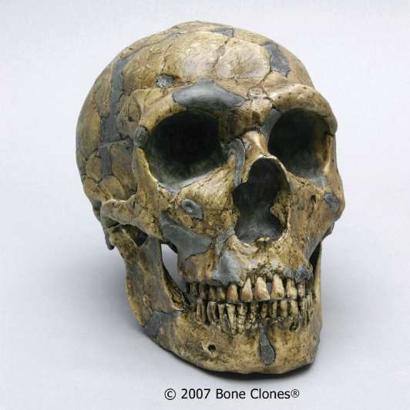
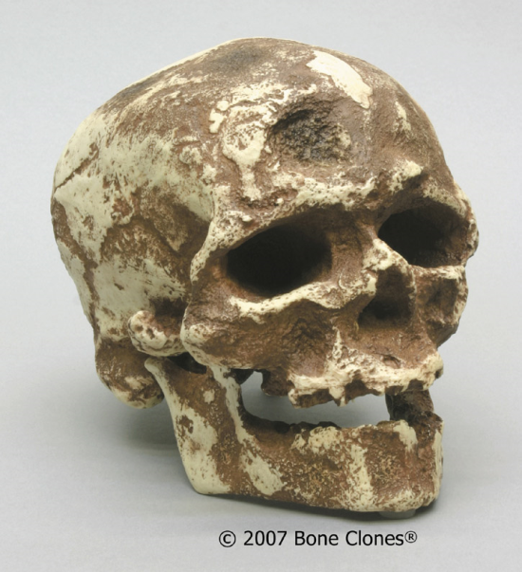
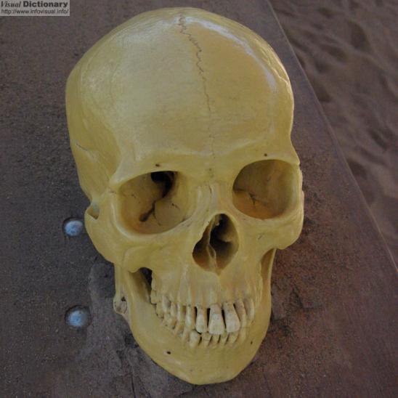
Matching Skulls
Neanderthal Cro Magnum Human

