Slide 1
AIM: Why are geographers concerned with scale and connectedness?
Do Now:Quiz?

Slide 2
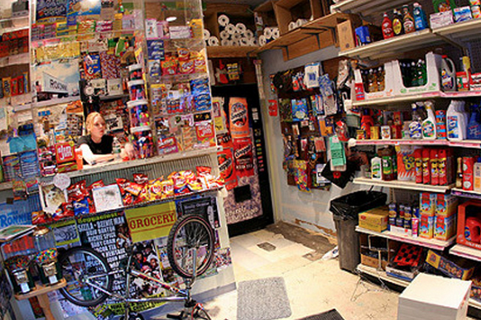
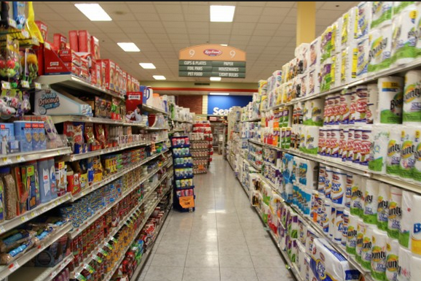
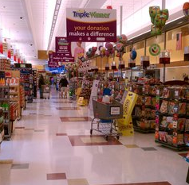
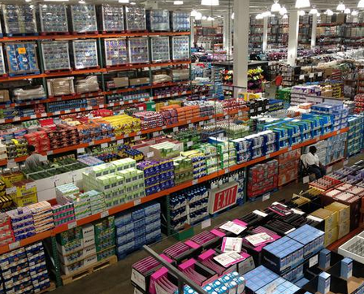
Back to scale.
Phenomena found at one scale are usually influenced by what is happening at other scales.
Bodegas → Key Food → Super Stop and Shop → Costco
Which has the best prices, worst prices, most choice, least choice, and which occurs at the highest frequency vs. lowest frequency?

Slide 3
Scale relates to region.
Based on the Internal Revenue Service’s 2010-2014 database below, here’s how much the top Americans make:
In the United States, it takes a total household income of $380,000/year to be in the top 1%
Worldwide, you only need an income of about $32,500 to be in the Top 1%. About 50% of all U.S. citizens are in the worldwide top 1%.
Do you feel rich yet?

Slide 4
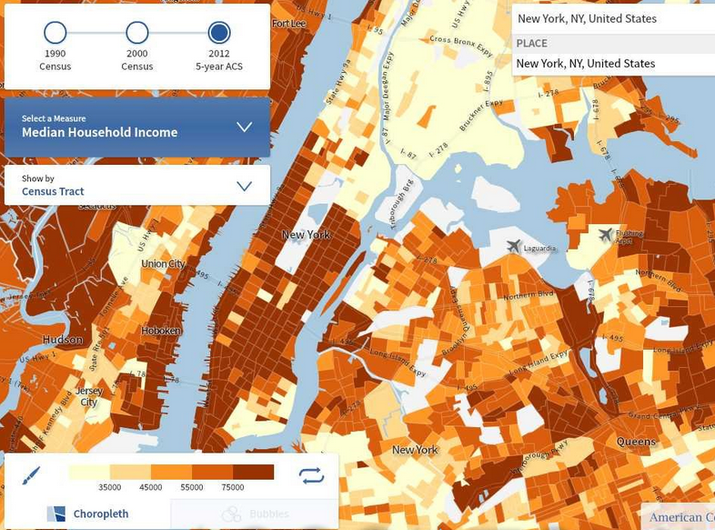
Where does your neighborhood fit?

Slide 5
Scale
Some cultural characteristics only exist in very small, localized areas.
Other cultural characteristics are spread worldwide.

Slide 6
Perceptual Regions
Exist in our head.
The more familiar we are with an area, the stronger and more detailed our perception of the region.

Slide 7
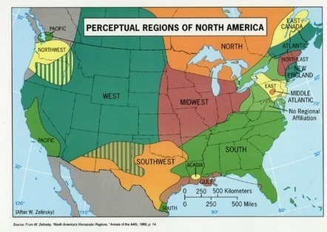
Perceptual Regions of North America

Slide 8
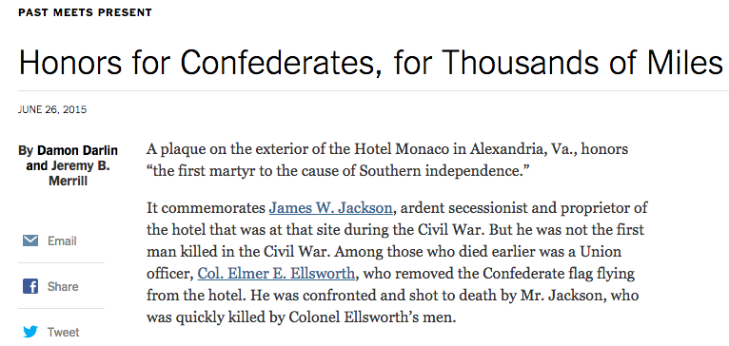
The toponyms of regions give away the region.

Slide 9
Connectedness
Helps us identify patterns in behavior and cultural characteristics.
-Relates to Tobler’s First Law and Distance Decay

Slide 10
Vocabulary
Culture Trait – Single attribute of a culture. IE: Wearing lederhosen.
Culture Complex – A distinct combination of cultural traits. IE: Wearing lederhosen, speaking German, riding cows, and drinking beer while celebrating Oktoberfest.
Cultural Hearth – An area where cultural traits develop and from where they diffuse. IE: Oktoberfest is celebrated worldwide.
Independent Invention – When a trait is invented in multiple places without spreading from one to another. IE: Agriculture

Slide 11
Space-Time Compression
The reduction in time it takes for something to reach another place.
Promotes rapid change and increased cultural diffusion.
In the past, most forms of interaction among cultural groups required the physical movement of settlers, explorers, and plunderers from one location to another.

Slide 12
Some things “retard” interaction
Oceans and other physical barriers
Language and traditions
Distance Decay

Slide 13
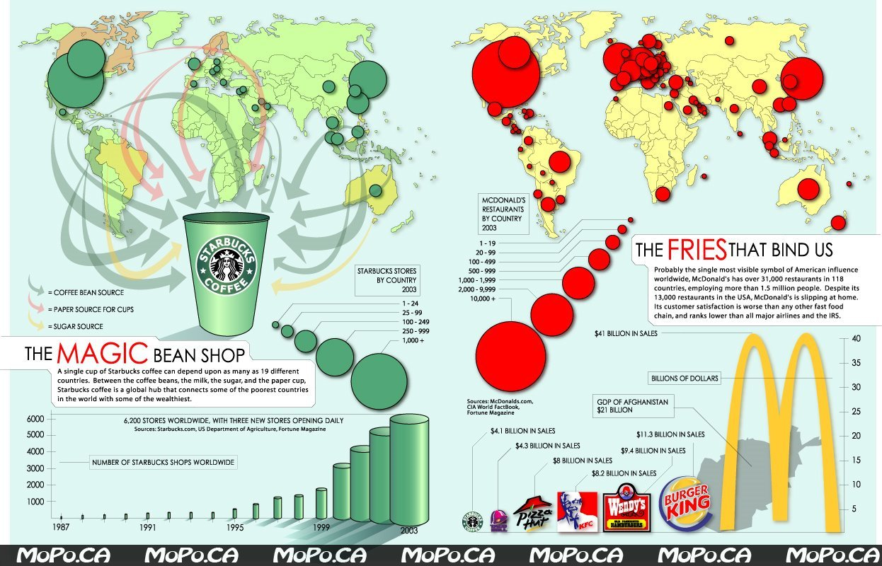
Distance-Decay
Contact diminishes with increasing distance and eventually disappears.

Slide 14
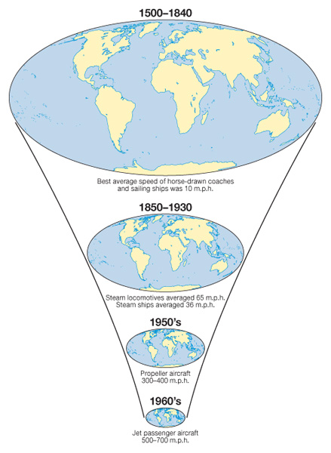
Space Time Compression
Aside from speed of transportation, how else has the world shrunk?

Slide 15
Cultural Diffusion
Cultural Diffusion occurs when two or more cultures meet and one absorbs characteristics of the other.

Slide 16
Diffusion
The process by which a characteristic spreads across space from one place to another over time.
How do ideas spread today?

Slide 17
There are two major types of diffusion;
Relocation Diffusion
Expansion Diffusion

Slide 18
Relocation Diffusion
The spread of an idea through physical movement of people from one place to another.
Ie: spread of language

Slide 19
Expansion Diffusion
The spread of a feature from one area to another in a snowballing process.
Can be subdivided into 3 categories
Hierarchical Diffusion
Contagious Diffusion
Stimulus Diffusion

Slide 20
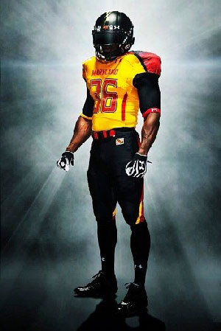
Hierarchical Diffusion
The spread of an idea from persons or nodes of authority or power to other persons or places.
Ie: ideas originating in a city, spread to another city or cities and then the countryside.

Slide 21
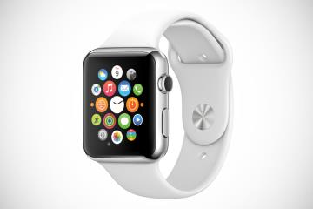
Contagious Diffusion
Rapid, widespread diffusion of a characteristic throughout a population.

Slide 22
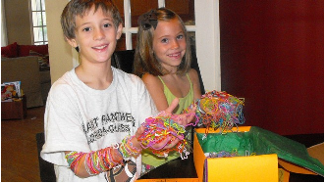
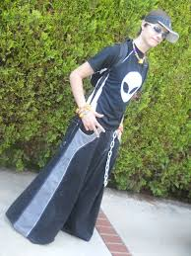
Past Fads

Slide 23
Stimulus Diffusion
when something is not readily adopted by a receiving population, but later on as the result of some sort of stimulus, is adopted

Slide 24
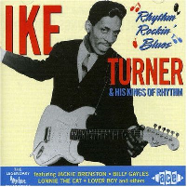
Rock and Roll was considered “jungle music”
It was made acceptable in the late 1950s by…

Slide 25
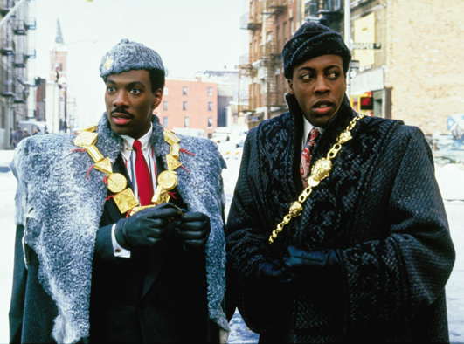
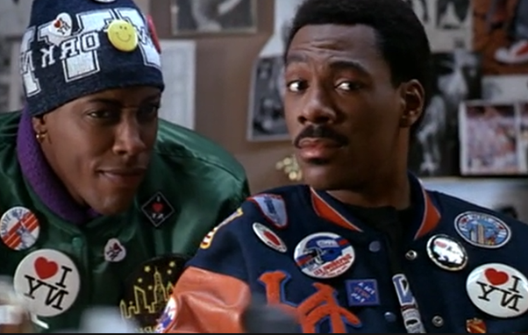
Acculturation
cultural modification of an individual, group, or people by adapting to or borrowing traits from another culture.
IE: Eddie Murphy and Arsenio Hall’s characters in Coming to America go through Acculturation.

Slide 26
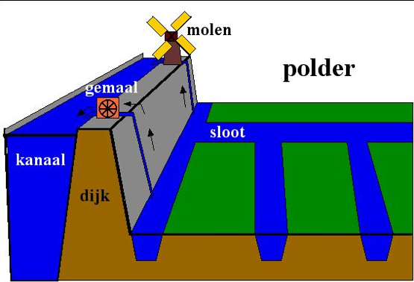
Useful Vocabulary
Polder - a tract of low land (as in the Netherlands) reclaimed from a body of water (as the sea)

Slide 27
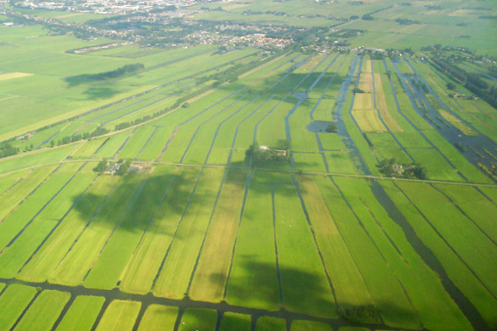
Polder

