Slide 1
AIM: Why are geographers concerned with scale and connectedness?
Do Now: Why are different areas similar?

Slide 2
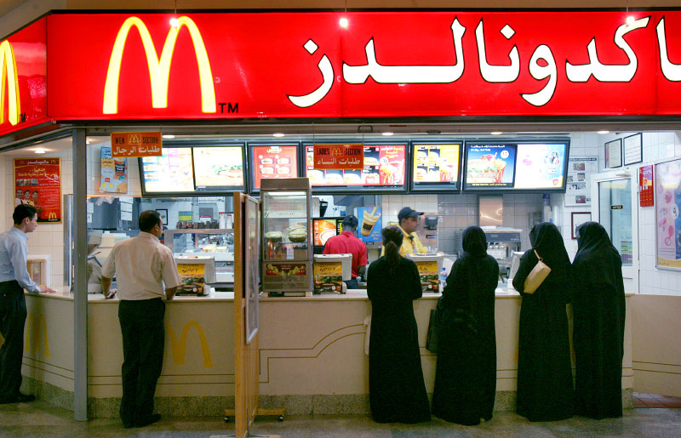
Globalization
The force or process that results in making something worldwide in scope.

Slide 3
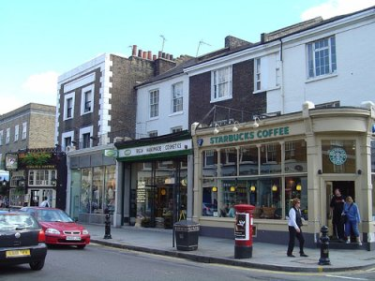
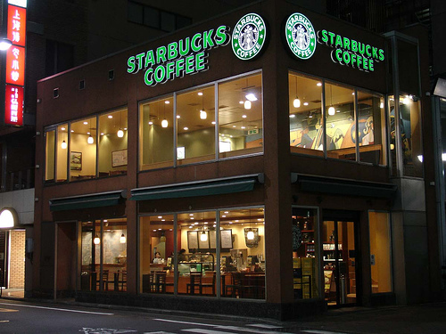
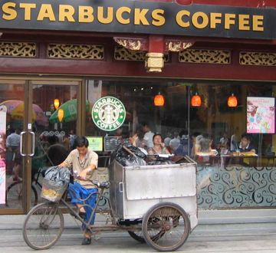
Globalization makes places look the same.
England Japan China

Slide 4
Transnational Corporations
Are agents of globalization.

Slide 5
Where do trans-national corporations keep their corporate headquarters?

Slide 6
Transnational Corporations
173 of the top 250 multi-national corporations keep their head offices in either North America or Western Europe.
68 head offices alone are in New York, London, Paris, Tokyo, Beijing and Moscow.

Slide 7
Core-Periphery Model
The basic principle of the 'Core-Periphery' theory is that as general prosperity grows worldwide, the majority of that growth is enjoyed by a 'core' region of wealthy countries despite being severely outnumbered in population by those in a 'periphery' that are ignored.

Slide 8
The Core
The 'core' consists of Europe (excluding Russia, Ukraine, and Belarus) , the United States, Canada, Australia, New Zealand, Japan, South Korea, and Israel. Within this region is where most of the positive characteristics of globalization typically occur.

Slide 9
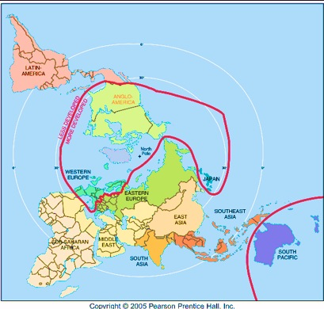
Core-Periphery Model

Slide 10
How has modern technology played a role in globalization?
Communication and travel are much easier. This makes the world smaller.

Slide 11
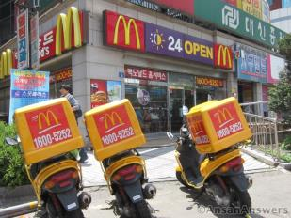
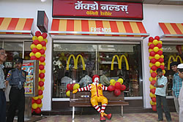
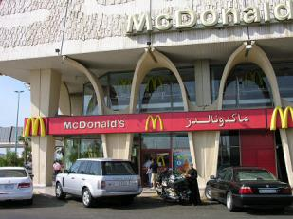
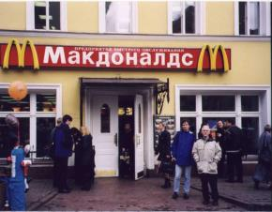
In what ways is globalization of culture manifest in the landscape?
Look familiar?

Slide 12
In what ways has the communication revolution played a role in globalization?
It preserves cultural diversity.
We have choices in what to watch and wear.
But two people in two different locations can watch the same thing at the same time.

Slide 13
Not everyone embraces globalization.
Can lead to intolerance of groups in certain places.
Al-Qaeda is a terrorist group opposed to globalization,
Can lead to political unrest and conflict.

Slide 14
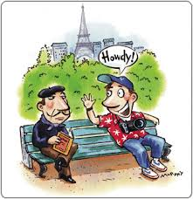
What Parisians think of tourists…
Thus, according to the guide, Americans want to eat at 6pm, expect to have Wi-Fi everywhere and will call you by your first name within a few seconds. The Chinese are obsessed with shopping and expect everyone to smile. The Germans like precision, cleanliness and handshakes. The Italians are impatient, travel in groups and eat late. The Japanese never complain, except when they go home. The Spanish eat absurdly late (11pm), so warn them about when you close.

Slide 15
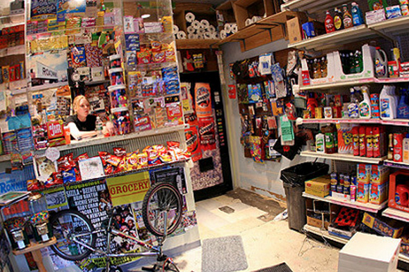
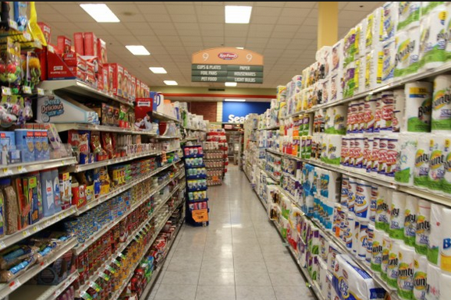
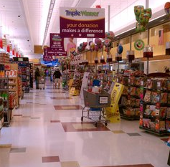
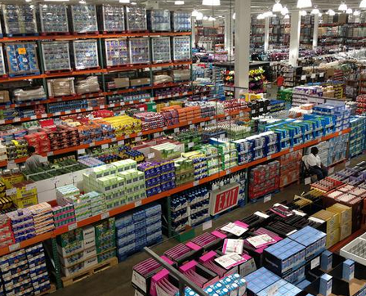
Back to scale.
Phenomena found at one scale are usually influenced by what is happening at other scales.
Bodegas → Key Food → Super Stop and Shop → Costco
Which has the best prices, worst prices, most choice, least choice, and which occurs at the highest frequency vs. lowest frequency?

Slide 16
Scale relates to region.
Based on the Internal Revenue Service’s 2010-2014 database below, here’s how much the top Americans make:
In the United States, it takes a total household income of $380,000/year to be in the top 1%
Worldwide, you only need an income of about $32,500 to be in the Top 1%. About 50% of all U.S. citizens are in the worldwide top 1%.
Do you feel rich yet?

Slide 17
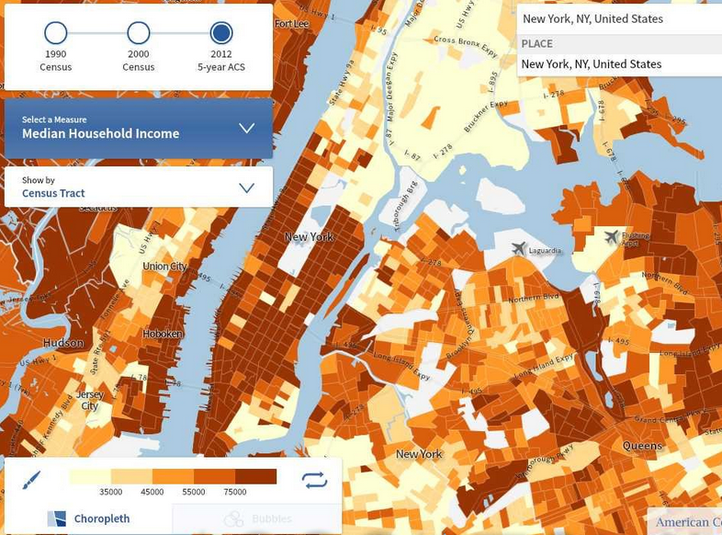
Where does your neighborhood fit?

Slide 18
AIM: How does connectedness influence diffusion?
Do Now: How have you changed since coming to Tech?

Slide 19
Scale
Some cultural characteristics only exist in very small, localized areas.
Other cultural characteristics are spread worldwide.

Slide 20
Perceptual Regions
Exist in our head.
The more familiar we are with an area, the stronger and more detailed our perception of the region.

Slide 21
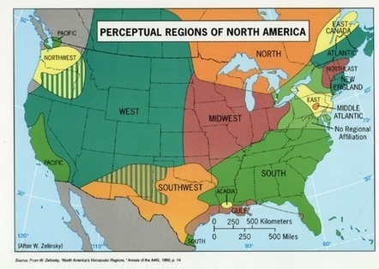
Perceptual Regions of North America

Slide 22
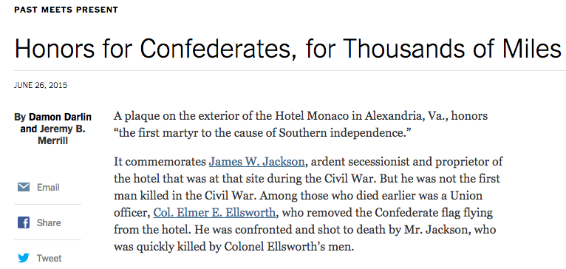
The toponyms of regions give away the region.

Slide 23
Connectedness
Helps us identify patterns in behavior and cultural characteristics.
-Relates to Tobler’s First Law and Distance Decay

Slide 24
Vocabulary
Culture Trait – Single attribute of a culture. IE: Wearing lederhosen.
Culture Complex – A distinct combination of cultural traits. IE: Wearing lederhosen, speaking German, riding cows, and drinking beer while celebrating Oktoberfest.
Cultural Hearth – An area where cultural traits develop and from where they diffuse. IE: Oktoberfest is celebrated worldwide.
Independent Invention – When a trait is invented in multiple places without spreading from one to another. IE: Agriculture

Slide 25
Space-Time Compression
The reduction in time it takes for something to reach another place.
Promotes rapid change and increased cultural diffusion.
In the past, most forms of interaction among cultural groups required the physical movement of settlers, explorers, and plunderers from one location to another.

Slide 26
Some things “retard” interaction
Oceans and other physical barriers
Language and traditions
Distance Decay

Slide 27
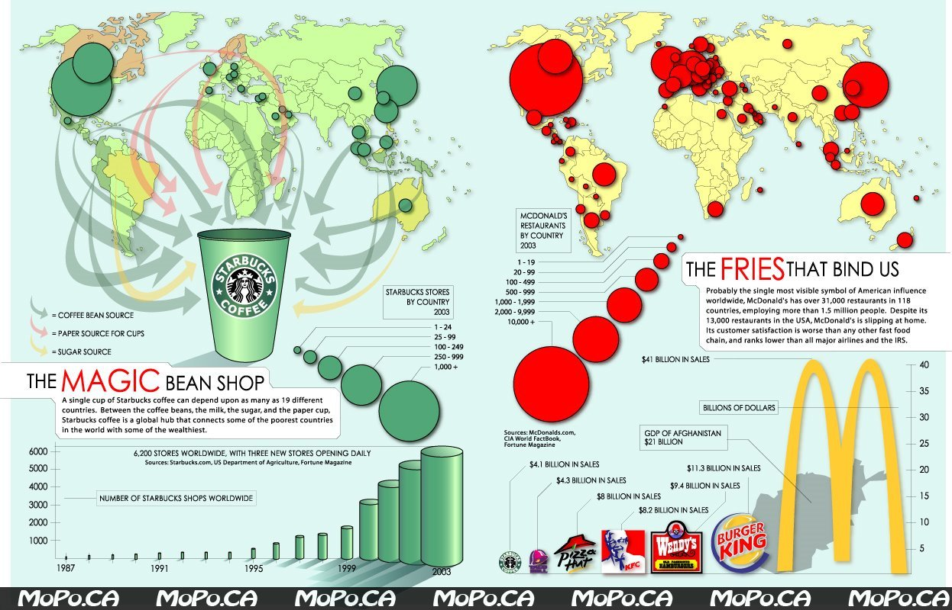
Distance-Decay
Contact diminishes with increasing distance and eventually disappears.

Slide 28
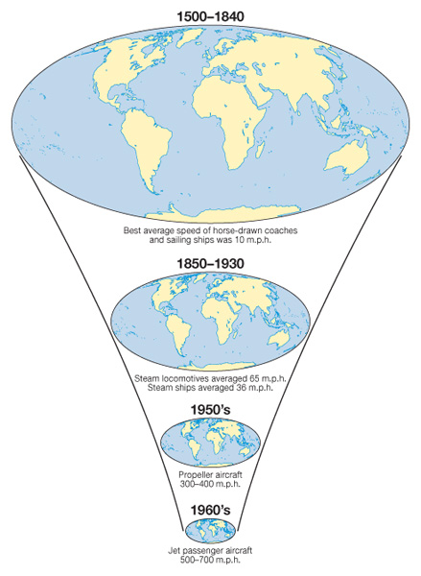
Space Time Compression
Aside from speed of transportation, how else has the world shrunk?

Slide 29
Cultural Diffusion
Cultural Diffusion occurs when two or more cultures meet and one absorbs characteristics of the other.

Slide 30
Diffusion
The process by which a characteristic spreads across space from one place to another over time.
How do ideas spread today?

Slide 31
There are two major types of diffusion;
Relocation Diffusion
Expansion Diffusion

Slide 32
Relocation Diffusion
The spread of an idea through physical movement of people from one place to another.
Ie: spread of language

Slide 33
Expansion Diffusion
The spread of a feature from one area to another in a snowballing process.
Can be subdivided into 3 categories
Hierarchical Diffusion
Contagious Diffusion
Stimulus Diffusion

Slide 34
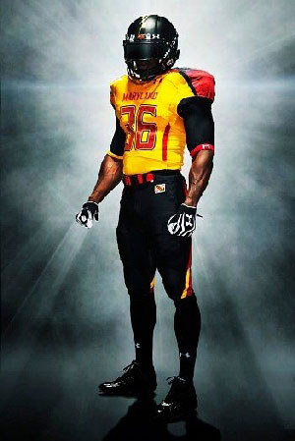
Hierarchical Diffusion
The spread of an idea from persons or nodes of authority or power to other persons or places.
Ie: ideas originating in a city, spread to another city or cities and then the countryside.

Slide 35
Contagious Diffusion
Rapid, widespread diffusion of a characteristic throughout a population.

Slide 36
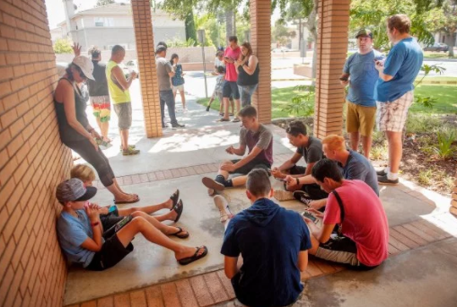
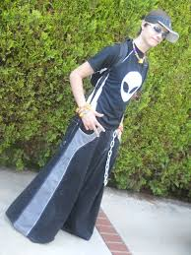
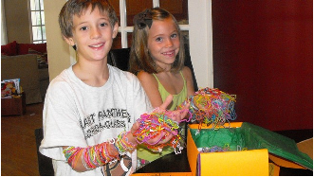
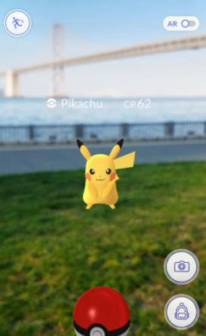
Past Fads

Slide 37
Stimulus Diffusion
when something is not readily adopted by a receiving population, but later on as the result of some sort of stimulus, is adopted

Slide 38
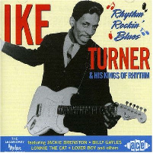
Rock and Roll was considered “jungle music”
It was made acceptable in the late 1950s by…

Slide 39
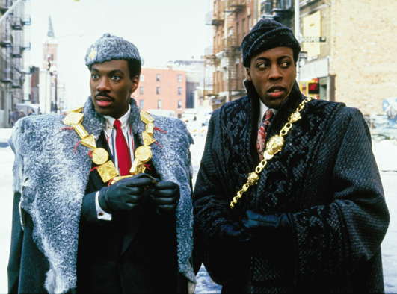
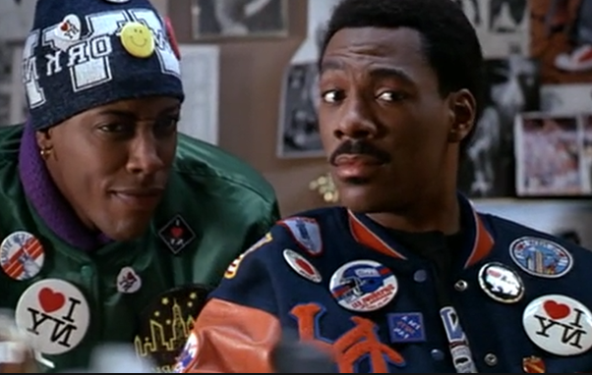
Acculturation
cultural modification of an individual, group, or people by adapting to or borrowing traits from another culture.
IE: Eddie Murphy and Arsenio Hall’s characters in Coming to America go through Acculturation.

Slide 40
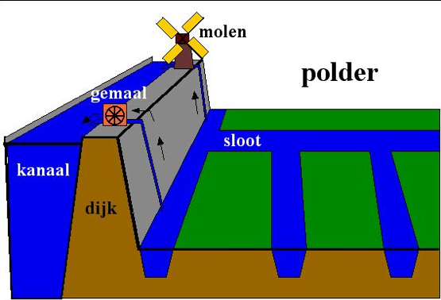
Useful Vocabulary
Polder - a tract of low land (as in the Netherlands) reclaimed from a body of water (as the sea)

