Slide 1
Model and Theory Review

Slide 2
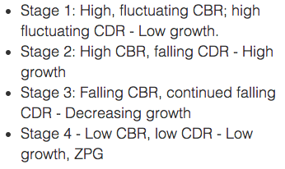
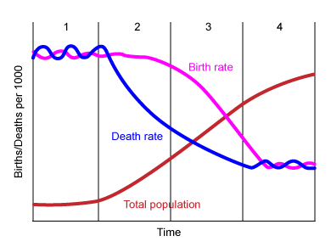
Demographic Transition Model
Stage 5 - CBR drops below the low CDR leading to population decline.

Slide 3
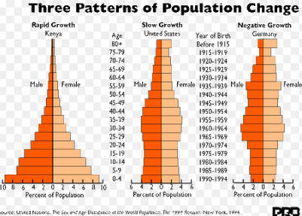
Population Pyramids

Slide 4
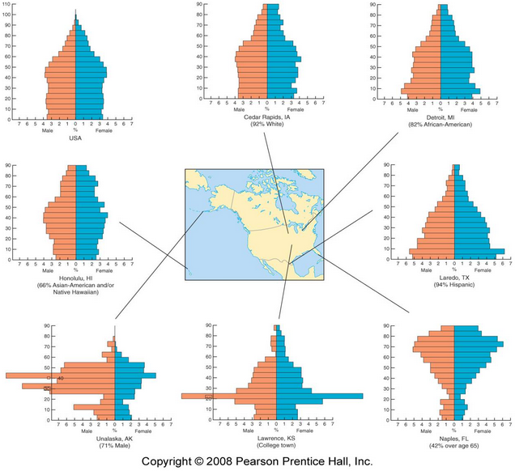

Slide 5
Epidemiologic Transition Model by Abdel Omran
1. The Age of Pestilence and Famine: Where mortality is high and fluctuating, precluding sustained population growth, with low and variable life expectancy, vacillating between 20 and 40 years.
2. The Age of Receding Pandemics: Where mortality progressively declines, with the rate of decline accelerating as epidemic peaks decrease in frequency. Average life expectancy increases steadily from about 30 to 50 years. Population growth is sustained and begins to be exponential.
3. The Age of Degenerative and Man-Made Diseases: Mortality continues to decline and eventually approaches stability at a relatively low level.

Slide 6
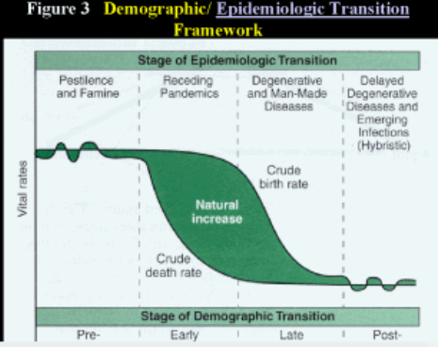

Slide 7
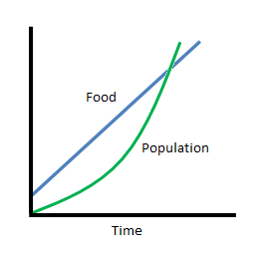
Malthusian Theory
Postulated that while food production tends to increase arithmetically, population tends to increase naturally at a (faster) geometric rate.
Hasn’t occurred.

Slide 8
Religions
Universalizing
Ethnic
Christianity
Islam
Buddhism
Sikhism
Mormonism (a form of Christianity)
Seek converts, proselytize, appeal to all. Holidays based around important figures’ lives.
Judaism
Hinduism
Animism
Shinto
Practiced by an ethnic group. Holidays based around calendar events.

Slide 9
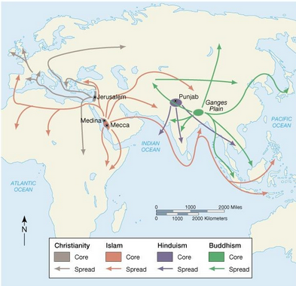
Religious Hearths

Slide 10
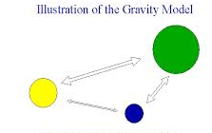
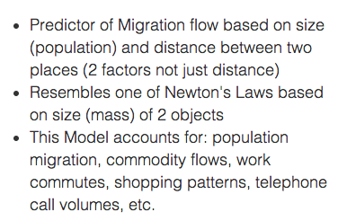
Gravity Model

Slide 11
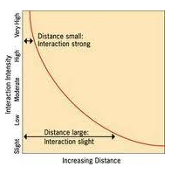
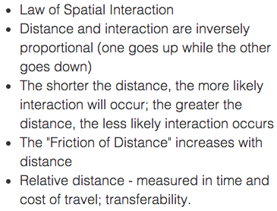
Distance Decay Model

Slide 12
Heartland Theory
-This theory was developed in 1904 by Halford J MacKinder.
-His geopolitical theory argued that political power depended on geographical location. More specifically, his theory can be explained with the following sequence:
-1) He who rules inland Europe ( “Heartland) à rules Eastern Europe
-2) He who rules inland Europe ( “Heartland”) à rules Europe, Asia, and Africa ( “World Island”)
-3) He who rules Europe, Asia, Africa ( “World Island”) à rules the World ( “World Domination”)

Slide 13
Rimland Theory by Nicholas John Spykman
Spykman thought Rimland, the strip of coastal land that encircles Eurasia, is more important than the central Asian zone (the so-called Heartland) for the control of the Eurasian continent. Spykman's vision is at the base of the "containment politics" put into effect by the United States in its relation/position to the Soviet Union during the post-war period.
According to him, "who controls the Rimland rules Eurasia, Who rules Eurasia contents destinies of the world."

Slide 14
Domino Theory
The domino theory was a foreign policy theory during the 1950s to 1980s, promoted at times by the government of the United States, that speculated that if one land in a region came under the influence of communism, then the surrounding countries would follow in a domino effect. The domino effect suggests that some change, small in itself, will cause a similar change nearby, which then will cause another similar change, and so on in linear sequence, by analogy to a falling row of dominoes standing on end.
Led to the development of Vietnam as a shatterbelt between the United States and the Soviet Union.

Slide 15
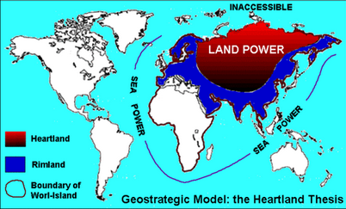
Heartland vs. Rimland

Slide 16
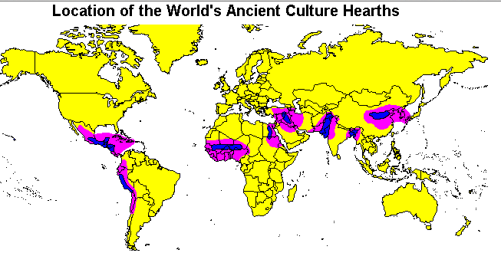
Cultural Hearths

Slide 17
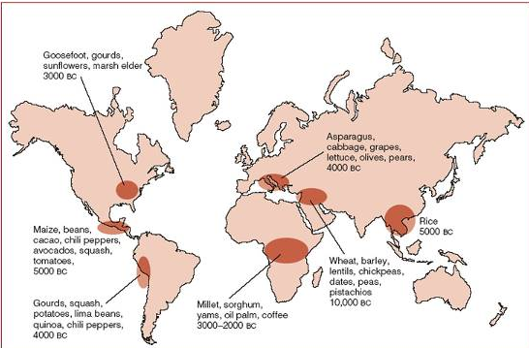
Agricultural Hearths

Slide 18
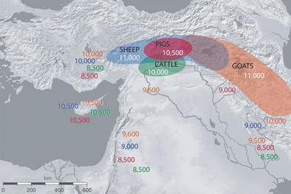
Animals – Many animals were first domesticated in Mesopotamia and Egypt

Slide 19
Agricultural Revolutions
1st Agricultural Revolution – Neolithic Revolution (12000BCE-4000BCE) roughly – domestication of plants and animals
2nd Agricultural Revolution –Coincided with Industrial Revolution. After Columbian Exchange. Led to first Commercial Farms.
3rd Agricultural Revolution (Green Revolution) – Development of more efficient techniques, fertilizers, GM crops, hybrid crops, started with rice.

Slide 20
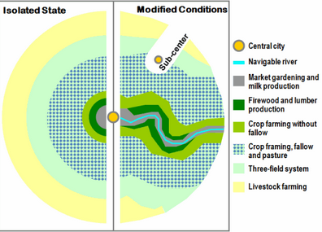

Vonn Thunen Agricultural Model
Developed to determine the most profitable place to grow crops.
1800s

Slide 21
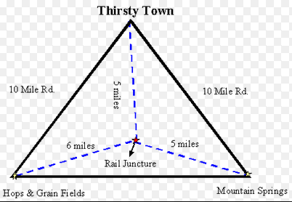
Weber – Model of Industrial Location
Alfred Weber formulated a least cost theory of industrial location which tries to explain and predict the locational pattern of the industry at a macro-scale. It emphasizes that firms seek a site of minimum transport and labour cost.
To determine the best place to put a factory.
Bulk-gaining vs. bulk reducing industries.
Transportation is the most important cost to control.

Slide 22
Types of Industry
Primary Industry – Extract materials from the Earth
Secondary Industry – Turn the materials into something else in factories. Build stuff.
Tertiary Industry – Services
Quaternary Industry – The quaternary sector of the economy is a way to describe a knowledge-based part of the economy, which typically includes services such as information technology, information-generation and -sharing, media, and research and development, as well as knowledge-based services like consultation, education, financial planning, blogging, and designing.
Quinary Sector - The quinary sector involves the highest levels of decision making in fields such as government, research, education, healthcare, recreation, and other information-based industries

Slide 23
Country Shapes
Compact – Poland, Uruguay
Elongated – Chile, Pakistan
Perforated – Italy, South Africa
Fragmented – Indonesia, Japan, Philipines
Prorupted – Democratic Republic of the Congo, Thailand, Afghanistan, Namibia

Slide 24
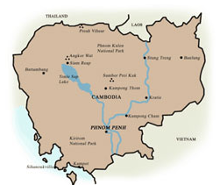
Compact

Slide 25
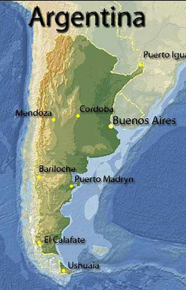
Elongated

Slide 26
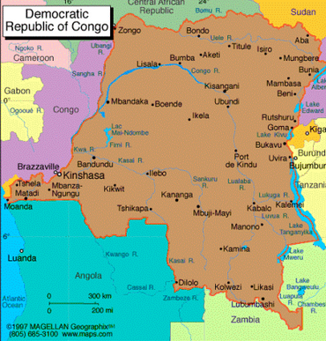
Prorupted

Slide 27
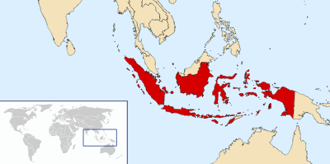
Fragmented

Slide 28
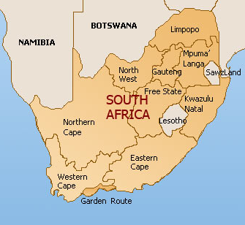
Perforated

Slide 29


Slide 30
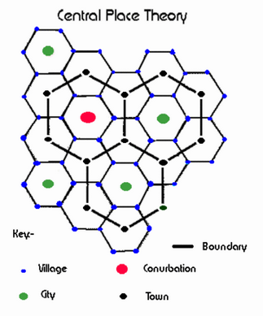
Central Place Theory – Walter Christaller
(Christaller) is a geographical theory that seeks to explain the number, size and location of human settlements in an urban system. The theory was created by the German geographer Walter Christaller, who asserted that settlements simply functioned as 'central places' providing services to surrounding areas

Slide 31
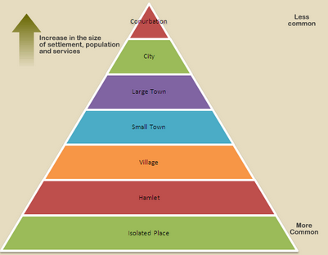
Settlement Size

Slide 32
Rank Size Rule
The largest city will be twice as large as the second largest city by population
Three times as large as the third largest city by population.
Four times as large as the fourth largest city by population.
And so forth
So if the largest city has 10 million people, the size would decrease from
10 million→5 million→3.3 million →2.5 million → 2 million

Slide 33
Primate City Model
One city is far and away larger than all of the others in a country
IE: Bangkok Thailand, Mexico City, Mexico
Paris, France

Slide 34
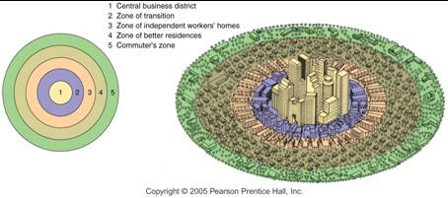
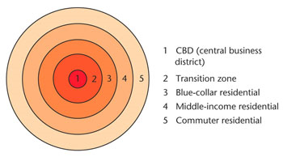
Concentric Zone (Burgess Model) Model ie: Nashville Tennessee
(Burgess) Based on human ecology theories done by Burgess and applied on Chicago, it was the first to give the explanation of distribution of social groups within urban areas. This concentric ring model depicts urban land use in concentric rings: the Central Business District (or CBD) was in the middle of the model, and the city expanded in rings with different land uses. It is effectively an urban version of Von Thunen's regional land use model developed a century earlier. It contrasts with Homer Hoyt's sector model and the multiple nuclei model.

Slide 35
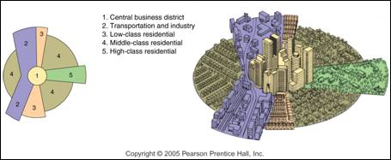
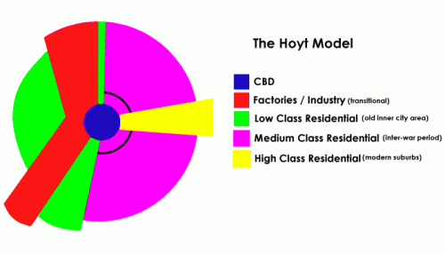
Sector Model ie: Chicago
is a model of urban land use proposed in 1939 by economist Homer Hoyt. It is a modification of the concentric zone model of city development. The benefits of the application of this model include the fact it allows for an outward progression of growth.

Slide 36
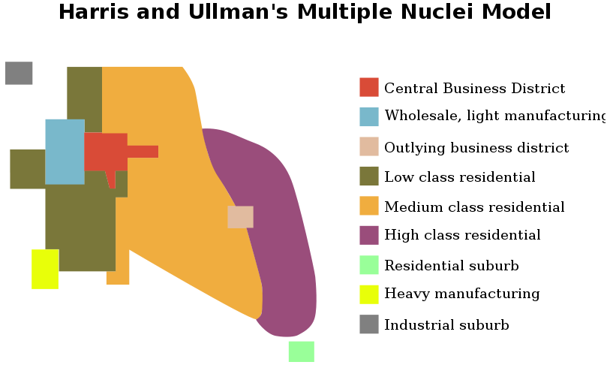
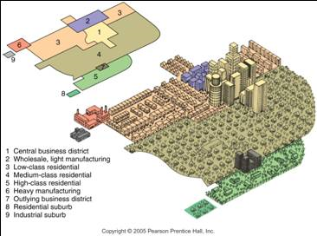
Multiple Nuclei Model (ie: NYC, Atlanta, LA)
an ecological model put forth by Chauncy Harris and Edward Ullman in the 1945 article "The Nature of Cities." The model describes the layout of a city. It notes that while a city may have started with a central business district, similar industries with common land-use and financial requirements are established near each other. These groupings influence their immediate neighborhood. Hotels and restaurants spring up around airports, for example. The number and kinds of nuclei mark a city's growth.

Slide 37
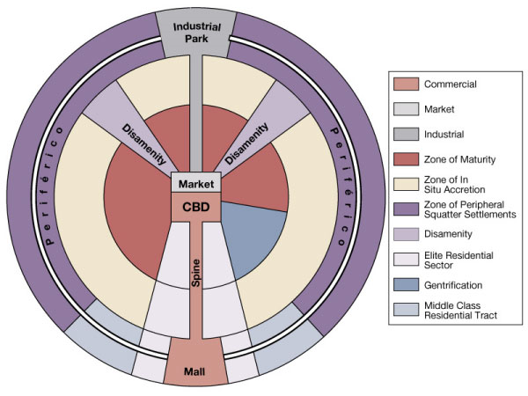
Latin American City Model

Slide 38
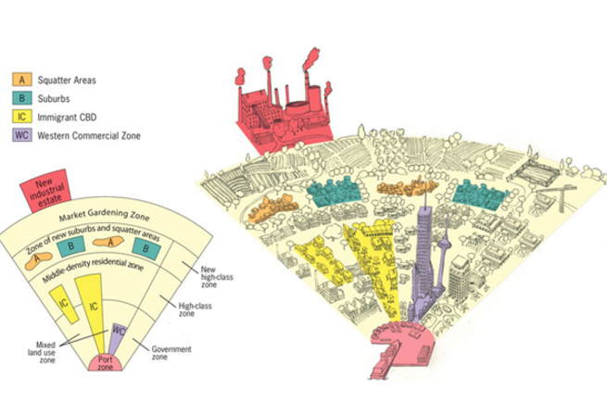
The Southeast Asian City Model

Slide 39
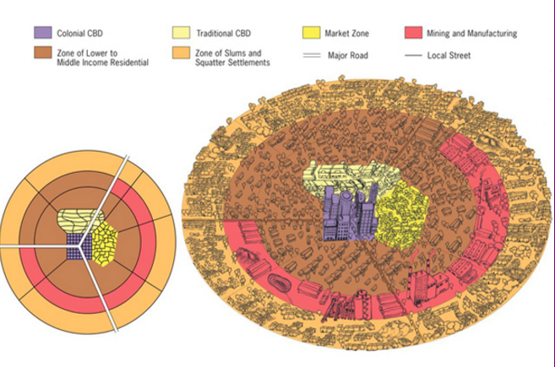
The Sub-saharan Africa City Model

Slide 40
Industrial Sectors
Primary – extract natural resources (farming, fishing, logging, mining)
Secondary – Construct and build things from natural resources (factories, construction, metal refineries)
Tertiary – Service Sector
Quarternary - knowledge-based part of the economy which typically includes services such as information generation and sharing (intellectual activities)
Quinary – health, culture, research (decision making)

Slide 41
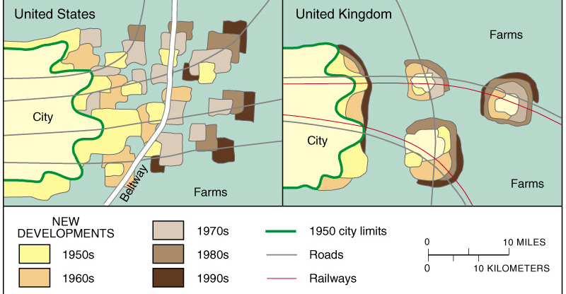
Remember the difference

Slide 42
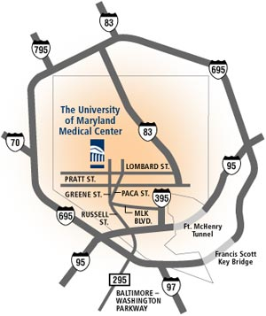
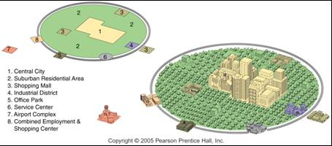
The Peripheral Model (Galactic City Model)
According to the peripheral model, an urban area consists of an inner city surrounded by large suburban residential and business areas tied together by a beltway or ring road.
Peripheral areas lack the distinct problems of inner cities but are often segregated and suffer from sprawl.

Slide 43

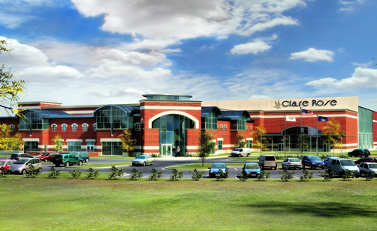
Edge City
Edge cities exist around beltways and ring roads. They are nodes of consumer and business services.
Originated as suburban residences for people who worked in the central city.
Specialized nodes develop in edge cities (office parks, hotels and warehouses near airports.)

Slide 44
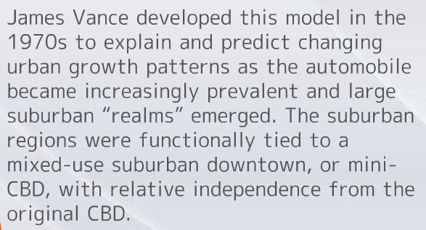
Urban Realms Model (James Vance)

Slide 45
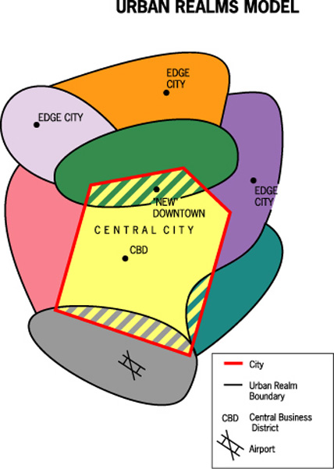
Urban Realms Model

Slide 46
Structuralist or Liberal Theories of Development
Structuralist – Believe that inequality exists and that core states exploit the periphery (Since there are winners, there are also losers and all the games are rigged to protect the winners) - Marxist
Liberal – Believe all countries can modernize and become more developed by following the same path. (Everyone can be a winner) - Capitalist

Slide 47
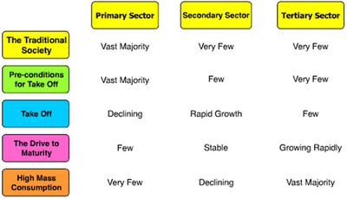
Rostow Take-Off Model (Modernization Model) –Walt Whitman Rostow (Liberal)
Used to measure levels of development.

Slide 48
Modernization Theory (Liberal)
The theory looks at the internal factors of a country while assuming that, with assistance, "traditional" countries can be brought to development in the same manner more developed countries have. Modernization theory attempts to identify the social variables which contribute to social progress and development of societies, and seeks to explain the process of social evolution. Not surprisingly, modernization theory is subject to criticism originating among communist and free-market ideologies, world systems theorists, globalization theory and dependency theory among others.

Slide 49
Neocolonialism (Structuralist)
is a term used by post-colonial critics of developed countries' involvement in the developing world. Writings within the theoretical framework of neocolonialism argue that existing or past international economic arrangements created by former colonial powers were or are used to maintain control of their former colonies and dependencies after the colonial independence movements of the post-World War II period.

Slide 50
Dependency Theory (Singer and Prebisch)
A structuralist theory that offers a critique of the modernization model of development. Based on the idea that certain types of political and economic relations (especially colonialism) between countries and regions of the world have created arrangements that both control and limit the extent to which regions can develop.

Slide 51
Premises of Dependency Theory (Singer and Prebisch) - Structuralist
1. Poor nations provide natural resources, cheap labour, a destination for obsolete technology, and markets for developed nations, without which the latter could not have the standard of living they enjoy.
2. Wealthy nations actively perpetuate a state of dependence by various means. This influence may be multifaceted, involving economics, media control, politics, banking and finance, education, culture, and sport.

Slide 52
World Systems Theory (Immanuel Wallerstein) Structuralist
the founder of the intellectual school of world-systems theory, characterizes the world system as a set of mechanisms which redistributes resources from the periphery to the core. In his terminology, the core is the developed, industrialized part of the world, and the periphery is the "underdeveloped", typically raw materials-exporting, poor part of the world; the market being the means by which the core exploits the periphery.
Core→SemiPeriphery→Periphery

Slide 53
Core-Periphery Model
The other name for World Systems Theory.
Core Region - The centers of economic, political, and/or cultural power within a given territorial entity.
Peripheral Region - The least powerful regions and therefore are often marginalized or under the control of both semi-peripheral regions and core regions.
Semi-Peripheral Region - The intermedency regions in terms of the hierarchy of power between core regions and peripheral regions.

Slide 54
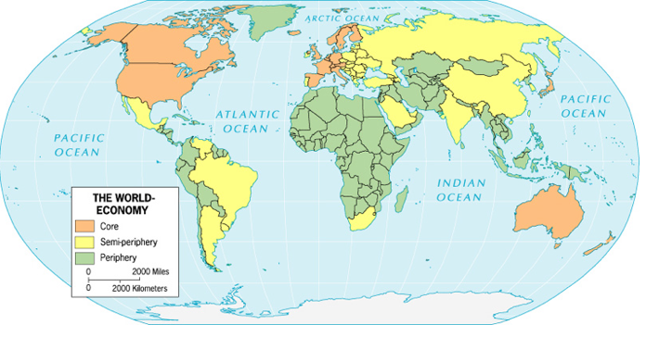
Core-Periphery Model

Slide 55
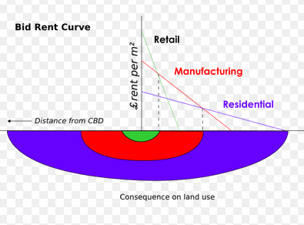
Bid-Rent Theory
that refers to how the price and demand for real estate changes as the distance from the Central Business District (CBD) decreases. It states that different land users will compete with one another for land close to the city centre. This is based upon the idea that retail establishments wish to maximise their profitability, so they are much more willing to pay more money for land close to the CBD and less for land further away from this area.

Slide 56
Zelinksy Model of Migration Transition
Migration trends follow demographic transition stages. People become increasingly mobile as industrialization develops. More industrial migration is seen in stage 2 as migrants search for more space and opportunities in countries in stages 3 and 4. Stage 4 countries show less emigration and more intraregional migration.

Slide 57
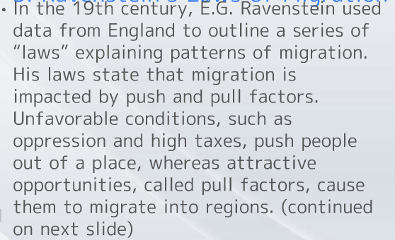
Ravenstein’s Laws of Migration

Slide 58
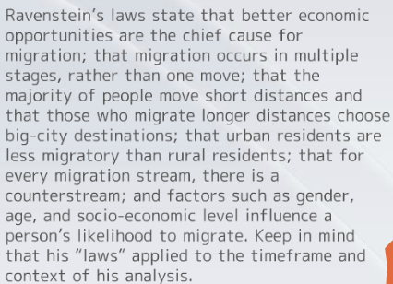
Ravenstein Continued

Slide 59
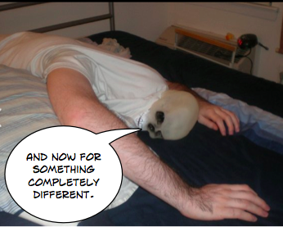

Slide 60



Slide 61
Locational Interdependence (Hotelling)
Hotelling’s theory of locational interdependence asserts than an industry’s locational choices are heavily influenced by the location of their chief competitors and related industries. In other words, industries do not make isolated decisions on locations without considering where other, related industries exist.

Slide 62
Bochert’s Model of Urban Evolution
Bochert created this model in the 1960s to predict and explain the growth of cities in for phases of transportation history.
Stage 1 – “Sail Wagon era of 1790-1830”
Stage 2 – “Iron Horse era of 1830-1970”
Stage 3 – “Steel Rail epoch of 1870-1920”
Stage 4 – “Car and Air Travel 1920-present”

Slide 63
Possible Indo-European Language Hearths
Kurgan Hypothesis - Indo-European peoples arrived in the 4th millennium BC across the steppes north of the Black Sea. A warlike people, they imposed themselves as an elite on the Old European populations, who adopted their language. The hypothesis that Indo-European speakers reached Europe from the Pontic steppes in the Bronze Age
Anatolian Hearth Hypothesis - suggests that the speakers of the Proto-Indo-European language (PIE) lived in Anatolia during the Neolithic era, and associates the distribution of historical Indo-European languages with the expansion during the Neolithic revolution during the seventh and sixth millennia BC.

Slide 64
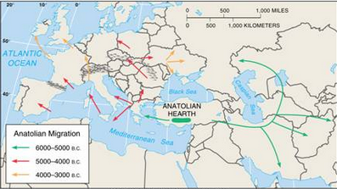
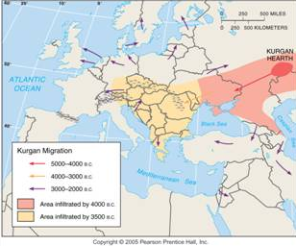
Anatolian vs. Kurgan

Slide 65
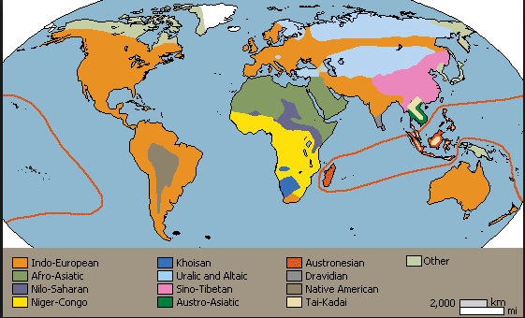
Language Families of the World
Distribution of the world’s main language families. Languages with more than 100 million speakers are named.

Slide 66
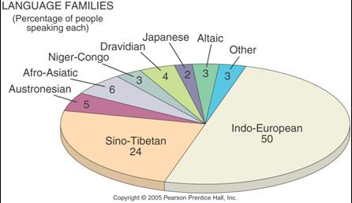
Major Language Families
Percentage of World Population
The percentage of world population speaking each of the main language families. Indo-European and Sino-Tibetan together represent almost 75% of the world’s people.

Slide 67
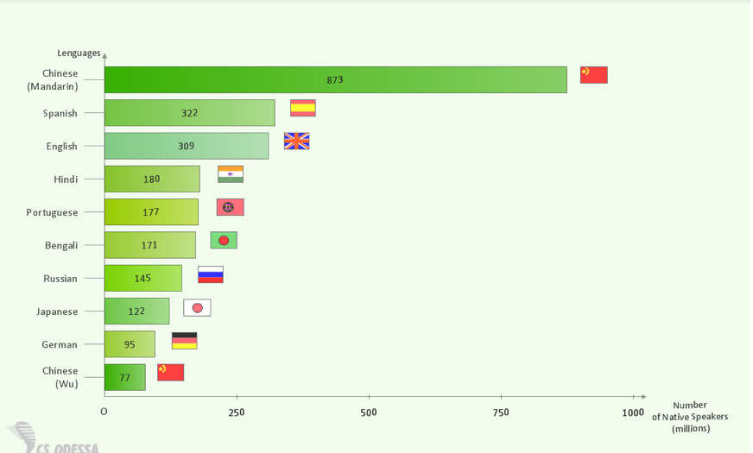
Most Spoken Languages

Slide 68

Projections – Mercator Projection

Slide 69

Robinson Projection

Slide 70

Winkel-Tripel Projection

Slide 71

Interrupted Projection

Slide 72

Azimuthal Projection

Slide 73

Mollweide Projection

