Slide 1
AIM: Where in the world do people live and why?

Slide 2
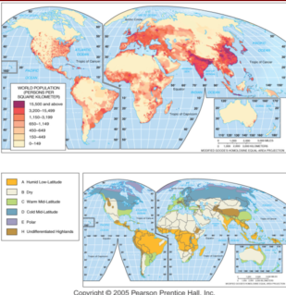
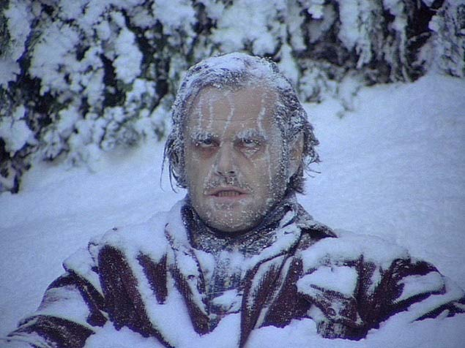
World Population Distribution
World population is very unevenly distributed across the Earth’s surface and it can be compared to climate distribution.

Slide 3
Vocabulary
Ecumene – the portion of the earth’s surface with permanent human settlement.

Slide 4
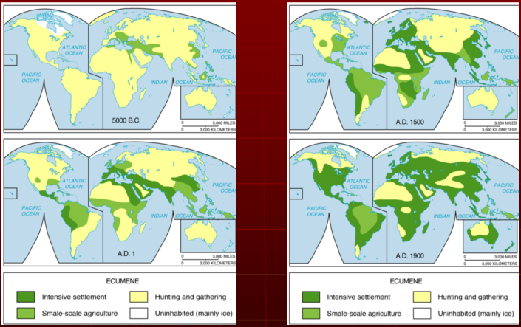
Expansion of the Ecumene 5000 B.C.–A.D. 1900
The ecumene, or the portion of the Earth with permanent human settlement, has expanded to cover most of the world’s land area.

Slide 5
Sparsely Populated Areas
Dry Areas
Areas too dry for farming cover approximately 20 percent of Earth’s land surface.
Deserts generally lack sufficient water to grow crops.

Slide 6
Dry Areas

Slide 7
Sparsely Populated Areas
Wet Areas
Areas that receive very high levels of precipitation.
These areas are located primarily near the equator.
The combination of rain and heat rapidly depletes nutrients from the soil, hindering agriculture

Slide 8
Wet Areas

Slide 9
Sparsely Populated Areas
Cold Areas
Much of the land near the North and South poles, perpetually covered with ice (permafrost).

Slide 10
Cold Areas

Slide 11
Sparsely Populated Areas
High Areas
Relatively few people live at high elevations with some significant exceptions in Latin America and Africa.

Slide 12
High Areas

Slide 13
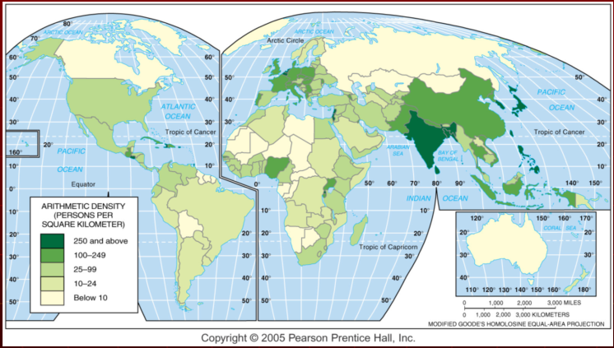
Arithmetic Population Density
Arithmetic population density is the number of people per total land area. The highest densities are found in parts of Asia and Europe.

Slide 14
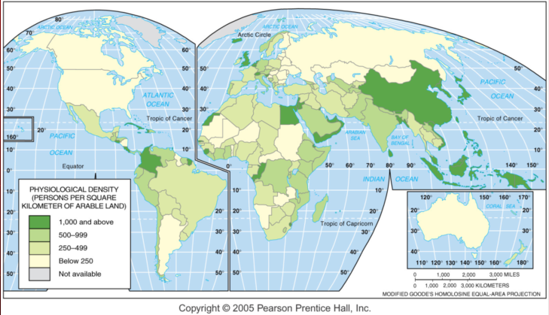
Physiological Density
Physiological density is the number of people per arable land area. This is a good measure of the relation between population and agricultural resources in a society.

Slide 15
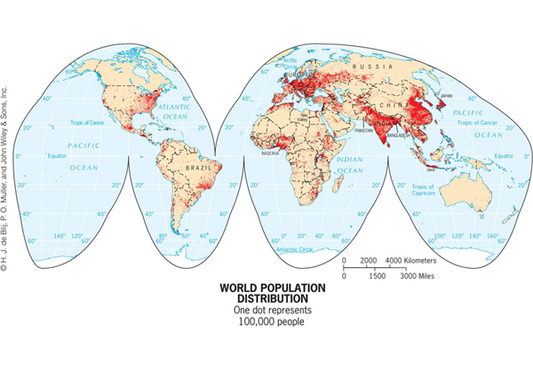
So where do the people live anyway?

Slide 16
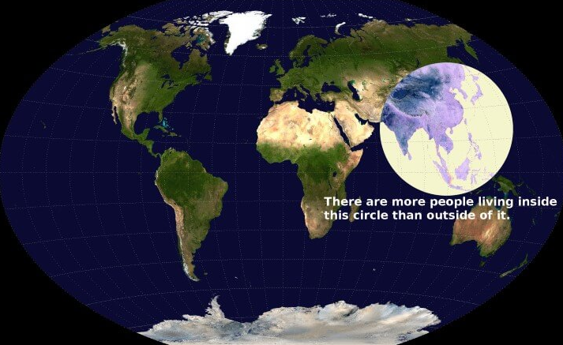
Where do people really live?

Slide 17
East Asia - China
The second largest cluster of inhabitants is in East Asia. (1.5 billion)
One-fifth of the world’s people live in this region.
Five-sixths of the people in this region live in China

Slide 18
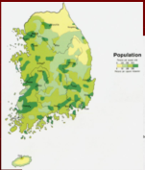
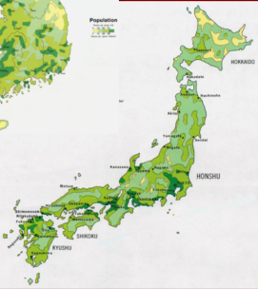
East Asia – Japan & Korea
Japan and South Korea’s population is distributed differently and is also not uniform.
Here, more than three-fourths of the Japanese and Koreans live in urban areas.

Slide 19
South Asia
The largest concentration of people, roughly one-fifth of the worlds population, is in South Asia. (1.7 billion)
India is the world’s second most populous country and it contains more than three-fourths of the South Asia population concentration.

Slide 20
Europe
Combining the populations of Western & Eastern Europe and the European Russia forms the world’s third-largest population cluster. (742.5 million)
One-ninth of the world’s people live in this region.
Three-fourths of Europe’s inhabitants live in cities.
Interestingly, they import food and other resources

Slide 21
Southeast Asia
The world’s fourth-largest population cluster, after Europe, is in Southeast Asia, mostly on a series of islands. Indonesia, which consists of 13,677 islands, is the world’s fourth most populous country. (618 million)

Slide 22
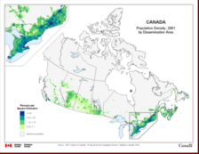
The United States & Canada
The largest population concentration in the Western Hemisphere is in the northeastern United States and southeastern Canada.
About 2 percent of the world’s people live in these areas. (354 million)
An interesting point is that less than 5% of the people in this area are farmers.

Slide 23
West Africa
Another 2 percent of the world’s population is clustered in West Africa, especially along the south- facing Atlantic coast. (340 million)
Approximately half is in Nigeria, and the other half is divided among several small countries west of Nigeria.
Most people work in agriculture.

Slide 24
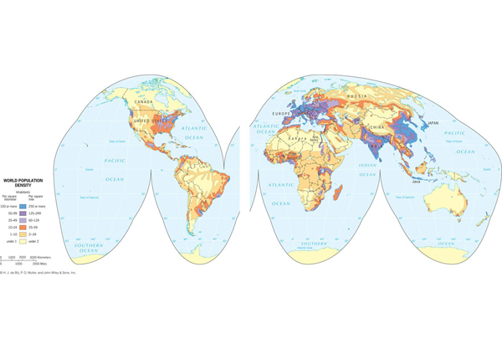
Population Density

Slide 25
Agricultural Density
Two countries can have similar physiological densities, but they may produce significantly different amounts of food because of different economic conditions.
Agricultural density is the ratio of the number of farmers to the amount of arable land.
To understand the relationship between population and resources in a country, geographers examine its physiological and agricultural densities together.

Slide 26
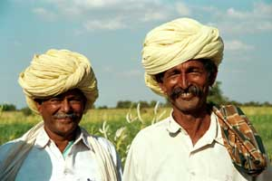
If the Netherlands has a much higher physiological density than does India but a much lower agricultural density, which country has more farmers?
India!!!

