Slide 1
AIM: Why do populations rise or fall in particular places?
Do Now: Why do people live longer now than they did 200 years ago?

Slide 2
Reasons
Antibiotics
Diet
Education
Vaccinations
Better understanding of germ theory.
Healthier habits

Slide 3
The Main Points of this issue are:
Distribution of World Population Growth
Natural Increase
Fertility
Mortality

Slide 4
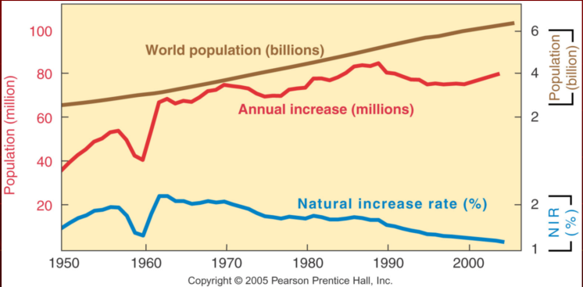
World Population Growth 1950–2000
Total world population increased from 2.5 to 6 billion in this half century. The natural increase rate peaked in the early 1960s and has declined since, but the number of people added each year did not peak until 1990.

Slide 5
This is serious

Slide 6
Another view

Slide 7
Population Basics
Geographers measure population change through three measures:
Crude birth rate (CBR) is the total number of live births in a year for every 1,000 people.
Crude death rate (CDR) is the total number of deaths in a year for every 1,000 people.

Slide 8
Population Basics
Natural increase rate (NIR) is the percentage by which a population grows in a year.
The term natural means that a country’s growth rate excludes migration.
The term crude means that we are concerned with society as a whole rather than a refined look at particular individuals or groups.

Slide 9
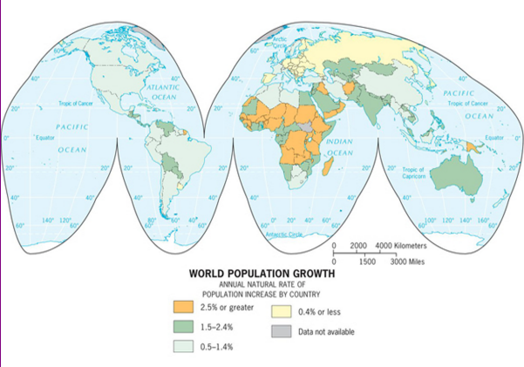
Natural Increase Rates
The natural increase rate (NIR) is the percentage growth or decline in the population of a country per year (not including net migration). Countries in Africa and Southwest Asia have the highest current rates, while Russia and some European countries have negative rates.

Slide 10
Natural Increase Stats
The natural increase rate of the planet during the last decade (200-2010) is estimated to be 1.3 percent.
It is lower today than at its all-time peak of 2.2 percent in 1963.
The NIR during the second half of the twentieth century was high by historical standards.
The number of people added each year has dropped at a slower rate than the NIR, because the population base is much higher now than in the past.
The rate of natural increase affects the doubling time, which is the number of years needed to double a population.
When the NIR was 2.2 percent back in 1963, doubling time was 35 years.

Slide 11
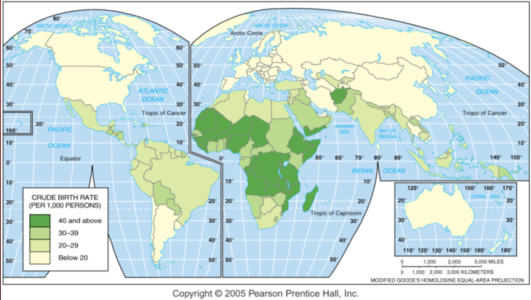
Crude Birth Rates
The crude birth rate (CBR) is the total number of births in a country per 1,000 population per year. The lowest rates are in Europe, and the highest rates are in Africa and several Asian countries.

Slide 12
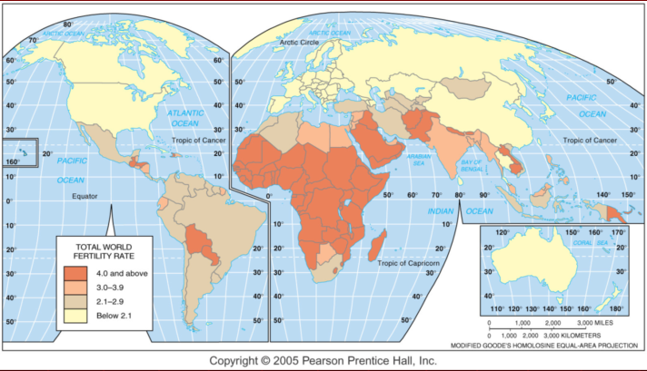
Total Fertility Rates
The Total fertility rate (TFR) is the number of children an average woman in a society will have through her childbearing years.

Slide 13
Some countries are leading to this!

Slide 14
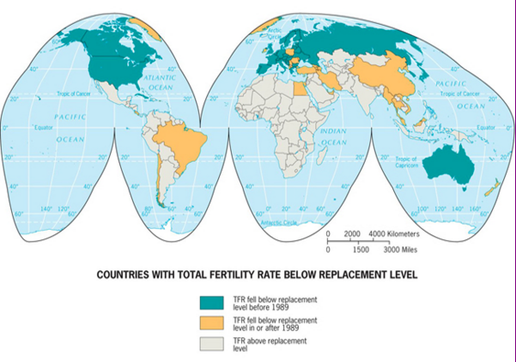
Replacement Level Fertility
If all women had 2.1 babies during their lifetime, the world population would stay the same. Replacement Level Fertility leads to Zero Population Growth (ZPG)

Slide 15
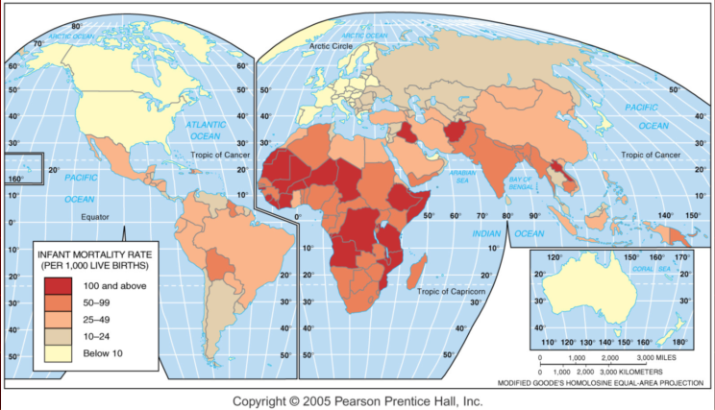
Infant Mortality Rates
The infant mortality rate is the number of infant deaths per 1,000 live births per year.

Slide 16
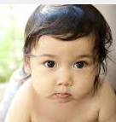
Wealthy Countries = More of these!
Healthy Babies!!!!

Slide 17
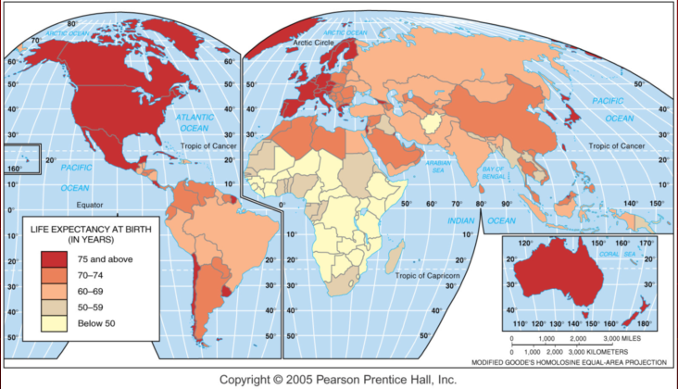
Life Expectancy at birth
Life expectancy at birth is the average number of years a newborn infant can expect to live.

Slide 18
Wealthy Countries = More of this!

Slide 19
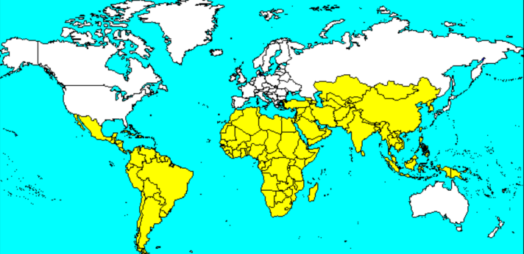
Where These Rates Are Highest
Higher rates of natural increase, crude birth, total fertility, and infant mortality, and lower life expectancy are in Less Developed Countries.

Slide 20
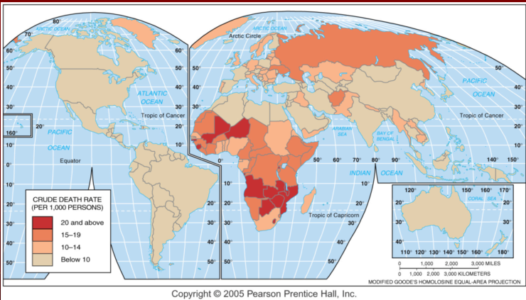
Crude Death Rate
The crude death rate (CDR) is the total number of deaths in a country per 1,000 population per year.

Slide 21
In wealthy countries, the death rate is actually going up because of this.

Slide 22
In poorer countries, the death rate may remain high because of disease and overtaxed resources

