Slide 1
AIM: How does a country’s level of development impact it’s population growth?
Do Now: What makes a country more developed vs. less developed?
Vocabulary Flash Cards Due Next Monday

Slide 2
Key Issue 3
The Main Points of this issue are:
The Demographic Transition
1. Low growth – 3. Moderate growth
2. High growth – 4. Low growth
Population pyramids
Age distribution
Sex ratio
Countries in different stages of demographic transition
Demographic transition and world population growth

Slide 3
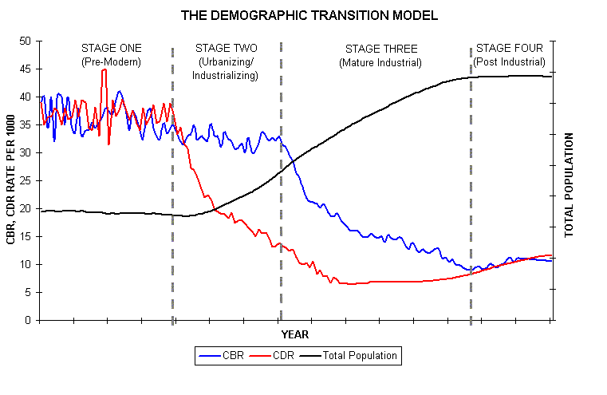
The Demographic Transition
The demographic transition consists of five stages, which move from high birth and death rates, to declines first in death rates, then in birth rates, and finally to a stage of low birth and death rates. Population growth is most rapid in the second stage.

Slide 4
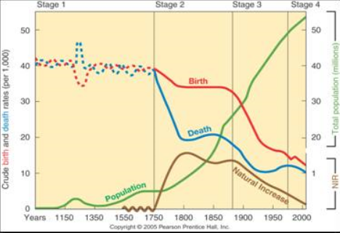
Demographic Transition in England
England was one of the first countries to experience rapid population growth in the mid-18th century, when it entered stage 2 of the demographic transition.

Slide 5
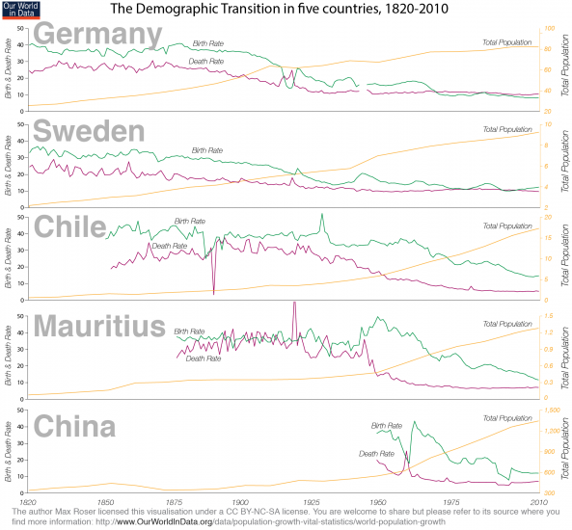
More Examples

Slide 6
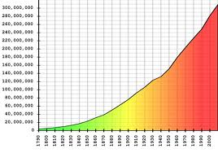
US Population Growth
The United States has moved slightly below Zero Population Growth since 2000.
When most families lived on farms, employment and child rearing were conducted at the same place, but in urban societies most parents must leave the home to work.

Slide 7
Russian Population Growth
Several Eastern European countries, like Russia, have negative natural increase rates, a legacy of a half century of Communist rule.
In time, Russians and other Eastern Europeans may display birth & death rates more comparable to those in Western Europe.
Demographers have identified a fifth stage, characterized by higher death rates than birth rates and an irreversible population decline.

Slide 8
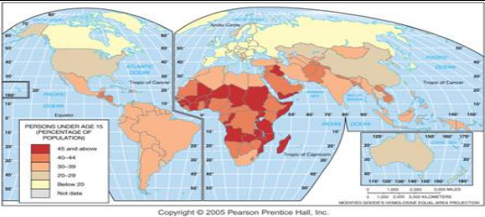
Percent of Population under 15
About 1/3 of world population is under 15, but the percentage by country varies from over 40% in most of Africa and some Asian countries, to under 20%

Slide 9
Population Disparities
The number of males per hundred females in the population is the sex ratio.
In Europe and North America the ratio of men to women is about 95:100.
In the rest of the world the ratio is 102:100.
Why do you think poorer countries have more men than women?

Slide 10
Theorize why poorer countries have more men than women.
1. More women die in childbirth
2. Infanticide of girls

Slide 11
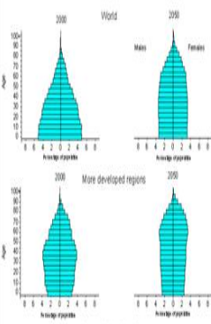
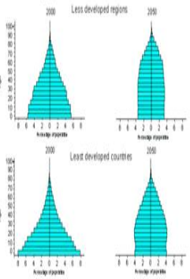
Population Pyramids
Population in a country is influenced by the demographic transition in two principal ways: the percentage of the population in each age group, and the distribution of males and females.
A country’s population can be displayed by age and gender groups on a bar graph called a population pyramid.

Slide 12
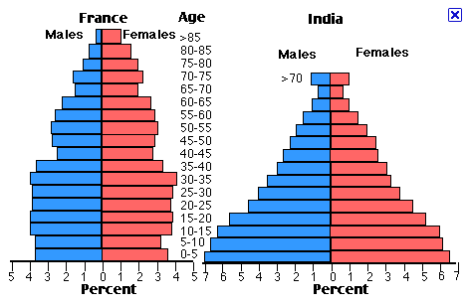
Young Pop. vs. Older Pop.
Young dependents outnumber elderly ones by 10:1 in stage 2 countries, but the numbers of young and elderly dependents are roughly equal in stage 4 countries.
The large percentage of children in Sub-Saharan Africa and other stage 2 countries strains the ability of poorer countries to provide needed services.

Slide 13
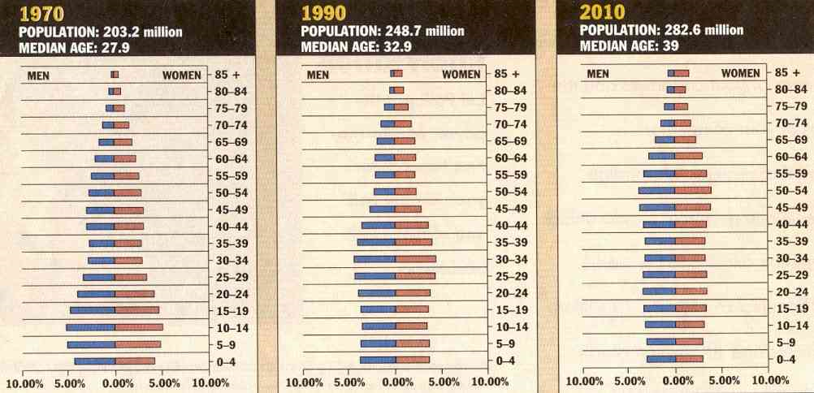
Changes in the Pyramid
As countries pass through the stages of the demographic transition, the percentage of elderly people increases.
More than one-fourth of all government expenditures in the United States, Canada, Japan, and many European countries go to programs for the older population.

Slide 15
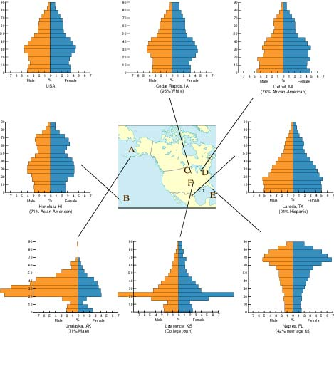
Population Pyramids in U.S. Cities
Population pyramids can vary greatly, with different fertility rates (Laredo vs. Honolulu), or among military bases (Unalaska), college towns (Lawrence), and retirement communities (Naples).

Slide 17
Countries in Different Stages of Demographic Transition
No country today remains in stage 1 of the demographic transition.
You can compare countries the other 4 stages.

Slide 18
Cape Verde

Slide 19
Rapid Growth in Cape Verde
Cape Verde, which entered stage 2 of the demographic transition in about 1950, is experiencing rapid population growth. Its population history reflects the impacts of famines and out-migration

Slide 20
Chile

Slide 21
Moderate Growth in Chile
Chile entered stage 2 of the demographic transition in the 1930s, and it entered stage 3 in the 1960s.

Slide 22
Denmark

Slide 23
Low Growth in Denmark
Denmark has been in stage 4 of the demographic transition since the 1970s, with little population growth since then. Its population pyramid shows increasing numbers of elderly and few children.

Slide 24
Demographic Transition and World Population Growth
The Worldwide population increased rapidly during the second half of the twentieth century.
The four- stage demographic transition is characterized by two big breaks with the past.
•The first break—the sudden drop in the death rate—has been accomplished everywhere.
•The second break—the sudden drop in the birth rate—has yet to be achieved in many countries.

Slide 25
Play time

Slide 26
Summation
The nineteenth-century decline in the CDR in Europe and North America took place in conjunction with the Industrial Revolution.
In contrast, the sudden drop in the CDR in Africa, Asia, and Latin America in the twentieth century was accomplished by different means and with less internal effort by local citizens.
Medical technology was injected from Europe and North America instead of arising within the country as part of an economic revolution.
In the past, stage 2 lasted for approximately 100 years in Europe and North America, but today’s stage 2 countries are being asked to move through to stage 3 in much less time in order to curtail population growth.

