Slide 1
AIM: Why do business services locate in large settlements?
Do Now:Use your best judgment to determine some of the differences between living in the city, suburbs or a rural area.
How is life easier?
How is life harder?
Which life affords more freedom?

Slide 2
Business Services
Services that primarily meet the needs of other businesses.
(IT, Business Management, Services for businesses)

Slide 3
Consumer Services
Businesses that provide services primarily to individual consumers, including retail services and personal services.
Retail (stores), education (college, private school, consulting, doctors, lawyers)

Slide 4
Public Services
Services offered by the government to provide security and protection for citizens and businesses.
Public education, sanitation, police, firefighters, road workers)

Slide 5
Activity – Label each of the following as either Public, Consumer, or Business Services.
Hotels
Schools
MTA
Health Insurance
Information Security
Computer Forensics specialist
Lawyer
Babysitter
Pizzeria
Television Station

Slide 6
Why do business services locate in large settlements?

Slide 7
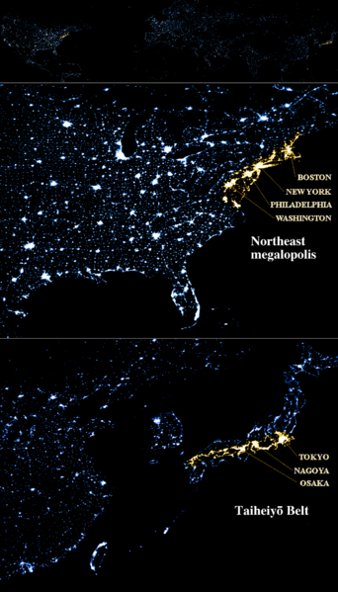
Conurbation
A megalopolis (sometimes called a megapolis or megaregion) is typically defined as a chain of roughly adjacent metropolitan areas.

Slide 8
Economic Base of Settlements
Often times, governments make policy decisions based upon attracting basic industries. This is why local governments go out and give subsidies to certain industries and businesses in order to get them to relocate to their community. Basic employment drives the engine of economic development. Towns and cities will build infrastructure improvements and grant tax abatements.

Slide 9
Newspaper Reading

Slide 10
What changes to infrastructure did the Town of Huntington make in order to draw Canon to Melville? (Melville is part of Huntington)

Slide 11
Big Vocabulary
Basic Industry – an industry that brings wealth to an area from the outside. More is produced than is needed by the local populace. Basic industries determine the extra-local importance of a place.
Non-basic Industry – A non-basic industry is an industry that serves, and only serves the needs of the local populace and typically involves retail trade and services for the locals. Teachers are examples of non-basic employees.

Slide 12
Basic vs. Non-Basic
The main difference between the two types of industries is that one creates wealth from the outside, while the other services the local populace. Economic Base Studies relate basic to non-basic employment. The Regional Multiplier Effect is calculated from these ratios. If you create X amount of basic jobs, how many non-basic jobs will result from the need to service the local population? Home Construction is the ultimate non-basic industry.

Slide 13
Can a primary economic activity (farming or mining) be a basic industry?

Slide 14
Answer:

Slide 15
Label each of the following types of businesses as a B for basic or N for non-basic.
Shoe Store
University
Drug Manufacturer
Canon Headquarters
Wall Street
One branch of Citibank

Slide 16
Label each of the following types of businesses as a B for basic or N for non-basic.
1. Chevrolet Assembly Plant 8. Movie studio 2. A University 9. Disneyworld
3. Family Farm
4. Gold Mine
5.Wall Street
6. Corner Store
7.Construction company

Slide 17
What were the features of early Mesopotamian city-states?

Slide 18
Protective Walls

Slide 19
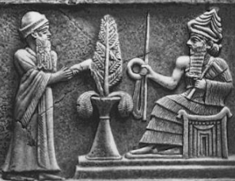
Seat of Government

Slide 20
Central Religious Buildings

Slide 21
Centers of Trade

Slide 22
What could cause the decline of early cities?

Slide 23
River Changes Course
Before Earthquake
After Earthquake

Slide 24
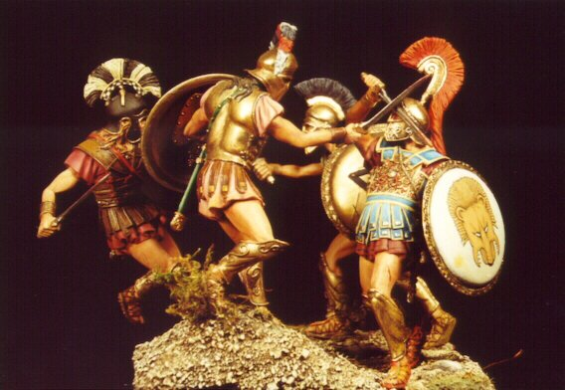
The development of rival cities
Athens and Sparta

Slide 25
Foreign invasion

Slide 26
Corrupt governments

Slide 27
Taxes too high

