Slide 1
AIM: Why do people migrate within their own country?
Do Now: Why might a person move away from New York City?

Slide 2
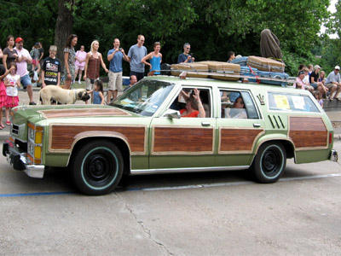
In the United States, the average family moves once every six years

Slide 3
Some internal moves are in a circuit
Our daily commute.
Personal interactions between businesses
Going shopping
Going out with friends.
Vacations

Slide 4
Some internal moves require a temporary change of residence
Military Assignment
Migrant Labor
College or Prison

Slide 5
Some moves are permanent
Migration for economic improvement
Migration for social and psychological reasons
Migration due to physical necessity or force
Migration for retirement

Slide 6
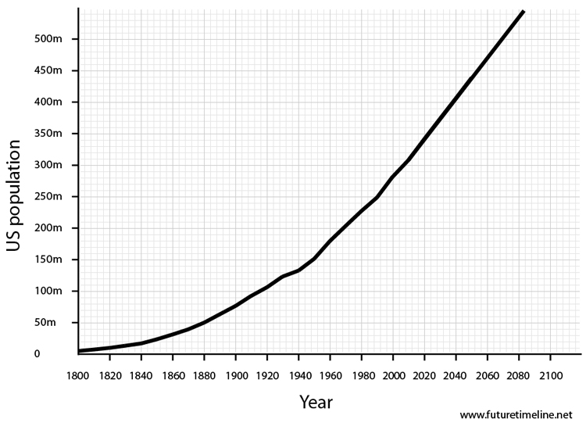
Migration Inside the US
In the United States, interregional migration was more prevalent in the past, when most people were farmers.
The most famous example of large-scale internal migration is the opening of the American West.

Slide 7
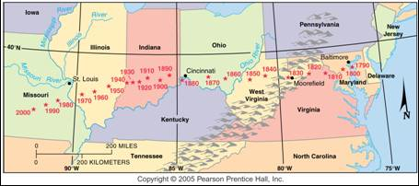
Center of Population in the U.S.
The center of U.S. population has consistently moved westward, with the population migration west. It has also begun to move southward with migration to the southern sunbelt.

Slide 8
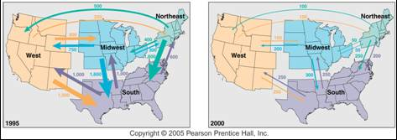
Interregional Migration in the U.S.
Average annual migrations between regions in the U.S. in 1995 and in 2000.

Slide 9
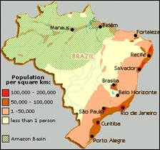
Population, Migration and Brazil
Most Brazilians live in a string of large cities near the Atlantic Coast.
To increase the attractiveness of the interior, the government moved its capital in 1960 from Rio to a newly built city called Brasilia.

Slide 10
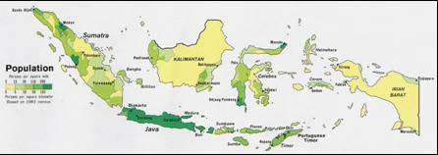
Population, Migration and Indonesia
Since 1969 the Indonesian government has paid for the migration of more than 5 million people, primarily from the island of Java, where nearly two-thirds of its people live, to less populated islands.
The number of participants has declined in recent years, primarily because of environmental concerns.

Slide 11
What sorts of challenges do immigrants face in developed countries?

Slide 12
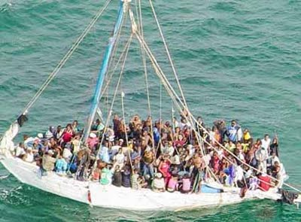
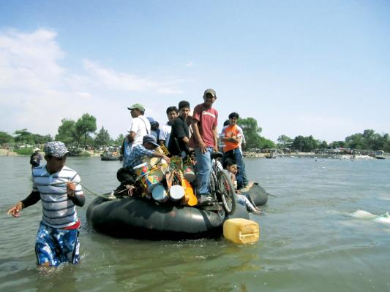
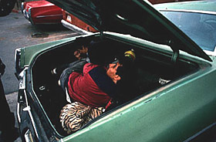

Slide 13
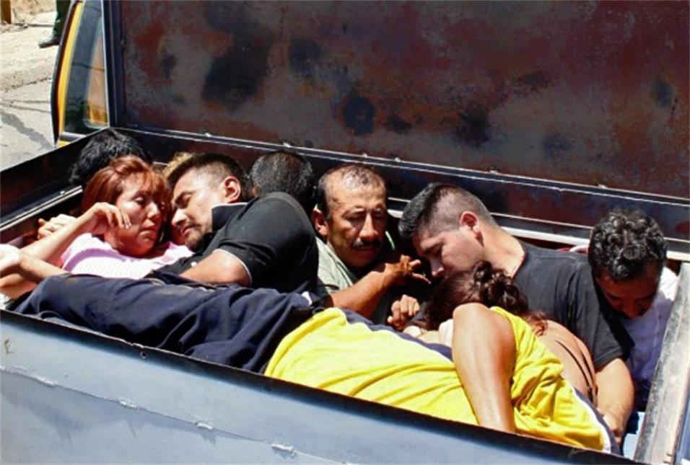

Slide 14
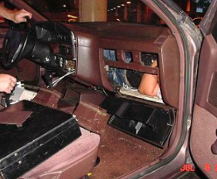
The terms “human smuggler” or “coyote” are used for people who smuggle people illegally across borders. Coyote fees, which are the fees charged by coyotes for their services, are a measure of the extent of people’s desire to migrate. We can also add to coyote fees the costs paid for document forgery and other costs needed to avoid being caught by immigration enforcement authorities.
Average price to illegally come to the United States in 2005
Asia - $26041
Europe - $6389
Africa $2,200
Mexicans - $3000-$4000 (by foot)

Slide 15
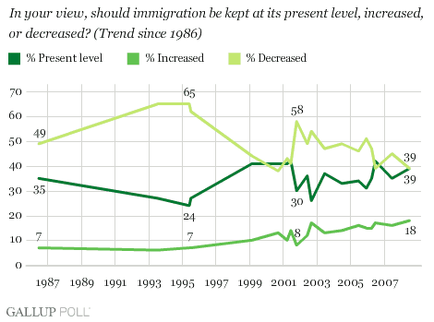

Slide 16
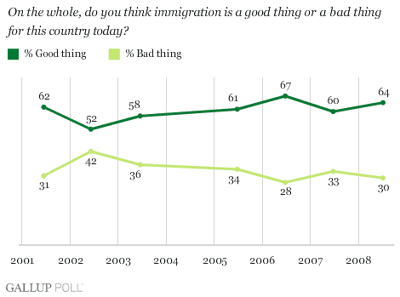

Slide 17
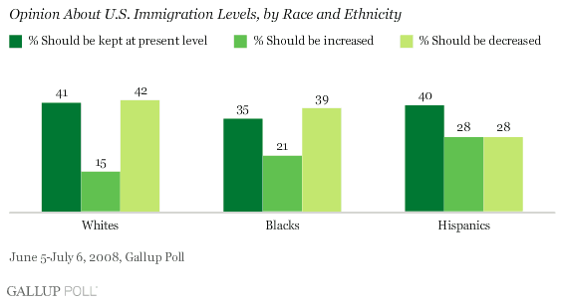

Slide 18
