Slide 1
AIM: How are LDC farming practices placing millions of people at an economic disadvantage
Do Now: List 3 ways Shifting Agriculture hurts of the environment.
FRQ Assessment for Agriculture next Friday.

Slide 2
Article: Tearing Down the Global Plantation
1. Why is Brazil’s rainforest in jeopardy?
2. Why has Brazil been embracing farming over the production of manufactured goods?
3. How has Brazil’s acceptance of agriculture as their primary export affected their economy?
4. In what ways are Brazil’s farming methods harmful to the environment?

Slide 3
Farming Techniques Review

Slide 4
How can we improve upon Slash and Burn?
Video Segments

Slide 5
AIM: What is the mission behind sustainable agriculture?
Do Now: What does the word “organic” mean when it is put on food labels?

Slide 6
More problems farmers face
Climate Change

Slide 7
Organic Food Movement
Started in the first half of the 20th century
Food grown without the assistance of man-made chemicals. (Use actual manure instead of synthetic manure) No synthetic pesticides.
Animals raised without hormones and antibiotics.
A government-approved certifier inspects a farm that wishes to be considered organic before allowing that farm to attach the label to their food.
The food costs more, but is believed to be healthier. However, there is no proof that organic vegetables are more nutritious than Genetically Modified Crops.

Slide 8
Sustainable Agriculture
Sustainable agriculture integrates three main goals: environmental stewardship, farm profitability, and prosperous farming communities.
This can apply to any and all types of farming.

Slide 9
Sustainable Goals
Satisfy human food and fiber needs.
Enhance environmental quality and the natural resource base upon which the agricultural economy depends.
Make the most efficient use of non-renewable resources and on-farm resources and integrate, where possible, natural biological cycles and controls.
Sustain the economic viability of farm operations.
Enhance the quality of life for farmers and society as a whole.

Slide 10
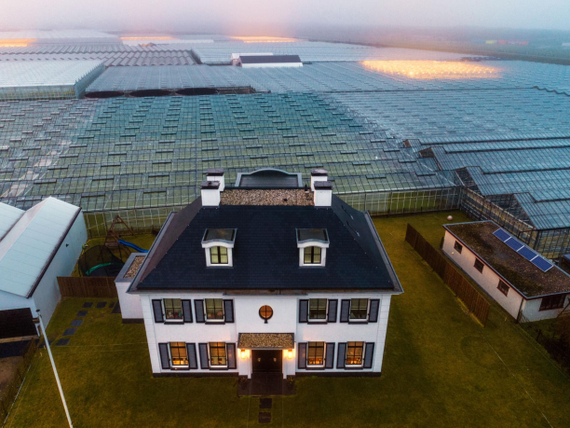
Possible Solutions to Feeding the World
The Dutch solution is to build indoor farms.

Slide 11
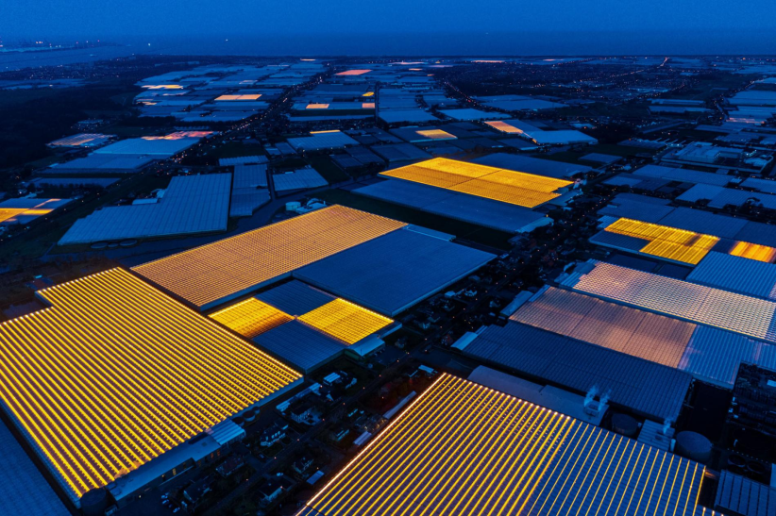

Slide 12
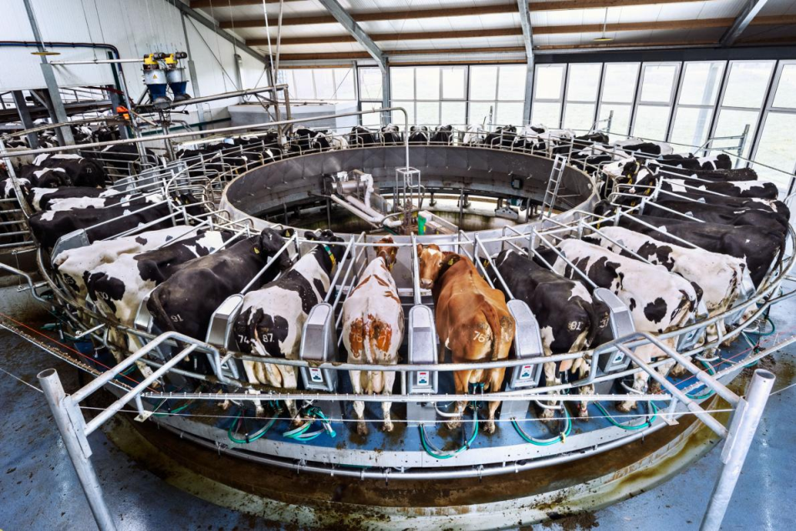

Slide 13
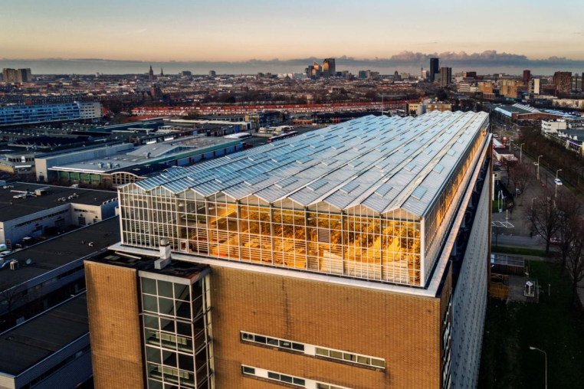

Slide 14
