Slide 1
AIM: Where is everything?
Do Now: Evaluate what it means to be an American.

Slide 2
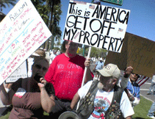
Who is he talking about?

Slide 3
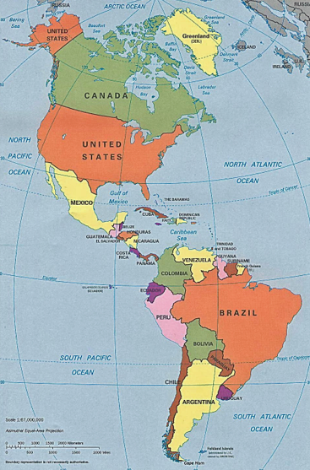
Technically, shouldn’t all people from the Americas be called Americans?

Slide 4
North America
Land Area - 9,361,791 square miles (24,247,039 square km)
Total Population - 522,807,432
Largest Country (Area) – Canada - 9,984,670 km2 3,854,085 sq mi
Smallest Country (Area)- Saint Kitts and Nevis: 104 square miles (261 sq km)
Island Nations - Antiqua and Barbuda, Bahamas, Barbados, Cuba, Dominica, Dominican Republic, Haiti, Grenada, Jamaica, Saint Lucia, Saint Kitts and Nevis, Saint Vincent and the Grenadines, Trinidad and Tobago
River Systems – Mississippi River, Rio Grande, Colorado River, Missouri River, St. Lawrence River, Ohio River, Churchill River,

Slide 5
North America
Highest Point - Mt. McKinley (Denali) (20,322 feet)
Mountain Ranges – Rockies, Appalachians, Sierra Nevada, Canadian Rockies, Cascades, Sierra Madre

Slide 6
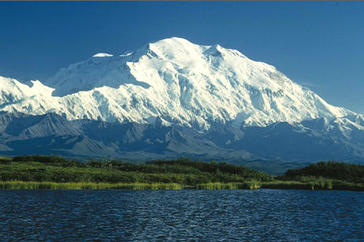
Mt. McKinley (Denali)

Slide 7
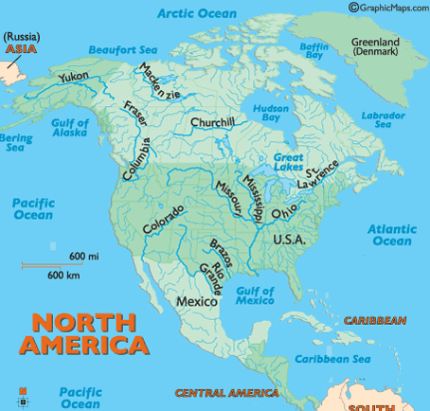
North American Rivers

Slide 8
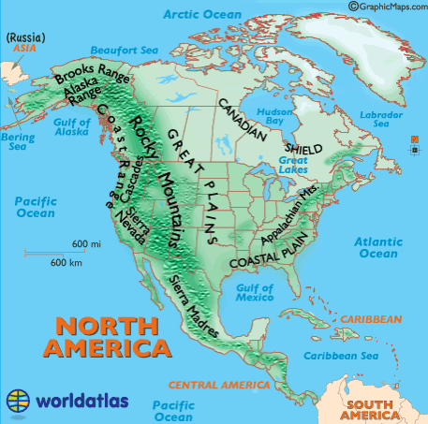
North American Landforms

Slide 9
North America – Bordered by Bodies of Water
Atlantic Ocean
Arctic Ocean
Gulf of Mexico
Pacific Ocean
Bering Sea
Caribbean Sea
Gulf of Alaska
Hudson Bay
Labrador Sea
Beaufort Sea

Slide 10
Bodies of Water

Slide 11
Main Religious Groups North America
Christianity (Catholicism in Latin America, Protestantism in USA and Canada), Islam (About 2-2.5%), Judaism (About 1%), Buddhism (0.5%), Hinduism (0.5 %)

Slide 12
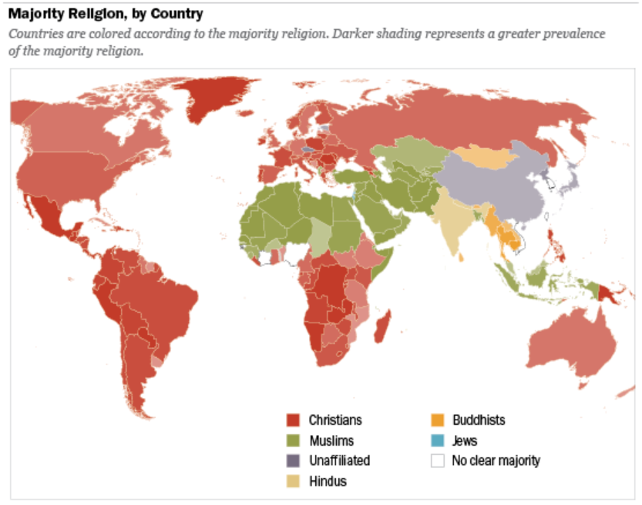

Slide 13
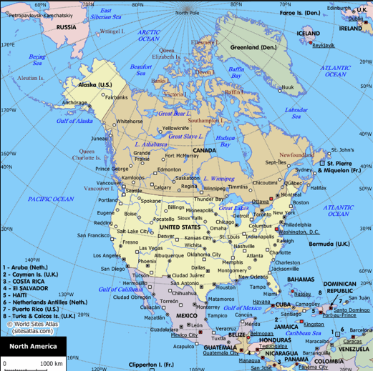
North America Political Map

Slide 14
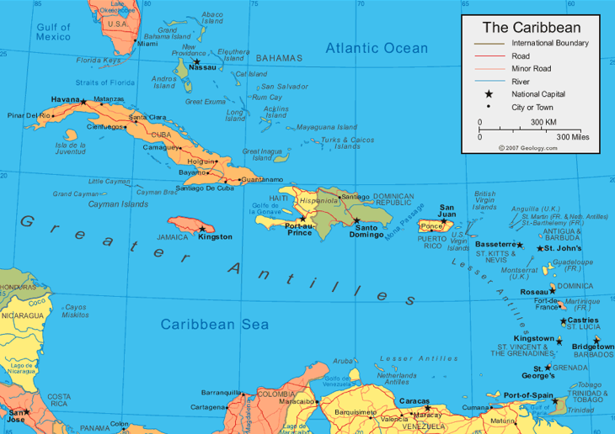
Caribbean Political Map

Slide 15
South America
Land Area - 17,840,000 km² (6,890,000 sq mi)
Total Population - 387,489,196
Largest Country (Area) – Brazil 8,515,767 km2
3,287,597 sq mi
Smallest Country (Area)- Suriname: 163,821 km2
63,251 sq mi
Island Nations - Zero
River Systems – Amazon River

Slide 16
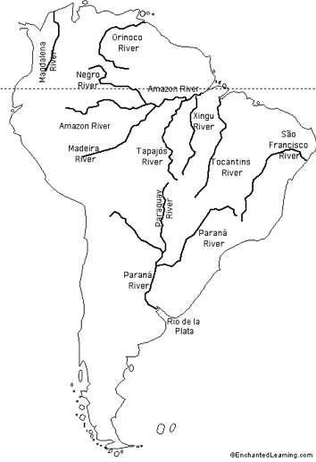
River Systems

Slide 17
North America
Highest Point - Aconcagua (22,841 ft)
Mountain Ranges – Andes Mountains, Guyana Highlands, Brazilian Highlands, Patagonia

Slide 18
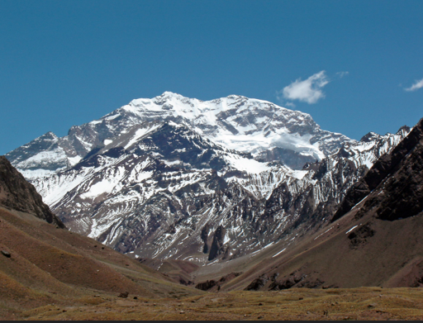
Aconcagua

Slide 19
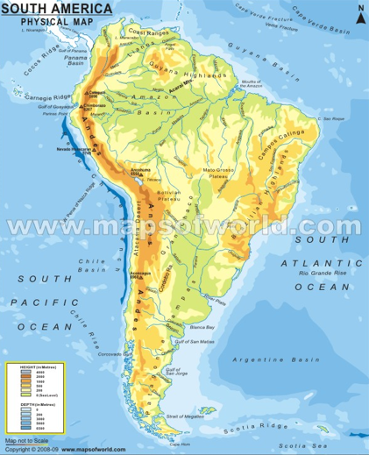

Slide 20
South America – Bordered by Bodies of Water
Atlantic Ocean
Scotia Sea
Southern Ocean
Pacific Ocean
Caribbean Sea

Slide 21
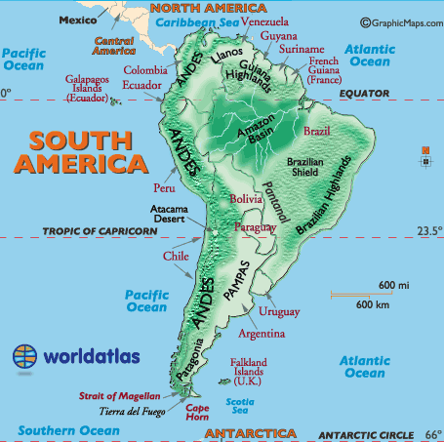
Bodies of Water

Slide 22
Main Religious Groups South America
Christianity (Catholicism 82% of total population), Judaism, Islam, Hinduism

Slide 25
