Slide 1
Unit 3: Migration HW#1: Read and complete Key Question 1, by Thursday 11/8 HW#2: Read and complete Key Question 2, by Friday 11/9

Slide 2
AIM: Determine why geographers care about migration.
Do Now: Test Feedback

Slide 3
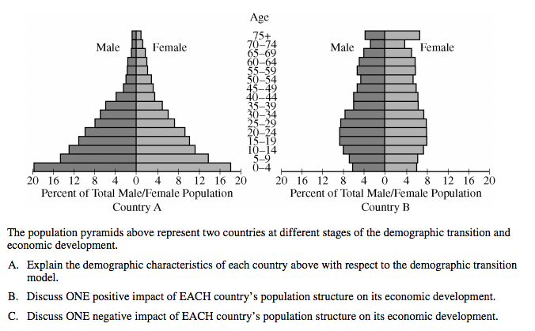
FRQ

Slide 4
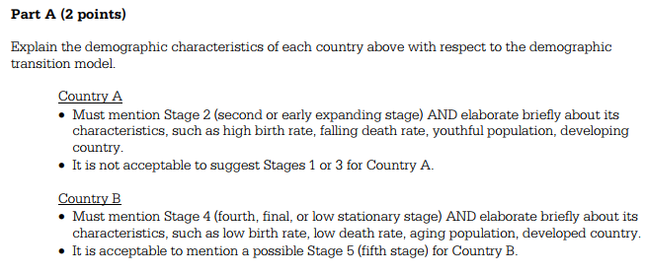
Part A

Slide 5
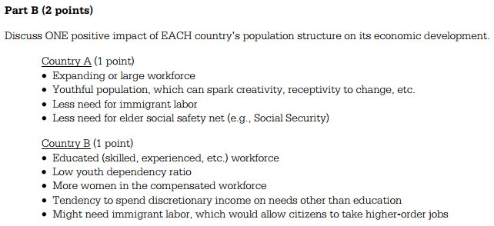
Part B

Slide 6
Part C

Slide 7
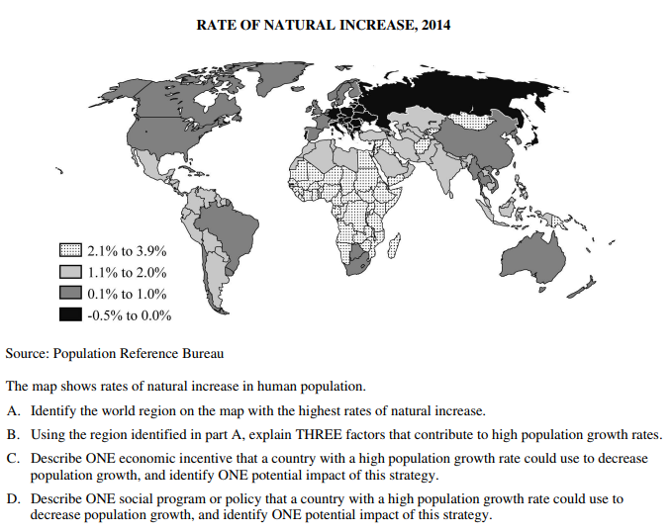
FRQ

Slide 8
Part A

Slide 9
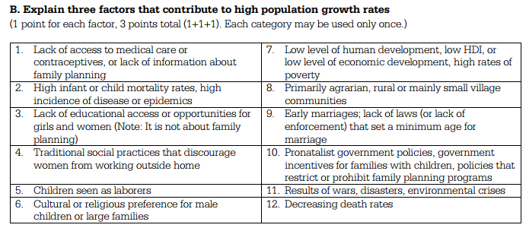
Part B

Slide 10
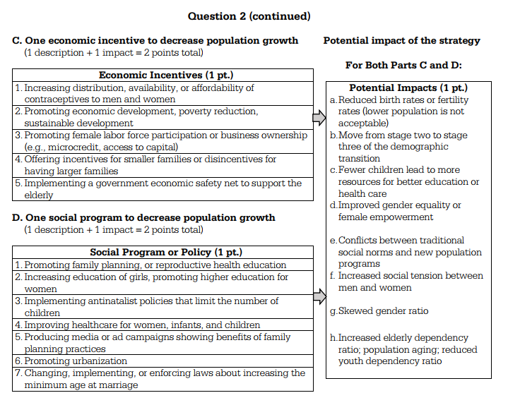
Part C and D

Slide 11
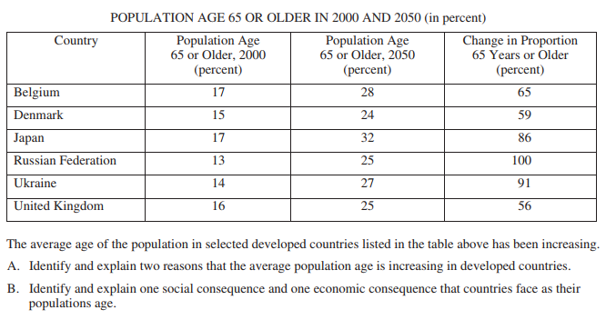
FRQ

Slide 12
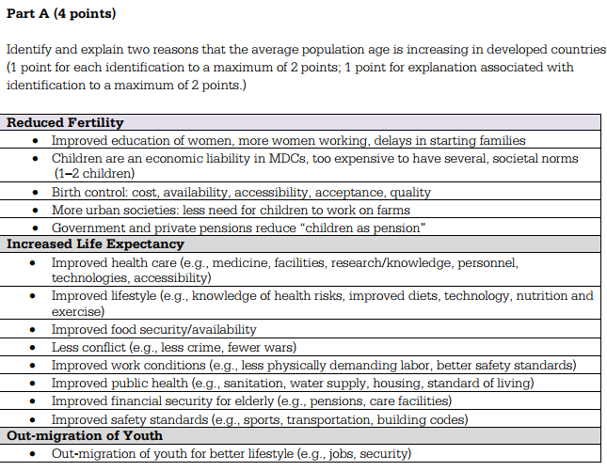
FRQ Part A

Slide 13
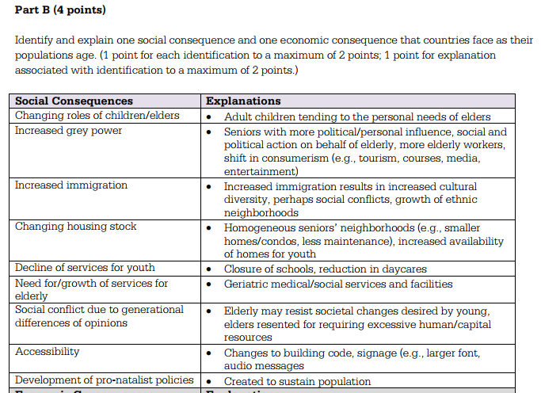
Part B

Slide 14
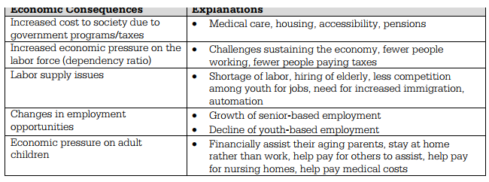
Part B continued

Slide 15
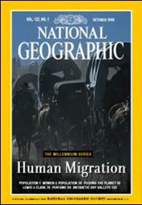
What Geographers Study
Geographers document from where people migrate and to where they migrate.
They also study reasons why people migrate.

Slide 16
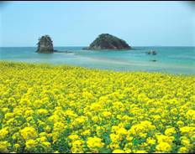
What Migrants Seek
Most people migrate in search of three objectives:
Economic opportunity
Cultural freedom
Environmental comfort

Slide 17
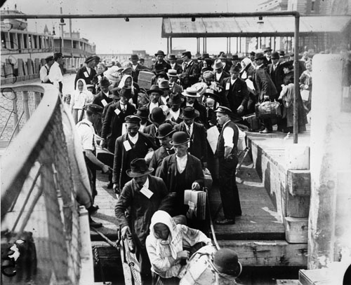
Net Migration
The subject of this chapter is a specific type of relocation diffusion called migration, which is a permanent move to a new location.
Emigration is migration from a location
Immigration is migration to a location
The difference between the number of immigrants and the number of emigrants is the net migration.

Slide 18
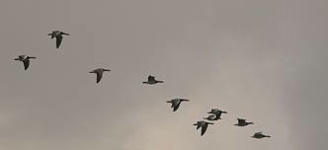
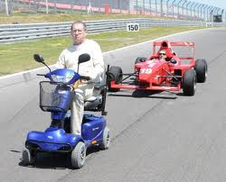
Migration and circulation
Migration is a form of mobility, which is a more general term covering all types of movements from one place to another.
Short-term repetitive, or cyclical movements that recur on a regular basis, such as daily, monthly, or annually, are called circulation.

Slide 19
Here’s a Good Question that relates to Migration in the 21st Century
If people can participate in the globalization of culture and economy regardless of place of residence, why do they still migrate in large numbers?
The answer is that place is still important to an individual cultural identity and economic prospects.

