Slide 1
AIM: Why do People Migrate?
Do Now: Why does the local government in Mumbai support the growth of Shanty Towns?
HW: Key Question #2 Due Friday. Expect a Quiz

Slide 2
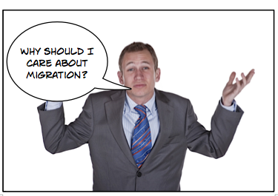
Migration is important

Slide 3
Migration transforms the areas at both ends, at the origin and the destination. Any decision to migrate is a balancing act for the individual.

Slide 4
Mumbai Shanty Town, Dharavi

Slide 5
Dharavi

Slide 6
U.S./Mexico Border Tijuana, Mexico

Slide 7
San Ysidro U.S./Mexico Border Crossing

Slide 8
Sudanese Refugee Camp, Uganda

Slide 9
What are some typical forms of cyclic movement?
Commuting
Nomadism
Movement to and from activity spaces.

Slide 10
What are some typical forms of periodic movement?
Transhumance
Active duty Military Service
Prison
College

Slide 11
What are the typical forms of migration?
Internal migration
Moving within a country’s borders.
International migration
Movement across country borders.
Note: Many international migrants will make further internal migrations after arriving in the destination country.

Slide 12
How is internal migration different from international migration?

Slide 13
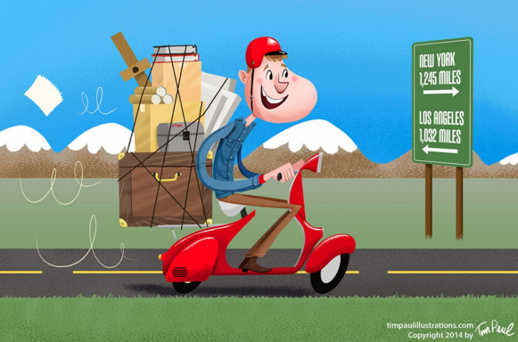
What is the most typical form of internal migration in most countries?
Rural → Urban

Slide 14
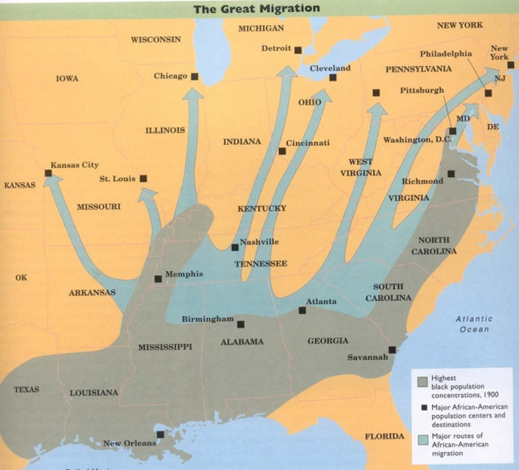
The Great Migration

Slide 15
Why do people migrate?
Forced vs. voluntary?
How might people be forced to migrate?
Why do people willingly migrate?

Slide 16
Cultural Push and Pull Factors
Forced international migration usually happens for two reasons;
Slavery
Political instability

Slide 17
Tony Horowitz, The Long Voyage Home
“About 1 million Europeans migrated to the American colonies prior to independence, and another million from the late 1700s until 1840…
Most African Americans are descended from Africans forced to migrate to the Western Hemisphere as slaves, About 400,000 Africans were shipped as slaves to the 13 colonies that later formed the United States during the eighteenth century, primarily by the British.”

Slide 18
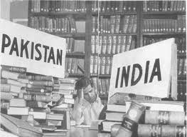
Twentieth Century Instability
In the twentieth century, forced international migration increased because of political instability resulting from cultural diversity.

Slide 19
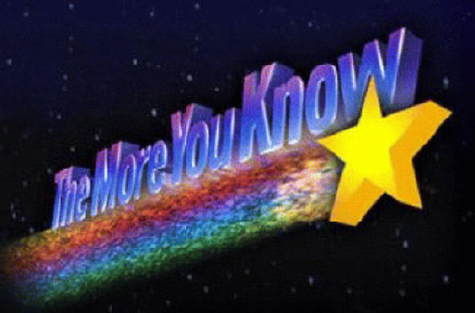
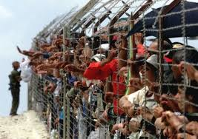
Refugees
People who have been forced to migrate from their home country and cannot return for fear of persecution.

Slide 20
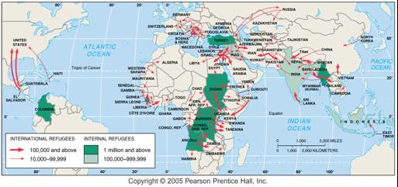
Major Sources and Destinations for Refugees

Slide 21
Large Forced Migrations
Trans-Atlantic and Trans-Saharan Slave Trades
Trail of Tears
The Holocaust
Potato Famine
Creation of Australia

Slide 22
What are the effects of these large forced migrations? Trans-Atlantic Slave Trade…
Most people from the Caribbean are of Afro-Caribbean descent rather than natives of the islands

Slide 23
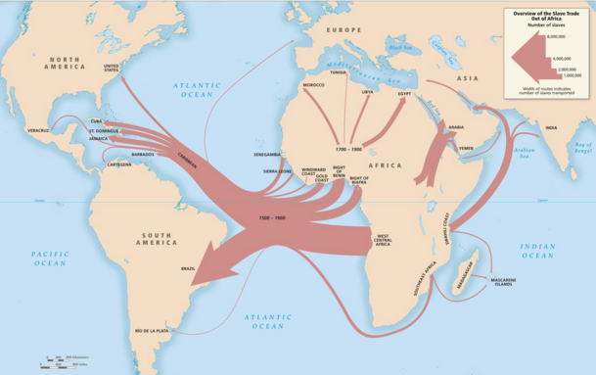

Slide 24
Trail of Tears
Many Native American Groups were forced onto reservations far from their native lands.
They have gotten back at us by building casinos.

Slide 25
AIM: Why do people Migrate?
Do Now: Quiz
HW: Key Question #3 Due Monday. Vocab due Friday.

Slide 26
Holocaust
The UN partitioned Palestine in 1947 and created Israel leading to an another series of forced migrations.

Slide 27
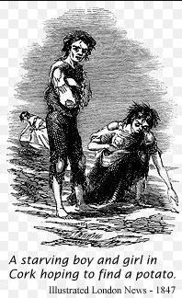
Potato Famine
About a million people emigrated to America , Canada , Australia or Britain . People continued to leave Ireland in large numbers for many years after the famine.
The Irish language also began to die out.

Slide 28
Australia
In 1788, Great Britain began shipping tens of thousands of convicts to Australia.
The Aussie accent is said to be influenced by…
The Australian accent developed because so many early settlers were drunk and slurring, an Australian academic has claimed.
The first British arrivals to the country were such big drinkers that the distortion to their speech caused a verbal hangover that persists to this day, according to Dean Frenkel, a communications expert at Victoria University in Melbourn.

Slide 29
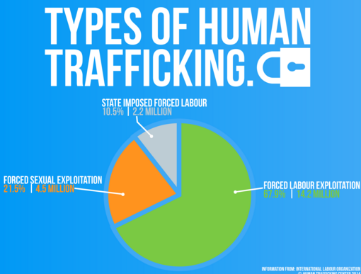
Human Trafficking – A modern forced migration.

Slide 30
Countries that are found to be less effective at combatting human trafficking face economic sanctions by the USA.

Slide 31
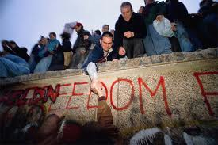
Twentieth Century Voluntary Migration
Political conditions can also operate as pull factors, especially the lure of freedom.
For instance, during the Cold War many people in Eastern Europe wanted to move to Western Europe.

Slide 32
Ravenstein’s Laws
Geography has no comprehensive theory of migration, but a 19th century essay of 11 migration “laws” written by E.G. Ravenstein is the basis for contemporary migration studies.
Ravenstein’s “laws” can be organized into three groups:
Reasons
Distance
Migrant Characteristics

Slide 33
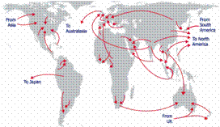
Distance Traveled
Ravenstein’s theories made two main points about the distance that migrants travel to their home:
Most migrants move a short distance and remain within the same country.
Long-Distance migrants to other countries often head for major centers of economic activity.

Slide 34
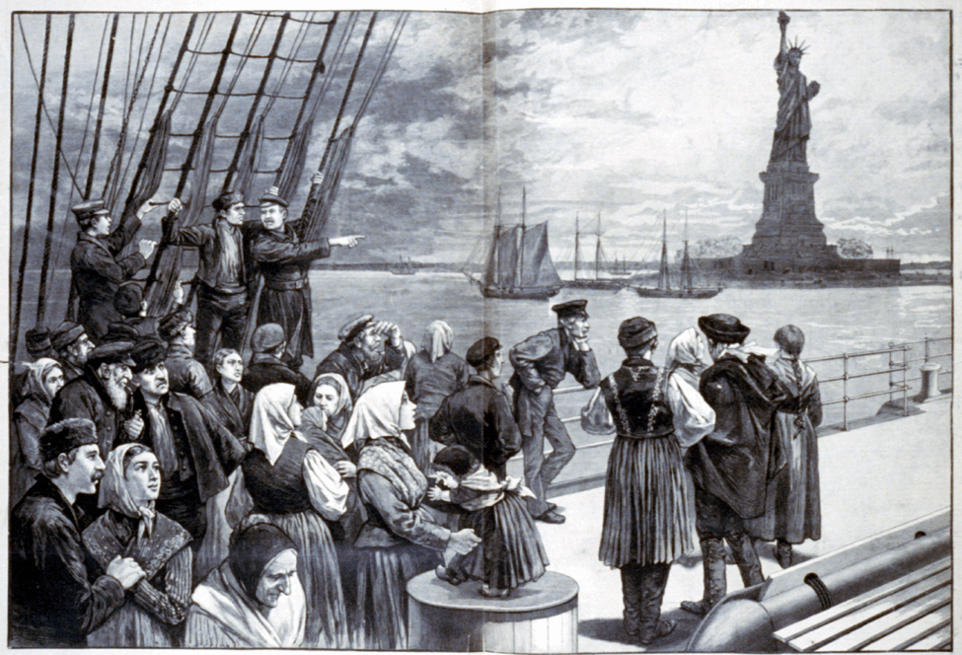
For Example

Slide 35
The Gravity Model
Assumes that spatial interaction (such as migration) increases as the size and importance of places becomes greater and decreases as distance between them grows.
Related Concepts;
Distance Decay

Slide 36
Models

Slide 37
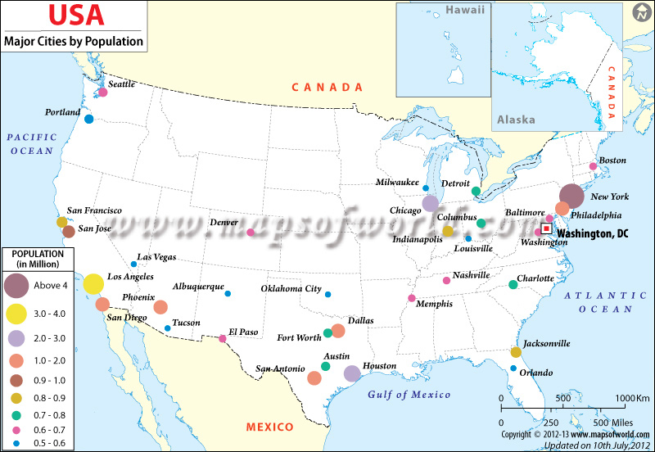

Slide 38
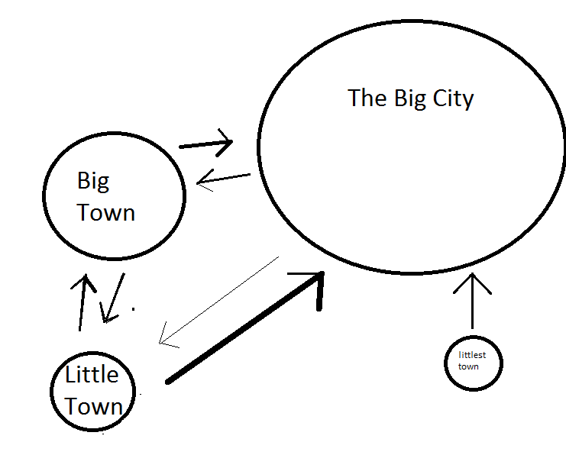

Slide 39
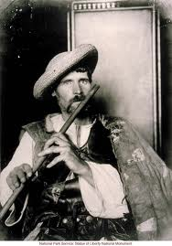
Characteristics of Migrants
Ravenstein noted distinctive gender and family-status patterns in his migration theories:
Most long-distance migrants have historically been male.
Most long-distance migrants have historically been adult individuals rather than families with children.
Changes in Gender of Migrants
Since the 1990s, the gender pattern has switched. Women now constitute about 55% of U.S. immigration.

Slide 40
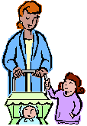
Single or Family
Ravenstein also believed that most long-distance migrants were young adults seeking work.
For the most part, this is true in the USA
With the increase of women migrating…more children are coming with their mothers.

Slide 41
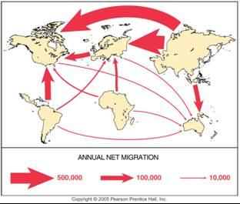
Global Migration Patterns
Most people migrate for economic reasons.
Cultural and environmental factors also induce migration, but less so.
The major flows of migration are from less developed to more developed countries.

Slide 42
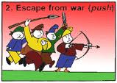
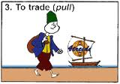
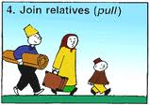
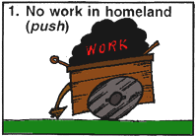
Push-Pull Factors
People decide to migrate because of push factors and pull factors.
A push factor causes people to move away.
A pull factor draws people in.
Both usually play a role in human migration.

Slide 43
The following terms are synonymous with push-pull
Push
Pull
Centripetal
Expel
Repulsion
Centrifugal
Attract
Attraction

Slide 44
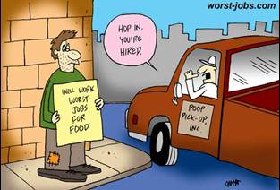
Economic Push and Pull Factors
Most people migrate for economic reasons.
The relative attractiveness of a region can shift with economic change.

Slide 45
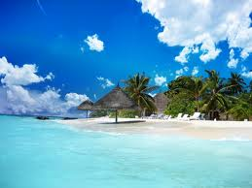
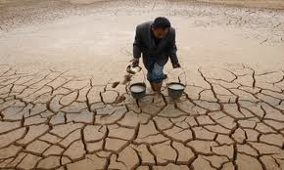
Environmental Push-Pull Factors
People also migrate for environmental reasons, pulled toward attractive places, and pushed from hazardous ones.
Attractive environments include; mountains, seasides, and warm climates.
Migrants also leave due to harsh conditions
Water (too much or too little) most common environmental threat

Slide 46
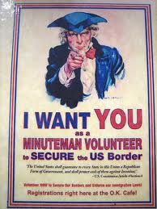
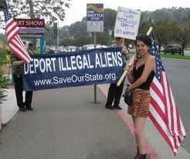
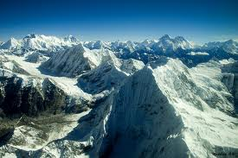
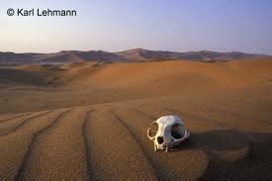
Intervening Obstacles
Migrants don’t always get to their desired destination. They may be blocked by an intervening obstacle.
A physical barrier (desert, mountain)
Bodies of water
But now, governments create obstacles

Slide 47
Connections to Demographic Transition
Geographer Wilber Zelinsky has identified a migration transition with changes in society similar to those in demographic transition.
Stage 1 – unlikely to migrate permanently. Might have a high daily or seasonal mobility in search of food.
Stage 2 - have many emigrants
Stage 3 and 4 – receive many immigrants in search of economic opportunities.
Internal migration within countries in stage 3-4 is intraregional, from cities to surrounding suburbs.

