Slide 1
AIM: Why do people Migrate?
Do Now: Quiz
HW: Key Question #3 Due Thursday. Vocab due Friday.

Slide 2
Ravenstein’s Laws
Geography has no comprehensive theory of migration, but a 19th century essay of 11 migration “laws” written by E.G. Ravenstein is the basis for contemporary migration studies.
Ravenstein’s “laws” can be organized into three groups:
Reasons
Distance
Migrant Characteristics

Slide 3
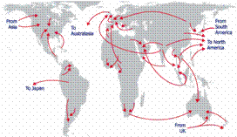
Distance Traveled
Ravenstein’s theories made two main points about the distance that migrants travel to their home:
Most migrants move a short distance and remain within the same country.
Long-Distance migrants to other countries often head for major centers of economic activity.

Slide 4
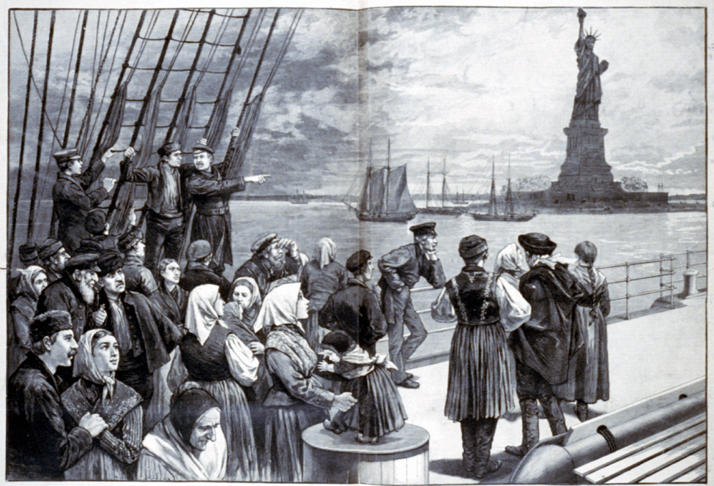
For Example

Slide 5
The Gravity Model
Assumes that spatial interaction (such as migration) increases as the size and importance of places becomes greater and decreases as distance between them grows.
Related Concepts;
Distance Decay

Slide 6
Models

Slide 7
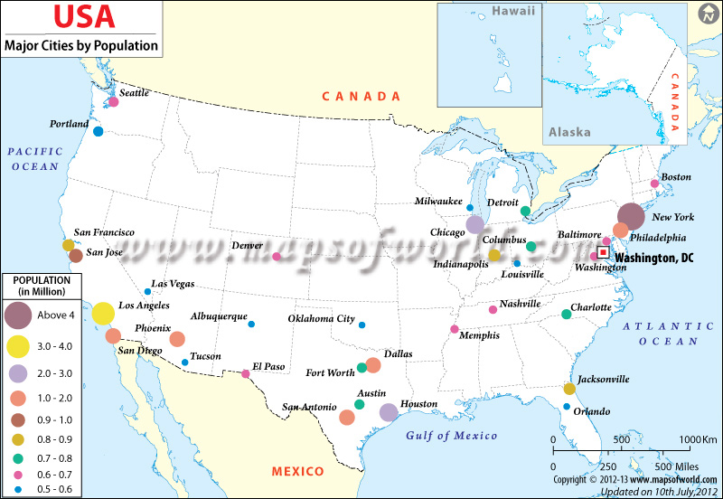

Slide 8
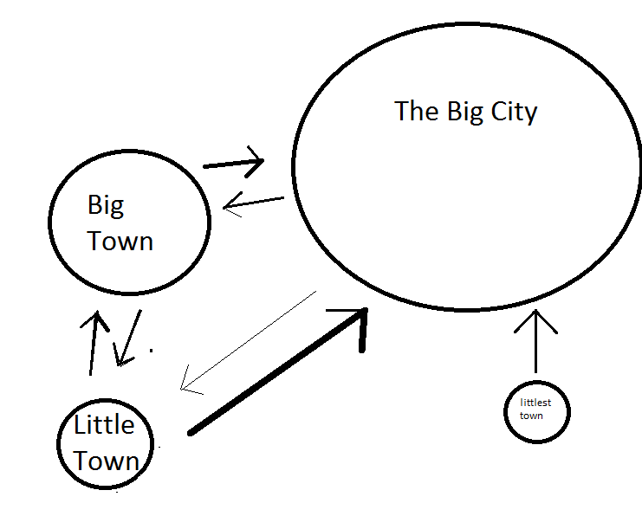

Slide 9
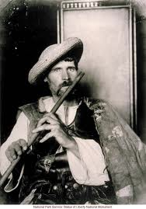
Characteristics of Migrants
Ravenstein noted distinctive gender and family-status patterns in his migration theories:
Most long-distance migrants have historically been male.
Most long-distance migrants have historically been adult individuals rather than families with children.
Changes in Gender of Migrants
Since the 1990s, the gender pattern has switched. Women now constitute about 55% of U.S. immigration.

Slide 10
AIM: Where do People Migrate?

Slide 11
Single or Family
Ravenstein also believed that most long-distance migrants were young adults seeking work.
For the most part, this is true in the USA
With the increase of women migrating…more children are coming with their mothers.

Slide 12
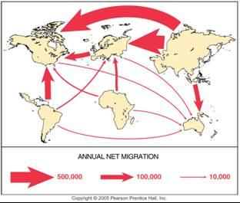
Global Migration Patterns
Most people migrate for economic reasons.
Cultural and environmental factors also induce migration, but less so.
The major flows of migration are from less developed to more developed countries.

Slide 13
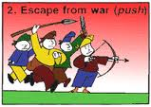
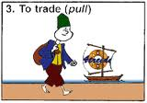
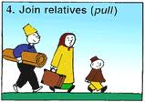
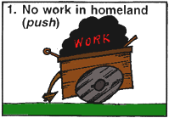
Push-Pull Factors
People decide to migrate because of push factors and pull factors.
A push factor causes people to move away.
A pull factor draws people in.
Both usually play a role in human migration.

Slide 14
The following terms are synonymous with push-pull
Push
Pull
Centripetal
Expel
Repulsion
Centrifugal
Attract
Attraction

Slide 15
Economic Push and Pull Factors
Most people migrate for economic reasons.
The relative attractiveness of a region can shift with economic change.

Slide 16
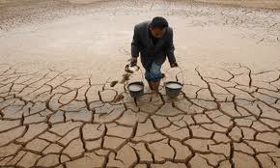
Environmental Push-Pull Factors
People also migrate for environmental reasons, pulled toward attractive places, and pushed from hazardous ones.
Attractive environments include; mountains, seasides, and warm climates.
Migrants also leave due to harsh conditions
Water (too much or too little) most common environmental threat

Slide 17
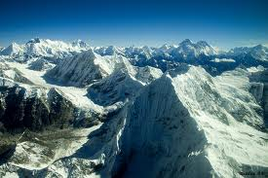
Intervening Obstacles
Migrants don’t always get to their desired destination. They may be blocked by an intervening obstacle.
A physical barrier (desert, mountain)
Bodies of water
But now, governments create obstacles

Slide 18
It really does equal

Slide 19
Remember Pull Factors are affected by distance decay.
Also most long migrations are carried out in steps, and can be halted by intervening opportunities.

Slide 20
Connections to Demographic Transition
Geographer Wilber Zelinsky has identified a migration transition with changes in society similar to those in demographic transition.
Stage 1 – unlikely to migrate permanently. Might have a high daily or seasonal mobility in search of food.
Stage 2 - have many emigrants
Stage 3 and 4 – receive many immigrants in search of economic opportunities.
Internal migration within countries in stage 3-4 is intraregional, from cities to surrounding suburbs.

Slide 21
Migration can be affected by a number of issues.
Legal Status- Do you receive a visa and what type is it? (Student. Tourist, Work)?
Economic Issues – Recessions lessen migration.
Power Relationships – Some areas prefer migrant laborers of one ethic/racial type over another.
Armed Conflict/Civil War
Environmental Conditions
Culture and Traditions – British Partition of India and ensuing migration.
Technological Advances – kinship links and chain migration.

Slide 22
AIM: Where do People Migrate?

Slide 23
Before 1500C.E.
Most long distance migrants were pursuing spices, fame or exploration

Slide 24
Major migration flows since 1500

Slide 25
Europeans pushed global migration from the 1500s until the early 1900s.
Before 1830 – 2.75 million Europeans left to settle overseas
Between 1835-1935, 75 million departed for colonies in Africa and Asia and economic opportunity in the Americas.

Slide 26
Slave Trade and Indentured Servitude
This accounted for the other major migration flow pre 1830, but it was driven by Europeans.
Until 1830, it was Africans Slaves to the Americas and Middle East.

Slide 27
Where did the British send South Asians as indentured servants?
The British also shipped 10s of thousands of South Asians to colonies in East and South Africa in the late 19th and early 20th centuries.
South Asians were also brought to the Malay Peninsula, and Trinidad & Tobago as well as Guyana.

Slide 28
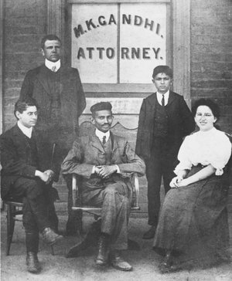
South Asians continued
Gandhi in South Africa
Freddie Mercury in Zanzibar

Slide 29
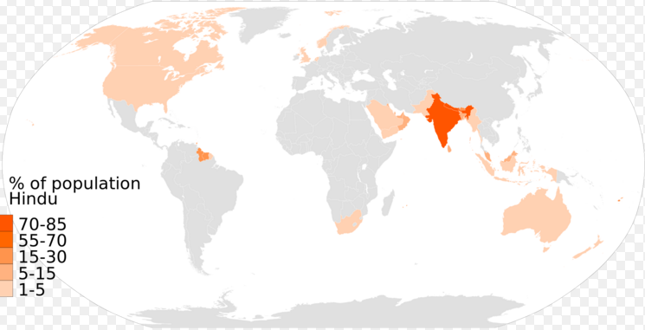
Hinduism Worldwide

Slide 30
Guest Workers
Western European governments call labor migrants guest workers.
Guest workers started arriving in Western Europe after WWII.
Both guest workers and their host countries regard the arrangement as temporary.
In reality, however, many guest workers remain indefinitely, especially if they are joined by other family members.
How are guest workers generally treated?

Slide 31
Attitudes toward Guest Workers
In Europe, many guest workers suffer from poor social conditions.
As a result of lower economic growth rates, Middle Eastern and Western European countries have reduced the number of guest workers in recent years.
Political parties that support restrictions on immigration have gained support in France, Germany, and other European countries, and attacks by local citizens on immigrants have increased.

Slide 32
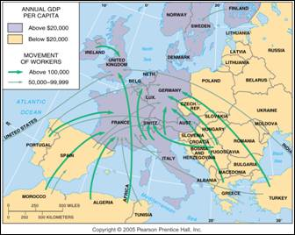
Guest Workers in Europe
Guest workers emigrate mainly from Eastern Europe and North Africa to work in the wealthier countries of Western Europe.

Slide 33
Turks in Germany
Were only granted citizenship in 2005 after being in the country for nearly 60 years.
This decision aided in their winning of the World Cup in 2014

Slide 34
Islands of Development
Port cities in developing countries that are the magnets for foreign investment, and providers of jobs.
They are generally in fairly stable countries, and have good infrastructure.
IE: Bangkok

