Slide 1
AIM: Why are some people who face hardship refugees while others are only migrants?
Do Now: Quiz

Slide 2
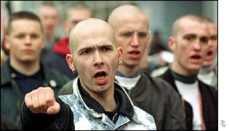
Attitudes toward Guest Workers
In Europe, many guest workers suffer from poor social conditions.
As a result of lower economic growth rates, Middle Eastern and Western European countries have reduced the number of guest workers in recent years.
Political parties that support restrictions on immigration have gained support in France, Germany, and other European countries, and attacks by local citizens on immigrants have increased.

Slide 3
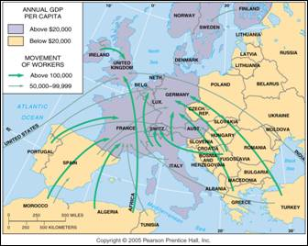
Guest Workers in Europe
Guest workers emigrate mainly from Eastern Europe and North Africa to work in the wealthier countries of Western Europe.

Slide 4
Turks in Germany
Were only granted citizenship in 2005 after being in the country for nearly 60 years.
This decision aided in their winning of the World Cup in 2014

Slide 5
Islands of Development
Port cities in developing countries that are the magnets for foreign investment, and providers of jobs.
They are generally in fairly stable countries, and have good infrastructure.
IE: Bangkok

Slide 6
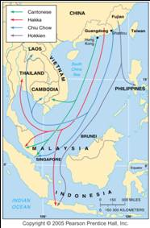
Time-contract Workers
Millions of Asians migrated in the nineteenth century as time-contract laborers, recruited for a fixed period to work in mines or on plantations.
More than 29 million ethnic Chinese currently live permanently in other countries, for the most part in Asia.
In recent years people have immigrated illegally in Asia to find work in other countries.
Estimates of illegal foreign workers in Taiwan range from 20,000 to 70,000.
Most are Filipinos, Thais, and Malaysians.
Various ethnic Chinese peoples have distinct patterns of migration to other Asian countries.

Slide 7
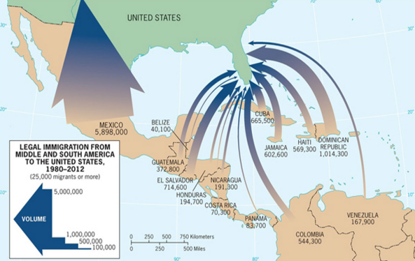

Slide 8
Why does intra-national migration occur?

Slide 9
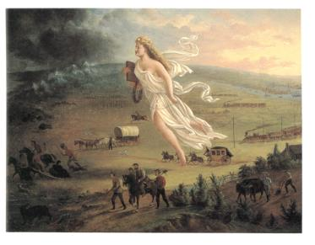
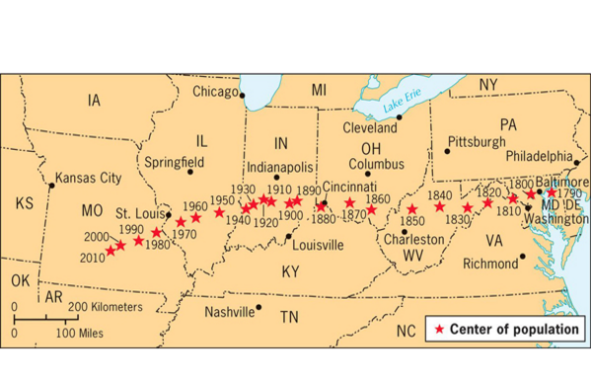
National Migration Flows
In the early 20th century, many African Americans migrated to northern cities in the USA.
The U.S.A. center of population has moved steadily westward and southward.
Manifest Destiny!
“American Progress” by John Gast (1872)

Slide 10
Russification
The Russian attempt to assimilate all people in Soviet territory to Russian culture.
Many ethnic Russians moved to the frontier including Siberia.

Slide 11
Reading 1
1. Why is the United States willing to fund projects in South America?
2. How could President Trump sabotage these efforts?
3. What types of projects are the U.S. funding in El Salvador and Honduras?

Slide 12
Reading 2
1. Why is the Egyptian government committed to building 2 extra megacities around Cairo?
Why are affluent Egyptians moving to these newly developed areas?
Why are less well off people not happy living in the new affordable housing developments?

Slide 13
New Cairo

Slide 14
New Cairo

Slide 15
Intra-Mexican Migration
Many Southern Mexicans have moved to Northern Mexico to take the jobs abandoned by Northern Mexicans who had moved to the USA to take American jobs.
Northern Mexican discriminate against southern Mexicans like the Huichol Indians in similar ways to how Americans discriminate against Mexicans.

Slide 16
Refugee
“A person with a well-founded fear of being persecuted for reasons of race, religion, nationality, membership of a particular social group, or political opinion.” – 1951 Refugee Convention
Different from an Internally Displaced Person (someone forced to leave home, but not their country) Think those displaced by Super-storm Sandy.

Slide 17
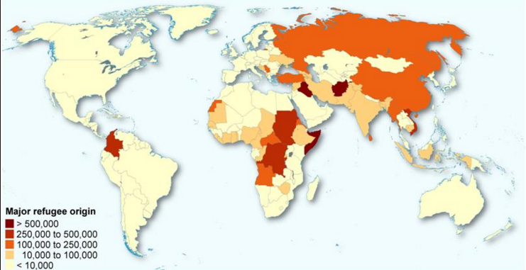
Where Refugees Come From

Slide 18
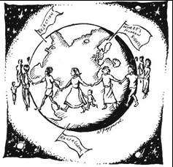
Distinguishing between Economic Migrants and Refugees
It is sometimes difficult to distinguish between migrants seeking economic opportunities and refugees fleeing from the persecution of an undemocratic government.
The distinction between economic migrants and refugees is important, because the United States, Canada, and Western European countries treat the two groups differently.

Slide 19
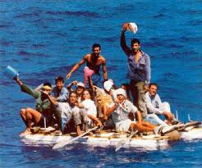
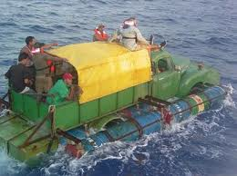
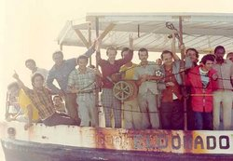
Emigrants from Cuba
Since the 1959 revolution that brought the Communist government of Fidel Castro to power, the U.S. government has regarded emigrants from Cuba as political refugees.
In the years immediately following the revolution, more than 600,000 Cubans were admitted to the United States.
A second flood of Cuban emigrants reached the United States in 1980, when Fidel Castro suddenly decided to permit political prisoners, criminals, and mental patients to leave the country.

Slide 20
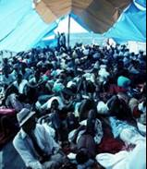
Emigrants from Haiti
Shortly after the 1980 Mariel boatlift from Cuba, several thousand Haitians also sailed in small vessels for the United States.
Claiming that they had migrated for economic advancement,. . . U.S. immigration officials would not let the Haitian boat people stay.
The Haitians brought a lawsuit.
The government settled the case by agreeing to admit the Haitians.
After a 1991 coup that replaced Haiti’s elected president, Jean-Bertrand Aristide, thousands of Haitians fled their country.. . but the U.S. State Department decided that most left Haiti for economic rather than political reasons.
The United States invaded Haiti in 1994 to reinstate Aristide as president.
Many Haitians still try to migrate to the United States.

Slide 21
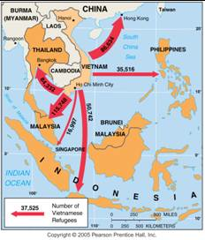
Migration of Vietnamese Boat People
Many Vietnamese fled by sea as refugees after the war with the U.S. ended in 1975. Later boat people were often considered economic migrants.

Slide 22
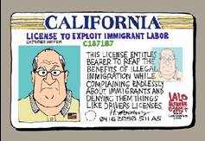
Cultural Problems Living in Other Countries
For many immigrants, admission to another country does not end their problems.
Politicians exploit immigrants as scapegoats for local economic problems.

Slide 23
What are some of the more common problems an immigrant can face in the USA?

Slide 24
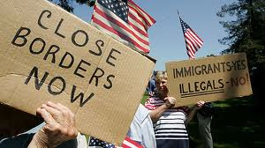
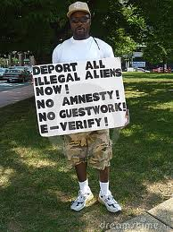
U.S. Attitudes toward Immigrants
Americans have always regarded new arrivals with suspicion but tempered their dislike during the nineteenth century because immigrants helped to settle the frontier and extend U.S. control across the continent.
Opposition to immigration intensified when the majority of immigrants ceased to come from Northern and Western Europe.
More recently, hostile citizens in California and other states have voted to deny undocumented immigrants access to most public services, such as schools, day-care centers, and health clinics.

Slide 25
Current Largest Refugee Groups
Syrians
Palestinians
Columbians
Afghanis
Kurds
Sudanese
Sri Lankan Tamils

Slide 26
AIM: How do governments affect migration?
Do Now: Why are some people opposed to new immigrants in the United States?

Slide 27
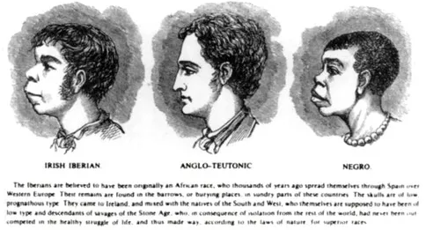
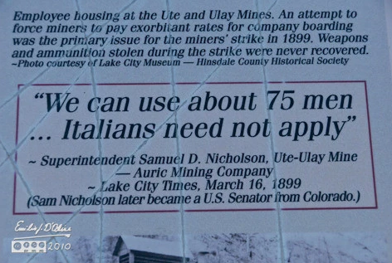
We have a history of discriminating against new immigrants.

Slide 28
Historical Attempts to Keep Foreigners Out
The Great Wall of China
King Edward I kicked the Jews out of England in 1290.
The United States passed the Chinese Exclusion Act in 1882 in order to limit immigration from anywhere other than Western and Northern Europe.
In 1901, Australia passed a law banning all non-white immigration into Australia.

Slide 29
U.S. Quota Laws
The era of unrestricted immigration to the United States, ended when Congress passed the Quota Act in 1921 and the National Origins Act in 1924.
Quota laws were designed to assure that most immigrants to the United States continued to be Europeans.
Quotas for individual countries were eliminated in 1968 and replaced with hemispheric quotas.
In 1978 the hemisphere quotas were replaced by a global quota of 290,000, including a maximum of 20,000 per country.
The current law has a global quota of 620,000, with no more than 7 percent from one country, but numerous qualifications and exceptions can alter the limit considerably.

Slide 30
Brain Drain
Other countries charge that by giving preference to skilled workers, U.S. immigration policy now contributes to a brain drain, which is a large-scale emigration by talented people.
The average immigrant has received more education than the typical American: nearly one-fourth of all legal immigrants to the United States have attended graduate school, compared to less than one-tenth of native-born Americans.

Slide 31
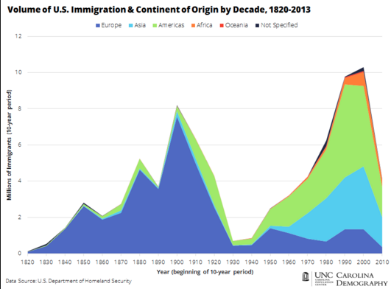
Major Waves of Migration to the United States

Slide 32
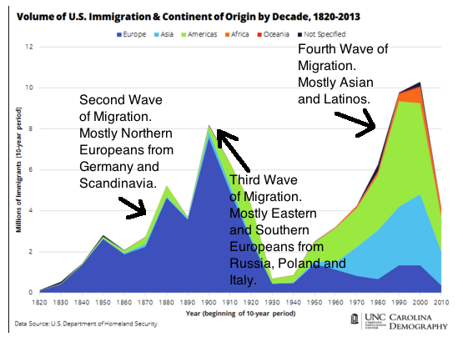

Slide 33
First Peak of European Immigration
From 1607.. . until 1840, a steady stream of Europeans (totaling 2 million) migrated to the American colonies and after 1776. . . the United States.
Ninety percent of European immigrants. . . prior to 1840 came from Great Britain. During the 1840s and 1850s, the level of immigration. . . surged.
More than 4 million people migrated,.. . more than twice as many as in the previous 250 years combined.
More than 90 percent of all U.S. immigrants during the 1840s and 1850s came from Northern and Western Europe, including two fifths from Ireland and another one third from Germany.

Slide 34
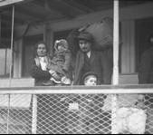
Second Peak of European Immigration
U.S. immigration declined somewhat during the 1860s as a result of the Civil War (1861—1865).
A second peak was reached during the 1880s, where more than a half- million people, more than three-fourths during the late 1880s, came from Northern and Western Europe. (Sweden and Germany)

Slide 35
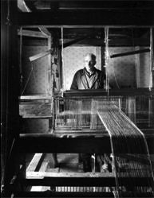
Third Peak of European Immigration
Economic problems in the United States discouraged immigration during the early 1890s, but by the end of the decade the level reached a third peak.
During this time, most people came from Italy, Russia, and Austria-Hungary, places that previously had sent few people.
The record year was 1907, with 1.3 million.
The shift coincided with the diffusion of the Industrial Revolution.. . to Southern and Eastern Europe.

Slide 36
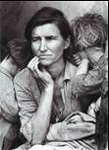
Recent Immigration from Less Developed Regions
Immigration to the United States dropped sharply in the 1930s and 1940s, during the Great Depression and World War II, then it steadily increased during the 1950s, 1960s, and 1970s.
It surged during the 1980s and 1990s to historically high levels.

Slide 37
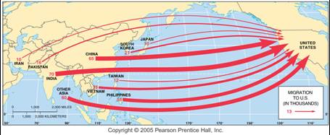
Migration from Asia to the U.S.
Migration in 2001. The largest numbers of migrants from Asia come from India, China, the Philippines, and Vietnam.

Slide 38
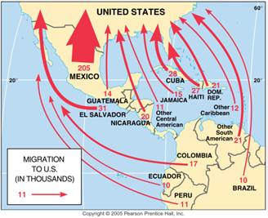
Migration from Latin America to the U.S.
Mexico has been the largest source of migrants to the U.S., but migrants have also come from numerous other Latin American nations.

Slide 39
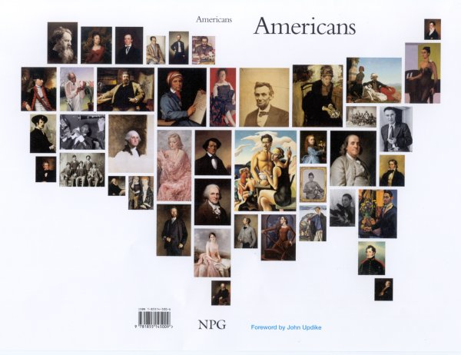
Impact of Immigration on the United States
The U.S. population has been built up through a combination of emigration from Africa and England primarily during the eighteenth century, from Europe primarily during the nineteenth century, and from Latin America and Asia primarily during the twentieth century.
In the twenty-first century, the impact of immigration varies around the country.
Massive European migration ended with the start of World War I.

Slide 40
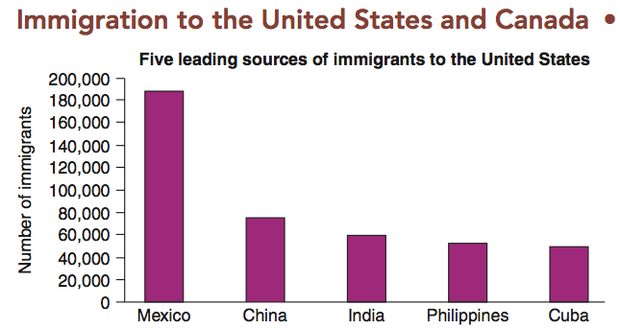

Slide 41
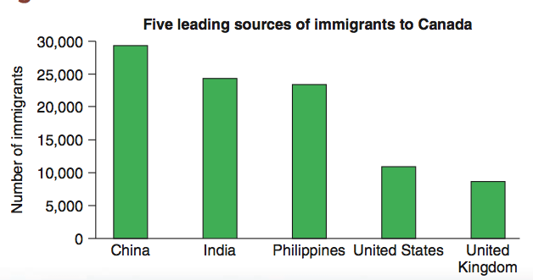

Slide 42
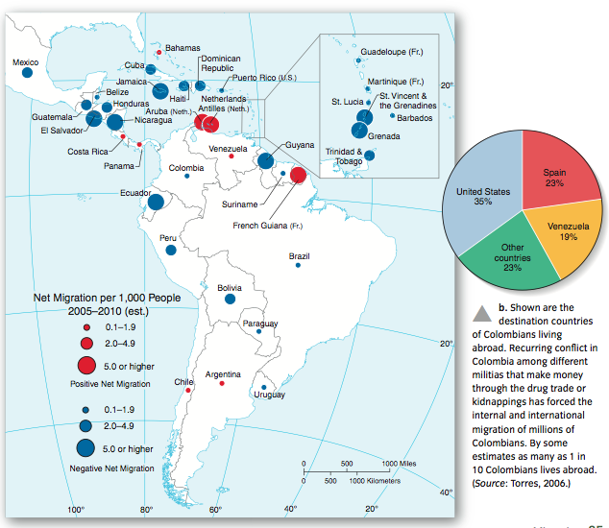

Slide 43
Europe’s Demographic Transition.
Rapid population growth in Europe fueled emigration, especially after 1800.
Application of new technologies.. . pushed much of Europe into stage 2 of the demographic transition.
To promote more efficient agriculture, some European governments forced the consolidation of several small farms into larger units.
Displaced farmers could choose between working in factories in the large cities or migrating to the United States or another country where farmland was plentiful.

Slide 44
Diffusion of European Culture
Europeans frequently imposed political domination on existing populations and injected their cultural values with little regard for local traditions.
Economies in Africa and Asia became based on extracting resources for export to Europe, rather than on using those resources to build local industry.
Many of today’s conflicts in former European colonies result from past practices by European immigrants.

Slide 45
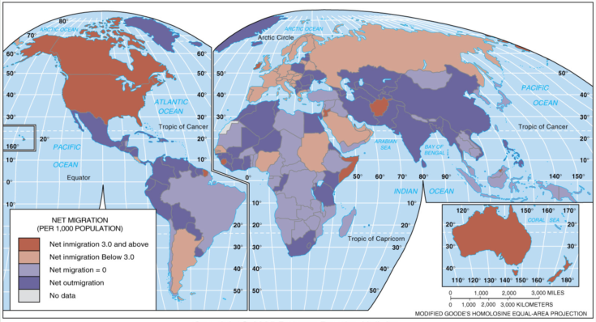
Net Migration (per population)
Net migration per 1,000 population. The U.S. has the largest number of immigrants, but other developed countries also have relatively large numbers.

Slide 46
Post-9/11 World
Many of the westernized countries are adopting more selective screening methods for in-migration in an attempt to keep undesirables out.
Many have proposed building a large wall on the U.S./Mexican border.
The current crisis in Syria has prompted more internal strife in the Western world over how to handle an large influx of refugees.
This is especially pertinent after the recent “terror” attacks in Paris. It appears at least one of the attackers came from Syria, and posed as a refugee.

