Slide 1
AIM: How do governments affect migration?
Do Now: Why are some people opposed to new immigrants in the United States?

Slide 2
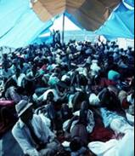
Emigrants from Haiti
Shortly after the 1980 Mariel boatlift from Cuba, several thousand Haitians also sailed in small vessels for the United States.
Claiming that they had migrated for economic advancement,. . . U.S. immigration officials would not let the Haitian boat people stay.
The Haitians brought a lawsuit.
The government settled the case by agreeing to admit the Haitians.
After a 1991 coup that replaced Haiti’s elected president, Jean-Bertrand Aristide, thousands of Haitians fled their country.. . but the U.S. State Department decided that most left Haiti for economic rather than political reasons.
The United States invaded Haiti in 1994 to reinstate Aristide as president.
Many Haitians still try to migrate to the United States.

Slide 3
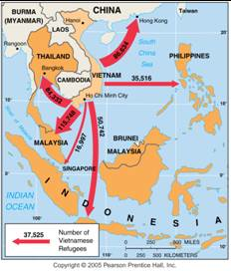
Migration of Vietnamese Boat People
Many Vietnamese fled by sea as refugees after the war with the U.S. ended in 1975. Later boat people were often considered economic migrants.

Slide 4
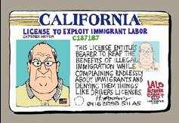
Cultural Problems Living in Other Countries
For many immigrants, admission to another country does not end their problems.
Politicians exploit immigrants as scapegoats for local economic problems.

Slide 5
What are some of the more common problems an immigrant can face in the USA?

Slide 6
U.S. Attitudes toward Immigrants
Americans have always regarded new arrivals with suspicion but tempered their dislike during the nineteenth century because immigrants helped to settle the frontier and extend U.S. control across the continent.
Opposition to immigration intensified when the majority of immigrants ceased to come from Northern and Western Europe.
More recently, hostile citizens in California and other states have voted to deny undocumented immigrants access to most public services, such as schools, day-care centers, and health clinics.

Slide 7
Current Largest Refugee Groups
Syrians
Palestinians
Columbians
Afghanis
Kurds
Sudanese
Sri Lankan Tamils

Slide 8
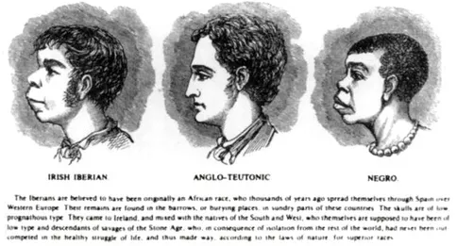
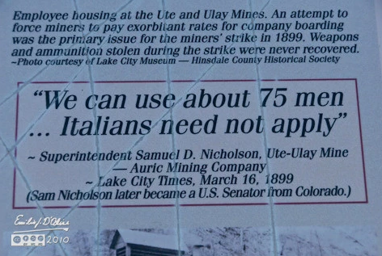
We have a history of discriminating against new immigrants.

Slide 9
Historical Attempts to Keep Foreigners Out
The Great Wall of China
King Edward I kicked the Jews out of England in 1290.
The United States passed the Chinese Exclusion Act in 1882 in order to limit immigration from anywhere other than Western and Northern Europe.
In 1901, Australia passed a law banning all non-white immigration into Australia.

Slide 10
U.S. Quota Laws
The era of unrestricted immigration to the United States, ended when Congress passed the Quota Act in 1921 and the National Origins Act in 1924.
Quota laws were designed to assure that most immigrants to the United States continued to be Europeans.
Quotas for individual countries were eliminated in 1968 and replaced with hemispheric quotas.
In 1978 the hemisphere quotas were replaced by a global quota of 290,000, including a maximum of 20,000 per country.
The current law has a global quota of 620,000, with no more than 7 percent from one country, but numerous qualifications and exceptions can alter the limit considerably.

Slide 11
Brain Drain
Other countries charge that by giving preference to skilled workers, U.S. immigration policy now contributes to a brain drain, which is a large-scale emigration by talented people.
The average immigrant has received more education than the typical American: nearly one-fourth of all legal immigrants to the United States have attended graduate school, compared to less than one-tenth of native-born Americans.

Slide 12
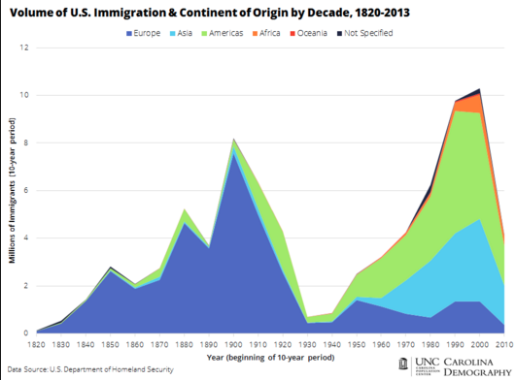
Major Waves of Migration to the United States

Slide 13
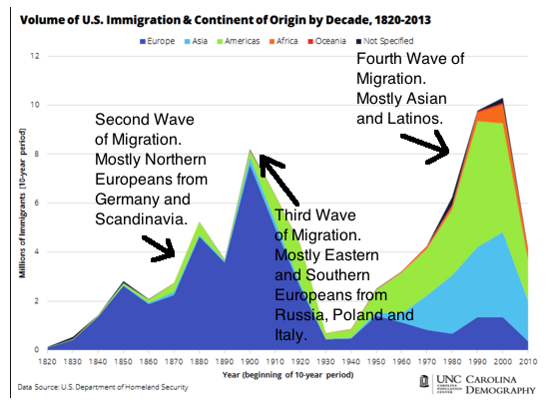

Slide 14
First Peak of European Immigration
From 1607.. . until 1840, a steady stream of Europeans (totaling 2 million) migrated to the American colonies and after 1776. . . the United States.
Ninety percent of European immigrants. . . prior to 1840 came from Great Britain. During the 1840s and 1850s, the level of immigration. . . surged.
More than 4 million people migrated,.. . more than twice as many as in the previous 250 years combined.
More than 90 percent of all U.S. immigrants during the 1840s and 1850s came from Northern and Western Europe, including two fifths from Ireland and another one third from Germany.

Slide 15
Second Peak of European Immigration
U.S. immigration declined somewhat during the 1860s as a result of the Civil War (1861—1865).
A second peak was reached during the 1880s, where more than a half- million people, more than three-fourths during the late 1880s, came from Northern and Western Europe. (Sweden and Germany)

Slide 16
Third Peak of European Immigration
Economic problems in the United States discouraged immigration during the early 1890s, but by the end of the decade the level reached a third peak.
During this time, most people came from Italy, Russia, and Austria-Hungary, places that previously had sent few people.
The record year was 1907, with 1.3 million.
The shift coincided with the diffusion of the Industrial Revolution.. . to Southern and Eastern Europe.

Slide 17
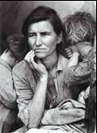
Recent Immigration from Less Developed Regions
Immigration to the United States dropped sharply in the 1930s and 1940s, during the Great Depression and World War II, then it steadily increased during the 1950s, 1960s, and 1970s.
It surged during the 1980s and 1990s to historically high levels.

Slide 18
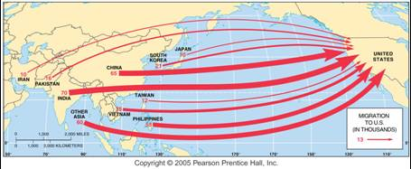
Migration from Asia to the U.S.
Migration in 2001. The largest numbers of migrants from Asia come from India, China, the Philippines, and Vietnam.

Slide 19
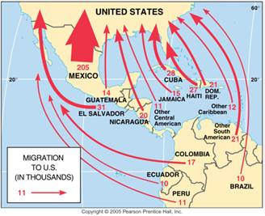
Migration from Latin America to the U.S.
Mexico has been the largest source of migrants to the U.S., but migrants have also come from numerous other Latin American nations.

Slide 20
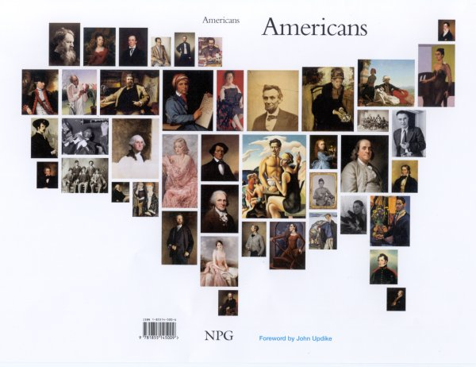
Impact of Immigration on the United States
The U.S. population has been built up through a combination of emigration from Africa and England primarily during the eighteenth century, from Europe primarily during the nineteenth century, and from Latin America and Asia primarily during the twentieth century.
In the twenty-first century, the impact of immigration varies around the country.
Massive European migration ended with the start of World War I.

Slide 21
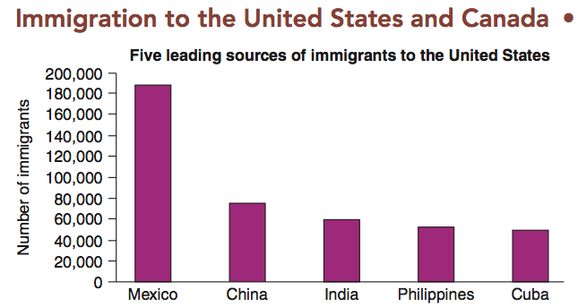

Slide 22
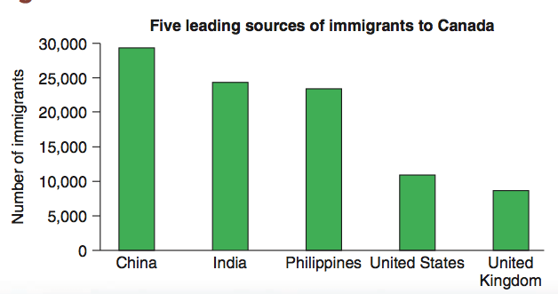

Slide 23
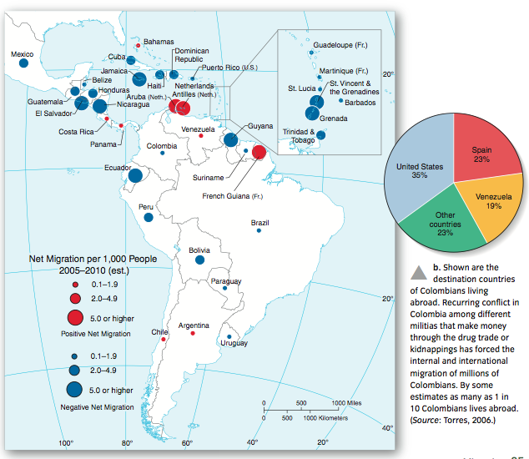

Slide 24
AIM: How is migration relevant to our world today?
Do Now: Finish migration notes.

Slide 25
Europe’s Demographic Transition.
Rapid population growth in Europe fueled emigration, especially after 1800.
Application of new technologies.. . pushed much of Europe into stage 2 of the demographic transition.
To promote more efficient agriculture, some European governments forced the consolidation of several small farms into larger units.
Displaced farmers could choose between working in factories in the large cities or migrating to the United States or another country where farmland was plentiful.

Slide 26
Diffusion of European Culture
Europeans frequently imposed political domination on existing populations and injected their cultural values with little regard for local traditions.
Economies in Africa and Asia became based on extracting resources for export to Europe, rather than on using those resources to build local industry.
Many of today’s conflicts in former European colonies result from past practices by European immigrants.

Slide 27
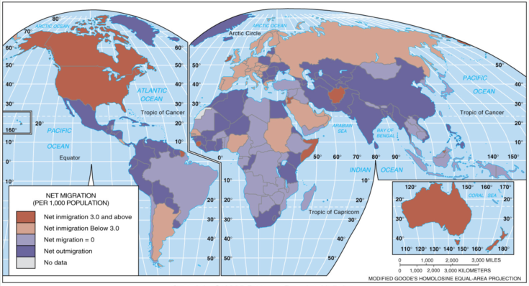
Net Migration (per population)
Net migration per 1,000 population. The U.S. has the largest number of immigrants, but other developed countries also have relatively large numbers.

Slide 28
Post-9/11 World
Many of the westernized countries are adopting more selective screening methods for in-migration in an attempt to keep undesirables out.
Many have proposed building a large wall on the U.S./Mexican border.
The current crisis in Syria has prompted more internal strife in the Western world over how to handle an large influx of refugees.
This is especially pertinent after the recent “terror” attacks in Paris. It appears at least one of the attackers came from Syria, and posed as a refugee.

Slide 29
Climate migration muddied by legal confusion in Pacific islands

Slide 30
When and how can foreign aid slow migration?
Children play in a makeshift refugee camp of the northern Greek border point of Idomeni, Greece, in May 2016. (AP)

