Slide 1
AIM: Why do we study languages?
Do Now: Which language is the most spoken native language on earth?

Slide 2
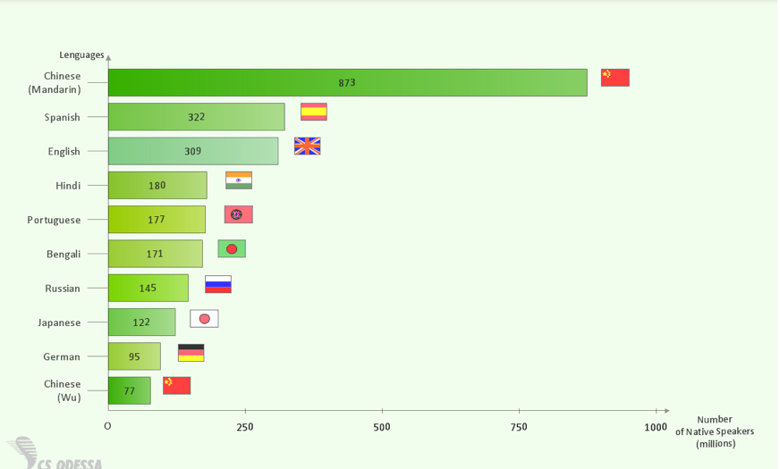
Most Spoken Languages

Slide 3
Unit 4: Languages
"Language is arguably the most important of the cultural universals. This is not to question the significance of religion or other traits: but language is essential to communicating and sharing many aspects of culture.“ - Charles Heatwole

Slide 4
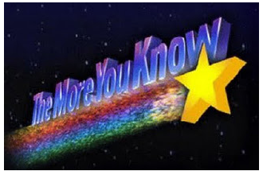
Language – n - a system of communication based on symbols that have agreed upon meanings.
Dialect – n – a particular variety of a language characterized by distinctive vocabulary, grammar, and/or pronunciation

Slide 5
Language and Communication
Many languages also have a literary tradition, or a system of written communication.
The lack of written record makes it difficult to document the distribution of many languages.

Slide 6
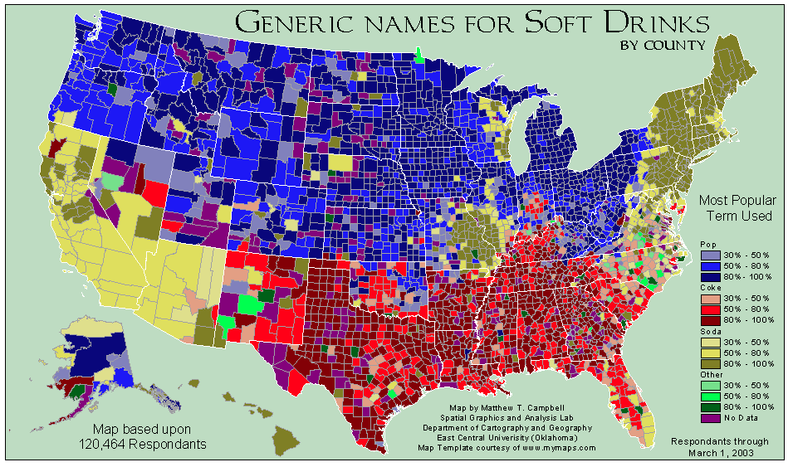
Dialect in action (Soda vs. Pop)

Slide 7
Dialect

Slide 8
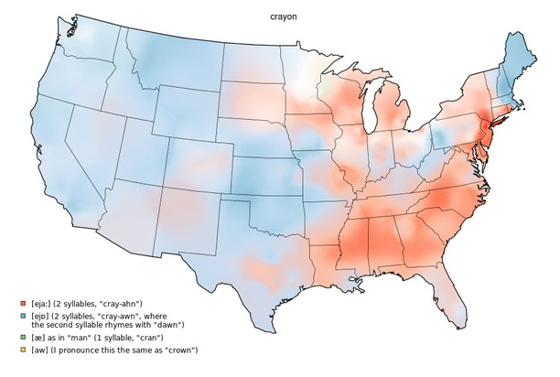
Dialect

Slide 9
What is this?

Slide 10
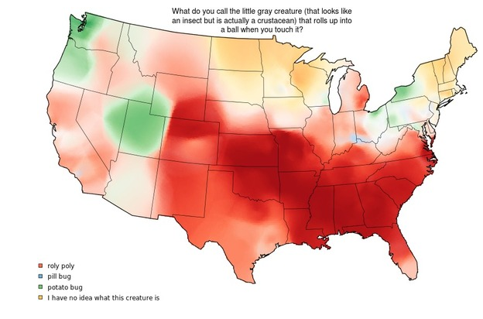
Dialect

Slide 11
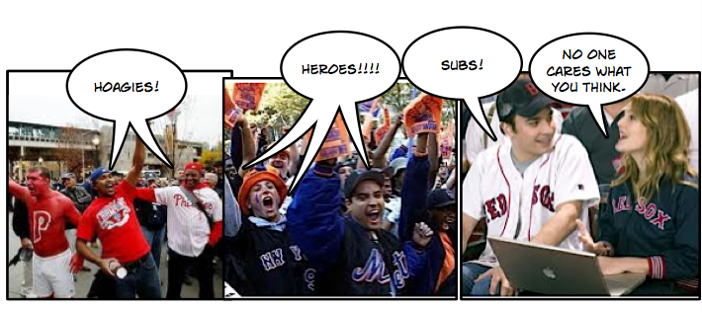
What do you call a big sandwich?

Slide 12
Environmental terminology
Your environment can affect the development of your language.
Languages tend to develop large vocabularies that relate to locally observed environmental conditions, and weak vocabularies that relate to unfamiliar settings.
English, for example, is weak in native terminology for deserts, the sub-arctic, very mountainous areas, and other characteristics that are not common to England.

Slide 13
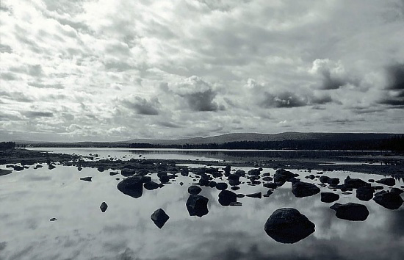
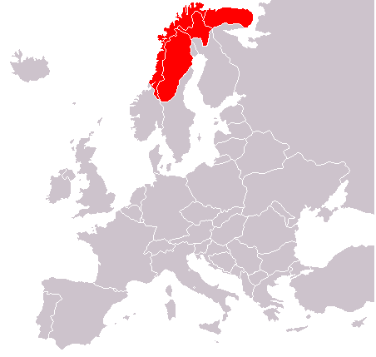
Environmental Factors on Language
The European Sami People, an indigenous circumpolar group, have hundreds of words for snow.

Slide 14
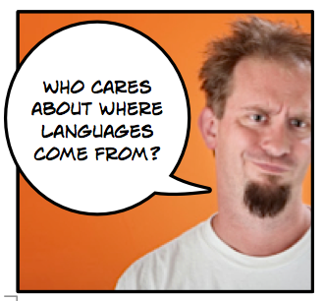

Slide 15
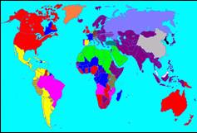
World of Tongues
Earth’s heterogeneous collection of languages is one of its most obvious examples of cultural diversity.
Estimates of distinct languages in the world range from 2,000 to 4,000.
Aside from the 10 largest languages,
About 100 languages are spoken by at least 5 million people
And, only about 70 languages are spoken by at least 2 million people.

Slide 16
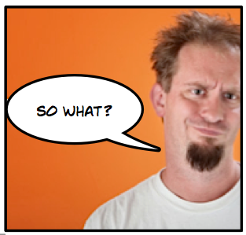

Slide 17
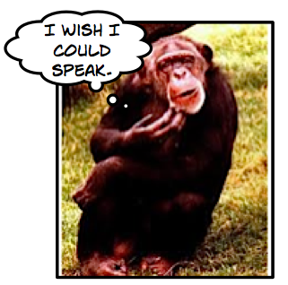
Without language, we wouldn’t be much more advanced than this.

Slide 18
Languge
The Key Issues are:
Where are English-language speakers distributed?
Why is English related to other languages?
Where are other language families distributed?
Why do people preserve local languages?

Slide 19
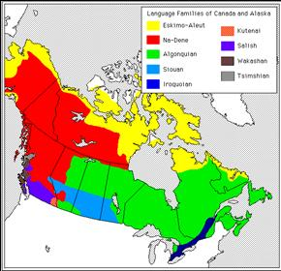
Countries and Languages
Countries usually designate at least one language as their official language.
A country with more than one official language may require all public documents to be in all languages.

Slide 20
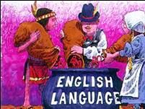
Languages Today
The study of language follows logically from migration, because the current distribution of languages around the world resulted largely from past migrations.
On the one hand, English has achieved an unprecedented globalization.
On the other hand, people are trying to preserve local diversity in language.
The global distribution of languages results from a combination of two geographic processes—interaction and isolation.

Slide 21
The global distribution of languages results from a combination of two geographic processes—interaction and isolation.
How do these processes impact language?

Slide 22
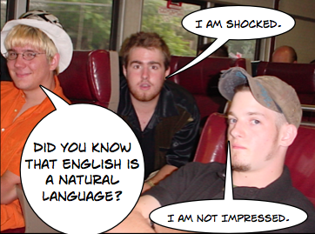
There are a few types of languages
Natural Languages – Languages that people use in every day life that evolved within living or historic communities.
Ie; English, Chinese, (all official languages)

Slide 23
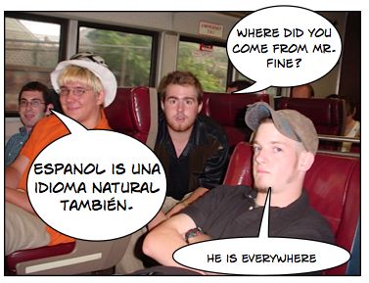

Slide 24
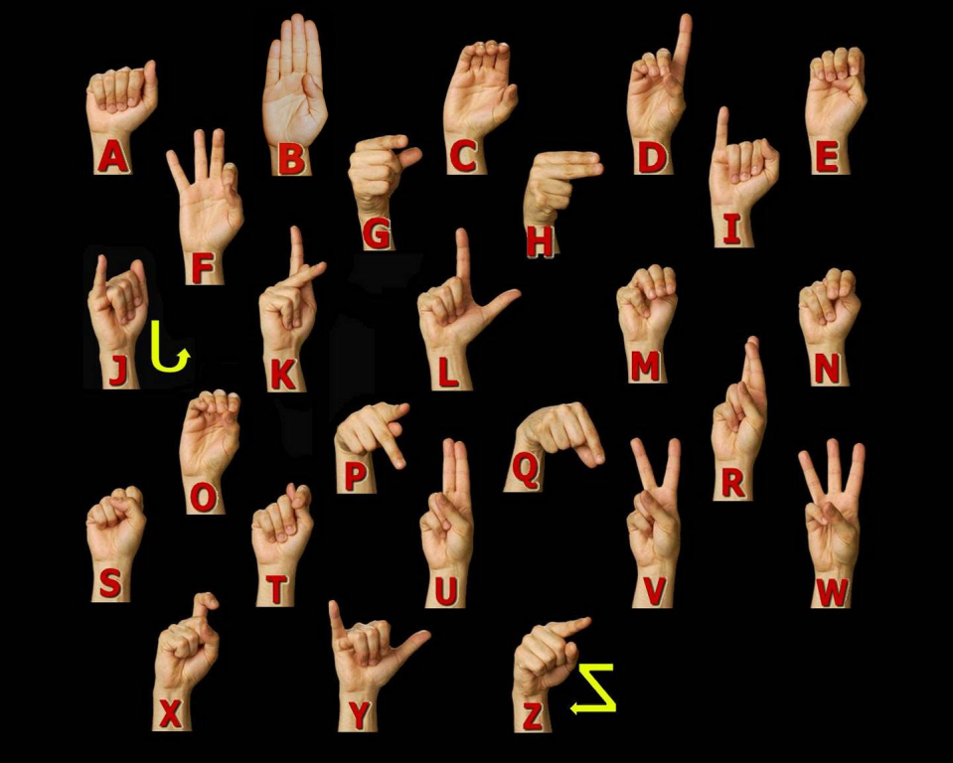
Body Languages
American Sign Language – only used in the USA, predominantly by the hearing impaired.
Gestures we all understand.

Slide 25
AIM: What are languages, and what role do they play in cultures?
Do Now: Why don’t the French understand a term a “quarter pounder with cheese” when they go to McDonalds?

Slide 26
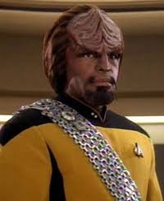
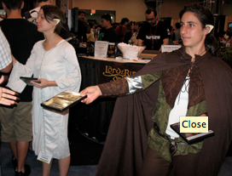
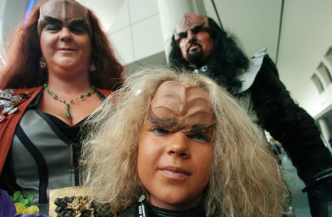
Artificial Languages
Elvish
Klingon
Dothraki

Slide 27
Universal Language
Esperanto – an artificial language created by a Polish doctor in the 19th century with the goal of creating one language for the earth.
Today somewhere between 1-15 million people speak it worldwide

Slide 28
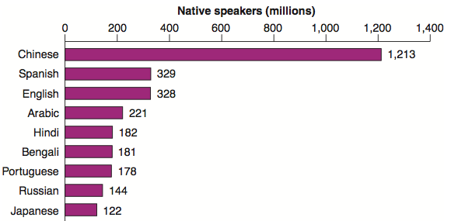
10 most major languages today.

Slide 29
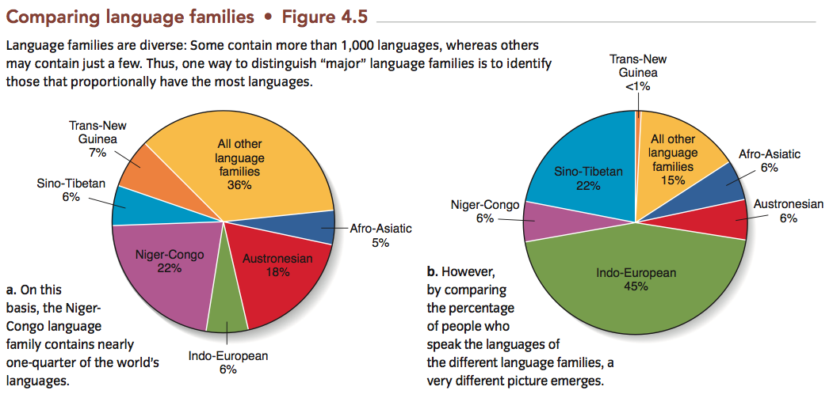

Slide 30
Language Family
A collection of languages that share a common, but distant ancestor.

Slide 31
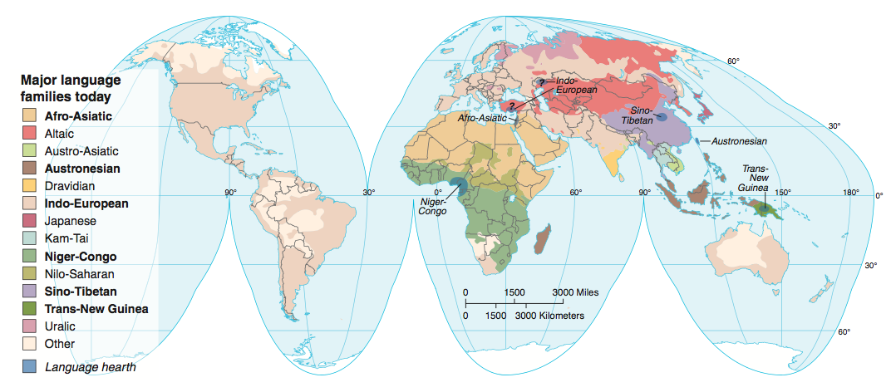
Major Language Families Today

Slide 32
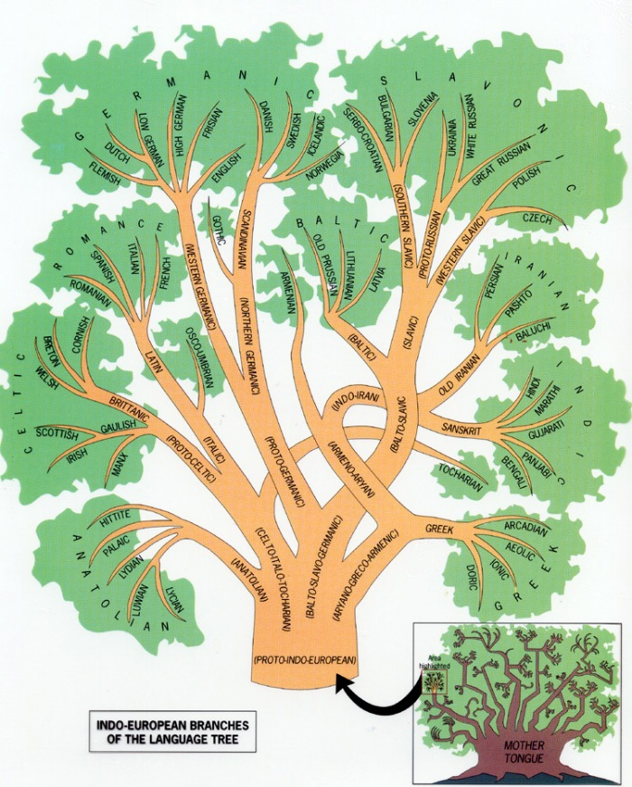
Indo-European Language Tree
The Indo-European language family developed as a result of migration and subsequent isolation of people that can only be reconstructed through linguistic and archaeological theories.

Slide 33
Why have the French been obsessed with protecting their language?
The 1994 law demands the creation of French translations for globalized words.
I.E. e-mail= “courrier electronique”

Slide 34
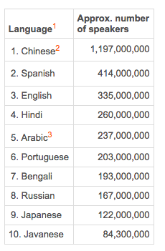
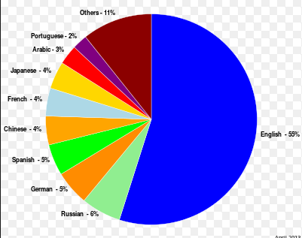
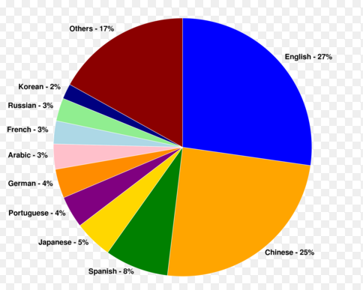
Languages Used on the Internet
Internet Content by language
Internet users by Native Language

Slide 35
Historically, how can the use of a specific language be used as a weapon?

Slide 36
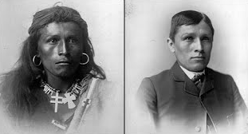
Languages Help Make Culture
If you want to rob a culture of it’s heritage, steal it’s language.
I.E.
Dawes Act – USA
Russia, Canada, New Zealand and Australia passed similar laws.

Slide 37
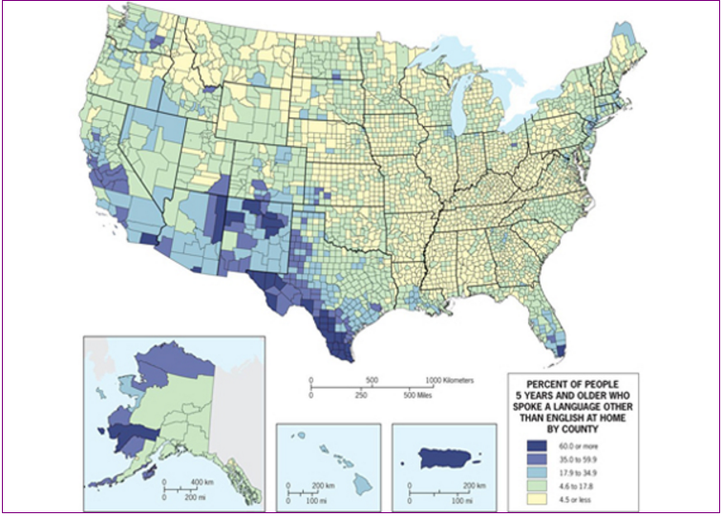
How diverse is the USA

Slide 38
Should the USA have an official language?

Slide 39
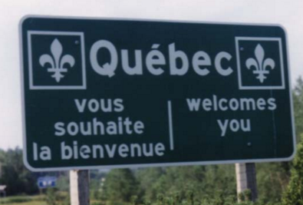
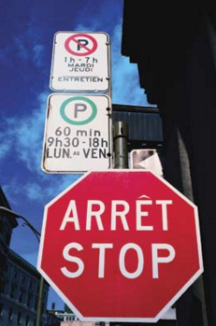
How has the Canadian Province of Quebec reinforced ties to France?
People who move to Quebec must learn French.
Maintains an embassy-like entity in Paris.
French must be more prominent than English on public signs.

Slide 40
Why are all Arabic speakers considered to be speaking the same language whereas Danish and Norwegian speakers are not? Danish and Norwegian can have mutual intelligibility.

Slide 41
Vocabulary
Standard Language – a language that is published, widely distributed and purposely taught
Dialect Chains – the closer the dialects are located to each other, the closer they are related.
Isogloss – a geographic boundary within which a particular linguistic feature occurs. (language border)

Slide 42
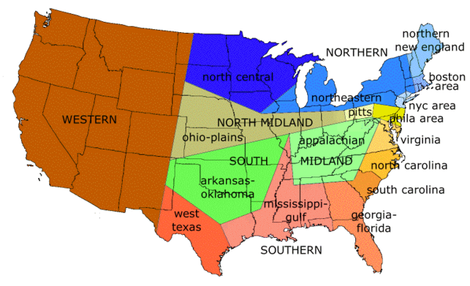
Dialect Isoglosses

