Slide 1
AIM: Where are English-language speakers distributed?
Do Now: Name one new word that has been recently added to the English dictionary.

Slide 2
Quiz 1

Slide 3
New Words added to the Oxford English Dictionary in 2018
Biohacking
Bingeable
Adorbs
Rando

Slide 4
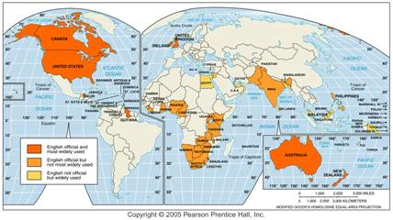
English Speaking Countries
English is the official language in 42 countries, including some in which it is not the most widely spoken language. It is also used and understood in many others.

Slide 5
Why is English used in so many parts of the world?

Slide 6
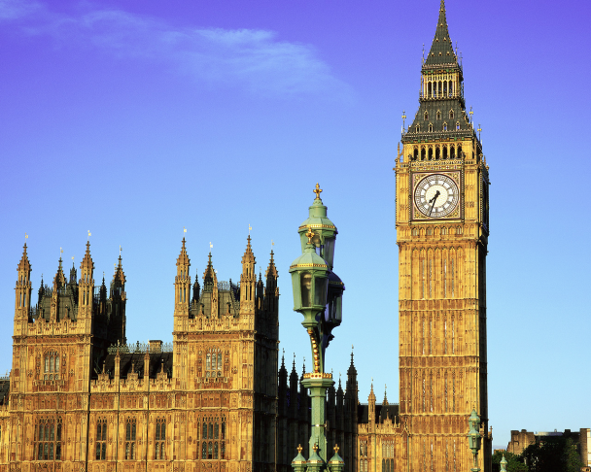
Origin and Diffusion of English
The contemporary distribution of English speakers around the world exists b/c the people of England migrated with their language when they established colonies during the past four centuries.
English first diffused west from England to North America in the seventeenth century.
More recently, the United States has been responsible for diffusing English to several places, like the Philippines.

Slide 7
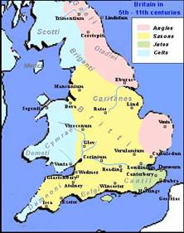
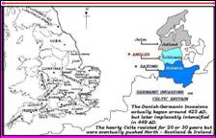
Basis of English
English originated with three invading Germanic groups who settled in different parts of Britain. (Anglos, Saxons, Jutes)
These languages, along with French, helped form English.

Slide 8
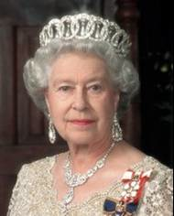
The Queen’s English/ British Received Pronunciation.
English has an especially large number of dialects.
One particular dialect of English, the one associated with upper-class Britons living in the London area, is recognized in much of the English-speaking world as the standard form of British speech, known as British Received Pronunciation (BRP).

Slide 9
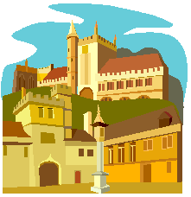
British Universities
Grammar books and dictionaries printed in the eighteenth century established rules for spelling and grammar that were based on the London dialect.

Slide 10
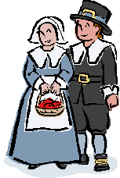
Differences between American and British English
The earliest colonists were most responsible for the dominant language patterns that exist today in the English-speaking part of the Western Hemisphere.

Slide 11
Differences in Vocabulary and Spelling
Since English in the United States and England evolved independently during the eighteenth and nineteenth centuries. U.S. English differs from that of England in three ways: vocabulary, spelling, and pronunciation.

Slide 12
Why might vocabulary change?
The vocabulary is different because settlers in America encountered many new objects and experiences, which were given names borrowed from Native Americans.
As new inventions appeared, they acquired different names on either side of the Atlantic. (elevator vs. lift)

Slide 13
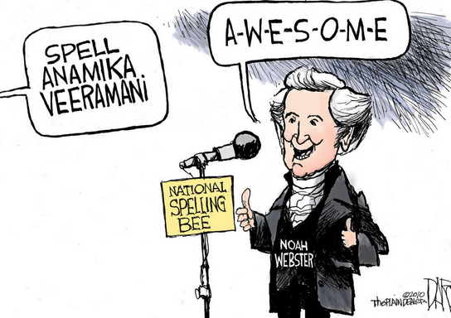
And why is the spelling different?
Spelling diverged because of a strong national feeling in the United States for an independent identity.

Slide 14
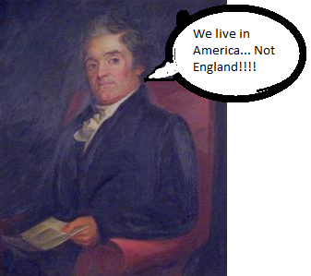
Webster’s Dictionary
Noah Webster, the creator of the first comprehensive American dictionary and grammar books, argued that spelling and grammar reforms would help establish a national language, reduce cultural dependence on England, and inspire national pride.

Slide 15
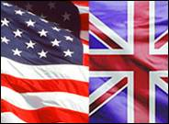
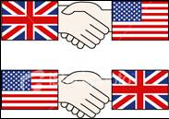
Differences in Pronunciation
Interaction between the two groups was largely confined to exchange of letters and other printed matter rather than direct speech. So we developed different accents.
Surprisingly, pronunciation has changed more in England than in the United States.
People in the United States do not speak “proper” English because when the colonists left England, “proper” English was not what it is today.

Slide 16
British Slang Words Below are a few slang words commonly used in Britain.
Bloke - man. 'John is a nice bloke to know.'
Botched - poor quality repairs. 'He made a botched job of fixing the television.'
Bottle - courage. 'He doesn't have the bottle to ask her.'
Cheesed Off - fed up
Chuck it down - to rain, often heavily. 'It is going to chuck it down soon.'
Chuffed - If you are chuffed, you are happy with something. 'I was chuffed to win a medal!'
Daft - Crazy / stupid
Dosh - Money / cash 'I haven't got much dosh to give you.'
Gobsmacked - Incredibly amazed. 'I was gobsmacked when I saw my birthday presents.

Slide 17
More Slang!
Gutted - Not happy because of an event that has occurred that didn't go your way. 'I was gutted when I didn't win the race'
Jammy - Used in place of lucky when describing someone else. 'He was very jammy winning the lottery'.
Scrummy - Delicious. Shortened from scrumptious. 'The food was very scrummy'
Skint - Broke. No money. 'I'm skint, I wont be able to buy the DVD today.'
to Snog - to long kiss
Telly – Television 'I watched the news on the telly last night.'

Slide 18
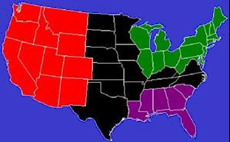
Dialects in the United States
Major differences in U.S. dialects originated because of differences in dialects among the original settlers.
The original American settlements can be grouped into three areas: New England, Middle Atlantic, and Southeastern.

Slide 19
New England – Southeast England
Two-thirds of the New England colonists were Puritans from East Anglia in southeastern England.

Slide 20
Southeast USA= Southeast England
About half of the southeastern settlers came from southeast England, although they represented a diversity of social-class backgrounds.

Slide 21
Mid-Atlantic Region-North England
The immigrants to the Middle Atlantic colonies were more diverse because most of the settlers came from the north rather than the south of England or from other countries.

Slide 22
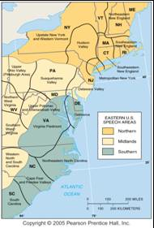
Dialects in the Eastern U.S.
Hans Kurath divided the eastern U.S. into three dialect regions, whose distribution is similar to that of house types.

Slide 23
20th Century Homogeny
Many words that were once regionally distinctive are now national in distribution.
Mass media, especially television and radio, influence the adoption of the same words throughout the country.

Slide 24
Regional Pronunciation
Regional pronunciation differences are more familiar to us than word differences, although it is harder to draw precise isoglosses for them.
The New England accent is well known for dropping the /r/ sound, shared with speakers from the south of England.
Residents of Boston maintained especially close ties to the important ports of southern England.
Compared to other colonists, New Englanders received more exposure to changes in pronunciation that occurred in Britain during the eighteenth century.
The mobility of Americans has been a major reason for the relatively uniform language that exists throughout much of the West.

Slide 25
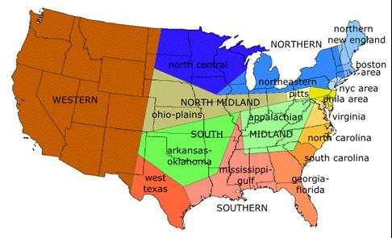
Minor Dialects Today

