Slide 1
AIM: How is English related to other languages?
Do Now: Name 6 languages from the Indo-European family.

Slide 2
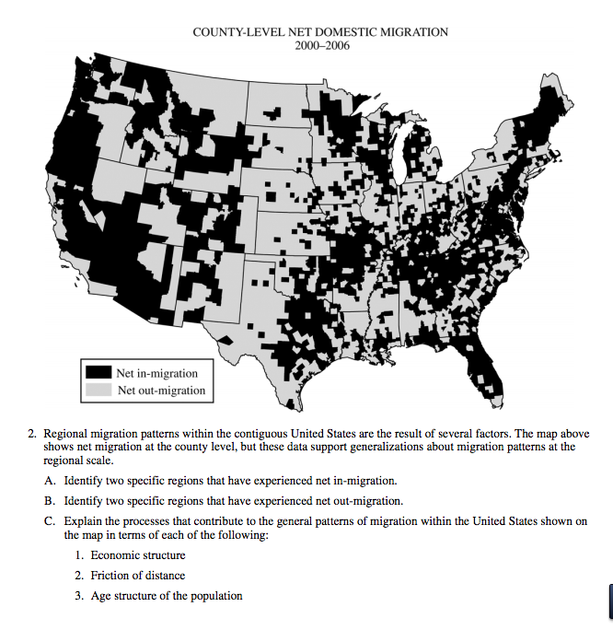

Slide 3
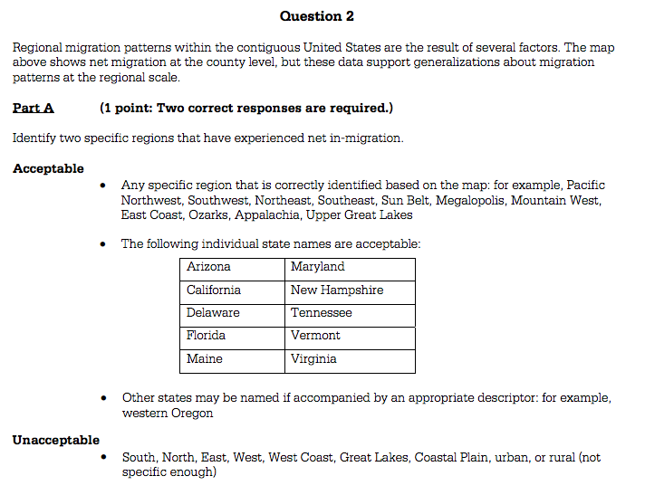

Slide 4
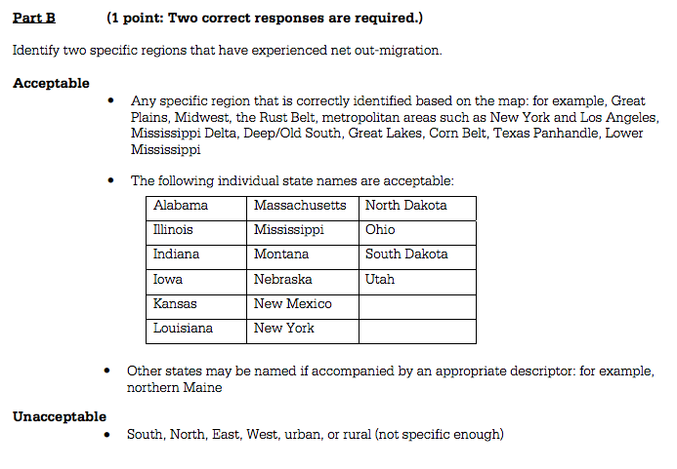

Slide 5
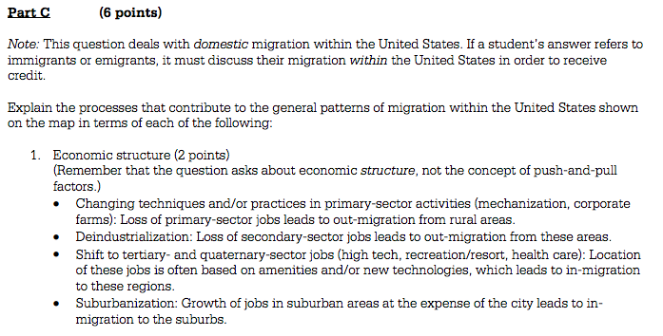

Slide 6
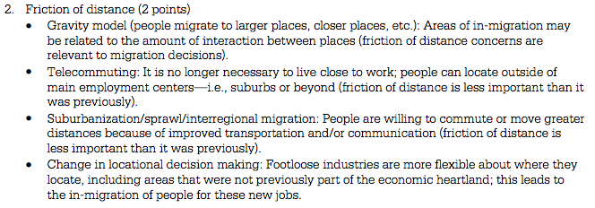

Slide 8
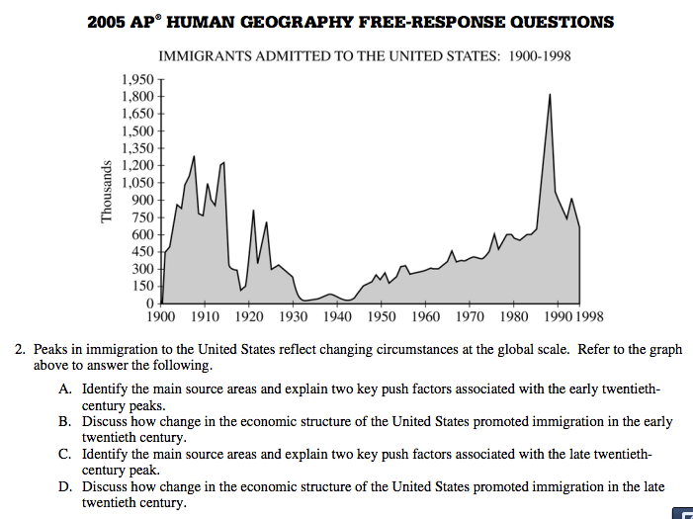

Slide 9
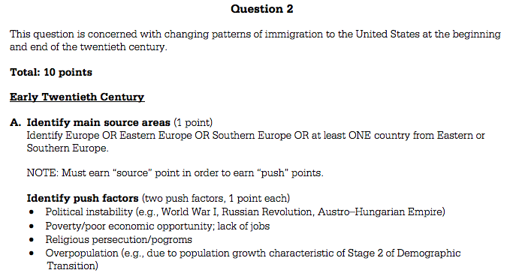

Slide 11
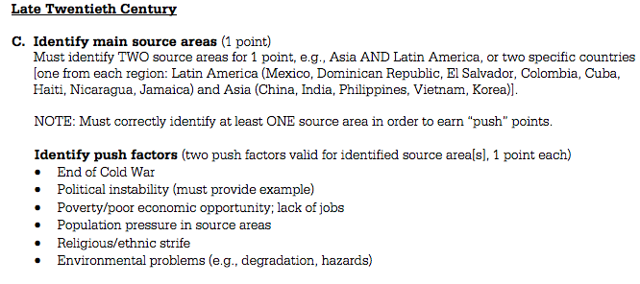

Slide 13
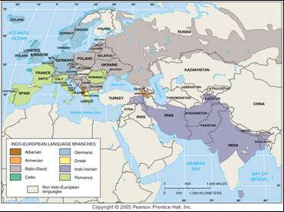
Indo-European Language Family
The main branches of the Indo-European language family include Germanic, Romance, Balto-Slavic, and Indo-Iranian.

Slide 15
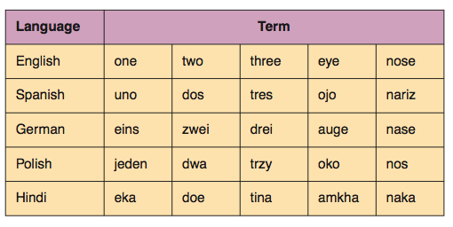
See how they are related?

Slide 16
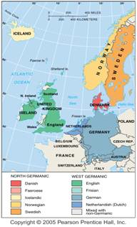
Germanic Branch of Indo-European
The Germanic branch today is divided into North and West Germanic groups. English is in the West Germanic group.

Slide 17
Germanic
English and German are both languages in the West Germanic group.
West Germanic is further divided into High Germanic and Low Germanic subgroups, so named because they are found in high and low elevations within present-day Germany.

Slide 18
Germanic Continued
High German = origin of modern German
Low German = origin of modern English
The Germanic language branch also includes North Germanic languages, spoken in Scandinavia.
The four Scandinavian languages—Swedish, Danish, Norwegian, and Icelandic—all derive from Old Norse.

Slide 19
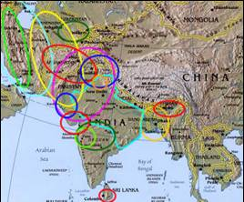
Indo-Iranian Branch of Indo-European
The branch of the Indo-European language family with the most speakers is Indo-Iranian, more than 100 individual languages divided into an eastern group (Indic) and a western group (Iranian).

Slide 20
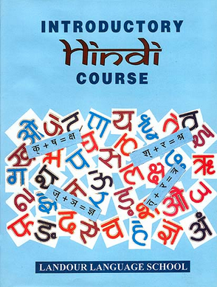
Indic (Eastern) Group of Indo-Iranian Language Branch
The most widely used languages in India, as well as in the neighboring countries of Pakistan and Bangladesh, belong to the Indic group of the Indo-Iranian branch of Indo-European.

Slide 21
Hindi
Approximately one-third of Indians, mostly in the north, use an Indic language called Hindi.
Hindi is spoken many different ways—and could be regarded as a collection of many individual languages, but there is only one official way to write the language, using a script called Devanagari.

Slide 22
Hindi as the dominant language
Hindi, originally a variety of Hindustani spoken in the area of New Delhi, grew into a national language in the nineteenth century when the British encouraged its use in government.

Slide 23
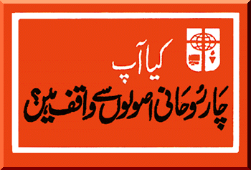
Pakistan
Pakistan’s principal language, Urdu, is spoken very much like Hindi but is written with the Arabic alphabet, a legacy of the fact that most Pakistanis are Muslims, and their holiest book (the Quran) is written in Arabic.

Slide 24
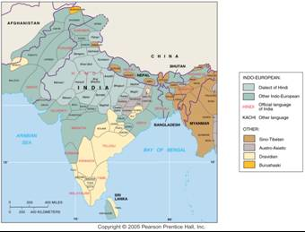
South Asian Languages and Language Families
Indo-European is the largest of four main language families in South Asia. The country of India has 18 official languages.

Slide 25
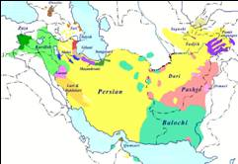
Iranian (Western) Group of Indo-Iranian Language Branch
Indo-Iranian languages spoken in Iran and neighboring countries form a separate group from Indic.
The major Iranian group languages include Persian (sometimes called Farsi) in Iran, Pathan in eastern Afghanistan and western Pakistan, and Kurdish, used by the Kurds of western Iran, northern Iraq, and eastern Turkey.
These languages are written in the Arabic alphabet.

Slide 26
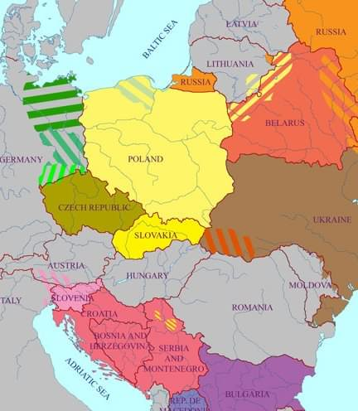
Balto-Slavic Branch of Indo-European
Slavic was once a single language, but differences developed in the seventh century A.D. when several groups of Slavs migrated from Asia to different areas of Eastern Europe.

Slide 27
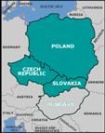
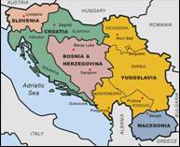
West and South Slavic Groups of Balto-Slavic Language Branch
The most spoken West Slavic language is Polish, followed by Czech and Slovak.
Czech and Slovak speakers can understand the other.
The two most important South Slavic languages are Serbo-Croatian and Bulgarian.
Although Serbs and Croats speak the same language, they use different alphabets.

Slide 28
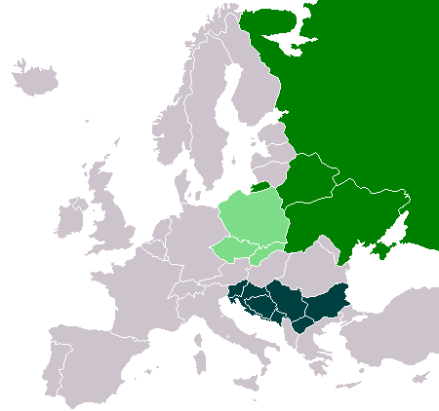
East Slavic and Baltic Groups of Balto-Slavic Language Branch
After Russian, Ukrainian and Belarusian (sometimes written Byelorussian) are the two most important East Slavic languages.
The desire to use languages other than Russian was a major drive in the Soviet Union breakup 2 decades ago.

Slide 29
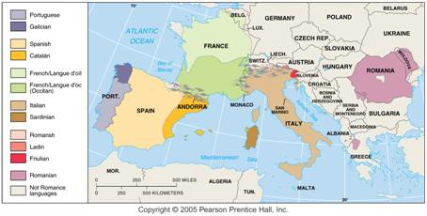
Romance Branch of Indo-European
The Romance branch includes three of the world’s 12 most widely spoken languages (Spanish, French, and Portuguese), as well as a number of smaller languages and dialects.

Slide 30
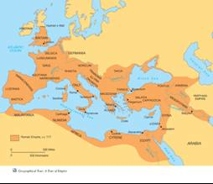
Origin and Diffusion of Romance Languages
As the conquering Roman armies occupied the provinces of it’s vast empire, they brought the Latin language with them the languages spoken by the natives of the provinces were either extinguished or suppressed.
Latin used in each province was based on that spoken by the Roman army at the time of occupation.
Each province also integrated words spoken in the area.

Slide 31
Origin and Diffusion of Romance Languages
The Latin that people in the provinces learned was not the standard literary form but a spoken form, known as Vulgar Latin, from the Latin word referring to “the masses” of the populace.

Slide 32
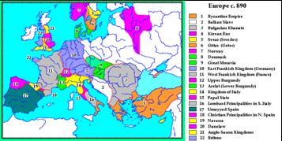
After the Fall of Rome
By the eighth century, regions of the former empire had been isolated from each other long enough for distinct languages to evolve.
Latin persisted in parts of the former empire.
People in some areas reverted to former languages, while others adopted the languages of conquering groups from the north and east, which spoke Germanic and Slavic.

Slide 34
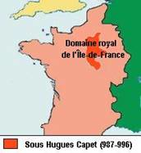
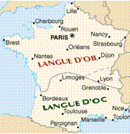
Romance Language Dialects – France
Distinct Romance languages did not suddenly appear.
They evolved over time.
The creation of standard national languages, such as French and Spanish, was relatively recent.
The dialect of the Ile-de-France region, known as Francien, became the standard form of French because the region included Paris.

Slide 35
French Continue
The most important surviving dialect difference within France is between the north and the south.
The northern dialect, langue d’oil and the southern langue d’ôc provide insight into how languages evolve.
These terms derive from different ways in which the word for “yes” was said.

Slide 36
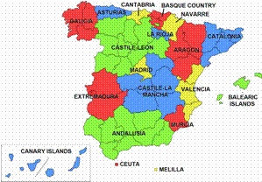
Romance Language Dialects – Spain
Spain, like France, contained many dialects during the Middle Ages.
In the fifteenth century, when the Kingdom of Castile and Leon merged with the Kingdom of Aragón, Castilian became the official language for the entire country.

Slide 37
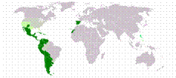
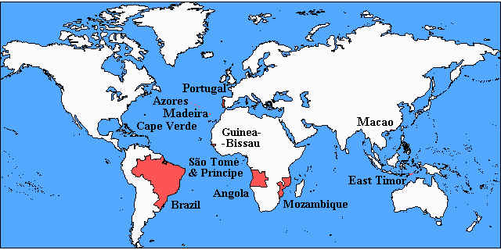
Spanish and Portuguese Speaking Countries
Spanish and Portuguese have achieved worldwide importance because of the colonial activities of their European speakers.
Spanish is the official language of 18 Latin American states, while Portuguese is spoken in Brazil.

Slide 38
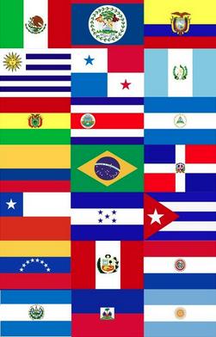
Spanish and Portuguese
Approximately 90% of Spanish and Portuguese speakers live outside Europe.

