Slide 1
AIM: Where are other language families distributed?
Do Now: Where was the Indo-European Hearth?

Slide 2
Hearth
Place of origin.
IE: Where was the hearth for Reggae music?
Where was the hearth for Islam?
Where was the hearth for Mr. Fine?

Slide 3
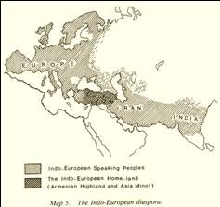
Origin and Diffusion of Indo-European
The existence of a single ancestor cannot be proved with certainty, because it would have existed thousands of years before the invention of writing or recorded history.
The evidence that Proto-Indo-European once existed is “internal.”

Slide 4
The Hearth
Individual Indo-European languages share common root words for winter and snow but not for ocean.
What might this tell us about the Proto Indo-European language?
Therefore, linguists conclude that original Proto-Indo-European speakers probably lived in a cold climate, or one that had a winter season, but did not come in contact with oceans.

Slide 5
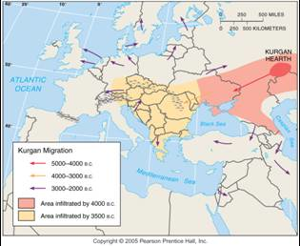
Kurgan Theory of Indo-European Origin
In the Kurgan theory, Proto-Indo-European diffused from the Kurgan hearth north of the Caspian Sea, beginning about 7,000 years ago.

Slide 6
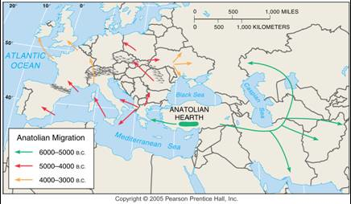
Anatolian Hearth Theory of Indo-European Origin
In the Anatolian hearth theory, Indo-European originated in Turkey before the Kurgans and diffused through agricultural expansion.

Slide 7
Creole
A creole or creolized language is defined as a language that results from the mixing of the colonizer’s language with the indigenous language.
A creolized language forms when the colonized group makes some changes, such as simplifying the grammar.
The word creole derives from a word in several Romance languages for a slave who is born in the master’s house.

Slide 8
AIM: Where are other language families distributed?
Do Now: Is grammar consistent from language to language?
HW: Key Question 4 Due Wednesday

Slide 9
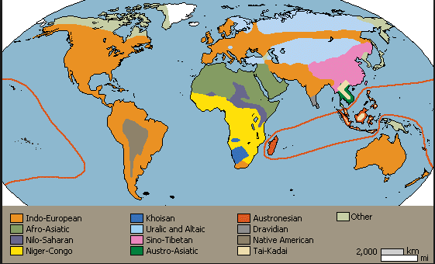
Language Families of the World
Distribution of the world’s main language families. Languages with more than 100 million speakers are named.

Slide 10
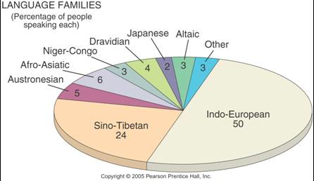
Major Language Families Percentage of World Population
The percentage of world population speaking each of the main language families. Indo-European and Sino-Tibetan together represent almost 75% of the world’s people.

Slide 11
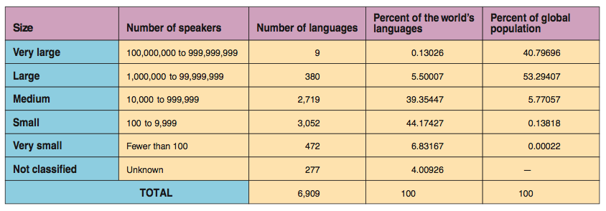
Major Languages

Slide 12
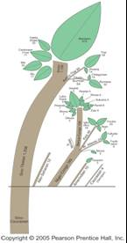
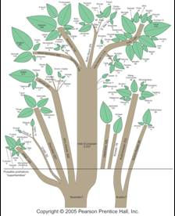
Language Family Trees
Family trees and estimated numbers of speakers for the main world language families.

Slide 13
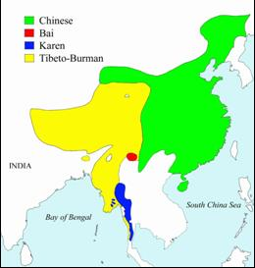
Sino-Tibetan Family
The Sino-Tibetan family encompasses languages spoken in the People’s Republic of China as well as several smaller countries in Southeast Asia.

Slide 14
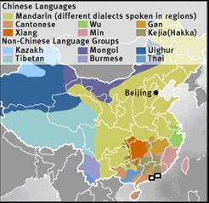
Sinitic Branch – Chinese Languages
There is no single Chinese language.
Spoken by approximately three-fourths of the Chinese people, Mandarin is by a wide margin the most used language in the world.
Other Sinitic branch languages are spoken by tens of millions of people in China.
The Chinese government is imposing Mandarin countrywide.

Slide 15
Structure of Chinese Language
The structure of Chinese languages is quite different (from Indo-European).
They are based on 420 one-syllable words.
This number far exceeds the possible one-syllable sounds that humans can make, so Chinese languages use each sound to denote more than one thing.

Slide 16
Chinese Continued
The listener must infer the meaning from the context in the sentence and the tone of voice the speaker uses.
In addition, two one-syllable words can be combined.

Slide 17
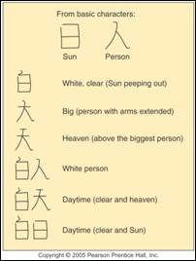
Chinese Ideograms
Chinese language ideograms mostly represent concepts rather than sounds. The two basic characters at the top can be built into more complex words.

Slide 18
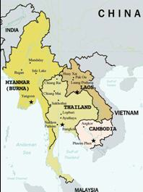
Austro-Thai and Tibeto-Burman
In addition to the Chinese languages included in the Sinitic branch, the Sino-Tibetan family includes two smaller branches, Austro-Thai and Tibeto-Burman.

Slide 19
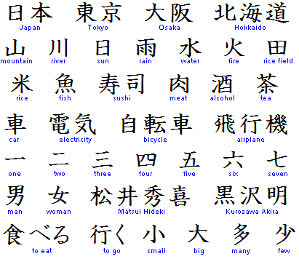
Distinctive Language Families - Japanese
Chinese cultural traits have diffused into Japanese society, including the original form of writing the Japanese language.
Japanese is written in part with Chinese ideograms, but it also uses two systems of phonetic symbols.

Slide 20
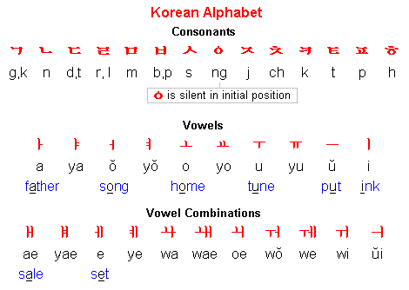
Distinctive Language Families - Korean
Korean is usually classified as a separate language family.
Korean is written not with ideograms but in a system known as hankul.
In this system, each letter represents a sound.

Slide 21
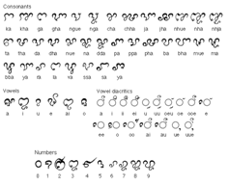
Distinctive Language Families - Vietnamese
Austro-Asiatic, spoken by about 1 percent of the world’s population, is based in Southeast Asia.
Vietnamese (is) the most spoken tongue of the language family.
The Vietnamese alphabet was devised in the seventh century by Roman Catholic missionaries.

Slide 22
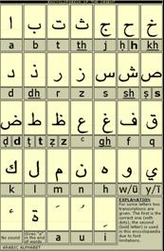
Afro-Asiatic Language Family
The Afro-Asiatic-—once referred to as the Semito-Hamitic—language family includes Arabic and Hebrew, as well as a number of languages spoken primarily in northern Africa and southwestern Asia.
Arabic is the major Afro-Asiatic language, an official language in two dozen countries of North Africa and southwestern Asia, from Morocco to the Arabian Peninsula.

Slide 23
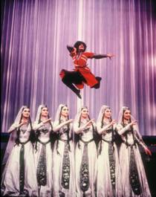
Altaic and Uralic language families
The Altaic and Uralic language families were once thought to be linked as one family because the two display similar word formation, grammatical endings, and other structural elements.
Recent studies, however, point to geographically distinct origins.

Slide 24
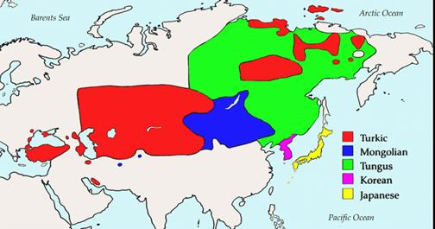
Altaic Languages

Slide 25
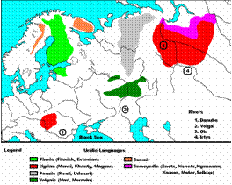
Uralic Languages
Every European country is dominated by Indo-European speakers, except for three: Estonia, Finland, and Hungary.
The Estonians, Finns, and Hungarians speak languages that belong to the Uralic family, first used 7,000 years ago by people living in the Ural Mountains north of the Kurgan homeland.

Slide 26
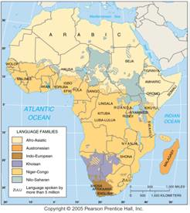
Language Families of Africa
The 1,000 or more languages of Africa are divided among five main language families, including Austronesian languages in Madagascar.

Slide 27
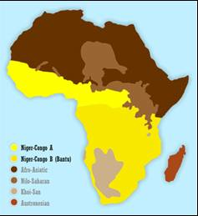
Niger-Congo Language Family
More than 95 percent of the people in sub-Saharan Africa speak languages of the Niger-Congo family, which includes six branches with many hard to classify languages.
The remaining 5 percent speak languages of the Khoisan or Nilo-Saharan families.

Slide 28
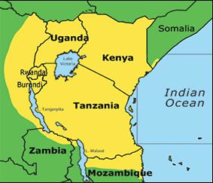
Swahili
The largest branch of the Niger- Congo family is the Benue-Congo branch, and its most important language is Swahili.
Its vocabulary has strong Arabic influences.
Swahili is one of the few African languages with an extensive literature.

Slide 29
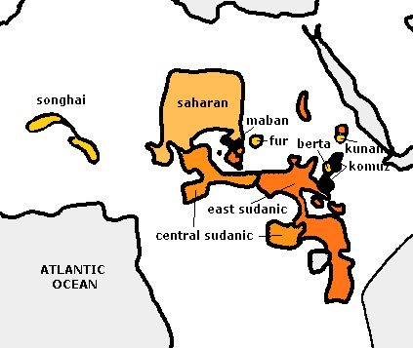
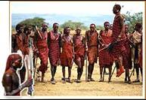
Nilo-Saharan Language Family
Nilo-Saharan languages are spoken by a few million people in north-central Africa, immediately north of the Niger-Congo language region.
The best known of these languages is Maasai, spoken by the tall warrior-herdsmen of east Africa.

Slide 30
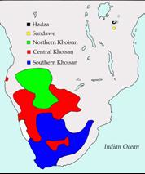
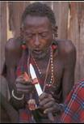
Khoisan Language Family
The third important language family of sub-Saharan Africa—Khoisan—is concentrated in the southwest.
Khoisan language use clicking sounds.

Slide 31
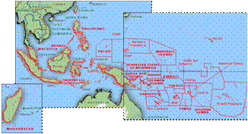
Austronesian Language Family
About 6 percent of the world’s people speak an Austronesian language, once known as the Malay-Polynesian family.
The most frequently used Austronesian language is Malay-Indonesian.
The people of Madagascar speak Malagasy, which belongs to the Austronesian family, even though the island is separated by 3,000 kilometers (1,900 miles) from any other Austronesian-speaking country.

Slide 32
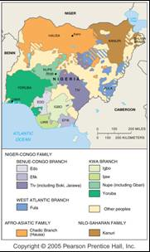
Languages of Nigeria
Africa’s most populous country, Nigeria, displays problems that can arise from the presence of many speakers of many languages.
Groups living in different regions of Nigeria have often battled.
Nigeria reflects the problems that can arise when great cultural diversity—and therefore language diversity—is packed into a relatively small region.
More than 200 languages are spoken in Nigeria, the largest country in Africa (by population). English, considered neutral, is the official language.

