Slide 1
AIM: Why do people preserve local languages?
Do Now: Write down characteristics that you would use to describe yourself.

Slide 2
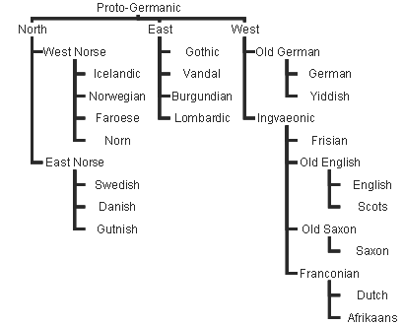
Preserving Language Diversity
Thousands of languages are extinct languages, once in use—even in the recent past but no longer spoken or read in daily activities by anyone in the world.
The eastern Amazon region of Peru in the sixteenth century (had) more than 500 languages.
Only 57 survive today, half of which face extinction.
Gothic was widely spoken in Eastern and Northern Europe in the third century A.D.
The last speakers of Gothic lived in the Crimea in Russia in the sixteenth century.
Many Gothic people switched to speaking the Latin language after their conversion to Christianity.

Slide 3
Hebrew: Reviving Extinct Languages
Hebrew is a rare case of an extinct language that has been revived.
Hebrew diminished in use in the fourth century B.C. and was thereafter retained only for Jewish religious services.
When Israel was established. in 1948, Hebrew became one of the new country’s two official languages, along with Arabic.
The effort was initiated by Eliezer Ben-Yehuda, credited with the invention of 4,000 new Hebrew words—related when possible to ancient ones—and the creation of the first modern Hebrew dictionary.

Slide 4
Celtic: Preserving Endangered Languages
Two thousand years ago Celtic languages were spoken in much of present-day Germany, France, and northern Italy, as well as in the British Isles.
Today Celtic languages survive only in remoter parts of Scotland, Wales, and Ireland, and on the Brittany peninsula of France.

Slide 5
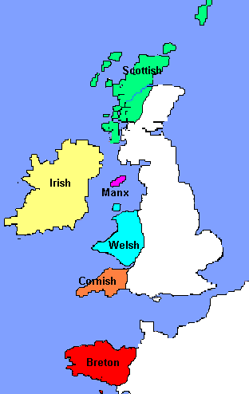
Celtic Groups
The Celtic language branch is divided into Goidelic (Gaelic) and Brythonic groups.
Two Goidelic languages survive: Irish Gaelic and Scottish Gaelic.
Only 75,000 people speak Irish Gaelic exclusively.
In Scotland fewer than 80,000 of the people (2 percent) speak it.
Over time, speakers of Brythonic (also called Cymric or Britannic) fled westward to Wales, southwestward to Cornwall, or southward across the English Channel to the Brittany peninsula of France.
An estimated one-fourth of the people in Wales still use Welsh as their primary language, although all but a handful know English as well.

Slide 6
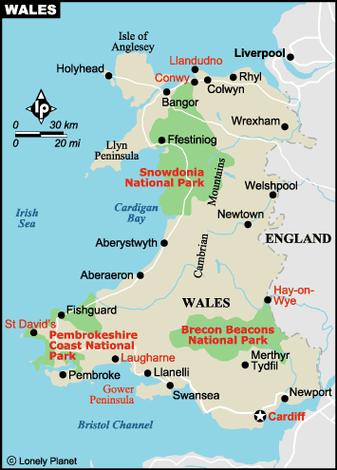
Revival of Celtic Languages
Recent efforts have prevented the disappearance of Celtic languages.
Britain’s 1988 Education Act made Welsh language training a compulsory subject in all schools in Wales, and Welsh history and music have been added to the curriculum.
The number of people fluent in Irish Gaelic has grown in recent years as well, especially among younger people.
An Irish-language TV station began broadcasting in 1996.
A couple of hundred people have now become fluent in the formerly extinct Cornish language, which was revived in the 1920s.

Slide 7
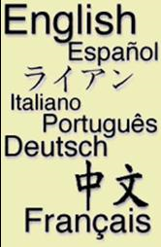
Multilingual States
Difficulties can arise at the boundary between two languages.
The boundary between the Romance and Germanic branches runs through the middle of Belgium and Switzerland.
Belgium has had more difficulty than Switzerland in reconciling the interests of the different language speakers.

Slide 8
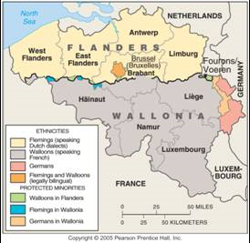
Language Divisions in Belgium
There has been much tension in Belgium between Flemings, who live in the north and speak Flemish, a Dutch dialect, and Walloons, who live in the south and speak French

Slide 9
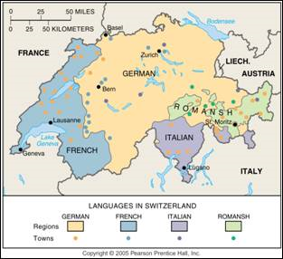
Language Areas in Switzerland
Switzerland remains peaceful with four official languages and a decentralized government structure.

Slide 10
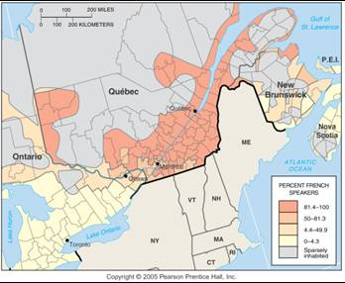
French-English Boundary in Canada
Although Canada is bilingual, French speakers are concentrated in the province of Québec, where 80% of the population speaks French.

Slide 11
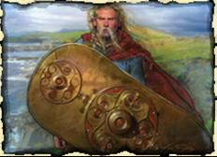
Isolated Languages
An isolated language is a language unrelated to any other and therefore not attached to any language family.
Isolated languages arise through lack of interaction with speakers of other languages.

Slide 12
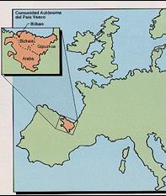
A Pre-Indo-European Survivor: Basque
The best example of an isolated language in Europe is Basque.
Basque is spoken by 1 million people in the Pyrenees Mountains.

Slide 13
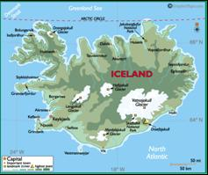
An Unchanging Language: Icelandic
Unlike Basque, Icelandic is related to other languages.
Icelandic’s significance is that over the past thousand years it has changed less than any other in the Germanic branch.

Slide 14
Global Dominance of English
One of the most fundamental needs in a global society is a common language for communication.
Increasingly in the modern world, the language of international communication is English.
When well-educated speakers of two different languages wish to communicate with each other in countries such as India or Nigeria, they frequently use English.

Slide 15
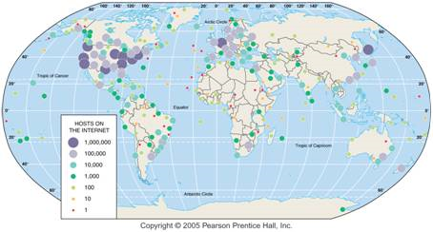
Internet Hosts
A large proportion of the world’s internet users and hosts are in the developed countries of North America and western Europe.

Slide 16
Internet Hosts, by Language
The large majority of internet hosts in 1999 used English, Chinese, Japanese, or European languages.

Slide 17
Lingua Franca
English: An Example of a Lingua Franca
A language of international communication (internet) is known as a lingua franca.
The term, which means language of the Franks, was originally applied by Arab traders during the Middle Ages to describe the language they used to communicate with Europeans, whom they called Franks.
A group that learns English or another lingua franca may learn a simplified form, called a pidgin language.
Two groups construct a pidgin language by learning a few of the grammar rules and words of a lingua franca, while mixing in some elements of their own languages.
Other than English, modern lingua franca languages include Swahili in East Africa, Hindustani in South Asia, and Russian in the former Soviet Union.

Slide 18
African-American Lingua Franca
African-American Lingua Franca
Examples include dialects spoken by African-Americans and residents of Appalachia.
African-American slaves preserved a distinctive dialect in part to communicate in a code not understood by their white masters.
In the twentieth century living in racially segregated neighborhoods within northern cities and attending segregated schools, many blacks preserved their distinctive dialect.
That dialect has been termed Ebonics, a combination of ebony and phonics.
The American Speech, Language and Hearing Association has classified Ebonics as a distinct dialect, with a recognized vocabulary, grammar, and word meaning.

Slide 19
Franglais
The French are particularly upset with the increasing worldwide domination of English.
French is an official language in 26 countries and for hundreds of years served as the lingua franca for international diplomats.
The widespread use of English in the French language is called franglais, a combination of francais and anglais, the French words for French and English.

Slide 20
Spanglish
Spanglish is a richer integration of English with Spanish than the mere borrowing of English words.
New words have been invented in Spanglish that do not exist in English but would be useful if they did.
Spanglish has become especially widespread in popular culture, such as song lyrics, television, and magazines aimed at young Hispanic women, but it has also been adopted by writers of serious literature.

Slide 21
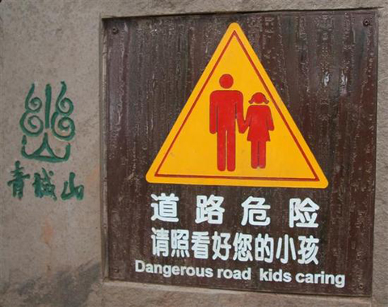
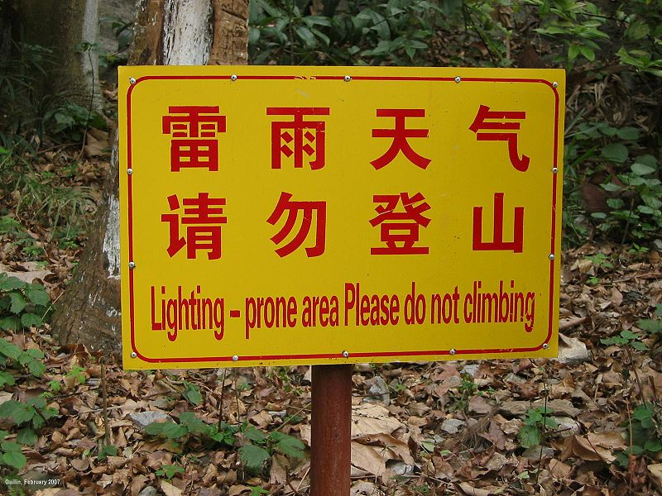
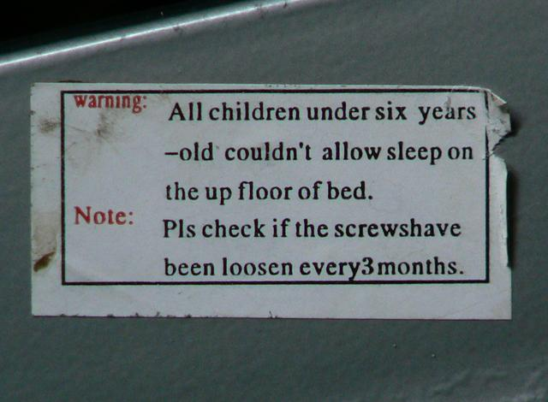
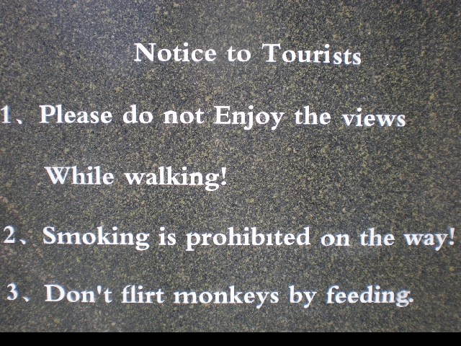
Chinglish
Combination of English and Chinese

