Slide 1
Why do territorial conflicts arise among religious groups?
Do Now: Current Events
What are the top 3 news stories that relate to this class from the last week?

Slide 2
Current Events
Times Square Bombing
President Trump recognizes Jerusalem as Israel’s capital city.
Roy Moore loses to Doug Jones in the Alabama Special Senate Election.

Slide 3
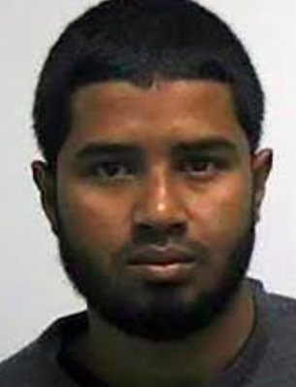
Times Square
Akayed Ullah – the suspect. Says he perpetrated the bombing because he was unhappy with President Trump recognizing Jerusalem as Israel’s capital.
He attempted to blow himself up with a pipe bomb. Luckily, it did not explode properly and no one was killed.

Slide 4
Times Square Bombing
Ullah appears to have worked alone.
He declared loyalty to ISIS.
The title “extremist” seems appropriate.

Slide 5
President Trump recognizes Jerusalem as Israel’s capital.
Why is this a big deal?

Slide 6
Doug Jones defeats Roy Moore

Slide 7
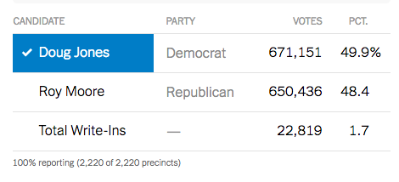
Election Results
98% of African American women voted for Jones and 93% of African American men.

Slide 8
Religion vs. Government Policies
The role of religion in organizing Earth’s surface has diminished in some societies, due to political and economic change.
Yet in recent years, religious principles have become increasingly important in the political organization of countries, especially where a branch of Christianity or Islam is the prevailing religion.

Slide 9
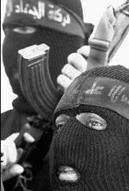
Religion vs. Social Change
Participation in the global economy and culture can expose local residents to values and beliefs originating in more developed countries.
North Americans and Western Europeans may not view economic development as incompatible with religious values, but many religious followers in LDC’s do, especially where Christianity is not the predominant religion.

Slide 10
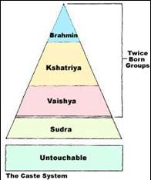
Hinduism vs. Social Equality
Hinduism has been strongly challenged since the 1800s, when British colonial administrators introduced their social and moral concepts to India.
The most vulnerable aspect of the Hindu religion was its rigid caste system.
British administrators and Christian missionaries pointed out the shortcomings of the caste system, such as neglect of the untouchables’ health and economic problems.
The Indian government legally abolished the untouchable caste, and the people formerly in that caste now have equal rights with other Indians.

Slide 11
Religion vs. Communism
Organized religion was challenged in the twentieth century by the rise of communism in Eastern Europe and Asia.
In 1721 Czar Peter the Great made the Russian Orthodox Church a part of the Russian government.
Following the 1917 Bolshevik revolution, which overthrew the czar, the Communist government of the Soviet Union pursued antireligious programs.
People’s religious beliefs could not be destroyed overnight, but the role of organized religion in Soviet life was reduced.
All church buildings and property were nationalized and could be used only with local government permission.
With religious organizations prevented from conducting social and cultural work, religion dwindled in daily life.

Slide 12
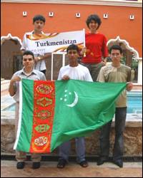
Eastern Orthodox Christianity and Islam vs. the Soviet Union
The end of Communist rule in the late twentieth century brought a religious revival in Eastern Europe, especially where Roman Catholicism is the most prevalent branch.
Property confiscated by the Communist governments reverted to Church ownership, and attendance at church services increased.
Central Asian countries that were former parts of the Soviet Union are struggling to determine the extent to which laws should be rewritten to conform to Islamic custom rather than to the secular tradition inherited from the Soviet Union.

Slide 13
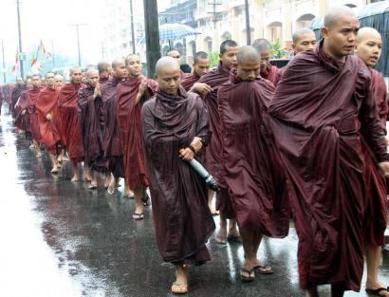
Buddhism vs. Southeast Asian Countries
In southeast Asia, Buddhists were hurt by the long Vietnam War.
Neither antagonist was particularly sympathetic to Buddhists.
The current Communist governments in SE Asia have discouraged religious activities and permitted monuments to decay.
These countries do not have the funds necessary to restore the structures.

Slide 14
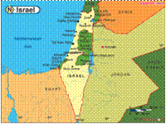
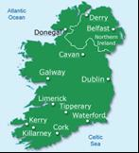
Religion vs. Religion
Conflicts are most likely to occur at a boundary between two religious groups.
Two longstanding conflicts involving religious groups are in the Middle East and Northern Ireland.

