Slide 1
AIM: Why is there conflict in the Middle East?
Do Now: Which major religions consider Jerusalem to be a holy place?

Slide 2
Jerusalem contains sites sacred to Christians, Jews, and Muslims that are in very close proximity and in some cases overlapping. Each group thinks they should have exclusive rights to these areas.

Slide 3
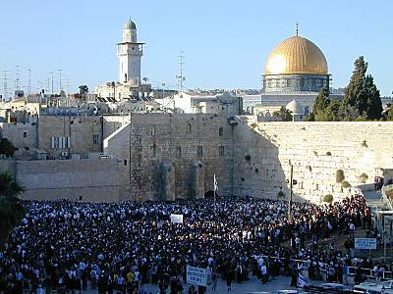
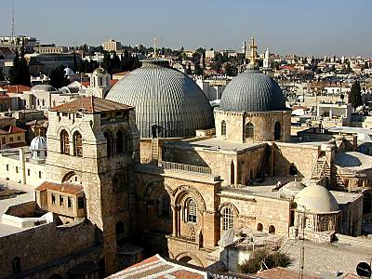
Jerusalem
The Old City of Jerusalem contains holy sites for Judaism, Christianity, and Islam.

Slide 4
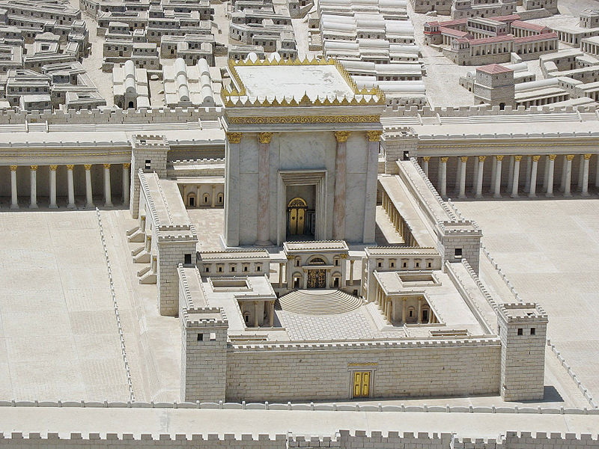
The Romans kicked the ancient Hebrews out after the Bar Kokhba rebellion
After kicking most of the Hebrews out, the Roman emperor Hadrian had Judea renamed Syria-Palestine.
This was intended to destroy their connection to their land.

Slide 5
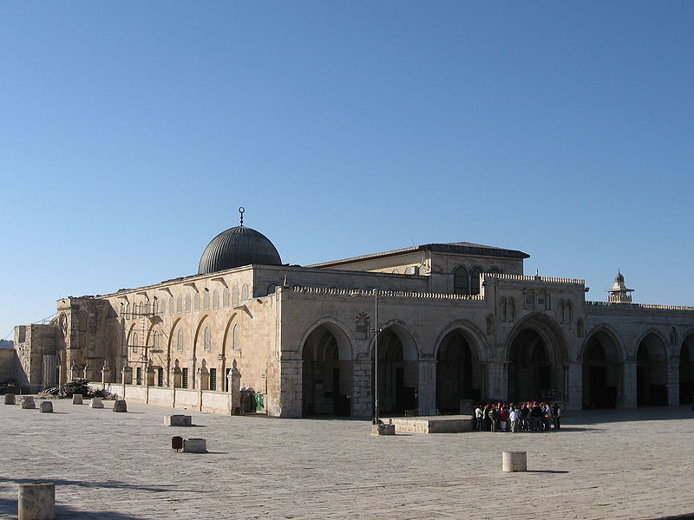
After the spread of Islam
Jerusalem came to be seen as the third holiest city in Islam, and the Muslims constructed a mosque on the spot of the old Jewish Temple Mount.
It is believed that Muhammad ascended to heaven from that spot.

Slide 6
Dome of the Rock

Slide 7
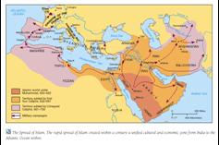
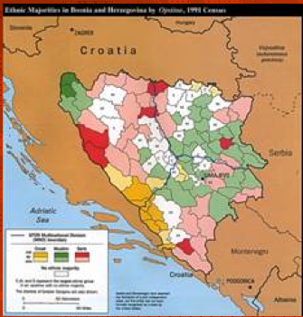
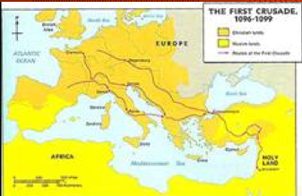
Crusades Between Christians and Muslims

Slide 8
Crusades
Led to distrust between Muslim and Christian world that persists to this day.

Slide 9
Controlled by…
The area of Palestine was ruled by a series of large empires. The most recent to groups to rule the area were the Ottomans, and the British.

Slide 10
Zionism
is a form of nationalism of Jews and Jewish culture that supports a Jewish nation state in the territory defined as the Land of Israel. Zionism supports Jews upholding their Jewish identity, opposes the assimilation of Jews into other societies and has advocated the return of Jews to Israel as a means for Jews to be a majority in their own nation, and to be liberated from antisemitic discrimination, exclusion, and persecution tha had historically occurred in the diaspora.

Slide 11
Zionism
Emerged in the late 19th century.
Some Jewish people started moving back to Palestine and bought up land.
It was a secular movement.

Slide 12
Balfour Declaration
In 1917, the British issued the Balfour Declaration.
“His Majesty's government view with favour the establishment in Palestine of a national home for the Jewish people, and will use their best endeavours to facilitate the achievement of this object, it being clearly understood that nothing shall be done which may prejudice the civil and religious rights of existing non-Jewish communities in Palestine, or the rights and political status enjoyed by Jews in any other country.”
What have the British promised in this declaration?

Slide 13
Sykes–Picot Agreement 1916
"The Palestine position is this. If we deal with our commitments, there is first the general pledge to Hussein in October 1915, under which Palestine was included in the areas as to which Great Britain pledged itself that they should be Arab and independent in the future ... Great Britain and France – Italy subsequently agreeing—committed themselves to an international administration of Palestine in consultation with Russia, who was an ally at that time ...
Who did Great Britain promised Palestine to in this agreement?

Slide 14
Legacy
Eighty-five years later, in a 2002 interview with The New Statesman, British Foreign Secretary Jack Straw observed "A lot of the problems we are having to deal with now, I have to deal with now, are a consequence of our colonial past. ... The Balfour Declaration and the contradictory assurances which were being given to Palestinians in private at the same time as they were being given to the Israelis—again, an interesting history for us but not an entirely honourable one."

Slide 15
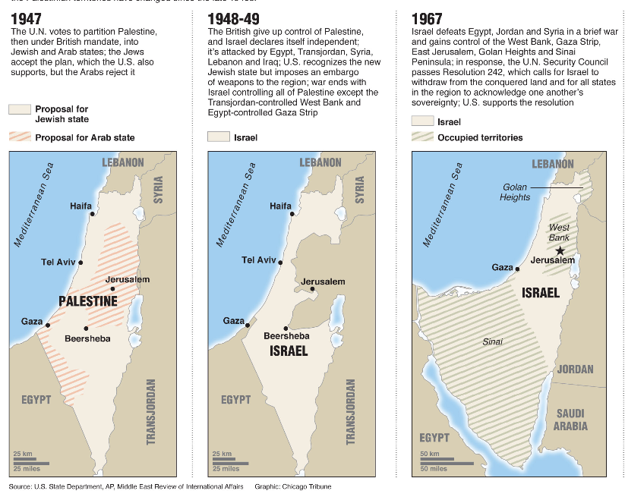
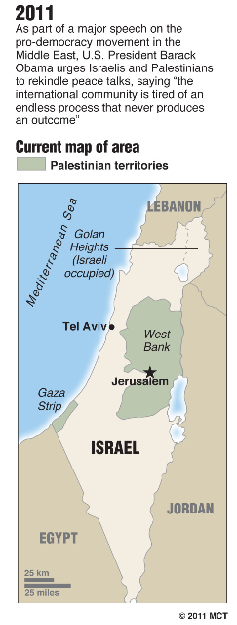
Boundary Changes in Palestine/Israel
The UN partition plan for Palestine in 1947 contrasted with the boundaries that were established after the 1948-49 War. Major changes later resulted from the 1967 War.

Slide 16
Who is to blame for the Palestinian refugee crisis?

Slide 17
Camp David Accord
After the 1973 war, Egypt and Jordan eventually signed peace treaties with Israel, and Syria stopped actively plotting attacks on Israel.
Despite movement toward peace among the neighboring nations in the Middle East, unrest persists.
To complicate the situation, 5 groups of people consider themselves Palestinians.

Slide 18
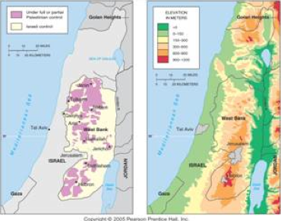
The West Bank: Political and Physical Geography
Political control of the West Bank has been split between Palestinians and Israelis (though under overall Israeli control). The West Bank includes many of the higher altitude areas of the region.

Slide 19
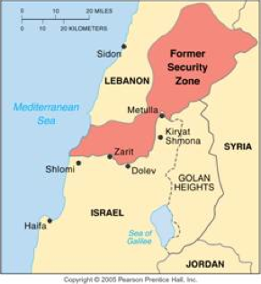
Israel’s Security Zone in Lebanon
Israel established a security zone in southern Lebanon in 1982, When Israel withdrew in 2000, the UN helped draw the boundary between the counties.

Slide 20
Impeding Peace
Israeli Settlements in the West Bank
Hamas controls the Gaza Strip.
Benjamin Netanyahu does not seem interested in peace.
The Palestinian Authority does not have a stable leader.
Syria and Israel will not negotiate with each other.
Lebanon is unstable, and Hezbollah (a leading militant group) is against peace.
A wall
Control of Jerusalem.

Slide 21
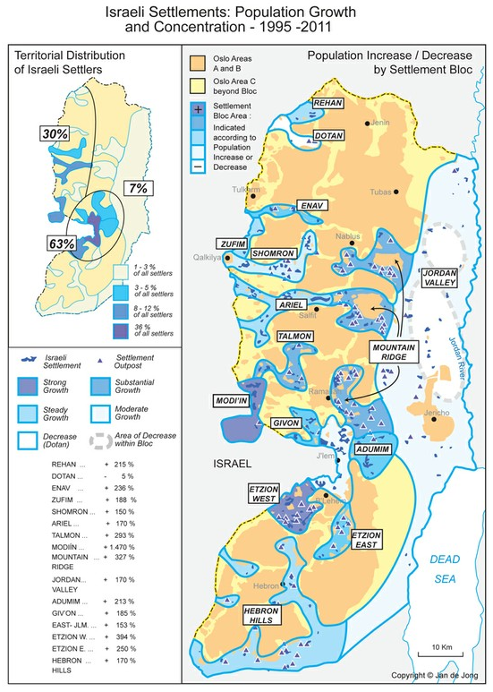
Settlements

Slide 22
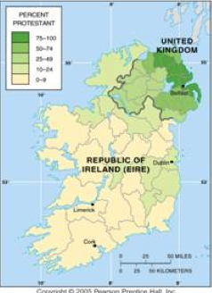
Protestants in Northern Ireland
Percent Protestant population by district in Ireland, 1911. When Ireland became independent in 1937, 26 northern districts with large Protestant populations chose to remain part of the United Kingdom.

Slide 23
The Irish Republican Army
Since then, more than 3,000 have been killed in Northern Ireland—both Protestants and Roman Catholics.
A small number of Roman Catholics in both Northern Ireland and the Republic of Ireland joined the Irish Republican Army (IRA), a militant organization dedicated to achieving Irish national unity by whatever means available, including violence.
Similarly, a scattering of Protestants created extremist organizations to fight the IRA, including the Ulster Defense Force (UDF). As long as most Protestants want to remain in the United Kingdom, and most Catholics want union, peaceful settlement appears difficult.

Slide 24
The Partition of India
Also influenced by religion.
Muslim countries (Pakistan, Bangladesh)
Hindu Country (India, Nepal)
Buddhist Countries (Sri Lanka, Bhutan, )

