Slide 1
Religion
AIM: Why study religion?
Do Now: Why do we have religions?

Slide 2
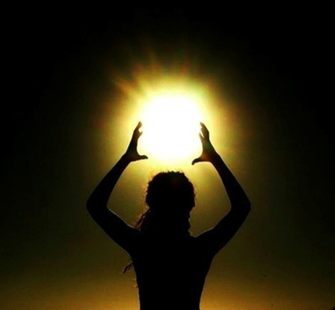
Religion
A system of beliefs and practices that attempts to order life in terms of culturally perceived ultimate priorities.
What is our place in the universe?

Slide 3
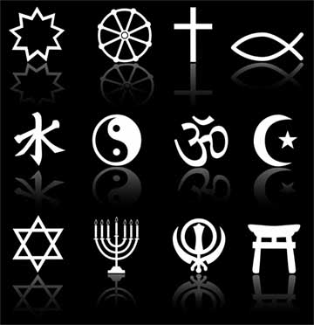
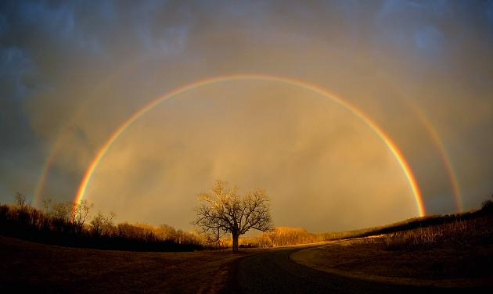
Religion Continued
A religion can be very personal, or it can be highly institutionalized. Religion may involve the worship of the divine or supernatural.

Slide 4
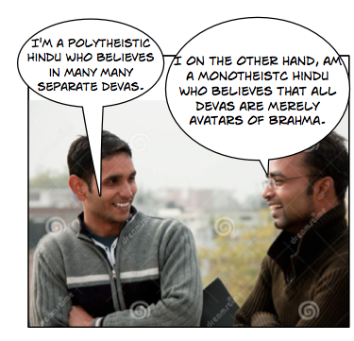
Oversimplification
A religion may be monotheistic, polytheistic, or atheistic. However, it is important that we keep in mind that these are simplistic labels

Slide 5
Syncretic Religions
Many religions are also syncretic —that is, they demonstrate a notable blending of beliefs and practices, usually as a result of contact between people who practice different religions.

Slide 6
Awesome Vocabulary
Cosmogony – explanation for the origin of the earth

Slide 7
Cosmonogy
How did the earth begin?

Slide 8
Geography of Religion
Religion, like language, is a symbol of group identity and a rallying point.
It often leads to conflict between different religious groups, even when all claim they want peace.
”The geographer’s approach to religion [is an interest] in religions’ patterns and processes of diffusion with the spatial distributions they have achieved, and with the impact and imprint of different religious systems on the landscape.”

Slide 9
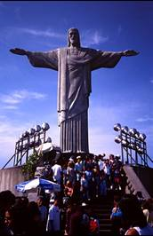
Geographers and Religion
Religion interests geographers because it is essential for understanding how humans occupy Earth.
We’re not theologians though, so we will focus on the elements that are geographically significant.

Slide 10
Which spatial connections will we study?
–the distinctive place of origin
–the extent of diffusion
–the processes by which religions diffused
–practices and beliefs that lead some to have more widespread distributions.

Slide 11
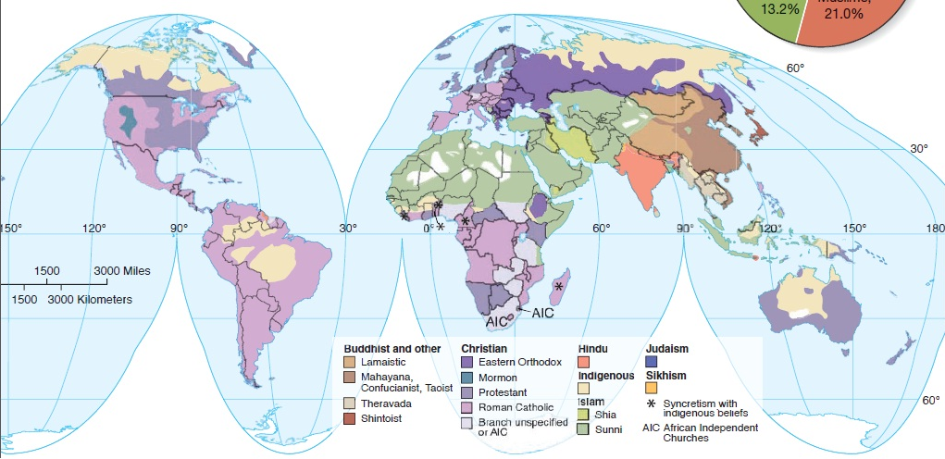

Slide 12
Globalization and Local Diversity of Religion
Geographers find the tension in scale between globalization and local diversity especially acute in religion for a number of reasons.
Firstly,
People care deeply about their religion.

Slide 13
Some religions are designed to appeal to people throughout the world, whereas other religions appeal primarily in geographically limited areas.
IE: Christianity vs. Hinduism

Slide 14
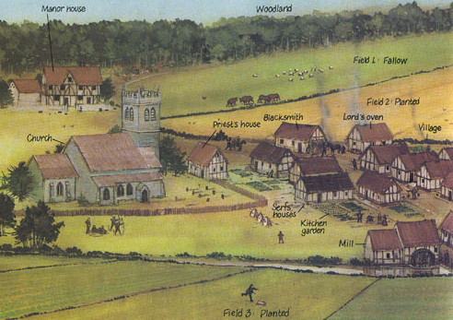
Religious values are important in how people identify themselves, (and) the ways they organize the landscape

Slide 15
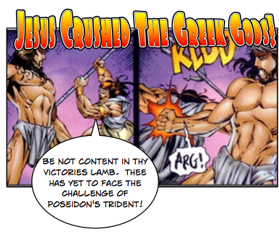
Adopting a global religion usually requires turning away from a traditional local religion.

Slide 16
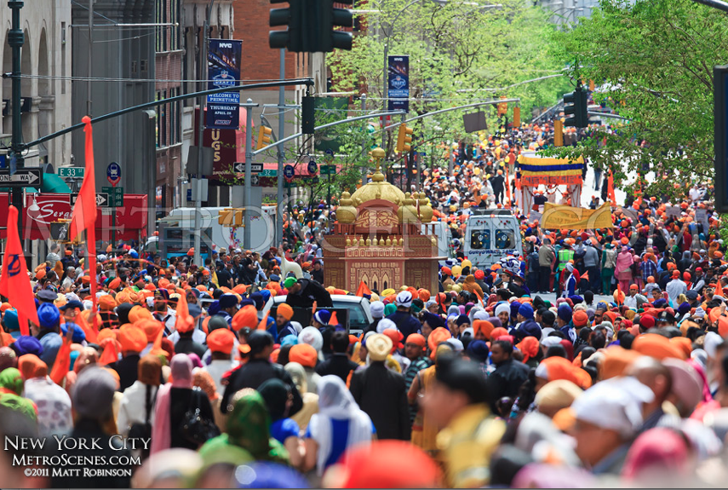
While migrants typically learn the language of the new location, they retain their religion.

Slide 17
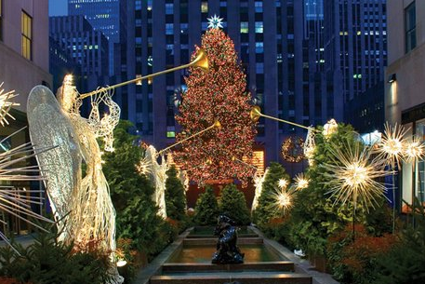
AIM: What is religion, and what role does it play in culture?
Do Now: How does religion impact our daily lives in December?

Slide 18
How does the religion manifest in the cultural landscape?
Houses of worship
Styles of dress
Burial practices
“shouldness”

Slide 19
How do organized religions affect human societies?
Positive
Negative
Combat social ills
Sustain the poor
Promote the arts
Educate the deprived
Advance medical knowledge
Block scientific study
Encourage oppression of dissidents
Support colonialism
Support exploitation
Condemn women to inferior status.

