Slide 1
Ethnicity AIM: How do we differentiate between ethnicity and race?

Slide 2
Race vs. Ethnicity
Race
Ethnicity
Race refers to the highly influential but mistaken idea that one or more genetic traits can be used to identify distinctive and exclusive categories of people.
The prevailing view among academics is that race is best thought of as a social construction—an idea or a phenomenon that does not exist in nature but is created and given meaning by people
The personal and behavioral basis of an individual’s identity that generates a sense of social belonging.
ethnic group -People who share a collective identity that may derive from common ancestry, history, language, or religion, and who have a conscious sense of belonging to that group.

Slide 3
Differentiating Ethnicity and Race
Ethnicity is distinct from race, which is an identity with a group of people who share a biological ancestor.
Race comes from a middle-French word for generation.
Race and ethnicity are often confused.

Slide 4
Consider the Difference
In the United States, consider the three prominent ethnic groups—Asian-Americans, African- Americans, and Hispanic-Americans.
Asian is considered a race and Asian-American is considered an ethnicity.
However, both encompass basically the same group.
African-American and black are sometimes considered different groups.
Some American blacks trace their cultural heritage to regions other than Africa, including Latin America, Asia, or Pacific islands.
Hispanic or Latino is not usually considered a race.

Slide 5
Ethnicity and Geography
Ethnicity is important to geographers because its characteristics derive from the distinctive features of particular places on Earth.
In contrast, contemporary geographers reject the entire biological basis of classifying humans because these features are not rooted in specific places.
One feature of race does matter to geographers—the color of skin.
The distribution of persons of color matters because it is the most fundamental basis by which people in many societies sort out where they reside, attend school, recreate, and perform many other activities of daily life.
The term African-American identifies a group with an extensive cultural tradition, whereas the term black in principle denotes nothing more than a dark skin.

Slide 6
Race is imaginary
How would you describe this woman?

Slide 7
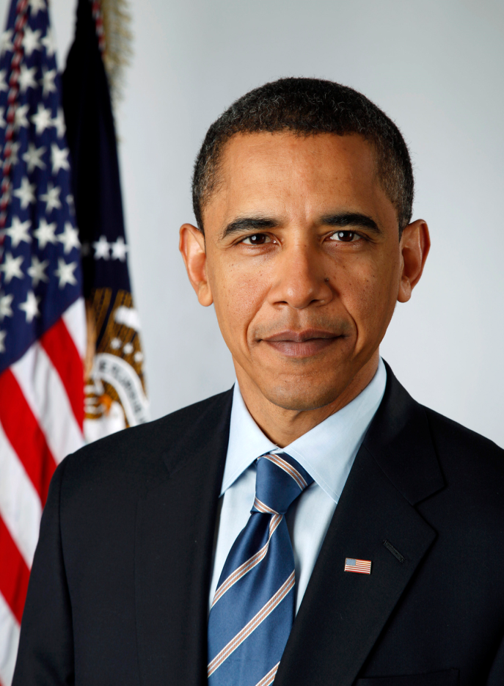
Race is imaginary
And how would you describe her son?

Slide 8
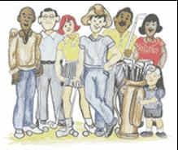
Ethnicity
Ethnicity is a source of pride to people, a link to the experiences of ancestors and to cultural traditions.
The ethnic group to which one belongs has important measurable differences.
Ethnicity also matters in places with a history of discrimination by one ethnic group against another.

Slide 9
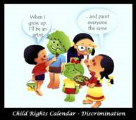
Controversy and Ethnicity
The significance of ethnic diversity is controversial in the United States:
To what extent does discrimination persist against minority ethnicities?
Should preferences be given to minority ethnicities to correct past patterns of discrimination.
To what extent should the distinct cultural identity of ethnicities be encouraged or protected?

Slide 10
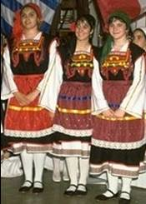
The Study of Ethnicity
Ethnicity is an especially important cultural element of local diversity because our ethnic identity is immutable.
The study of ethnicity lacks the tension in scale between preservation of local diversity and globalization observed in other cultural elements.
No ethnicity is attempting or even aspiring to achieve global dominance.
In the face of globalization. . . ethnicity stands as the strongest barricade for the preservation of local diversity.

