Slide 1
What are local and popular cultures?
Do Now: Where is Hip Hop’s hearth?

Slide 2
Review
What is the difference between local and popular culture?

Slide 3
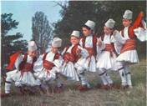
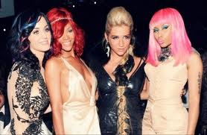
Local (Folk) vs. Popular Culture
Local (Folk) Culture is traditionally practiced by small, homogenous groups living in isolated rural areas.
Popular culture is found in large, heterogeneous societies, and changes quickly.

Slide 4
Local Culture
A group of people in a particular place who see themselves as a collective or a community, who share experiences, customs, and traits, and who work to preserve those traits and customs in order to claim uniqueness and to distinguish themselves from others.

Slide 5
Both Local and Popular Culture can be further divided by
Material Culture – The things groups of people construct, such as art, clothing, houses, sports, dance and foods.
Non-material Culture – Include beliefs, practices, aesthetics, and values.

Slide 6
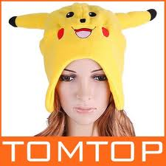
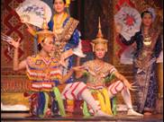
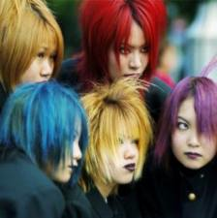
Local vs. Popular Culture Continued
Landscapes dominated by a collection of folk customs change relatively little over time.
In contrast, popular culture is based on rapid simultaneous global connections.
Local culture is more likely to vary from place to place at a given time, whereas pop culture is more likely to vary from time to time at a given place.

Slide 7
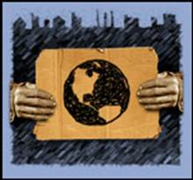
Effects of Popular Culture
In Earth’s globalization, popular culture is becoming more dominant, threatening the survival of unique folk cultures.
The disappearance of local folk customs reduces local diversity in the world and the intellectual stimulation that arises from differences in background.
The dominance of popular culture can also threaten the quality of the environment.

Slide 8
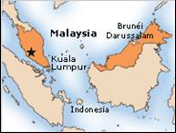
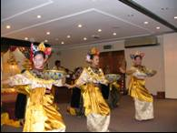
Origin of Local and Popular Cultures
A social custom originates at a hearth.
Folk customs often have anonymous hearths.
They may also have multiple hearths.
Pop culture is most often a product of the economically more developed countries.

Slide 9
Why does popular culture diffuse from more developed countries?
More developed countries have the industrial technology to mass produce uniform products.

Slide 10
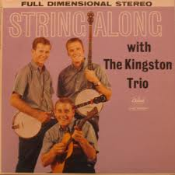
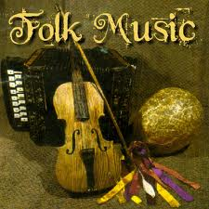
Folk Music
Music exemplifies the differences in the origins of folk and popular culture.
Folk songs tell a story or convey information about daily activities such as farming, life-cycle events, and mysterious natural events.

Slide 11
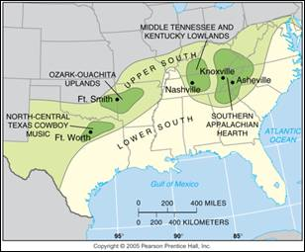
Origin of Country Music
U.S. country music has four main hearths, or regions of origin: southern Appalachia, central Tennessee and Kentucky, the Ozark-Ouachita uplands, and north-central Texas.

Slide 12
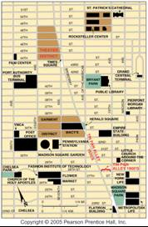
Tin Pan Alley and Popular Music
Writers and publishers of popular music were clustered in Tin Pan Alley in New York City in the early twentieth century. The area later moved north from 28th Street to Times Square.

Slide 13
Diffusion of American Music
The diffusion of American popular music worldwide began in earnest during WWII, when the Armed Forces Radio Network broadcast music to American soldiers.
English became the international language for popular music.

Slide 14
Example: Cheap Trick

Slide 15
Live at Budokan

Slide 16
Hip Hop
Hop hop is a more recent form of popular music that also originated in New York.
Lyrics make local references and represent a distinctive hometown scene.
At the same time, hip hop has diffused rapidly around the world through instruments of globalization.

Slide 17
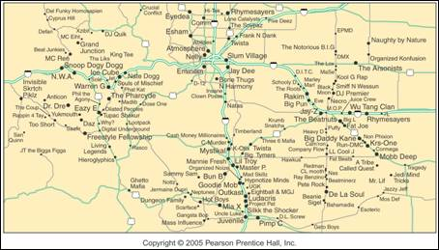
A Mental Map of Hip Hop
This mental map places major hip hop performers near other similar performers and in the portion of the country where they performed.

Slide 18
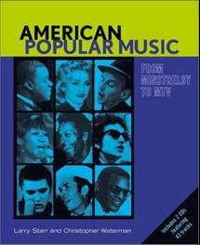
Diffusion of Folk and Popular Cultures
The broadcasting of American popular music on Armed Forces radio illustrates the difference in diffusion of folk and popular cultures.
The spread of pop culture typically follows the process of hierarchical diffusion.
In contrast, folk culture is transmitted primarily through migration, relocation diffusion.

Slide 19
How do folk cultures express themselves in the uSA?

Slide 20
Why is pop culture hierarchical?

Slide 21
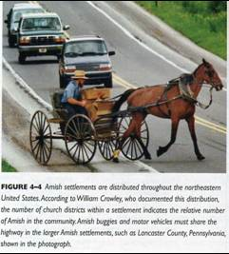
The Amish: Relocation Diffusion of Folk culture
Amish customs illustrate how relocation diffusion distributes folk culture.
Amish folk culture remains visible on the cultural landscape in 17 states.
In Europe, the Amish did not develop distinctive language, clothing, or farming practices and gradually merged with various Mennonite groups.
Several hundred Amish families moved to N. America in 2 waves.
The Amish in N. America retained their traditional customs by living in isolated communities.

Slide 22
Amish Traffic Jam

Slide 23
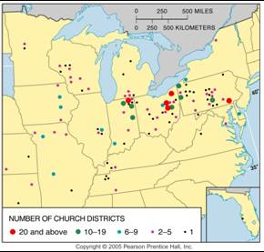
Amish Settlements in the U.S.
Amish settlements are distributed through the northeast U.S.

Slide 24
Sports: Hierarchical Diffusion of Popular Culture
Sports provide examples of how pop culture is diffused.
Many sports originated as isolated folk customs and were diffused like other folk culture, through the migration of individuals.
But the contemporary diffusion of sports displays characteristics of pop culture.

Slide 25
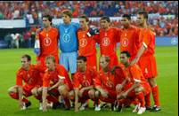
Folk Culture Origin of Soccer
Early soccer games resembled mob scenes.
In the 12th century the rules became standardized.
Because soccer disrupted village life, King Henry II banned the game from England in the late 12th century.
It was not legalized again until 1603, by King James I.
At this point, soccer was an English folk custom rather than a popular global custom.

Slide 26
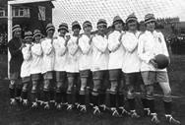
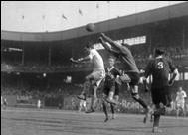
Globalization of Soccer
The transformation of soccer from an English folk custom to global pop culture began in the 1800s.
Sports became a subject taught in school.
Increasing leisure time permitted people to both view and participate in sporting events.

Slide 27
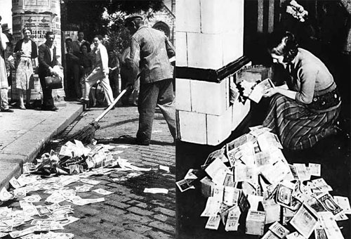
Why didn’t people pay to see sporting events before the industrial revolution?
Not enough money!!!!!
With higher incomes, people paid to see first-class events.

Slide 28
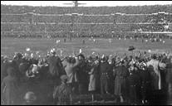
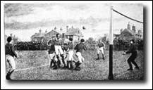
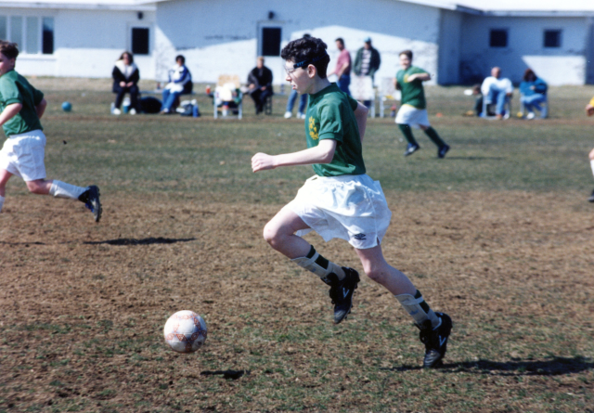
Soccer’s Globalization
Soccer was first played in continental Europe in the late 1870s by Dutch students who had been in Britain.
British citizens further diffused the game throughout the worldwide British Empire.
In the twentieth century, soccer, like other sports, was further diffused by new communication systems, especially radio and television.
But it never became as popular in the USA

Slide 29
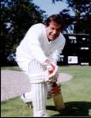
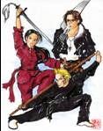
Sports in Popular Culture
Each country has its own preferred sports.
Cricket is popular primarily in Britain and former British colonies.
Ice Hockey prevails, in colder climates.
The most popular sports in China are martial arts including, wushu, archery, fencing, wrestling, and boxing.
Baseball became popular in Japan after it was introduced by American soldiers.

Slide 30
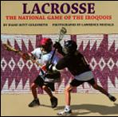
Lacrosse as a Popular Sport
Lacrosse is a sport played primarily in Ontario, Canada, and a few eastern U.S. cities, especially Baltimore and New York.
It has also fostered cultural identity among the Iroquois Confederation of Six Nations.
In recent years, the International Lacrosse Federation has invited the Iroquois nation to participate in the Lacrosse World Championships.

Slide 31
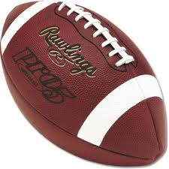
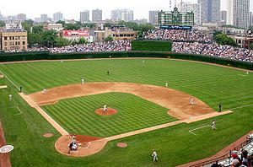
And the most popular sports in the usa are;

Slide 32
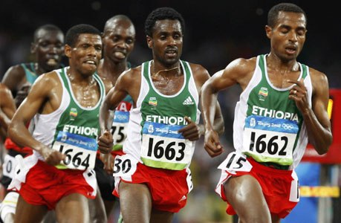
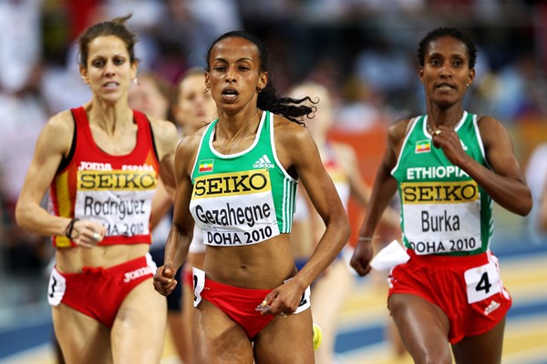
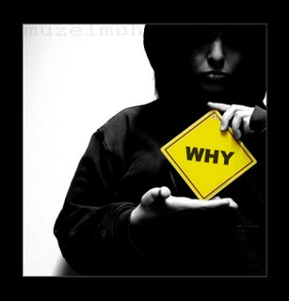
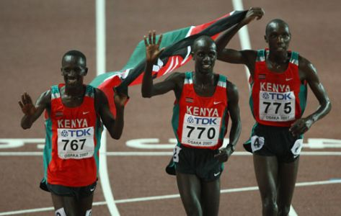
In Ethiopia and Kenya, the most popular sport is;

