Slide 1
AIM: How are local cultures sustained?
Do Now: You are going to see a series of pictures. Write down the country you think each picture represents.

Slide 2
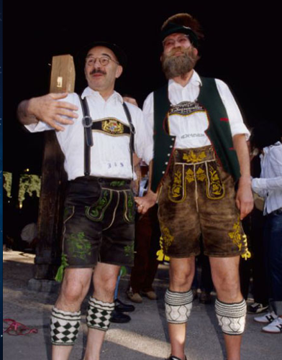
Which country?

Slide 3
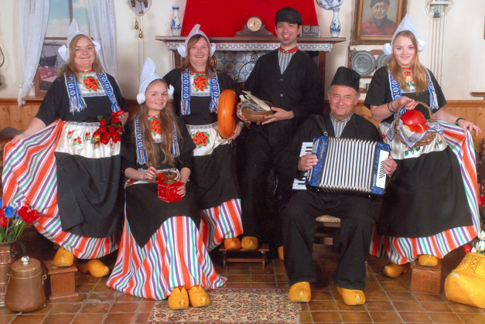
Which Country?

Slide 4
Which Country?

Slide 5
Which country?

Slide 6
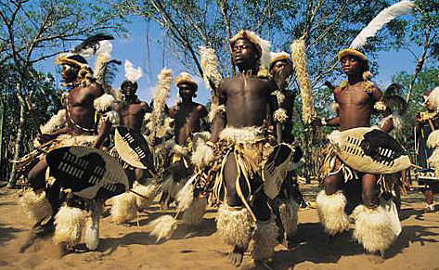
Which Country?

Slide 7
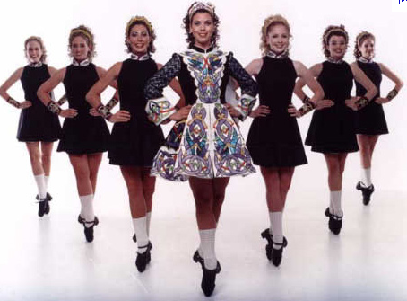
Which Country?

Slide 8
Which Country?

Slide 9
Which Country

Slide 10
Which Country?

Slide 11
Which Country?

Slide 12
Which Country?

Slide 13
Which Country?

Slide 14
Which Country?

Slide 15
Answers
Germany
Netherlands
Scotland
Japan
South Africa
Ireland
India
Australia
Russia
Saudi Arabia
USA
Thailand
Mexico

Slide 16
Folk/Local Culture
Refers to groups of people whose members share similar cultural traits, live predominantly in rural areas, and whose livelihood is minimally connected to the global market economy.
Many geographers prefer to use the term Local Culture when referring to folk culture.

Slide 17
Cultural Assimilation
Large countries sometimes try to force indigenous local cultures to assimilate into the larger national culture. (USA, Australia, Canada, Russia)
In the case of the USA, many Native American tribes have pushed back against assimilation by reviving local customs. (reviving language, religion, cuisine)

Slide 18
Customs
A practice that a group of people routinely follows.
Cultural Appropriation – the process by which other cultures adopt customs and knowledge and use them for their own benefit.

Slide 19
Rural Local Cultures
Anabaptist groups
Hutterites – live in colonies with up to 100 people. Accept technology.
Mennonites – will live in more remote areas to preserve traditions. Use more technology than the Amish.
Amish – Covered Yesterday

Slide 20
Why did residents of Lindsborg, Kansas proclaim their town “Little Sweden”? Is this cultural appropriation or neo-localism?

Slide 21
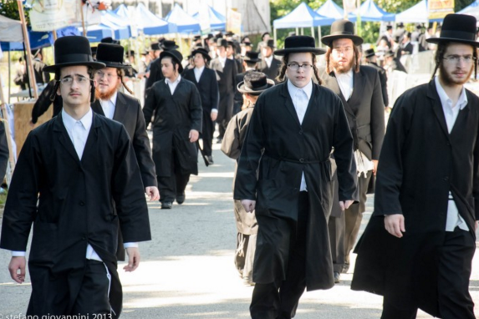
How do ethnic neighborhoods in cities maintain local cultures?
What challenges do they face?

Slide 22
How does commodification affect local culture?
How does commodification affect cultural authenticity?
Deltona, Florida

Slide 23
Is Disney Authentic?
Epcot Center

Slide 24
Are any local cultures truly untouched by popular culture?

Slide 25
Local Culture Affects Diet

Slide 26
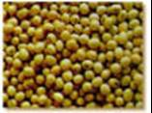
Distinctive Food Preferences
Folk food habits derive from the environment.
For example, rice demands a milder, moist climate, while wheat thrives in colder, drier regions.
People adapt their food preferences to conditions in the environment.
A good example is soybeans.

Slide 27
Soy Beans
In the raw state they are toxic and indigestible.
Lengthy cooking renders (soybeans) edible, but cooking fuel is scarce in Asia.
Asians make foods from soybeans that do not require extensive cooking.
Ie: Soy Sauce, Bean Curd and Bean Sprouts

Slide 28
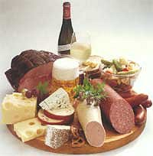
Food Preferences in Europe
In Europe, traditional preferences for quick- frying foods in Italy resulted in part from cooking fuel shortages.
In Northern Europe, an abundant wood supply encouraged the slow stewing and roasting of foods over fires, which also provided home heat in the colder climate.

Slide 29
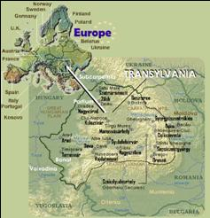
Food Diversity in Transylvania
Food customs are inevitably affected by the availability of products, but people do not simply eat what is available in their particular environment.
In Transylvania, currently part of Romania, food preferences distinguish among groups who have long lived in close proximity.
Soup, the food consumed by poorer people, shows the distinctive traditions of the neighboring cultural groups in Transylvania.
Long after dress, manners, and speech have become indistinguishable from those of the majority, old food habits often continue as the last vestige of traditional folk customs.

Slide 30
Food Attractions and Taboos
According to many folk customs, everything in nature carries a signature, or distinctive characteristic, based on its appearance and natural properties.
Certain foods are eaten because their natural properties are perceived to enhance qualities considered desirable by the society, such as strength, fierceness, or lovemaking ability.
People refuse to eat particular plants or animals that are thought to embody negative forces in the environment.
Such a restriction on behavior imposed by social custom is a taboo.

Slide 31
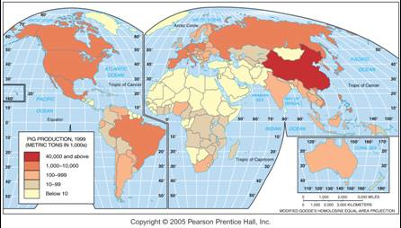
Hog Production and Food Cultures
Annual hog production is influenced by religious taboos against pork consumption in Islam and other religions. The highest production is in China, which is largely Buddhist.

Slide 32
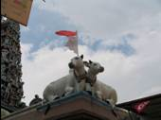
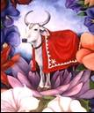
Food and Social Customs
Other social customs, such as sexual practices, carry prohibitions, but taboos are especially strong in the area of food.
Hindu taboos against consuming cows can also be explained partly for environmental reasons.
A large supply of oxen must be maintained in India, because every field has to be plowed at approximately the same time: when the monsoon rains arrive.

Slide 33
Meat taboos
But the taboo against consumption of meat among many people, including Muslims, Hindus, and Jews, cannot be explained primarily by environment factors.
Social values also influence what people eat.

Slide 34
What types of foods are taboo in the USA?

Slide 35
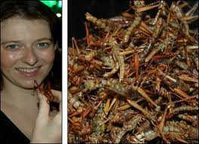
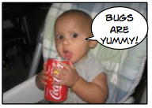
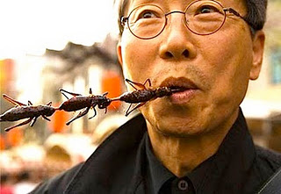
Insects
Most people in the United States refrain from knowingly eating insects, but…
Red dye used in many of our foods and confectionery's like Coca Cola is derived from Charmine which is extracted from cochineal beetles and their eggs.

Slide 36
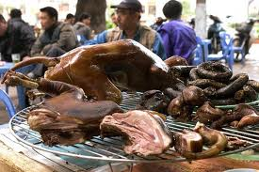
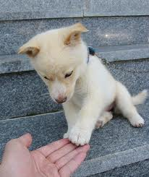
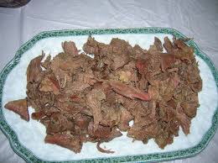
Dogs
Pet or dinner?

Slide 37
Folk Culture
In the past, most Western thinkers assumed local knowledge and folk cultures were outmoded and inferior to that of Western cultures.
This served as a rational excuse that led to the abuses committed under colonialism.
In modern society, we have come to discover the error of that line of thinking.

Slide 38
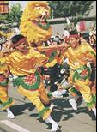
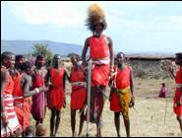
Isolation and Cultural Diversity
Folk culture typically has unknown or multiple origins among groups of living in relative isolation.
A combination of physical and cultural factors influences the distinctive distributions of folk culture.
Folk customs vary widely from one place to another, even among nearby places.

Slide 39
Examine what sort of social behaviors are taboo?

Slide 40
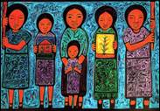
Influence of the Physical Environment
People respond to their environment, but the environment is only one of several controls over social customs.
Folk societies are affected by environment because of their low level of technology and the prevailing agricultural economy.
Yet folk cultures may ignore the environment.
Food and shelter demonstrate the influence of cultural values and the environment on development of unique folk culture.

Slide 41
Judge: Why are they taboo

Slide 42
Certain aspects of various folk cultures have become part of popular culture.
Traditional medicines
Acupuncture.
Holistic medicine

