Slide 1
AIM: How is pop culture diffused?
Do Now: What defines style today?

Slide 2
What would you say are the biggest agents of cultural change in the world today?

Slide 3
Social Media

Slide 4
Social Media
Limits Distance-Decay
Leads to more Time-Space Compression
Leads to Contagious Diffusion

Slide 5
Pop Culture Hearths
College Towns
Big Cities
How Culture Evolves.
-Hip Hop has mixed with other forms of music in various parts of the world to produce new, local forms of the music that incorporate local culture.
Reggaeton

Slide 6
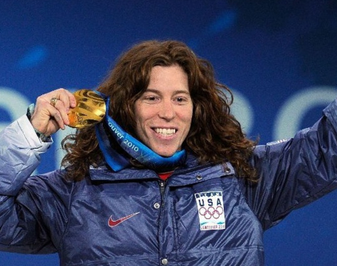
ESPN is a Merchant of Pop Culture
X-Games featured “cool sports”.
Many X-Games sports have migrated to the more traditional Olympic Games
The X-treme sports movement led us away from boxing and to MMA.

Slide 7
Some countries work to promote internal pop culture to compete against invasive pop culture.
France and South Korea heavily subsidize local tv shows and movies. South Korea’s protectionist policies have especially paid off.
They actively export their television dramas now.

Slide 8
Wide Dispersion of Popular Culture
Diffusion of popular housing, clothing, and food
Popular housing styles
Rapid diffusion of clothing styles
Popular food customs
Television and diffusion of popular culture
Diffusion of television
Diffusion of the internet
Government control of television

Slide 9
Diffusion of Popular Housing, Clothing, and Food
Some regional differences in food, clothing, and shelter persist in more developed countries, but differences are much less than in the past.

Slide 10
What types of trends tend to change the quickest? Why?

Slide 11
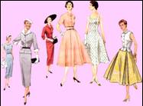
Rapid Diffusion of Clothing Styles
Individual clothing habits reveal how popular culture can be distributed across the landscape with little regard for distinctive physical features.
In the more developed countries clothing habits generally reflect occupations rather than particular environments.
A second influence on clothing in MDCs is higher income.
Improved communications have permitted the rapid diffusion of clothing styles from one region of Earth to another.

Slide 12
Occupation and clothing

Slide 13
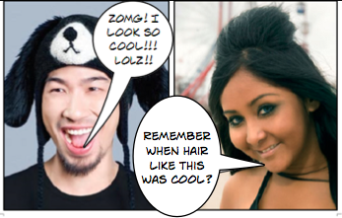
Clothing fads

Slide 14
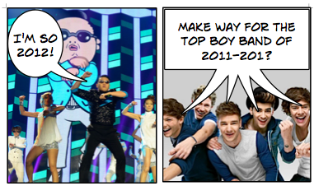
Music Fads

Slide 15
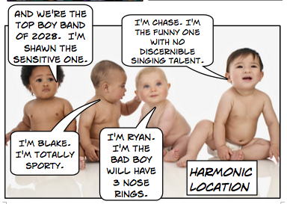
Music Fads

Slide 16
Rapid Diffusion of Clothing Styles Continued
Until recently, a year could elapse from the time an original dress was displayed to the time that inexpensive reproductions were available in the stores.
How long does it take for cheap knockoffs to be made now?
Now the time lag is less than six weeks.
The globalization of clothing styles has involved increasing awareness by North Americans and Europeans of the variety of folk costumes around the world.

Slide 17
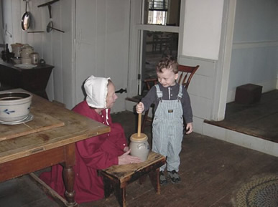
Tourism
The continued use of folk costumes in some parts of the globe may persist not because of distinctive environmental conditions or traditional cultural values but to preserve past memories or to attract tourists.
Old Bethpage Village
-Long Island

Slide 18
Blue Jeans
An important symbol of the diffusion of western popular culture is jeans, which became a prized possession for young people throughout the world.
Locally made denim trousers are available throughout Europe and Asia for under $10, but “genuine” jeans made by Levi Strauss, priced at $50 to $100, are preferred as a status symbol.
Jeans became an obsession and a status symbol among youth in the former Soviet Union, when the Communist government prevented their import.
The scarcity of high-quality jeans was just one of many consumer problems that were important motives in the dismantling of Communist governments in Eastern Europe around 1990.

Slide 19
Popular Food Customs
People in a country with a more developed economy are likely to have the income, time, and inclination to facilitate greater adoption of popular culture.
Consumption of large quantities of alcoholic beverages and snack foods are characteristic of the food customs of popular societies.
Americans choose particular beverages or snacks in part on the basis of preference for what is produced, grown, or imported locally.
However, cultural backgrounds also affect the amount and types of alcohol and snack foods consumed.
Geographers cannot explain all the regional variations in food preferences.

Slide 20
Alcohol Preferences in the U.S.
Per capita consumption of rum (top) and Canadian whiskey (bottom) show different distributions and histories of diffusion.

Slide 21
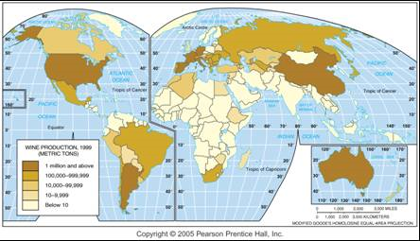
Wine Production per Year
The distribution of wine production shows the joint impact of the physical environment and social customs.

Slide 22
Role of Television in Diffusing Popular Culture
Watching television is an especially significant popular custom for two reasons. First, it is the most popular leisure activity in more developed countries throughout the world. Second, television is the most important mechanism by which knowledge of popular culture, such as professional sports, is rapidly diffused across Earth.

Slide 23
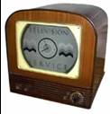
Diffusion of Television
Inventors in a number of countries, including the United States, the United Kingdom, France, Germany, Japan, and the Soviet Union, simultaneously contributed to the development of television.
The U.S. public first saw television in the 1930s. However, its diffusion was blocked for a number of years when broadcasting was curtailed or suspended entirely during World War II.

Slide 24
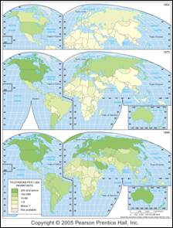
Diffusion of TV, 1954–1999
Television has diffused widely since the 1950s, but some areas still have low numbers of TVs per population.

Slide 25
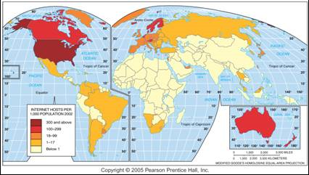
Distribution of Internet Hosts
he U.S. had two-thirds of the world’s internet hosts in 2002. Diffusion of internet service is likely to follow the pattern of TV diffusion, but the rate of this diffusion may differ.

Slide 26
Government Control of Television
In the United States most television stations are owned by private corporations.
Some stations, however, are owned by local governments or other nonprofit organizations and are devoted to educational or noncommercial programs.
In most countries the government(s) control TV stations to minimize the likelihood that programs hostile to current policies will be broadcast—in other words, they are censored.
Operating costs are typically paid by the national government from tax revenues, although some government-controlled stations do sell air time to private advertisers.
A number of Western European countries have transferred some government-controlled television stations to private companies.

Slide 27
Why is it harder for governments to censor information now than in the past?

Slide 28
Reduced Government Control
In the past, many governments viewed television as an important tool for fostering cultural integration.
In recent years, changing technology—especially the diffusion of small satellite dishes—has made television a force for political change rather than stability.
Governments have had little success in shutting down satellite technology.
The diffusion of small satellite dishes hastened the collapse of Communist governments in Eastern Europe during the late 1980s.
Facsimile machines, portable video recorders, and cellular telephones have also put chinks in government censorship.

