Slide 1
AIM: How do political and economic institutions influence uneven development within states?
Do Now: Current Events

Slide 2
Current Events

Slide 3
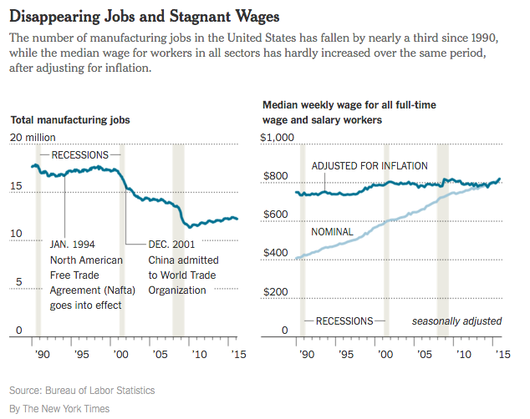

Slide 4
2. How can governments affect economic development with each of the following?

Slide 5
Regulations

Slide 6
Tariffs

Slide 7
Tax Structures

Slide 8
Trade Agreements

Slide 9
Land Ownership Rules

Slide 10
Forward Capitals
Sometimes countries move their capital cities in an attempt to either develop another part of the country.
or to move the capital to an area considered more central or welcoming if it is in a country with ethnic strife.
Or to build a new history after a colonial power leaves.

Slide 11
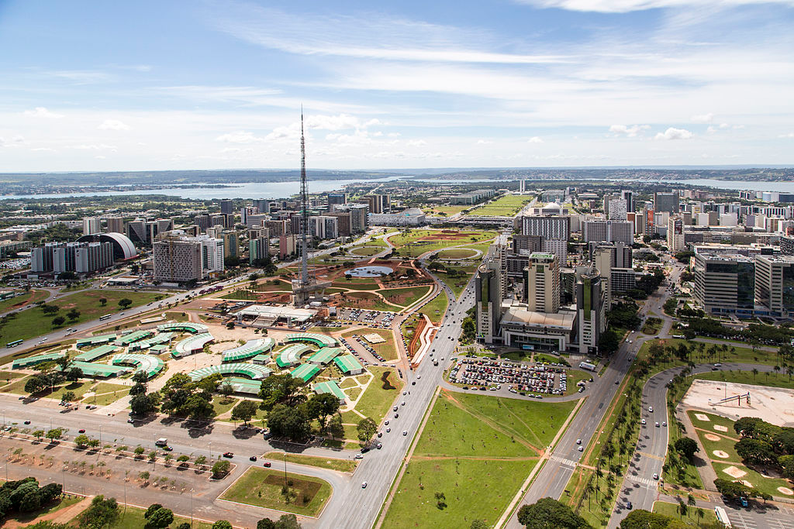
Brasilia
The capital of Brazil was founded in 1960. It was built in the Brazilian highlands in an attempt to develop the interior of the country.

Slide 12
Abuja and Islamabad
Both Nigeria and Pakistan moved their capitals to new areas in an attempt to lessen ethnic strife.

