Slide 1
AIM: Is our country still segregated?
Do Now: Review: Where did African Americans move during the Great Migration of the early 20th century and why?

Slide 2
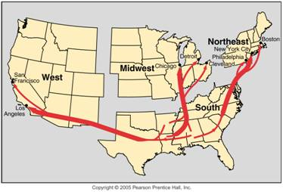
African American Migration in the U.S.A.
Twentieth-century African American migration within the U.S. consisted mainly of migration from the rural south to cities of the Northeast.

Slide 3
White Flight
Segregation laws were eliminated during the 1950s and 1960s.
Rather than integrate, whites fled.
The expansion of the black ghettos in American cities was made possible by “white flight.”
Detroit provides a clear example.
In the late 1960s the National Advisory Commission on Civil Disorders concluded that U.S. cities were divided into two separate and unequal societies.
Three decades later segregation and inequality persist.

Slide 4
Whites Moved to the Suburbs

Slide 5
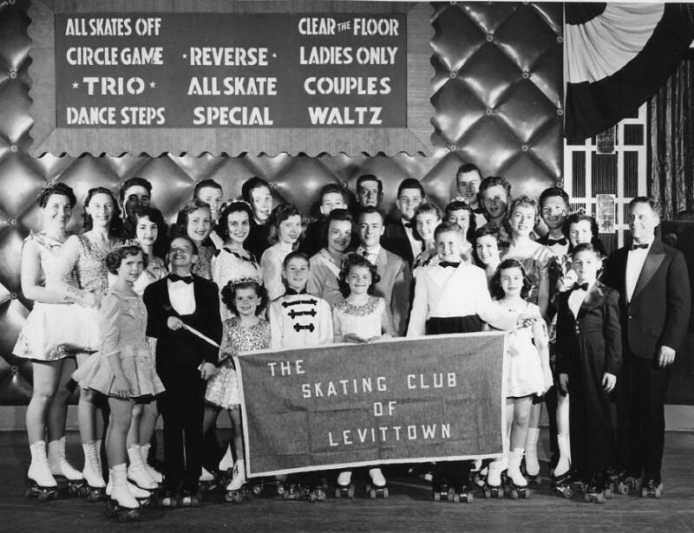
Levittown

Slide 6
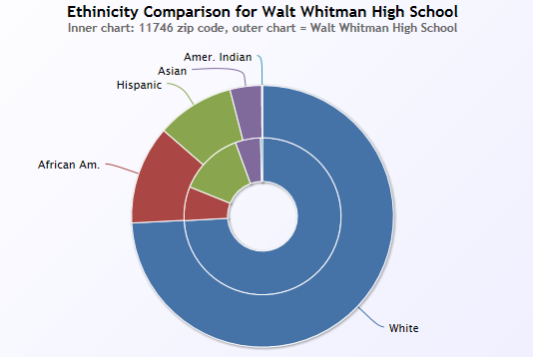
Huntington

Slide 7
Walt Whitman High School

Slide 8
De Facto Segregation
A de facto standard is a standard (formal or informal) that has achieved a dominant position, by tradition, enforcement, or market dominance. It has not necessarily received formal approval by way of a standardization process, and may not have an official standards document.
Public schools in any region of the USA may be de facto racially segregated (or nearly so) simply because they are in neighborhoods whose residents are all, or nearly all, of one race (such as urban ghettos or conversely, affluent suburbs).

Slide 9
Apartheid
The apartheid system was created by descendants of whites who arrived in South Africa from Holland in 1652.
They were known either as Boers, from the Dutch word for farmer, or Afrikaners, from the word “Afrikaans,” the name of their language, which is a dialect of Dutch.
A series of wars between the British and the Boers culminated in a British victory in 1902, and South Africa became part of the British Empire.
British descendants continued to control South Africa’s government until 1948, when the Afrikaner dominated Nationalist Party won elections.
Colonial rule was being replaced in the rest of Africa by a collection of independent states run by the local black population.

Slide 10
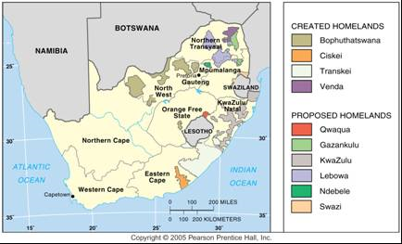
Black “Homelands” in South Africa
During the apartheid era, South Africa created a series of black “homelands” with the expectation that every black would be a citizen of one of them. These were abolished with the end of apartheid.

Slide 11
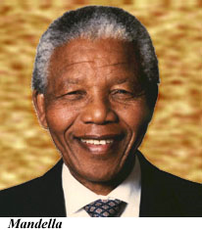
Dismantling Apartheid
In 1991 the white-dominated government of South Africa repealed the apartheid laws, including restrictions on property ownership and classification of people at birth by race.
The African National Congress was legalized, and its leader, Nelson Mandela, was released from jail after more than 27 years.
When all South Africans were permitted to vote in national elections for the first time, in April 1994, Mandela was overwhelmingly elected the country’s first black president.
Whites were guaranteed representation in the government during a five-year transition period, until 1999.

Slide 12
AIM: How does geography shape power relationships among groups of people?

Slide 13
What is seen vs. what is not.
The most powerful groups determine what was see and what we don’t see in the cultural landscape.
Ie: Fox News is unlikely to report news that portrays President Obama in a positive light.
The powerful determine what is on the news, and what is important. They can also erase evidence of news, or groups from the public discourse.

Slide 14
Power and subjugation
How can one group subjugate another?
What are some examples of how one group might be treated less fairly than another?

Slide 15
Historic examples.
3/5 compromise
Only white landowning males could vote in early American elections.
Women staying at home.

Slide 17
Who is undervalued in the workforce?

Slide 18
Women in the workforce
Many are part of the “informal work force” That is they do work that is unpaid at home.
Many women in the formal workforce are also paid less than men in similar positions.

Slide 19
At-risk Populations
Who are these?
The poor
The underprivileged
Those who live in remote areas.
In the West and other MDCs, gay men are more likely to get HIV. In sub-Saharan Africa, women are more likely to get HIV.
But women in cities are less likely to get it than women in remote rural area.

Slide 20
Sub-Saharan Africa
Abandoned Marriages
Dowry Deaths – India
Women who are beaten are often forced to stay with the abusive spouses in India.
Women are more likely to get abortions in India if the baby is going to be female.

Slide 21
When economics are good, ethnic strife can fade to the background.
The opposite occurs when the economy is bad.

Slide 22
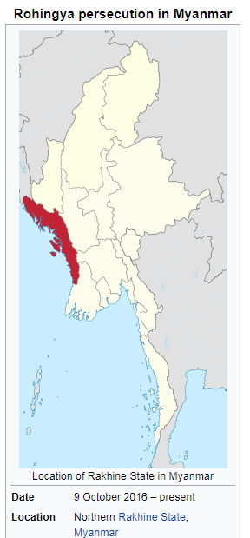
Rohingya Genocide
Rohingya are an ethnic minority in Myanmar.
They are a South Asian, predominantly Muslim people in an East Asian, Buddhist majority country.

Slide 23
Myanmar
Most Muslims in Myanmar do not have official citizenship and are not allowed to vote.
The Rohingya are not allowed to travel without permission from the government. They are also banned from having more than 2 kids.
Frequently subjected to forced labor.
The Myanmar government claims they are illegal immigrants from Bangladesh; however, they have lived in the area for 500 years.

Slide 24
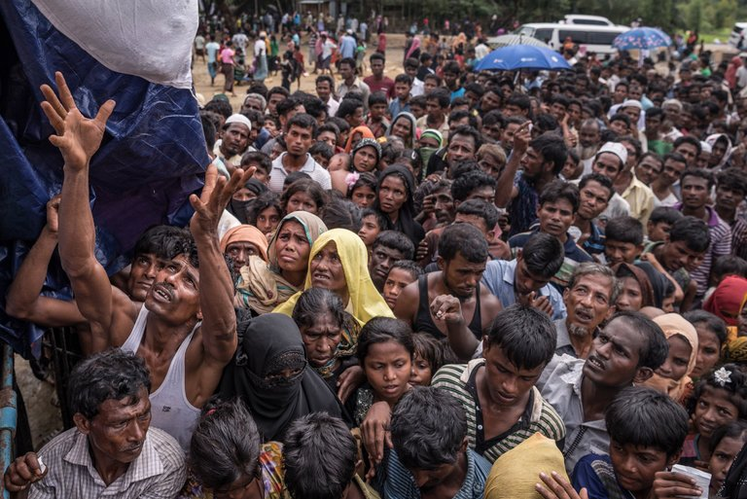
October 2016
Rohingya insurgents attacked Myanmar police leading to a crackdown on the Rohingya.

Slide 25
Statistics
Over 700,000 Rohingya have been forced to flee abroad as refugees.
Over 345 Rohingya villages have been burned to the ground.
At least 10,000 Rohingya died in Myanmar. Some estimates say 43,000 or more.

Slide 26
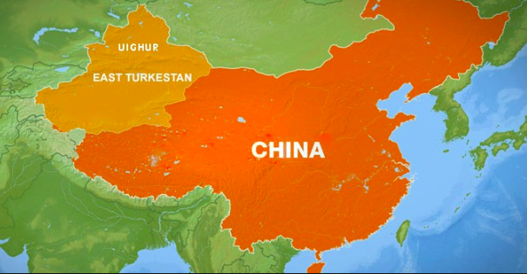
Uighur Persecution

Slide 27
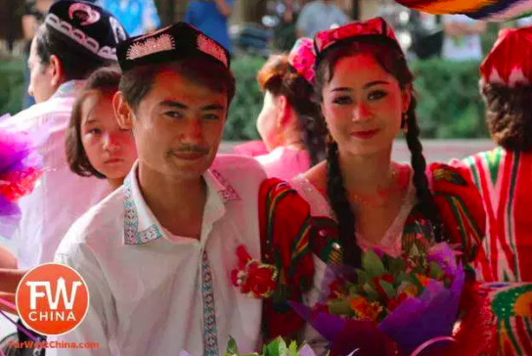
Uyghurs
The Uighurs (Uyghurs) are an ethnic Muslim minority in Western China.
Today, 47 percent of Xinjiang is Uighur and 41 percent is Han. ... Uighurs use a Turkic dialect and write in an Arabic-based script. Mostly Sunni Muslims, the Uighurs comprise more than a third of China's estimated 18 million Muslims. Uighurs are one of 55 nationally designated minorities in China.

Slide 28
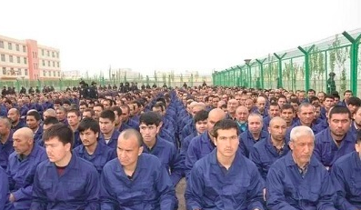
Xinjiang re-education camps
It is estimated that Chinese authorities may have detained hundreds of thousands to millions of Uyghurs, Kazakhs, Kyrgyz, Hui (Han Muslims) and other ethnic Muslims, Christians, and also foreign citizenssuch as Kazakhstanisto be kept in these shrouded internment camps throughout the region.

