Slide 1
AIM: What is identity and how are identities constructed?
Do Now: What do you identify with, and what do you identify against? Come up with at least 3 of each.

Slide 2
Identify Mr. Fine
With Me
Against me
Mets Fans
Union Members
My Family
Tea Partiers
The French
Phil AKA “That Guy”

Slide 3
Identifying Against
We do this to make ourselves feel better and put “others” down.
During the Age of Exploration Europeans saw themselves as civilized and saw natives of other places as barbaric, mystical, mysterious, savage.
Common divides people have used to Identify with or against include nationality, ethnicity, religion and race.

Slide 4
How can we scale Identity?
Country of origin.
State or province or origin.
City or town of origin.
Neighborhood.
School.
Relatives.
Religion.
Regions. (Northerners vs. Southerners)
Level of education.
Socio-economic class.
Gender Identity.
Sexual Preference.
Political Preference.
Food Preference.
Preferred side of the bed.
Left-Handed vs. Right Handed.
Roles in life (daughter, son, mother, father, grandson, brother, sister, granddaughter, niece, nephew, cousin, friend, enemy. Etc…)
Job.
Language.

Slide 5
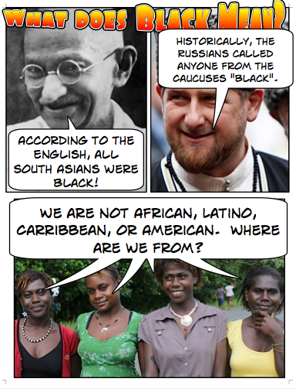
Remember. We make Race.

Slide 6
The United States is becoming more and more diverse.
As a result, we have changed our census forms.
We’ve developed more nuance when looking at terms like “Hispanic”.
But residential segregation by ethnicity or race still persists in our towns and cities.
What sort of ethnically segregated neighborhoods still exist in New York?

Slide 7
Little Italy

Slide 8
Crown Heights

Slide 9
Harlem

Slide 10
Washington Heights

Slide 11
Williamsburg
Not really an ethnicity****

Slide 12
Distribution of Ethnicities in the United States
The two most numerous ethnicities in the United States are African-Americans, about 13 percent, and Hispanics or Latinos, about 11 percent.
In addition, about 4 percent are Asian-American and 1 percent American Indian.

Slide 13
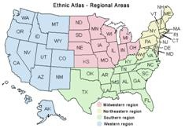
Clustering of Ethnicities.
Clustering of ethnicities can occur at two scales, particular regions of the country, and. particular neighborhoods within cities.
African-Americans are clustered in the Southeast, Hispanics in the Southwest, Asian-Americans in the West, and American Indians in the Southwest and Plains states.

Slide 14
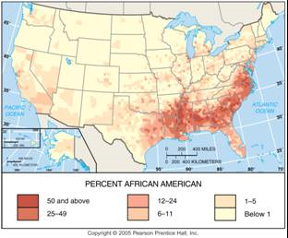
African Americans in the U.S.
Many African Americans live in the rural south…Why?

Slide 15
Slavery
Most slaves were sent to work in the south on plantations after being brought over from Africa.
After the passage of the 13th amendment, many stayed in the south.

Slide 16
Attitudes Towards Slaves
Freed as slaves, most African Americans remained in the rural South during the late nineteenth century working as sharecroppers.
A sharecropper works fields rented from a landowner and pays the rent by turning over to the landowner a share of the crops.
The sharecropper system burdened poor African-Americans with high interest rates and heavy debts.
Instead of growing food that they could eat, sharecroppers were forced by landowners to plant extensive areas of crops such as cotton that could be sold for cash.

Slide 17
African-American Migration Patterns.
Three major migration flows have shaped (African-American) distribution within the United States:
1.immigration from Africa. . . in the eighteenth century;
2.immigration to northern cities during the first half of the twentieth century;
3.(and) immigration from inner-city ghettos to other urban neighborhoods in the second half of the twentieth century.

Slide 18
Triangle Slave Trade

Slide 19
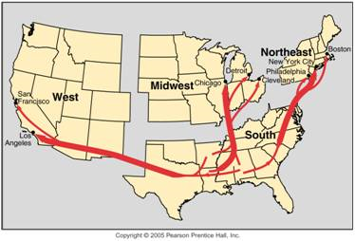
African American Migration in the U.S.A.
Twentieth-century African American migration within the U.S. consisted mainly of migration from the rural south to cities of the Northeast.

Slide 20
African Americans in Baltimore

Slide 21
Hispanic Americans
Hispanic or Hispanic-American is a term that the U.S. government chose in 1973 because it was an inoffensive label that could be applied to all people from Spanish-speaking countries.
Some Americans of Latin-American descent have adopted the term Latino instead.
Most Hispanics identify with a more specific ethnic or national origin.

Slide 22
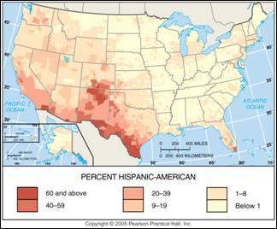
Hispanic Americans in the U.S.
Most Hispanic Americans live in the Southwest.

Slide 23
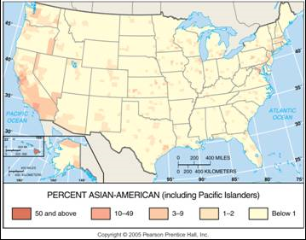
Asian Americans in the U.S.
The highest percentage of Asian Americans live on the west coast or in Hawaii.

Slide 24
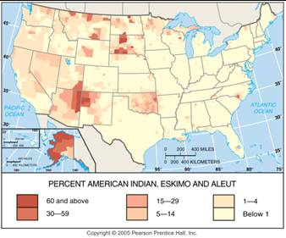
Native Americans
Many people of Native American descent are clustered in the Southwest and the Plains.

Slide 25
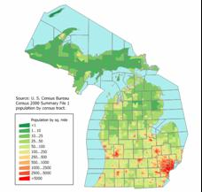
Concentrations of Ethnicities in Cities.
About one-fourth of all Americans live in cities, whereas more than half of African-Americans live in cities.
The contrast is greater at the state level.
For example, African-Americans comprise three-fourths of the population in the city of Detroit and only one-twentieth in the rest of Michigan.
The distribution of Hispanics is similar to that of African- Americans in large northern cities.

Slide 26
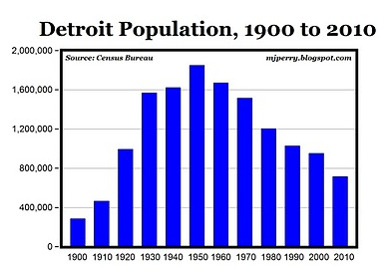

Slide 27
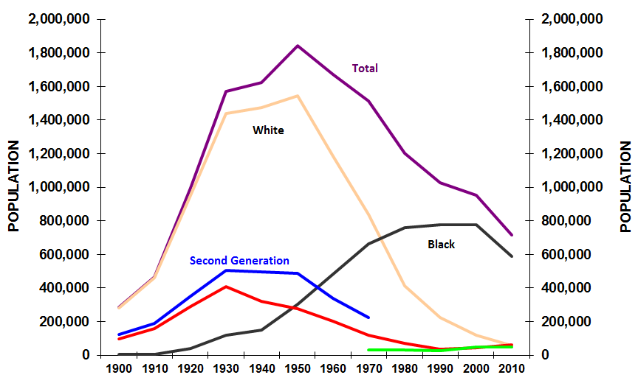
Why did the white people leave?

Slide 28
Brainstorm
White flight to the suburbs.
High crime rate.
Housing lost value.
Detroit’s jobs in the auto-industry started disappearing.
Race riots of 1967 scared Whites away.

Slide 29
Ethnic Distribution
In the states with the largest Hispanic populations—California and Texas—ethnic distribution is mixed.
The clustering of ethnicities is especially pronounced at the scale of neighborhoods within cities.
During the twentieth century the children and grandchildren of European immigrants moved out of most of the original inner-city neighborhoods.
For descendants of European immigrants, ethnic identity is more likely to be retained through religion, food, and other cultural traditions rather than through location of residence.

Slide 30
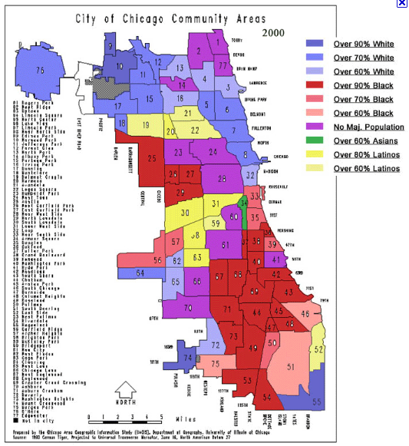
Ethnicities in Chicago
African Americans, Hispanic Americans, Asian Americans, and European Americans are clustered in different neighborhoods.

Slide 31
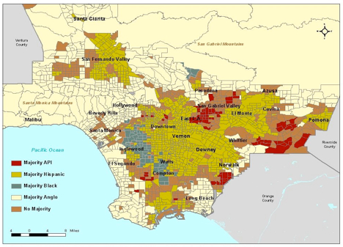
Ethnicities of Los Angeles
Hispanic, white, African American, and Asian areas in and around Los Angeles.

Slide 32
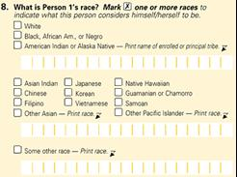
The Census
Every 10 years the U.S. Bureau of the Census asks people to classify themselves according to races with which they most closely identify.
The 2000 census permitted people to check more than 1 of 14 categories listed.
A distinctive feature of race relations in the United States has been the strong discouragement of spatial interaction the past through legal means, today through cultural preferences or discrimination.

Slide 33
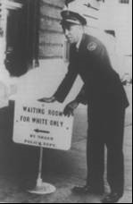
“Separate but Equal” Jim Crow
In 1896 the U.S. Supreme Court upheld a Louisiana law that required black and white passengers to ride in separate railway cars, in Plessy v. Ferguson.
Once the Supreme Court permitted “separate but equal” treatment of the races, southern states enacted a comprehensive set of laws to segregate blacks from whites as much as possible.

Slide 34
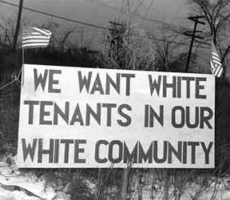
Racism and Ethnocentrism
Throughout the country, not just in the South, house deeds contained restrictive covenants that prevented the owners from selling to blacks, as well as to Roman Catholics or Jews in some places.

Slide 35
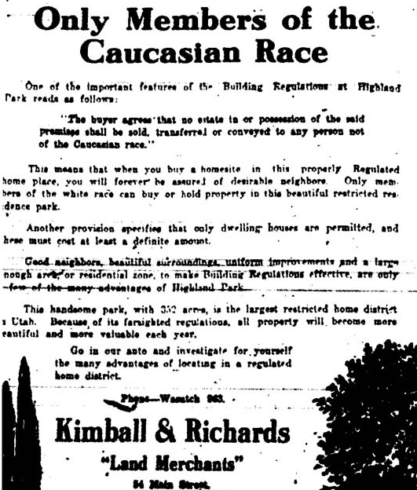

Slide 36
Integration did happen eventually.

Slide 37
Why do you suppose that people of similar backgrounds tend to cluster together?

