Slide 1
AIM: How do places affect identity, and how can we see identities in places?
Do Now: How do you “belong” to your place?
Place can mean city, country, state, borough, neighborhood, Brooklyn Tech. Be creative.

Slide 2
Ethnicity
Comes from the idea that people are closely bounded, or relayed in a certain place over time.
-Less relevant in the United States.
(South Asian-American vs. Bengali-American, Indian-American, Pakistani-American)

Slide 3
India is a diverse country.
Many people from India who move here might see themselves as (Indian-American), but India is a diverse country.
Two Indian-Americans in the United States might see themselves as the same here, but would have had nothing to do with each other in India.

Slide 4
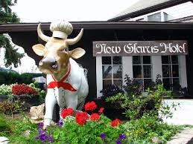
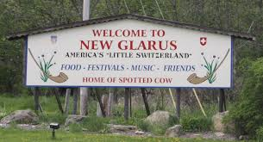
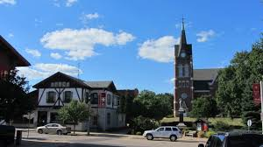
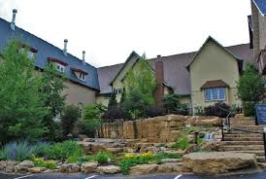
Ethnic Enclaves in the United States
New Glarus

Slide 5
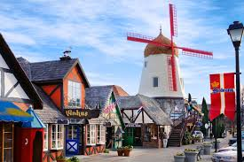
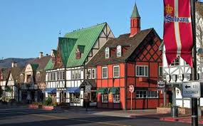
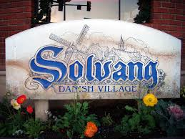
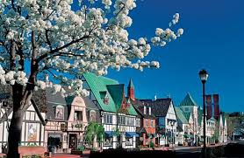
Solvang, California

Slide 6
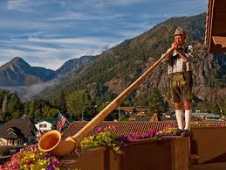
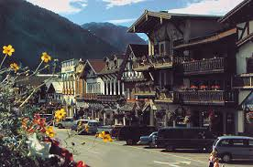
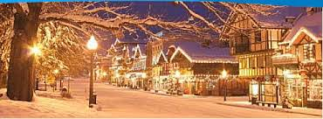
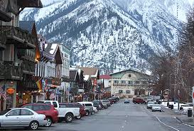
Leavenworth, Washington (modeled after a Bavarian Village, entirely for tourist reasons)

Slide 7
Why did Chinatowns form in many American cities?

Slide 8
Ethnicity is the root of many conflicts.
When race cannot be used to describe why conflict exists, ethnicity is often used.
Attempted genocides are usually carried out over ethnic differences. (Serbia, Rwanda, Guatemala, Sudan)

Slide 9
How is sexuality shown in space?
Some neighborhoods in NYC are seen as historically more “gay-friendly”.
The Village.
Chelsea.
As baby-boomer same-sex couples have aged, they have started moving to some retirement communities, changing the landscape in the new locations.
Same-sex couples have also played a role in the gentrification of inner-city neighborhoods.

Slide 10
How is identity infused in space?
Gender?
Age?
Stores?
https://www.youtube.com/watch?v=vCvVUHxf6Pg

