Slide 1
AIM: How does free trade affect life in the United States?
Do Now: How can governments affect economic development with each of the following?

Slide 2
Regulations

Slide 3
2. How can governments affect economic development with each of the following?

Slide 4
Tariffs

Slide 5
Tax Structures

Slide 6
Trade Agreements

Slide 7
Land Ownership Rules

Slide 8
What is free trade?
Free trade is international trade without the use of protective tariffs. Various Free Trade Agreements have taken effect throughout the world including the North American Free Trade Agreement. (NAFTA). All E.U. member states also have free trade agreements. A proposed free trade agreement between the United States and Pacific Rim countries has become a point of contention in the current presidential election.

Slide 9
In groups of 4, come up with reasons why free trade can both help and hurt U.S. workers.
Help
Hurt

Slide 10
How does free trade affect your work prospects?

Slide 11
The New International Division of Labor
The selective transfer of jobs is known as the new international division of labor.
Often times the foreign operations are overseen by independent companies.

Slide 12
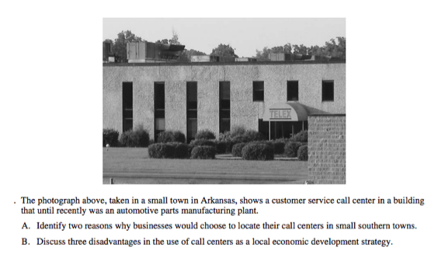
Services FRQ

Slide 13
Part A (2 points: one point for each correct response.
Low wage structure
Low tax structure (tax incentives)
Low land (site costs) or rent.
Low building costs/buildings available
Large labor pool (from deindustrialization) and small town/rural area.
Telecommunications in place or easily provided.
Business climate, e.g., right to work laws in place, zoning.

Slide 14
