Slide 1
AIM: Where did the major religions of the world originate, and how to religions diffuse?
Do Now: What is the difference between a religious branch, denomination and sect?

Slide 2
Awesome Vocabulary!
Branch – large and fundamental division in a religion. IE (Sunni and Shiite or Roman Catholic, Protestant, and Orthodox)
Denomination – a division of a branch that unites a number of local congregations.
Sect – small group that has broken away from an established denomination.

Slide 3
World Distribution of Religions

Slide 4
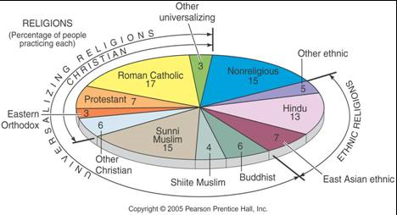
World Population By Religion
Over two-thirds of the world’s population belong to Christianity, Islam, Hinduism, or Buddhism. Christianity is the single largest world religion.

Slide 5
AIM: Where are the major religions distributed around the world?
Do Now: Identify which form of Christianity has the most followers in the North East United States.

Slide 6
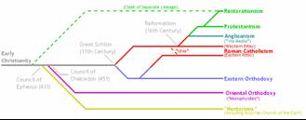
Christianity and it’s Branches
Christianity has about 2.18 billion adherents, far more than any other world religion, and has the most widespread distribution.
Christianity has three major branches:
–Roman Catholic
–Protestant
–Eastern Orthodox

Slide 7
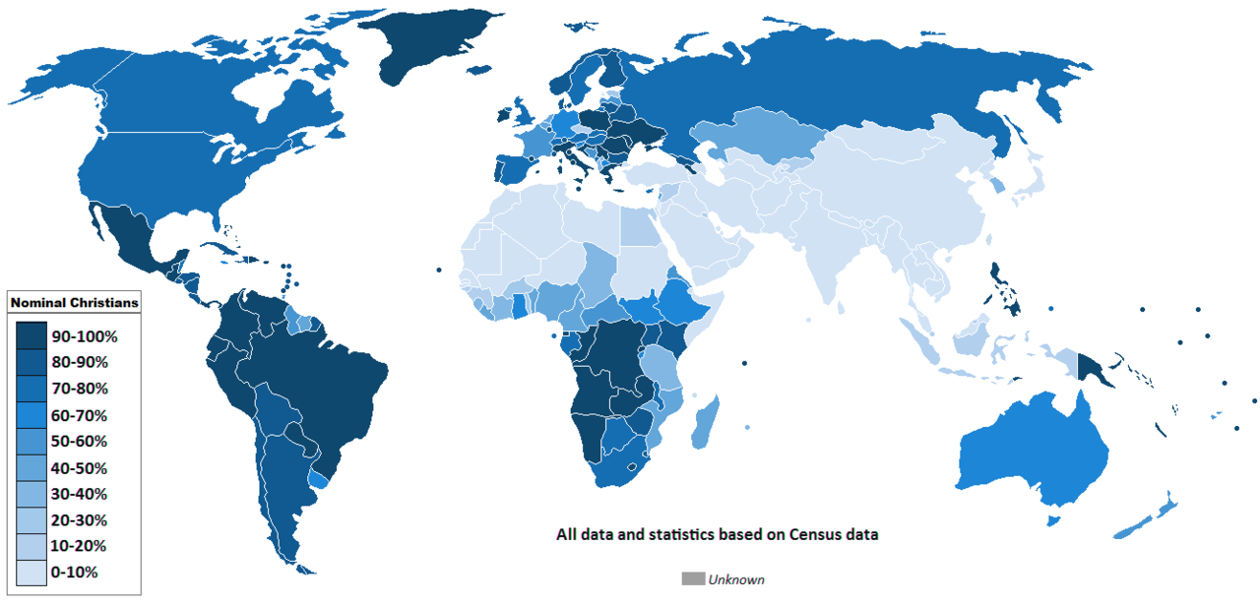
Christians worldwide

Slide 8
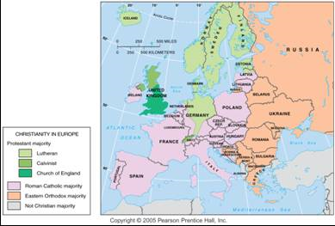
Christian Branches in Europe
Protestant denominations, Catholicism, and Eastern Orthodoxy are dominant in different regions of Europe—a result of many historic events.

Slide 9
The Eastern Orthodox Church
The Eastern Orthodox branch of Christianity is a collection of 14 self-governing churches in Eastern Europe and the Middle East.
40%+ of all Eastern Orthodox Christians belong to the Russian Orthodox Church, established in the sixteenth century.
Nine of the other 13 self- governing churches were established in the 1800s-1900s.
The second largest group is the Romanian Orthodox Church (20% of all Orthodox Christians).
The remaining 4 of the 14 Eastern Orthodox churches— Constantinople, Alexandria, Antioch, and Jerusalem—trace their origins to the earliest days of Christianity.

Slide 10
Christianity in the Western Hemisphere
Over 90% of people living in the Western Hemisphere are Christians.
About 5 percent belong to other religions.
North America = 25% Roman Catholic
South America = 95% Roman Catholic
Within North America, Roman Catholics are clustered in the southwestern and northeastern United States and the Canadian province of Québec.
Protestants comprise 40 percent of Christians in North America.
The three largest Protestant denominations in the United States are Baptist, Methodist, and Pentecostal, followed by Lutheran, Latter-Day Saints, and Churches of Christ.

Slide 11
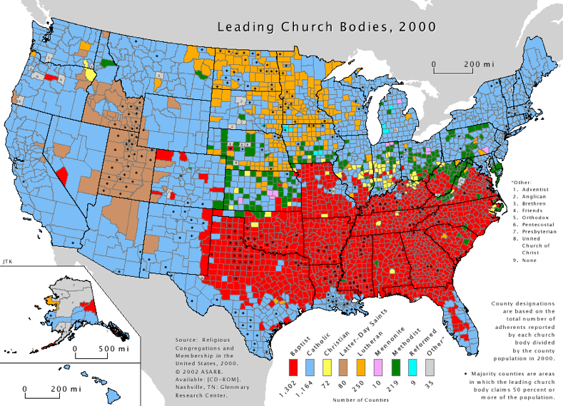
Christian Branches in the U.S.
Distribution of Christians in the U.S. Shaded areas are counties with more than 50% of church membership concentrated in Roman Catholicism or one of the Protestant denomination

Slide 12
Baptists are dominant in the South.
Lutherans are dominant in the Midwest.
Mormons are dominant in the West.
Why are each of these groups dominant where they are?

Slide 13
Why are there many Catholics in the Northeast and Southwest United States?

Slide 14
Smaller Branches of Christianity
Two small Christian churches survive in northeast Africa:
–the Coptic Church of Egypt
–the Ethiopian Church.

Slide 15
Armenian Church
The Armenian Church originated in Antioch, Syria, and was important in diffusing Christianity to South and East Asia between the seventh and thirteenth centuries.
The Armenian Church, like other small sects, plays a significant role in regional conflicts.
The Maronites, (clustered in Lebanon) are another example of a small Christian sect that plays a disproportionately prominent role in political unrest.

Slide 16
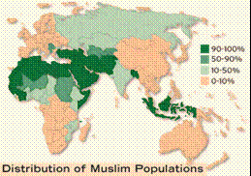
Islam
Islam, the religion of 1.6 billion people, is the predominant religion of the Middle East from North Africa to Central Asia.
However, half of the world’s Muslims live in four countries outside the Middle East: Indonesia, Pakistan, Bangladesh, and India.
Islam is a universalizing religion.

Slide 17
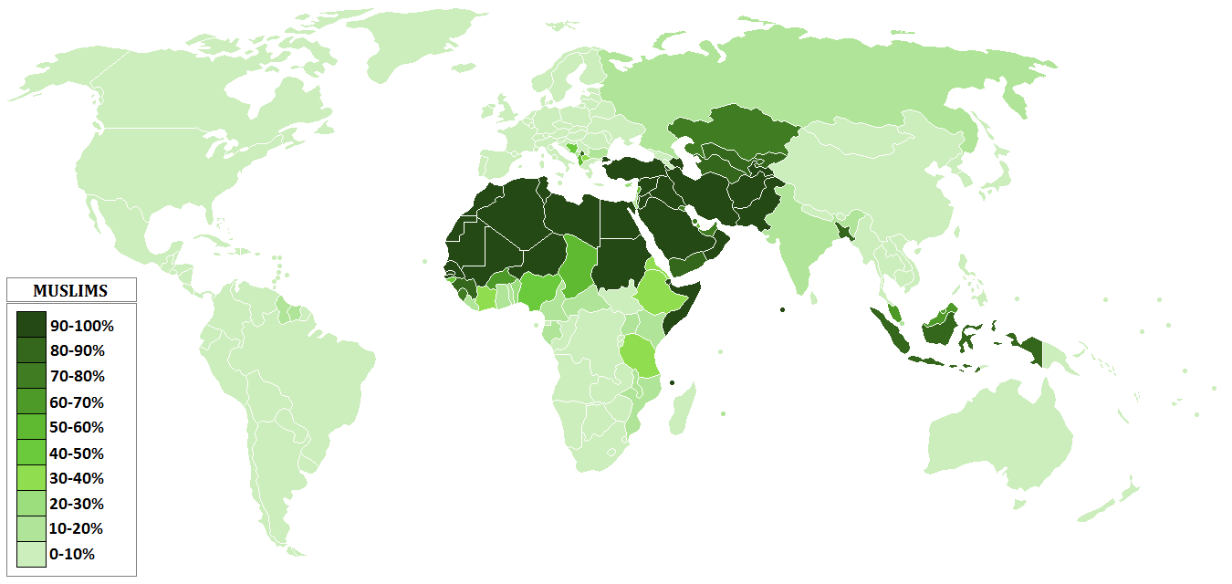
Muslims worldwide

Slide 18
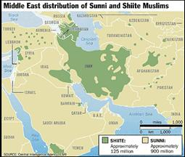
Branches of Islam
Islam is divided into two important branches:
–Sunni (from the Arabic word for orthodox) 83%
–Shiite (from the Arabic word for sectarian, sometimes written Shia in English). 16%
Sunni are the largest branch in most Muslim countries.
Shiite are clustered in a handful of countries.

Slide 19
Basics
What is a Muslim house of worship called?
What is a Muslim religious leader called?

Slide 20
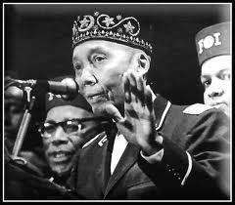
Islam in North America and Europe
Islam also has a presence in the United States through the Nation of Islam, also known as Black Muslims, founded in Detroit in 1930 and led for more than 40 years by Elijah Muhammad, who called himself “the messenger of Allah.”
Since Muhammad’s death, in 1975, his son Wallace D. Muhammad led the Black Muslims closer to the principles of orthodox Islam, and the organization’s name was changed to the American Muslim Mission.

Slide 21
Buddhism
Buddhism, the third of the world’s major universalizing religions, has 376 million adherents, especially in China and Southeast Asia.
Like the other two universalizing religions, Buddhism split into more than one branch.
An accurate count of Buddhists is especially difficult, because only a few people participate in Buddhist institutions.

Slide 22
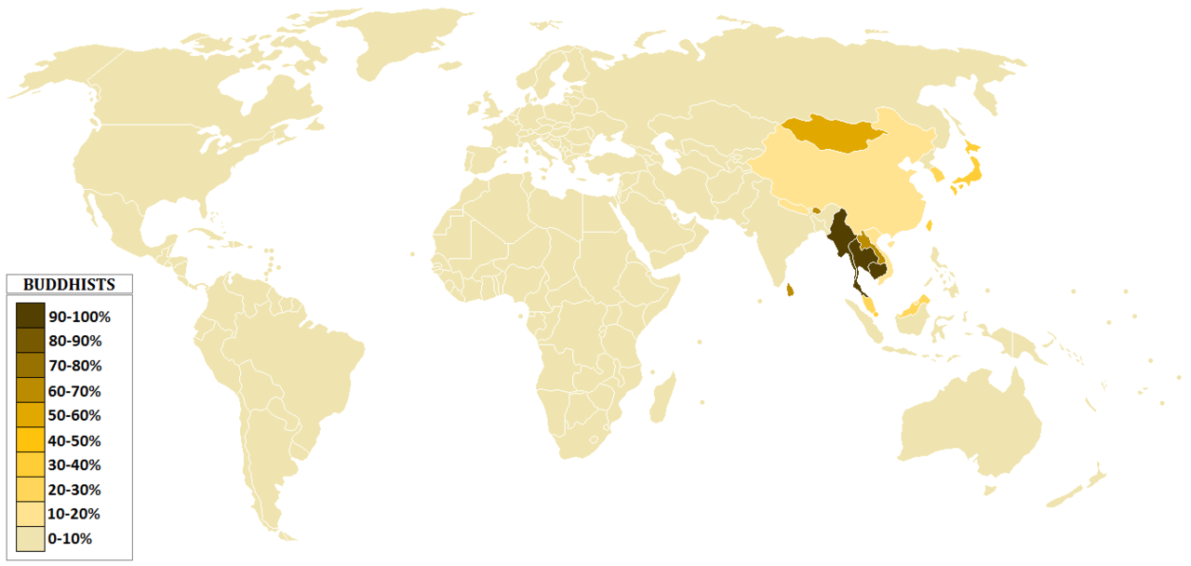
Buddhists worldwide

Slide 23
Three Main Branches
–Mahayana,
–Theravada,
–Tantrayana (Vajrayana) (Lamaistic)

Slide 24
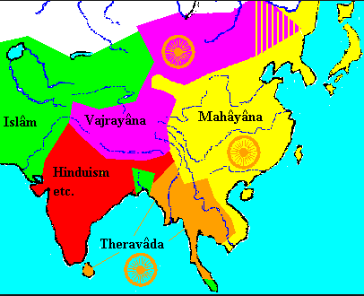

Slide 25
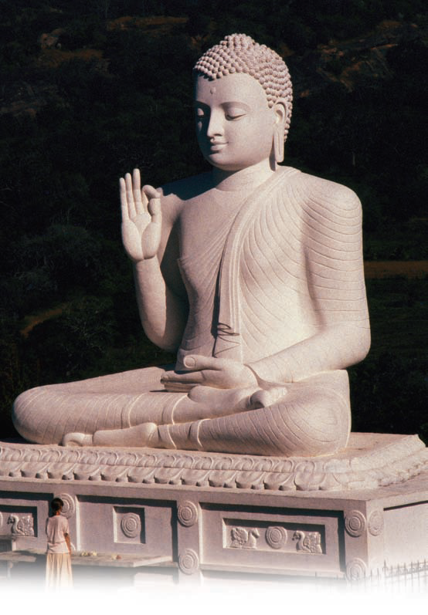
Buddhism
The Dalai Lama, shown here greeting Tibetans, serves as the spiritual authority of Tibet, but he has lived in exile since China invaded and occupied the region in 1959. Tibetan Buddhists believe that the Dalai Lama is the reincarnation of the bodhisattva of mercy and that when he dies his spirit will be reincarnated and enter a child.

Slide 26
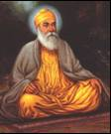
Other Universalizing Religions - Sikhism
Sikhism and Bahá’I are the two universalizing religions other than Christianity, Islam, and Buddhism with the largest numbers of adherents.
Sikhism’s first guru (religious teacher or enlightener) was Nanak (A.D. 1469—153 8), who lived in a village near the city of Lahore, in present-day Pakistan.

Slide 27
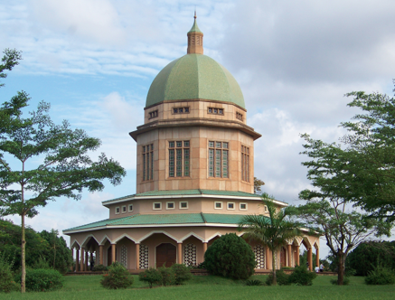
Bahá’I Faith (Other Universalizing Religions)
The Bahá’I religion is even more recent than Sikhism.
It grew out of the Bábi faith, which was founded in ShIráz, Iran, in 1844 by Siyyid ‘Au Muhammad, known as the Báb (Persian for gateway).

Slide 28
AIM: Where are the major ethnic religions located around the world?

Slide 29
Ethnic Religions
Ethnic religions typically have much more clustered distributions than do universalizing religions.
The ethnic religion with by far the largest number of followers is Hinduism. With 900 million adherents, Hinduism is the world’s third-largest religion, behind Christianity and Islam.

Slide 30
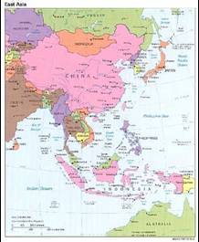
Other Ethnic Religions
Several hundred million people practice ethnic religions in East Asia, especially in China and Japan.
Buddhism does not compete for adherents with Confucianism, Daoism, and other ethnic religions in China, because many Chinese accept the teachings of both universalizing and ethnic religions.

Slide 31
Hinduism
Ninety-seven percent of Hindus are concentrated in one country, India.
Two percent are in the neighboring country of Nepal, and the remaining one percent are dispersed around the world.
The appropriate form of worship for any two individuals may not be the same.
Hinduism does not have a central authority or a single holy book.
The largest number of adherents—an estimated 70 percent— worships the god Vishnu, a loving god incarnated as Krishna.
An estimated 25 percent adhere to Siva, a protective and destructive god.
Shaktism is a form of worship dedicated to the female consorts of Vishnu and Siva.

Slide 32
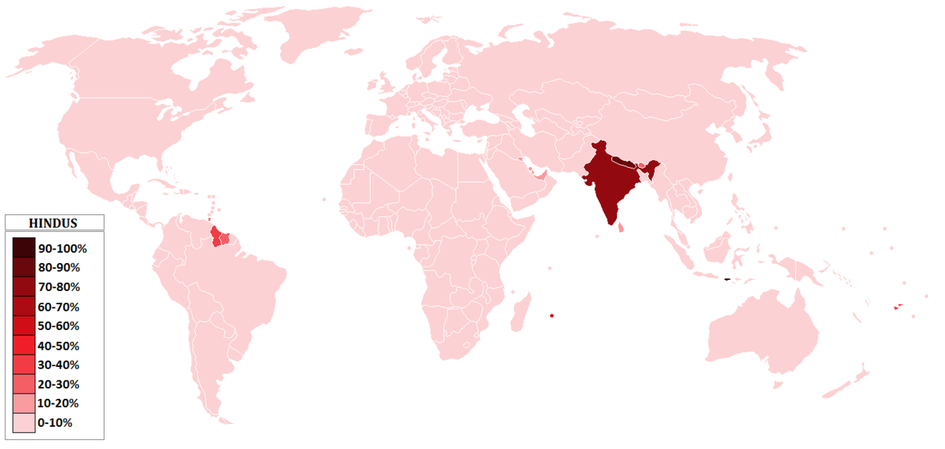
Hindus worldwide

Slide 33
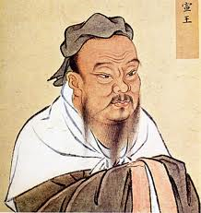
Confucianism
Confucius (551—479 B.C.) was a philosopher and teacher in the Chinese province of Lu.
Confucianism prescribed a series of ethical principles for the orderly conduct of daily life in China.

Slide 34
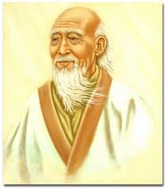
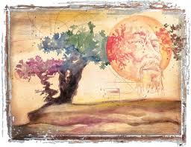
Daoism (Taoism)
Lao-Zi (604—531? B.C., also spelled Lao Tse), a contemporary of Confucius, organized Daoism.
Daoists seek dao (or tao), which means the way or path.
Dao cannot be comprehended by reason and knowledge, because not, everything is knowable.
Daoism split into many sects, some acting like secret societies, and followers embraced elements of magic.

Slide 35
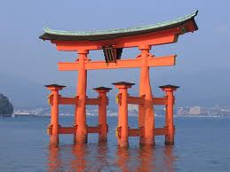
Shinto
Since ancient times, Shinto has been the distinctive ethnic religion of Japan.
Ancient Shintoists considered forces of nature to be divine.
Gradually, deceased emperors and other ancestors became more important deities for Shintoists than natural features.
Shinto still thrives in Japan

Slide 36
It features heavily in the movies of Hayao Miyazaki

Slide 37
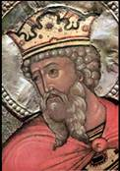
Judaism
Between 5.4 – 6.8 million Jews live in the USA, 6.1 million live in Israel, and another 2 to 3 million are spread between Europe, Brazil, Argentina, South Africa and Canada.
The number of Jews living in the former Soviet Union has declined rapidly since the late 1980s, when emigration laws were liberalized.

Slide 38
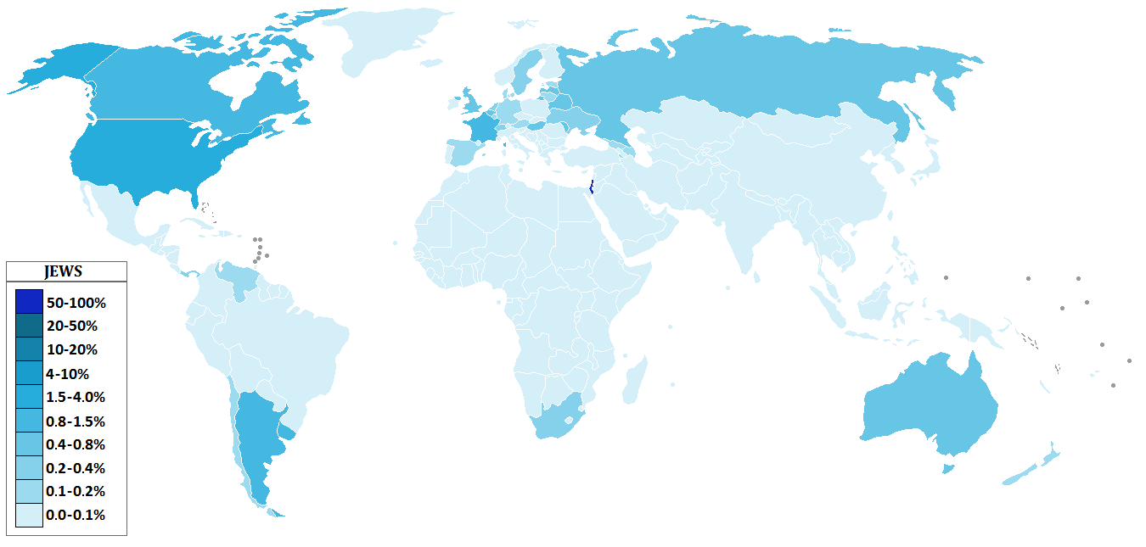
Judaism worldwide

Slide 39
Judaism plays a more substantial role in Western civilization than its number of adherents would suggest, because two of the three main universalizing religions—Christianity and Islam—find some of their roots in Judaism.
The name Judaism derives from Judah, one of the patriarch Jacob’s 12 sons; Israel is another biblical name for Jacob.

Slide 40
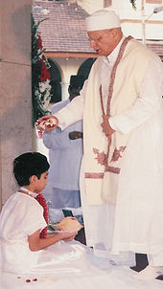
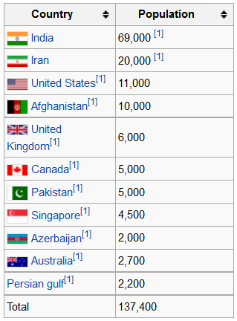
Zoroastrianism
Considered one of the two oldest monotheistic religions in the world.
Most adherents live in Iran or India.
In 2004, the number of Zoroastrians worldwide was estimated at between 145,000 and 210,000

Slide 41
The most famous follower of Zoroastrianism of the past century was named Farrokh Bulsara
Aka Freddie Mercury
The lead singer of “Queen”

Slide 42
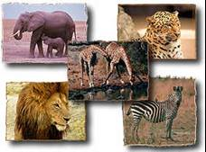
Ethnic African Religions
About 10 percent of Africans follow traditional ethnic religions, sometimes called animism.
African animist religions are apparently based on monotheistic concepts, although below the supreme god there is a hierarchy of divinities, assistants to god or personifications of natural phenomena, such as trees or rivers.
Some atlases and textbooks persist in classifying Africa as predominantly animist, even though the actual percentage is small and declining.

Slide 43
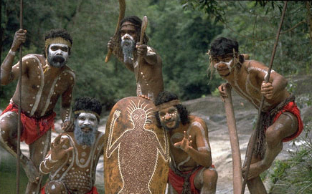
Other Traditional Religious Groups
Aborigines (Australia)
Some Native Americans

