Slide 1
AIM: How is religion seen in the cultural landscape?
Do Now: Where is evidence of religion in our landscape?

Slide 2
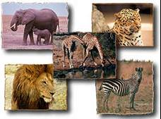
Ethnic African Religions
About 10 percent of Africans follow traditional ethnic religions, sometimes called animism.
African animist religions are apparently based on monotheistic concepts, although below the supreme god there is a hierarchy of divinities, assistants to god or personifications of natural phenomena, such as trees or rivers.
Some atlases and textbooks persist in classifying Africa as predominantly animist, even though the actual percentage is small and declining.

Slide 3
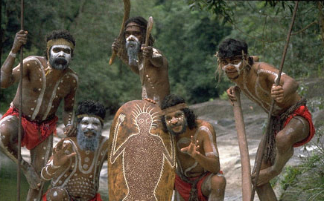
Other Traditional Religious Groups
Aborigines (Australia)
Some Native Americans

Slide 4
How is religion seen in the cultural landscape?
Sacred Sites – places or spaces people infuse with religious meaning.
They may be places to visit, or places to be feared.
Some religions encourage pilgrimages to sacred sites.

Slide 5
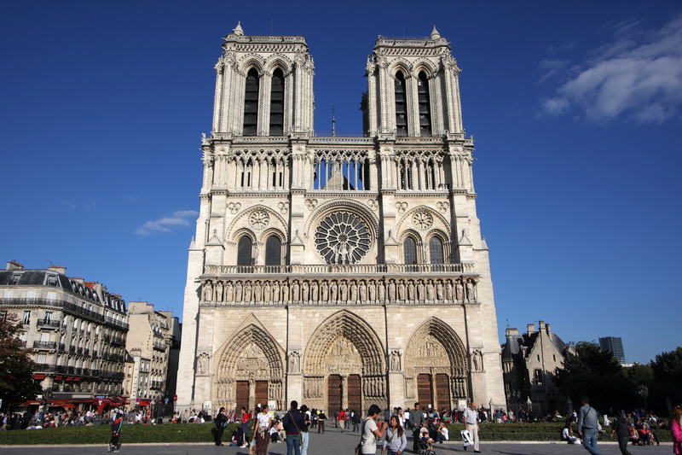
Catholicism
In Catholicism, many churches are home to sacred objects (goods that are connected to either Jesus or a Saint)
Sacred Sites are usually built in accessible, urban areas.

Slide 6
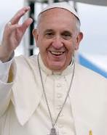
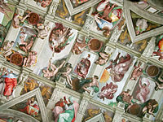
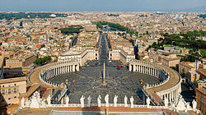
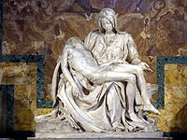
Catholicism
There are hundreds of sacred sites spread throughout Europe.
Perhaps the most important is the Vatican, where the Pope lives.
About 25 million visitors a year.

Slide 7
Christianity
Christianity also manifests in the landscape in the form of Churches. Christians are supposed to pray together in Church.

Slide 8
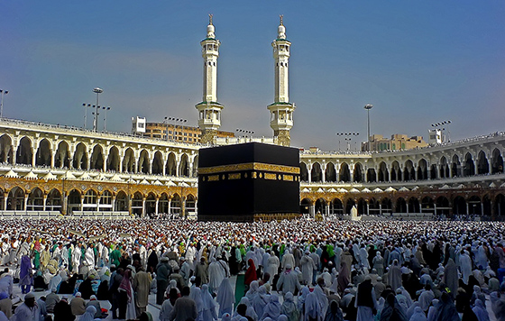
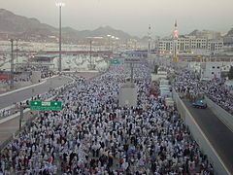
Islam
Millions of Muslims embark on the Hajj at least once during their lives. This Pilgrimage is a reenactment of the Prophet’s journey between Medina and Mecca.
The journey is not always safe.
In 2015, over 2000 people
were killed in a stampede in the
streets of Mecca.
The Hajj finishes when pilgrims
circle the Kaaba in the center of the
Al-Masjid al-Haram Mosque.
Most sacred sites in Islam center around
places the prophet went during his life.

Slide 9
Islam
Islam also manifests in the landscape through the construction of Mosques. Observant Muslims often pray together in Mosques; however, it is considered perfectly reasonable to pray on your own, and Mosques are not considered sanctified holy places.
Muslims are supposed to pray in the closest direction to Mecca.

Slide 10
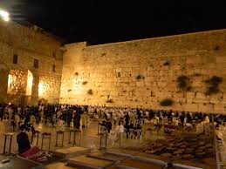
Judaism
The holiest site accessible in Judaism is the Western Wall. This wall was part of the holy temple that the Romans destroyed in 70CE, and is the closest remaining wall to where the temple apparently held the Ark containing the original 10 Commandments.
Many Jewish people visit this
site during their lifetimes, and
some residents of Jerusalem
pray outside of it every week.

Slide 11
Judaism
Jews pray in synagogues. The area that contains the Torahs is supposed to be in the part of the synagogue that is physically closest to Jerusalem (the holiest city in Judaism).

Slide 12
Cemeteries
The three Abrahamic religions generally frown on cremation. As such there are more cemeteries in the countries dominated by these religions.

Slide 13
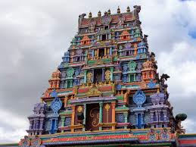
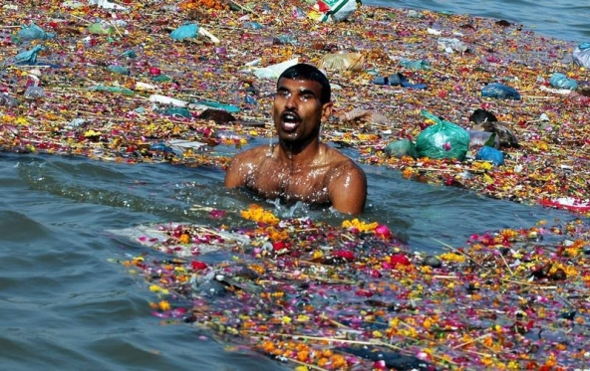
Hinduism
The holiest area in the world for Hindus is the Ganges River.
Hindus also erect temples in sacred sites, but it is not necessary to worship at the temples. The temples do not usually have large communal areas for prayer.

Slide 14
Hinduism
Whenever possible, Hindu temples are constructed in “comfortable” locations like beneath a shady tree.
Followers are supposed to make offerings at temples.

Slide 15
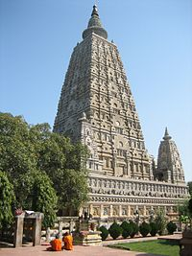
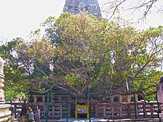
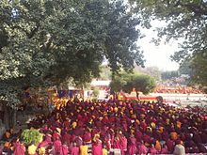
Buddhism
Most holy sites in Buddhism relate to where the Buddha lived and taught. Many Buddhists go on Pilgrimages to the Mahabodhi Temple in Bodh Gaya. This is where the
Buddha was said to have attained
enlightenment.

Slide 16
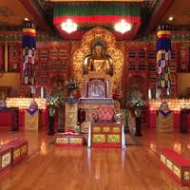
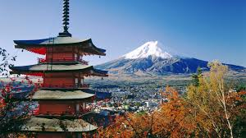
Buddhism
In general, it is not considered necessary for Buddhists to worship together.
Buddhist temples usually contain statues of Buddha.
The classic form of Buddhist architecture is the Pagoda.

Slide 17
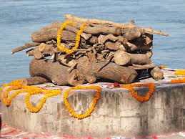
Cremation
Both Hindus and Buddhists typically cremate their dead. As a result, cemeteries are rare in India and Southeast Asia.

Slide 18
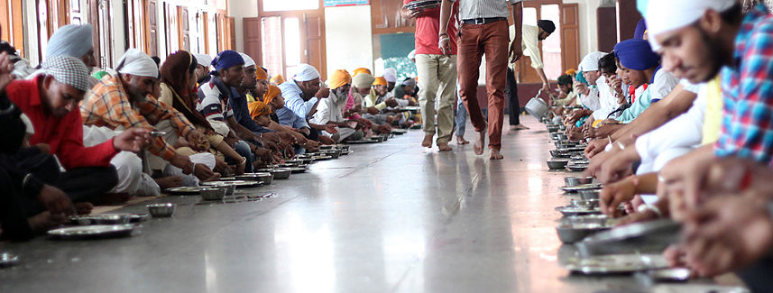
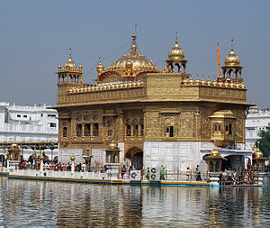
Sikhism
The Harmandir Sahib “Golden Temple” is an important site for Sikhs.
It was designed by the 5th Guru and completed by 1604.
It is open to followers of all religions, but requires all visitors to remove their shoes, cover their heads, and to refrain from meat, tobacco and drugs on the premises.

Slide 19
Sacred Sites
Can sometimes be claimed by multiple religions and cause conflict.

Slide 20
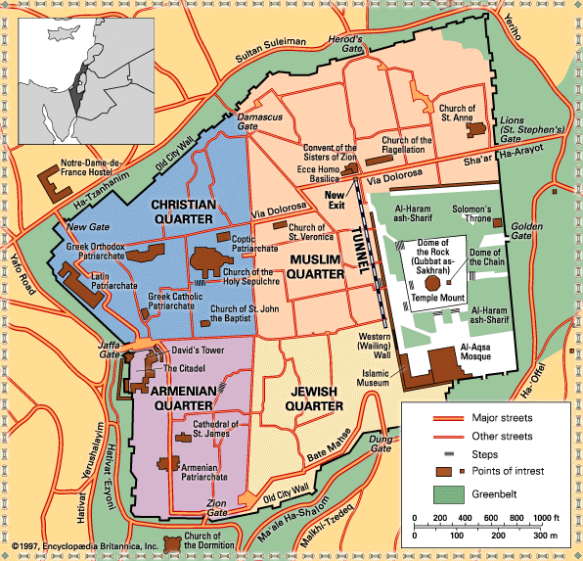
What are some examples of disputed holy places?

Slide 21
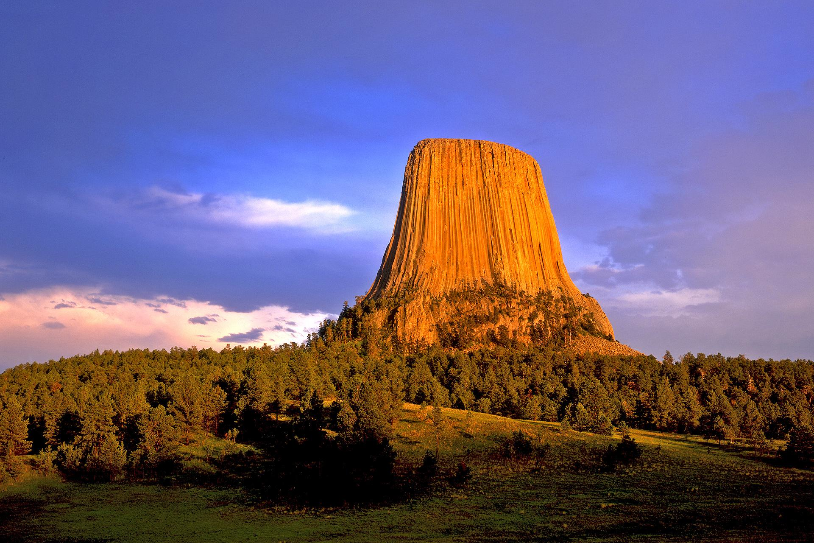
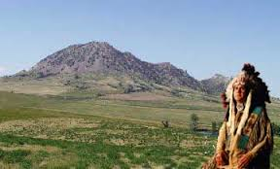
Bear Butte and Devils Tower
Considered holy by the Lakota, and a tourist spot for Americans. However, big oil would like to frack in this area.

Slide 22
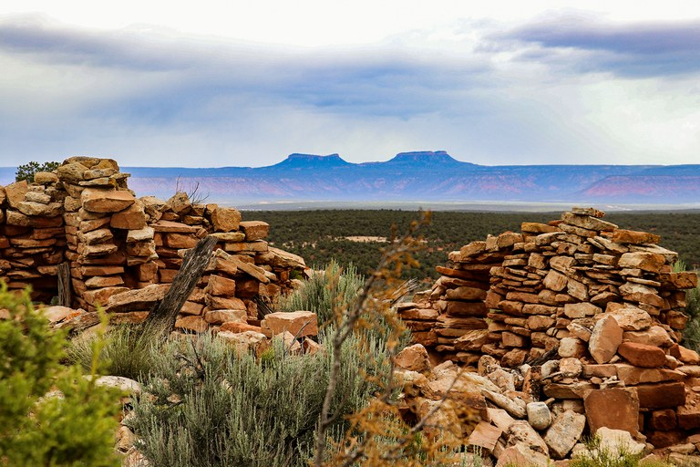
Bears Ears National Monument
Designated a National Monument by President Obama.
This land is considered holy to the Navajo Nation.

Slide 23
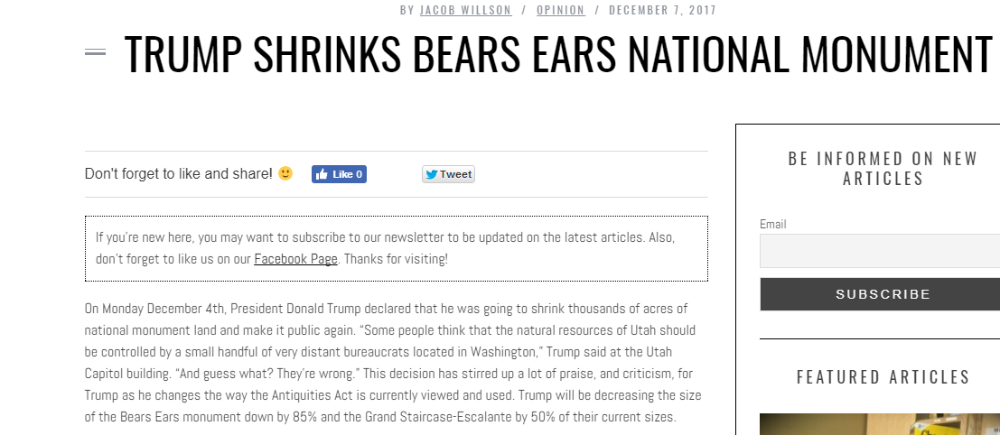
Recent Events

Slide 24
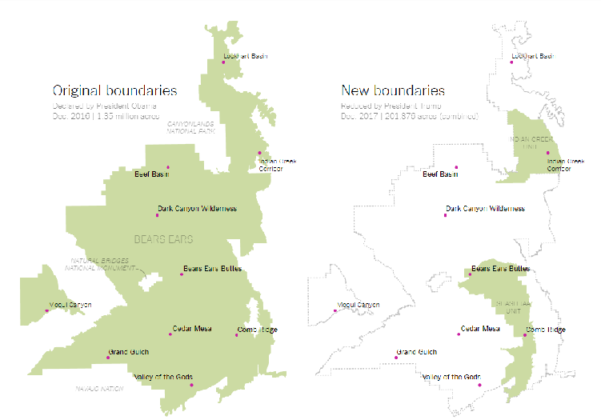
How it affects the National Monument

