Slide 1
AIM: Why do religions have different distributions?
Do Now: Which form of Christianity is the most dominant in New York City?

Slide 2
World Distribution of Religions

Slide 3
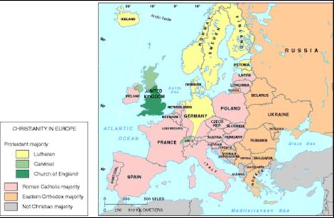
Origin of Christianity

Slide 4
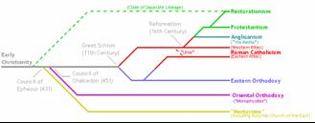
Christianity and it’s Branches
Christianity has about 2.4 billion adherents, far more than any other world religion, and has the most widespread distribution.
Christianity has three major branches:
–Roman Catholic
–Protestant
–Eastern Orthodox

Slide 5
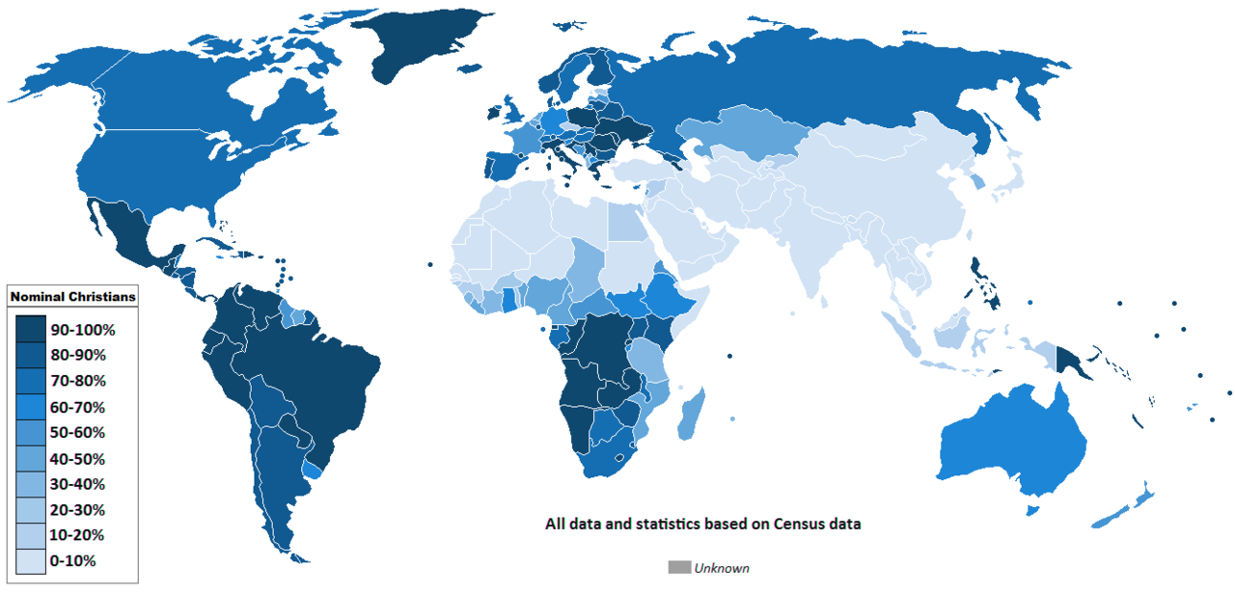
Christians worldwide

Slide 6
The Eastern Orthodox Church
The Eastern Orthodox branch of Christianity is a collection of 14 self-governing churches in Eastern Europe and the Middle East.
40%+ of all Eastern Orthodox Christians belong to the Russian Orthodox Church, established in the sixteenth century.
Nine of the other 13 self- governing churches were established in the 1800s-1900s.
The second largest group is the Romanian Orthodox Church (20% of all Orthodox Christians).
The remaining 4 of the 14 Eastern Orthodox churches— Constantinople, Alexandria, Antioch, and Jerusalem—trace their origins to the earliest days of Christianity.

Slide 7
Christianity in the Western Hemisphere
Over 90% of people living in the Western Hemisphere are Christians.
About 5 percent belong to other religions.
North America = 25% Roman Catholic
South America = 95% Roman Catholic
Within North America, Roman Catholics are clustered in the southwestern and northeastern United States and the Canadian province of Québec.
Protestants comprise 40 percent of Christians in North America.
The three largest Protestant denominations in the United States are Baptist, Methodist, and Pentecostal, followed by Lutheran, Latter-Day Saints, and Churches of Christ.

Slide 8
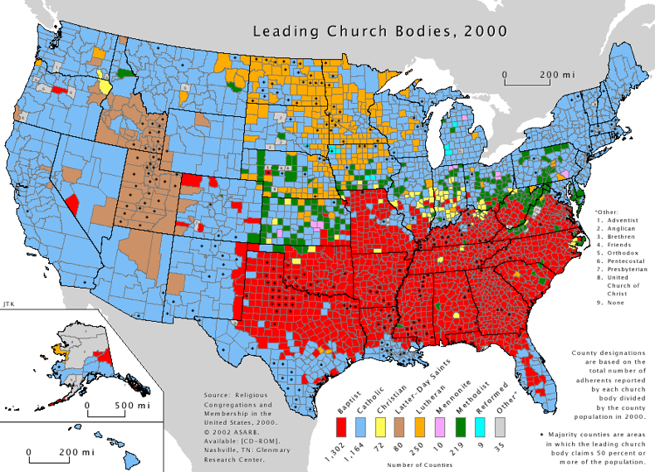
Christian Branches in the U.S.
Distribution of Christians in the U.S. Shaded areas are counties with more than 50% of church membership concentrated in Roman Catholicism or one of the Protestant denomination

Slide 9
Baptists are dominant in the South.
Lutherans are dominant in the Midwest.
Mormons are dominant in the West.
Why are each of these groups dominant where they are?

Slide 10
Why are there many Catholics in the Northeast and Southwest United States?

Slide 11
Smaller Branches of Christianity
Two small Christian churches survive in northeast Africa:
–the Coptic Church of Egypt
–the Ethiopian Church.

Slide 12
Armenian Church
The Armenian Church originated in Antioch, Syria, and was important in diffusing Christianity to South and East Asia between the seventh and thirteenth centuries.
The Armenian Church, like other small sects, plays a significant role in regional conflicts.
The Maronites, (clustered in Lebanon) are another example of a small Christian sect that plays a disproportionately prominent role in political unrest.

Slide 13
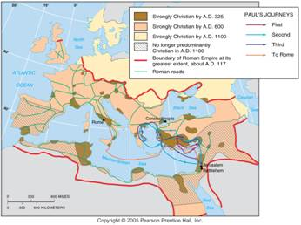
Diffusion of Christianity
Christianity diffused from Judea/Palestine through the Roman Empire and continued diffusing through Europe after the fall of Rome. It was later replaced by Islam in much of the Mideast and North Africa.

Slide 14
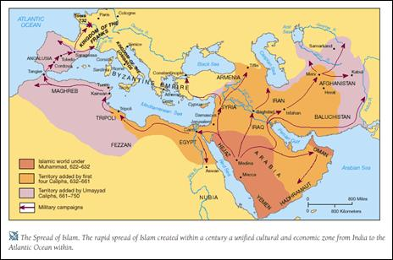
Origin of Islam

Slide 15
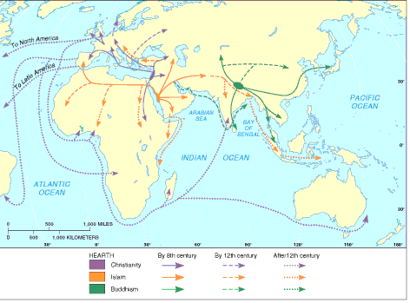
Diffusion of Universalizing Religions
Each of the three main universalizing religions diffused widely from its hearth.

Slide 16
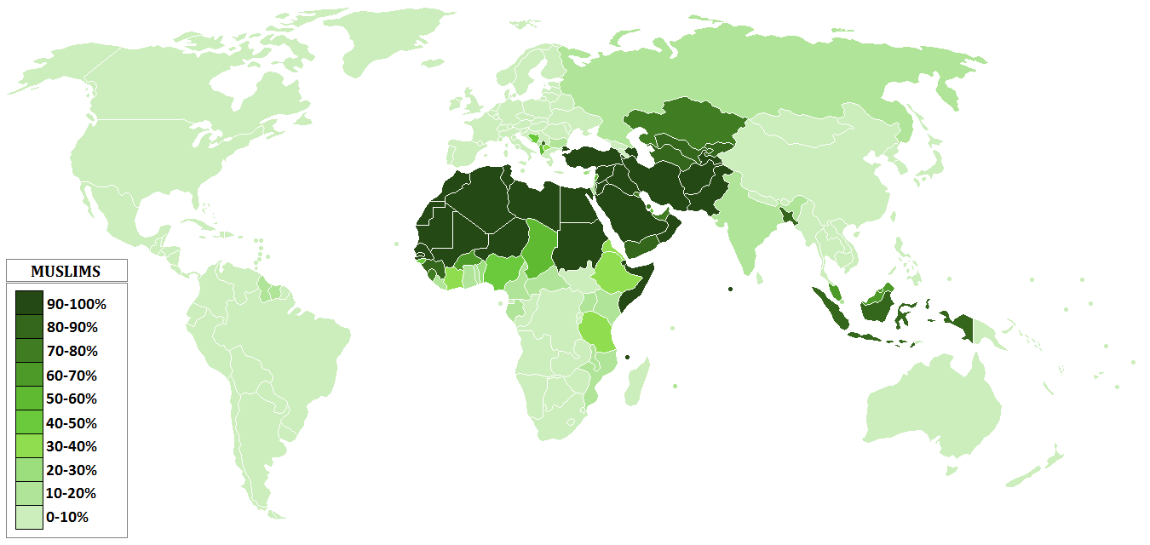
Muslims worldwide

Slide 17
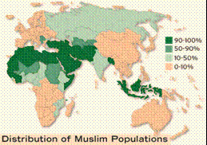
Islam
Islam, the religion of 2 billion people, is the predominant religion of the Middle East from North Africa to Central Asia.
However, half of the world’s Muslims live in four countries outside the Middle East: Indonesia, Pakistan, Bangladesh, and India.
Islam is a universalizing religion.

Slide 18
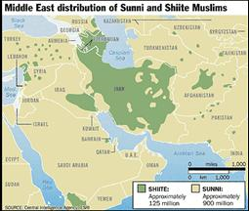
Branches of Islam
Islam is divided into two important branches:
–Sunni (from the Arabic word for orthodox) 83%
–Shiite (from the Arabic word for sectarian, sometimes written Shia in English). 16%
Sunni are the largest branch in most Muslim countries.
Shiite are clustered in a handful of countries.

Slide 19
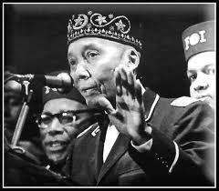
Islam in North America and Europe
Islam also has a presence in the United States through the Nation of Islam, also known as Black Muslims, founded in Detroit in 1930 and led for more than 40 years by Elijah Muhammad, who called himself “the messenger of Allah.”
Since Muhammad’s death, in 1975, his son Wallace D. Muhammad led the Black Muslims closer to the principles of orthodox Islam, and the organization’s name was changed to the American Muslim Mission.

Slide 20
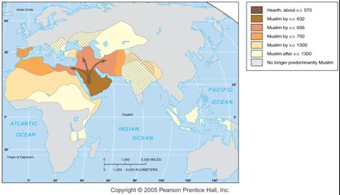
Diffusion of Islam
Islam diffused rapidly and widely from its area of origin in Arabia. It eventually stretched from southeast Asia to West Africa.

Slide 21
Basics
What is a Muslim house of worship called?
What is a Muslim religious leader called?

Slide 22
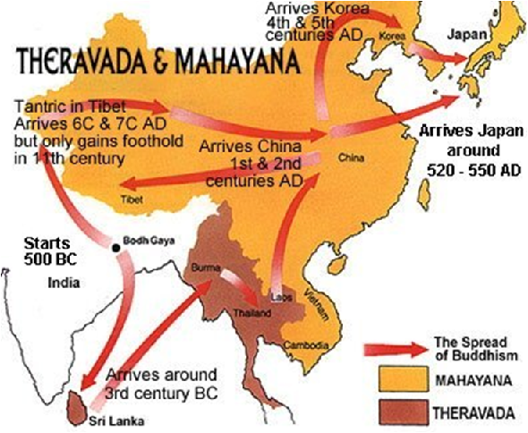
Origin of Buddhism

Slide 23
Buddhism
Buddhism, the third of the world’s major universalizing religions, has 376 million adherents, especially in China and Southeast Asia.
Like the other two universalizing religions, Buddhism split into more than one branch.
An accurate count of Buddhists is especially difficult, because only a few people participate in Buddhist institutions.

Slide 24
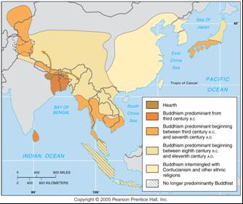
Diffusion of Buddhism
Buddhism diffused gradually from its origin in northeastern India to Sri Lanka, southeast Asia, and eventually China and Japan.

Slide 25
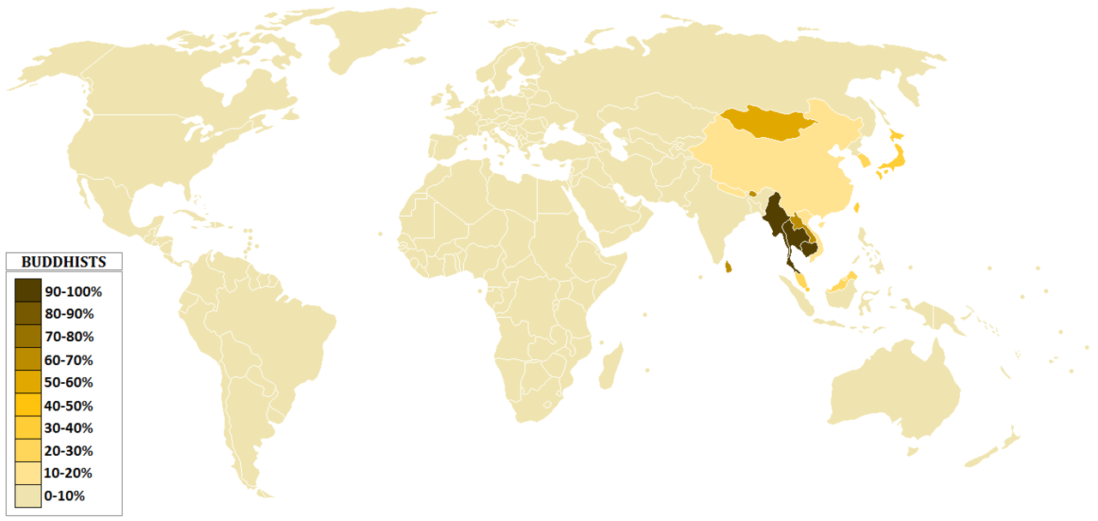
Buddhists worldwide

Slide 26
Three Main Branches
–Mahayana,
–Theravada,
–Tantrayana (Vajrayana) (Lamaistic)

Slide 27
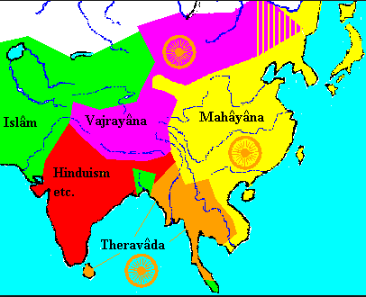

Slide 28
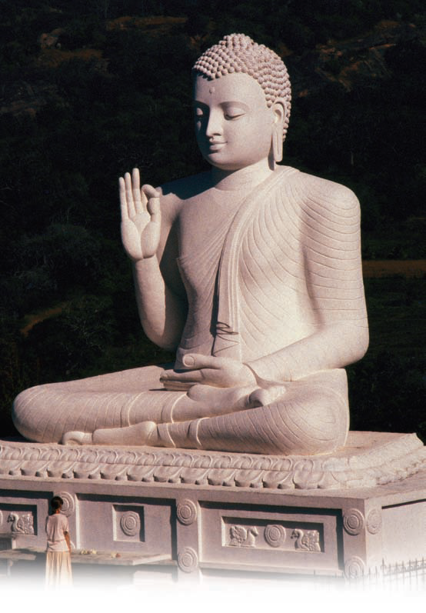
Buddhism
The Dalai Lama, shown here greeting Tibetans, serves as the spiritual authority of Tibet, but he has lived in exile since China invaded and occupied the region in 1959. Tibetan Buddhists believe that the Dalai Lama is the reincarnation of the bodhisattva of mercy and that when he dies his spirit will be reincarnated and enter a child.

