Slide 1
AIM: Why do religions have different distributions?
Do Now: Which religions are most common in New York City?

Slide 2
World Distribution of Religions

Slide 3
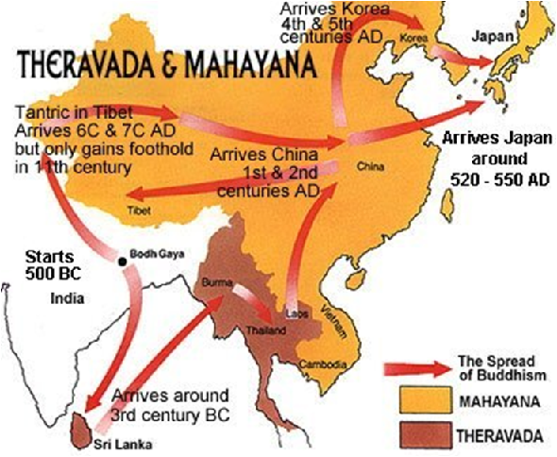
Origin of Buddhism

Slide 4
Buddhism
Buddhism, the third of the world’s major universalizing religions, has 376 million adherents, especially in China and Southeast Asia.
Like the other two universalizing religions, Buddhism split into more than one branch.
An accurate count of Buddhists is especially difficult, because only a few people participate in Buddhist institutions.

Slide 5
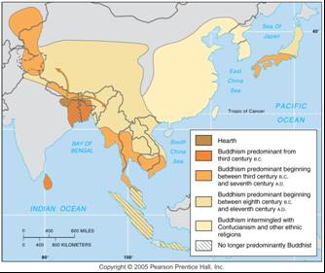
Diffusion of Buddhism
Buddhism diffused gradually from its origin in northeastern India to Sri Lanka, southeast Asia, and eventually China and Japan.

Slide 6
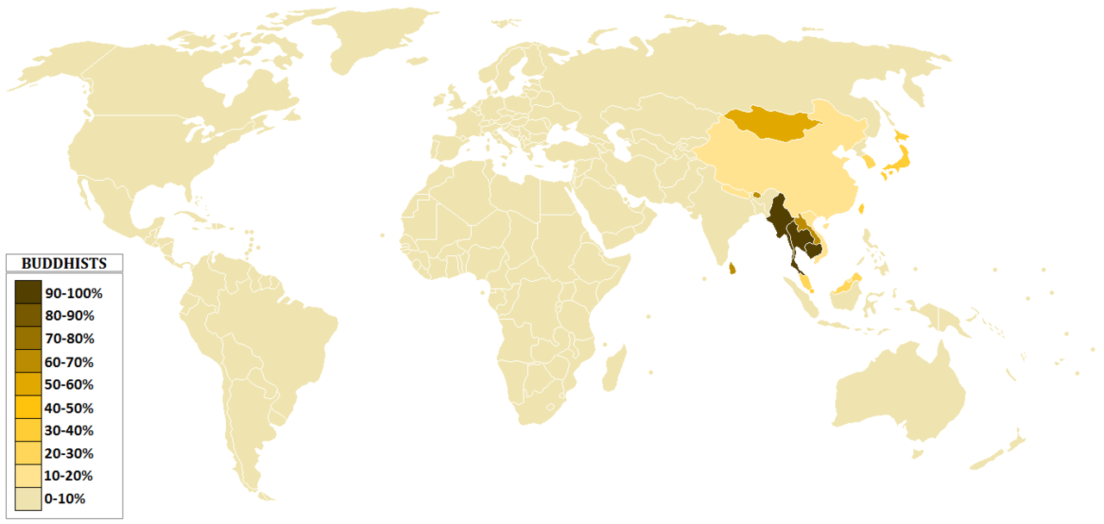
Buddhists worldwide

Slide 7
Three Main Branches
–Mahayana,
–Theravada,
–Tantrayana (Vajrayana) (Lamaistic)

Slide 8
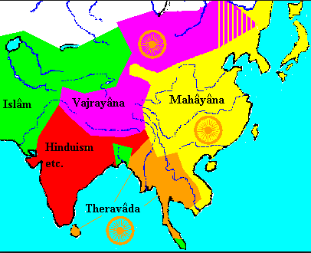

Slide 9
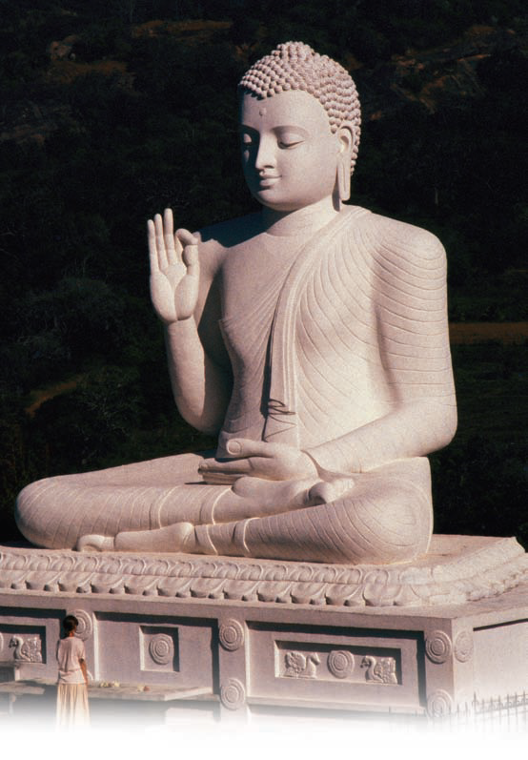
Buddhism
The Dalai Lama, shown here greeting Tibetans, serves as the spiritual authority of Tibet, but he has lived in exile since China invaded and occupied the region in 1959. Tibetan Buddhists believe that the Dalai Lama is the reincarnation of the bodhisattva of mercy and that when he dies his spirit will be reincarnated and enter a child.

Slide 10
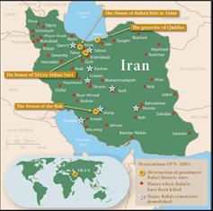
Origin of Other Universalizing Religions
Sikhism (ethnic) and Baha'i were founded more recently than the three large universalizing religions.
The founder of Sikhism, Guru Nanak, traveled widely through South Asia around 500 years ago preaching his new faith, and many people became his Sikhs, which is the Hindi word for disciples.
When it was established in Iran during the nineteenth century, Baha'i provoked strong opposition from Shiite Muslims.
The Bãb was executed in 1850, as were 20,000 of his followers.

Slide 11
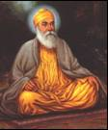
Other Universalizing Religions - Sikhism
Sikhism and Bahá’I are the two universalizing religions other than Christianity, Islam, and Buddhism with the largest numbers of adherents.
Sikhism’s first guru (religious teacher or enlightener) was Nanak (A.D. 1469—153 8), who lived in a village near the city of Lahore, in present-day Pakistan.

Slide 12
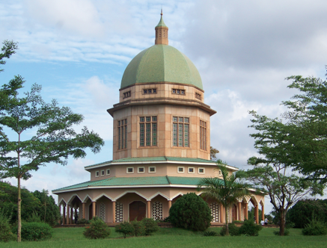
Bahá’I Faith (Other Universalizing Religions)
The Bahá’I religion is even more recent than Sikhism.
It grew out of the Bábi faith, which was founded in ShIráz, Iran, in 1844 by Siyyid ‘Au Muhammad, known as the Báb (Persian for gateway).

Slide 13
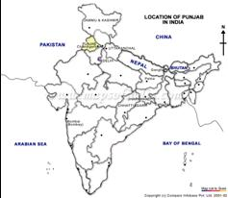
Diffusion of Other Universalizing Religions
The Baha'i religion diffused to other regions in the late nineteenth and early twentieth centuries, (then) spread rapidly during the late twentieth century, when a temple was constructed in every continent.
Sikhism remained relatively clustered in the Punjab, where the religion originated.
In 1802 they created an independent state in the Punjab.
But when the British government created the independent states of India and Pakistan in 1947, it divided the Punjab between the two instead of giving the Sikhs a separate country.

Slide 14
Ethnic Religions
Ethnic religions typically have much more clustered distributions than do universalizing religions.
The ethnic religion with by far the largest number of followers is Hinduism. With over 900 million adherents, Hinduism is the world’s third-largest religion, behind Christianity and Islam.

Slide 15
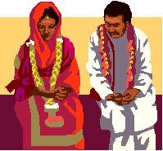
Origin of Hinduism, an Ethnic Religion
Unlike the universalizing religions, Hinduism did not originate with a specific founder.
Hinduism existed prior to recorded history.
Aryan tribes from Central Asia invaded India about 1400 B.C. and brought their religion.
Centuries of intermingling with the Dravidians already living in the area modified their religious beliefs.

Slide 16
Hinduism
Ninety-seven percent of Hindus are concentrated in one country, India.
Two percent are in the neighboring country of Nepal, and the remaining one percent are dispersed around the world.
The appropriate form of worship for any two individuals may not be the same.
Hinduism does not have a central authority or a single holy book.
The largest number of adherents—an estimated 70 percent— worships the god Vishnu, a loving god incarnated as Krishna.
An estimated 25 percent adhere to Siva, a protective and destructive god.
Shaktism is a form of worship dedicated to the female consorts of Vishnu and Siva.

Slide 17
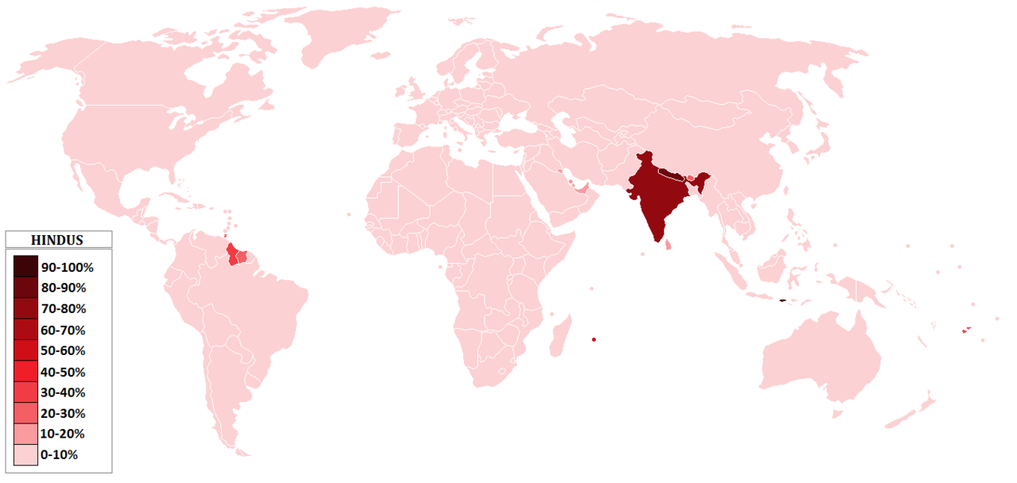
Hindus worldwide

Slide 18
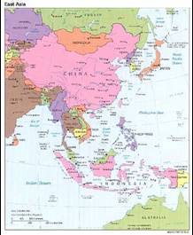
Other Ethnic Religions
Several hundred million people practice ethnic religions in East Asia, especially in China and Japan.
Buddhism does not compete for adherents with Confucianism, Daoism, and other ethnic religions in China, because many Chinese accept the teachings of both universalizing and ethnic religions.

Slide 19
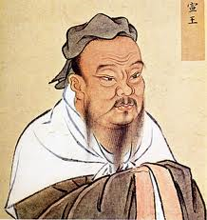
Confucianism
Confucius (551—479 B.C.) was a philosopher and teacher in the Chinese province of Lu.
Confucianism prescribed a series of ethical principles for the orderly conduct of daily life in China.

Slide 20
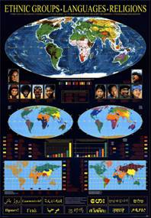
Lack of Diffusion of Ethnic Religions
Most ethnic religions have limited, if any, diffusion.
These religions lack missionaries.
Diffusion of universalizing religions, especially Christianity and Islam, typically comes at the expense of ethnic religions.

Slide 21
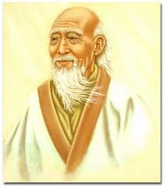
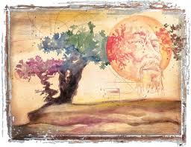
Daoism (Taoism)
Lao-Zi (604—531? B.C., also spelled Lao Tse), a contemporary of Confucius, organized Daoism.
Daoists seek dao (or tao), which means the way or path.
Dao cannot be comprehended by reason and knowledge, because not, everything is knowable.
Daoism split into many sects, some acting like secret societies, and followers embraced elements of magic.

Slide 22
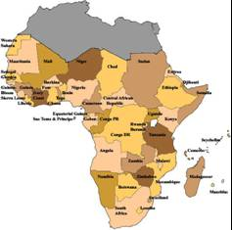
Mingling of Ethnic and Universalizing Religions.
Universalizing religions may supplant ethnic religions or mingle with them.
Equatorial Guinea, a former Spanish colony, is mostly Roman Catholic, whereas Namibia, a former German colony, is heavily Lutheran.
Elsewhere, traditional African religious ideas and practices have been merged with Christianity.

Slide 23
Shinto
Since ancient times, Shinto has been the distinctive ethnic religion of Japan.
Ancient Shintoists considered forces of nature to be divine.
Gradually, deceased emperors and other ancestors became more important deities for Shintoists than natural features.
Shinto still thrives in Japan

Slide 24
It features heavily in the movies of Hayao Miyazaki

Slide 25
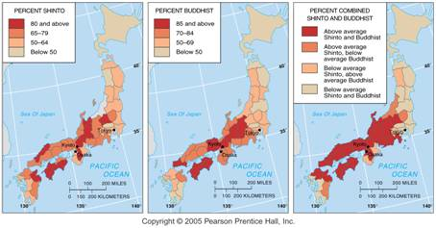
Shintoism and Buddhism in Japan
Since Japanese can be both Shinto and Buddhist, there are many areas in Japan where over 2/3 of the population are both Shinto and Buddhist.

Slide 26
How it works
Shinto is used more as the religion of celebrations; i.e.: marriages
Buddhism is used for examining the hereafter.

Slide 27
If you could pick and choose religious beliefs from 2 or more religions, what would you choose?

Slide 28
Judaism
Between 5.4 – 6.8 million Jews live in the USA, 6.1 million live in Israel, and another 2 to 3 million are spread between Europe, Brazil, Argentina, South Africa and Canada.
The number of Jews living in the former Soviet Union has declined rapidly since the late 1980s, when emigration laws were liberalized.

Slide 29
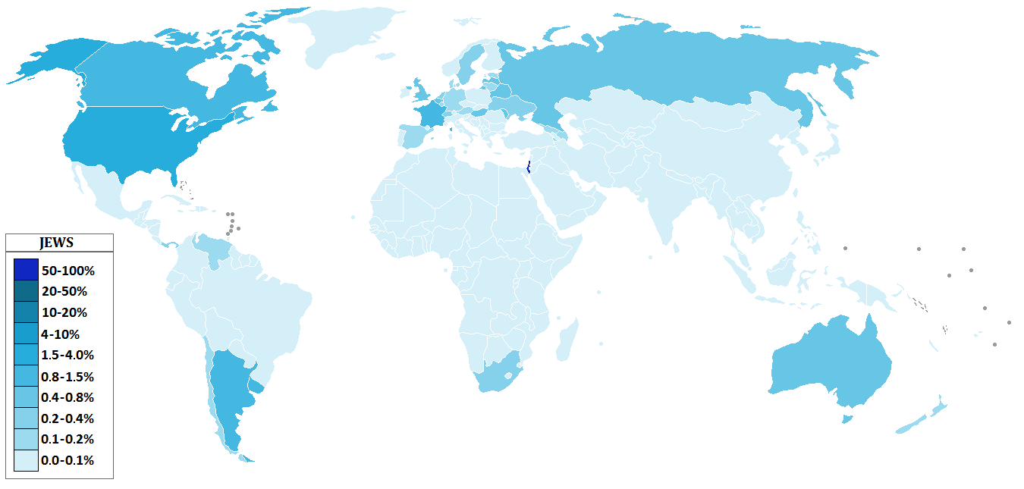
Judaism worldwide

Slide 30
Judaism plays a more substantial role in Western civilization than its number of adherents would suggest, because two of the three main universalizing religions—Christianity and Islam—find some of their roots in Judaism.
The name Judaism derives from Judah, one of the patriarch Jacob’s 12 sons; Israel is another biblical name for Jacob.

Slide 31
Judaism, an Exception
Only since the creation of the state of Israel in 1948 has a significant percentage of the world’s Jews lived in their Eastern Mediterranean homeland.
The Romans forced the Jewish diaspora, (from the Greek word for dispersion) after crushing an attempt by the Jews to rebel against Roman rule.
Jews lived among other nationalities, retaining separate religious practices but adopting other cultural characteristics of the host country, such as language.

Slide 32
Continued
Other nationalities often persecuted the Jews living in their midst.
Historically, the Jews of many European countries were forced to live in a ghetto, a city neighborhood set up by law to be inhabited only by Jews.
During World War II the Nazis systematically rounded up European Jews and exterminated them.
Many of the survivors migrated to Israel.
Today about 10 percent of the world’s 14 million Jews live in Europe, compared to 90 percent a century ago.

Slide 33
Ghetto

Slide 34
Where Jews live in the United States
Jews generally live in urban areas in the United States.
Urban areas are generally more diverse than rural areas.
A majority live in the Northeast.

Slide 35
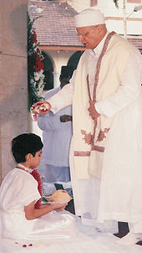
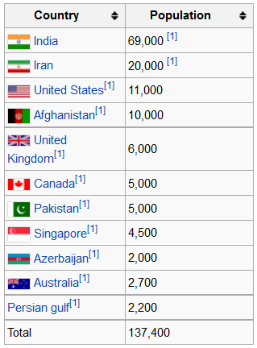
Zoroastrianism
Considered one of the two oldest monotheistic religions in the world.
Most adherents live in Iran or India.
In 2004, the number of Zoroastrians worldwide was estimated at between 145,000 and 210,000

Slide 36
The most famous follower of Zoroastrianism of the past century was named Farrokh Bulsara
Aka Freddie Mercury
The lead singer of “Queen”

Slide 37
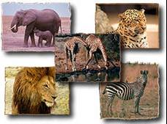
Ethnic African Religions
About 10 percent of Africans follow traditional ethnic religions, sometimes called animism.
African animist religions are apparently based on monotheistic concepts, although below the supreme god there is a hierarchy of divinities, assistants to god or personifications of natural phenomena, such as trees or rivers.
Some atlases and textbooks persist in classifying Africa as predominantly animist, even though the actual percentage is small and declining.

